Slide 1

TailorPro
Custom Clothing Ordering and Tracking System
Presented by:
Lokesh S.
Register No: 2303737714821020
Department of Artificial Intelligence & Machine Learning
K.S. Rangasamy College of Technology
Organization
Mentor
R-Sequence
Sugul, Mithilesh
Date
16th July 2026

Slide 2
Project Introduction
TailorPro is a full-stack web application that simplifies the process of ordering custom-made clothing. Customers can browse clothing designs, provide body measurements, place customized orders, and track the status of their orders online.
Problem Statement
Target Users
Traditional tailoring shops rely on manual order books, paper measurements, and phone calls, making order management time-consuming and prone to errors.
Customers
Tailors
Need for the Project
Shop Owners
Administrators
Digitize tailoring business operations
Reduce manual paperwork
Improve customer experience
Simplify order tracking
Maintain customer measurement records

Slide 3
Objectives
Main Objective
Expected Outcome
Develop a web application for managing customized clothing orders efficiently.
Digital tailoring management
Faster order processing
Better customer experience
Organized database of customers and orders
Functional Objectives
User Registration & Login
Browse clothing designs
Place custom orders
Store body measurements
Track order status
Admin order management

Slide 4
Technology Stack
Technology
Purpose
HTML5
Web Page Structure
CSS3
Styling
Bootstrap 5
Responsive UI
JavaScript
Client-side Validation
Java
Backend Logic
Java Servlets
Request Processing
Apache Tomcat
Web Server
MySQL
Database
JDBC
Database Connectivity
Git & GitHub
Version Control

Slide 5
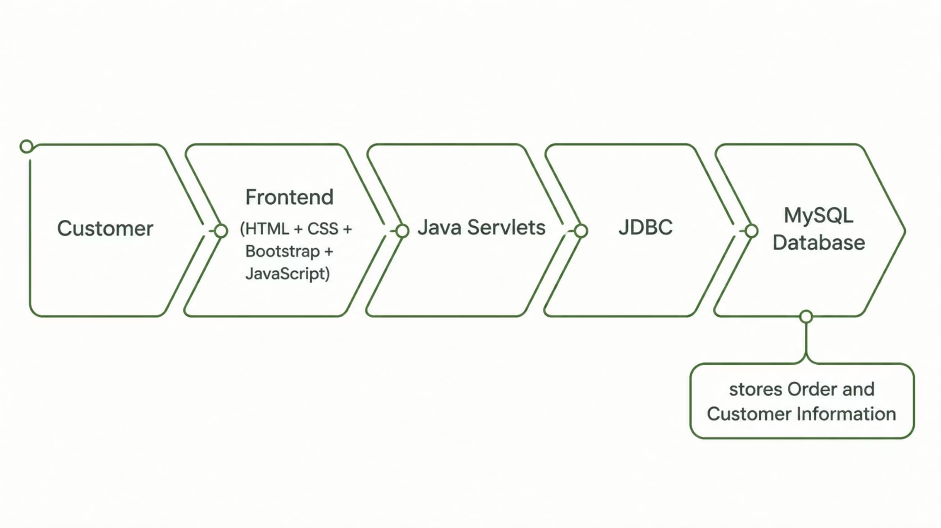
System Architecture
Workflow
User signs up
User logs in
User browses clothing gallery
User places custom order
Order is stored in MySQL
Admin updates order status
Customer tracks progress

Slide 6






Modules
User Authentication
User Registration
Secure Login
Gallery
Display clothing designs
Browse available styles
Orders
Place customized clothing orders
Enter body measurements
View order history
Dashboard
Customer dashboard
Admin dashboard
About Us
Tailor shop information
Contact details
Feedback
Customer reviews
Suggestions

Slide 7

Database Design
Tables
Users
Orders
User ID
Name
Email
Password
Order ID
Customer Name
Phone
Email
Dress Type
Measurements
Requirements
Order Status
MySQL is used to store customer details and order information securely.

Slide 8










Key Features
User Registration
Secure Login
Responsive Interface
Clothing Gallery
Custom Measurement Form
Order Placement
Order Tracking
Dashboard
Database Integration
Bootstrap Responsive Design

Slide 9
Screenshots
Later, replace with screenshots of your project.
Use placeholders:
Login Page
Signup Page
Home Page
Gallery
Orders Page
Dashboard

Slide 10
Challenges & Solutions
Challenge
Solution
Learning new technologies
Practiced HTML, CSS, Java, Bootstrap
Connecting Java with MySQL
Used JDBC
Responsive layout
Implemented Bootstrap Grid
Database creation
Designed relational tables
Frontend navigation
Added Navbar and page routing

Slide 11
TailorPro
A Modern Digital Solution for Tailoring Businesses

Slide 12









Learning Outcomes
Frontend Development
Java Programming
Database Design
JDBC Connectivity
Bootstrap Components
Responsive Web Design
Project Planning
Problem Solving
Debugging
Team Collaboration

Slide 13
Future Enhancements
1
Email Notifications
2
AI-based Size Recommendation
3
Delivery Tracking
4
Mobile Application
5
Cloud Deployment
6
Inventory Management
7
Tailor Appointment Booking

Slide 14

Conclusion
TailorPro provides a modern digital solution for tailoring businesses by simplifying order management, customer measurement storage, and order tracking. The project enhances efficiency, improves customer satisfaction, and demonstrates practical full-stack development skills using Java and MySQL.

Slide 15
GitHub Repository & Demo
GitHub Repository
Demo
(Add your GitHub project link)
(Localhost / Deployed Link)
(Optional)
QR Code linking to the GitHub repository.

Slide 16

Thank You
Questions & Answers
Presented by
Lokesh S.

