Slide 1

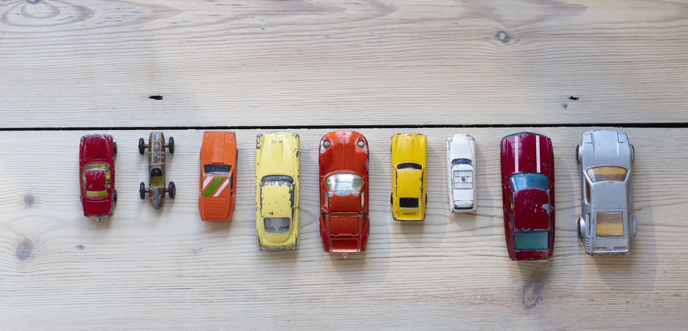
Used Cars Price Analysis
A Comprehensive Data Analytics Study of USED CARS
Presented By:
Adada Lokeswararao

Slide 2


Introduction
This project explores used car prices by analyzing data collected from CarWale. The aim is to uncover trends across brands, fuel types, EMI options, and identify best-value vehicles.

Slide 3

Problem Statement
• Lack of transparent pricing for used cars
• Buyers struggle to compare models across brands and locations
• No centralized view of EMI trends or fuel type value
• Data analytics helps simplify decision-making

Slide 4

Project Objectives
• Scrape data from CarWale
• Clean and process data
• Visualize and analyze pricing patterns
• Identify affordable, high-quality used cars
• Assist buyers with informed choices

Slide 5
Methodology
• Data Collection: Web scraping
• Data Cleaning: Handling nulls, duplicates, formatting
• Data Analysis: Brand/fuel/EMI-based comparisons
• Visualization: Using Matplotlib, Seaborn, Plotly

Slide 6
Tools & Technologies Used
• Python: Pandas, NumPy, BeautifulSoup, Matplotlib, Seaborn, Plotly
• Jupyter Notebook
• PowerPoint, Excel

Slide 7
Web Scraping Process
• Source: CarWale listings
• Fields extracted: Car name, brand, price, fuel type, EMI, location
• Tools: BeautifulSoup, requests
• Output: Structured dataset (CSV)

Slide 8
Data Extracted
• Car Brand and Model
• Price and EMI
• Fuel Type
• Location
• Car Condition and Year

Slide 9

Data Cleaning Techniques
• Converted price fields to numeric
• Removed duplicates
• Filled or dropped missing values
• Standardized fuel and brand categories

Slide 10
Visual Analysis
• Price distribution by brand and fuel type
• EMI vs Price heatmaps
• Car count by company
• Interactive plots using Plotly

Slide 11
Key Insights
• Budget cars show significant price variation across cities
• Diesel cars slightly cheaper than petrol counterparts
• EMI often increases disproportionately with brand value
• Some lesser-known brands offer better value

Slide 12
Dashboard Preview
• Price vs Brand
• Fuel Type Distribution
• EMI-wise segmentation
• Filterable views for comparison

Slide 13
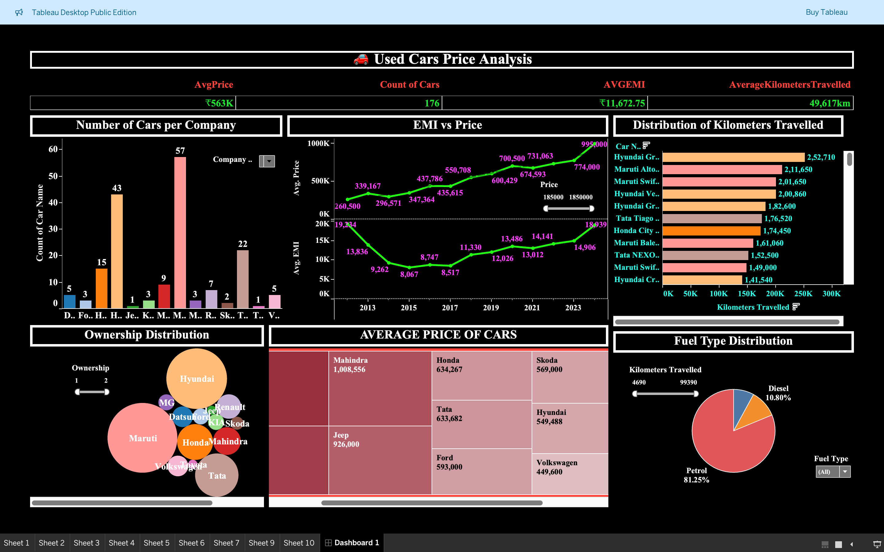
DASHBOARD

Slide 14
Conclusion
• Data analytics offers clarity in used car markets
• Identified quality cars at lower prices
• Can be extended with ML models for price prediction

Slide 15
Challenges Faced
• Inconsistent HTML structures on CarWale
• Some missing or ambiguous values
• Normalizing price formats
• Cleaning and aligning categorical values

Slide 16

Thank You

