Slide 1
Predictive Modeling for Attorney Involvement in Claims
Presented by: Lokesh R

Slide 2
Overview
Introduction
Abstract
Methodology
Steps Performed
Data Extraction
Data Visualization
Train and Evaluate Different Regression Models
Models:- ROC-AUC, SVC.Decision Tree ,Random Forest ,Linear Regression,
Output
Conclusion

Slide 3
Introduction
Insurance companies often face challenges in managing claims involving attorney intervention, which can lead to increased legal costs, inefficient resource allocation, and delayed settlements. These factors not only strain operational budgets but also negatively impact customer satisfaction.
The goal of this project is to develop a predictive model using machine learning to determine the likelihood of attorney involvement in insurance claims. By identifying high-risk claims early, insurance companies can allocate resources more effectively, streamline legal processes, and focus on resolving straightforward claims quickly.
This approach will enhance cost efficiency, improve customer experience, and provide strategic insights into factors that contribute to attorney involvement.

Slide 4
Abstract
This project focuses on developing a predictive model to determine the likelihood of attorney involvement in insurance claims, enabling insurance companies to optimize their operations and reduce associated legal costs.
Using a dataset containing claim-related factors such as claimant demographics, accident severity, and financial loss, the model leverages machine learning techniques to identify patterns that lead to attorney intervention. By proactively predicting high-risk claims, the solution aims to improve resource allocation, streamline claim processing, and enhance overall efficiency.
This data-driven approach not only helps reduce legal expenses but also accelerates settlements for straightforward claims, ultimately enhancing customer satisfaction and operational performance.

Slide 5
Methodology
Training and Testing both were done in Jupyter Notebook, Google Collab which provides Jupyter notebook environment and free RAM and GPU to train and test the models.
Programming Language :- Python
Libraries :- Pandas , Numpy , Seaborn, Sklearn etc
Algorithm :- ROC-AUC, SVC , Decision Tree ,Random Forest , Linear Regression

Slide 6
Steps Performed
Importing Data
Split the Data into Training & Test sets
Creating & Training the Model
Making Predictions
Evaluating & Improving Predictions

Slide 7
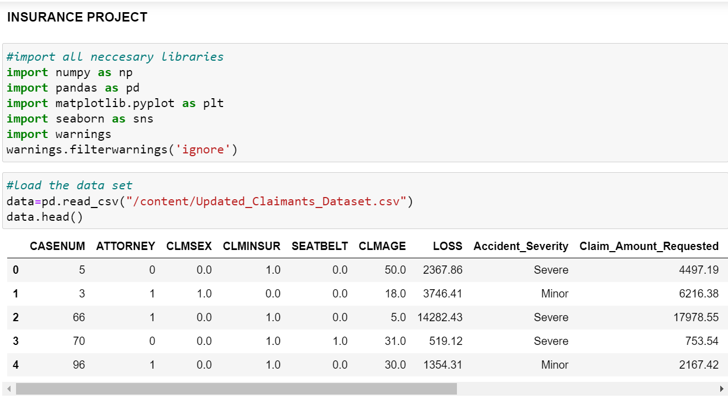
Dataset extraction

Slide 8
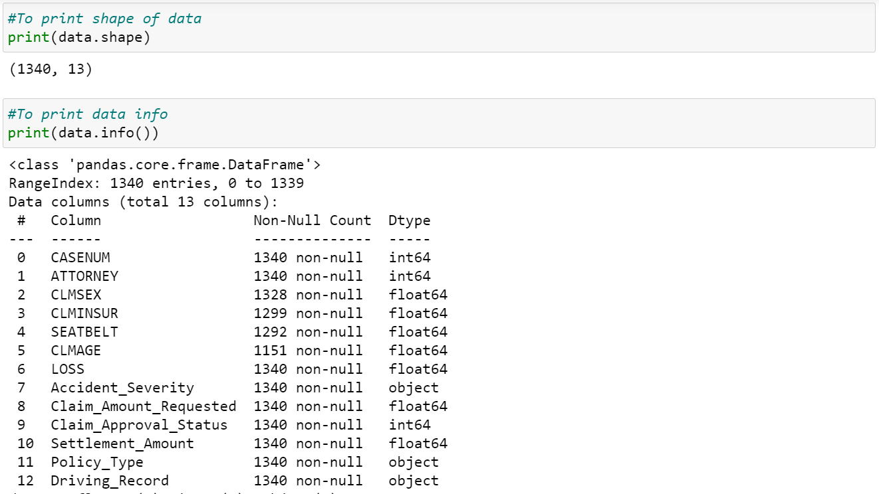
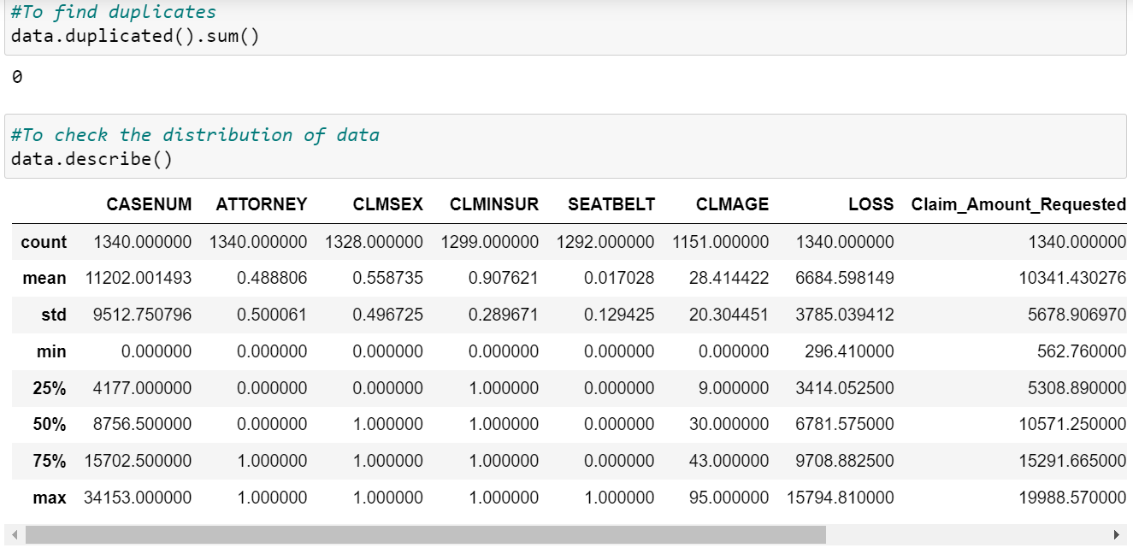
Continue…

Slide 9
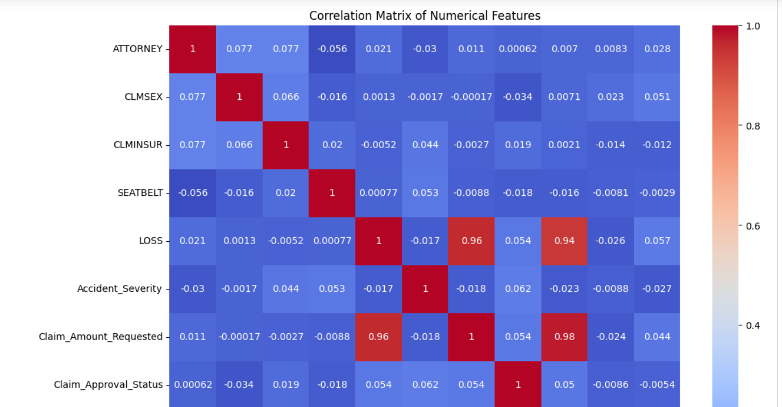
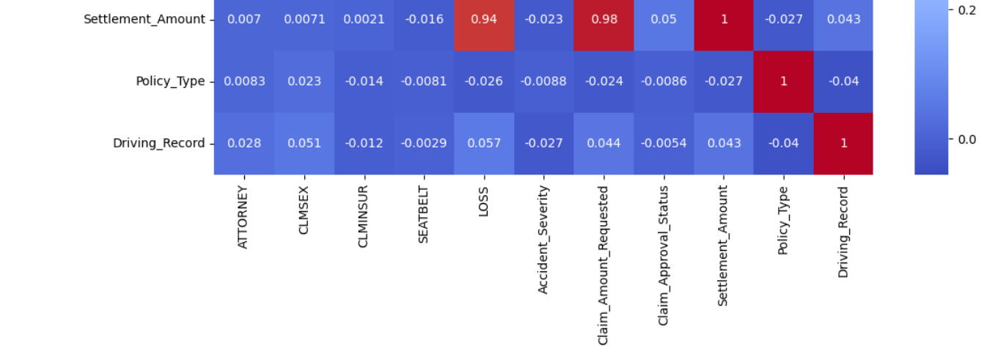
Data visualization

Slide 10
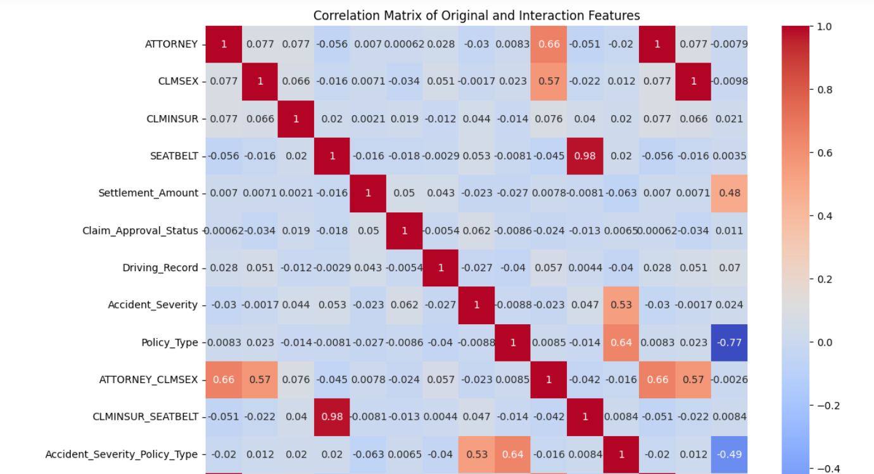
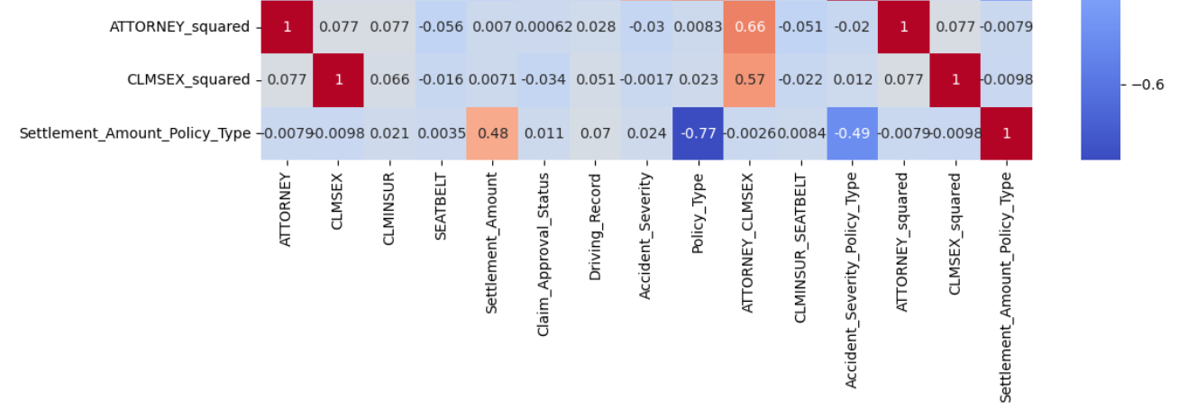
Continue…

Slide 11
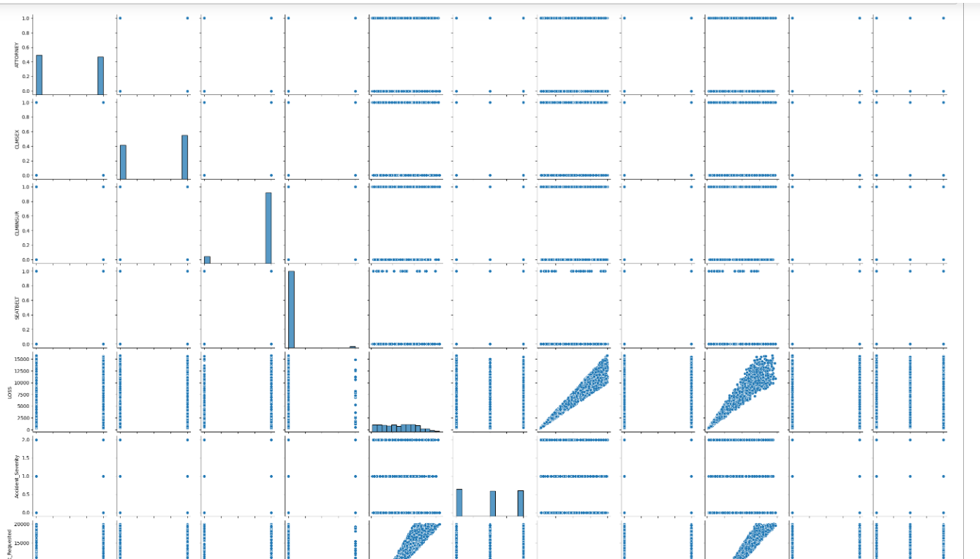
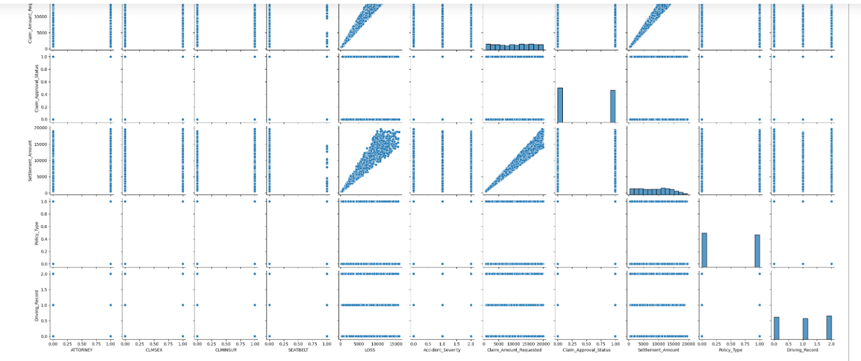
Continue….

Slide 12
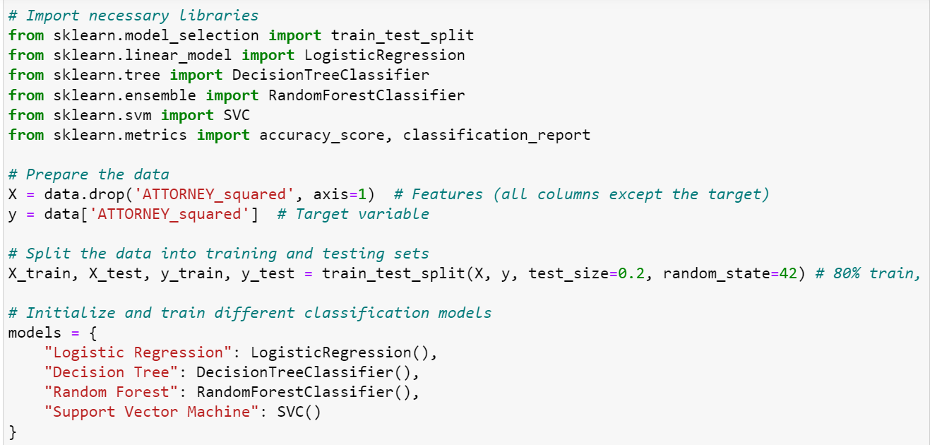
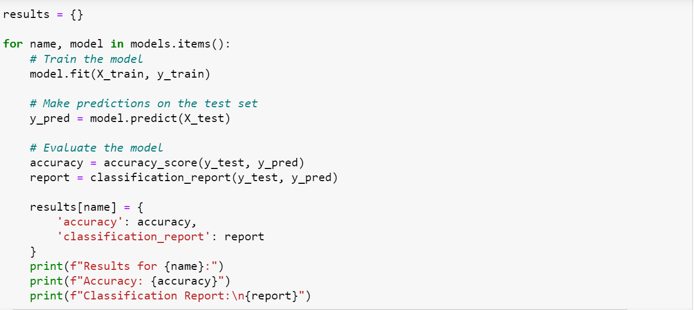
Train and Evaluate Different Regression Models

Slide 13
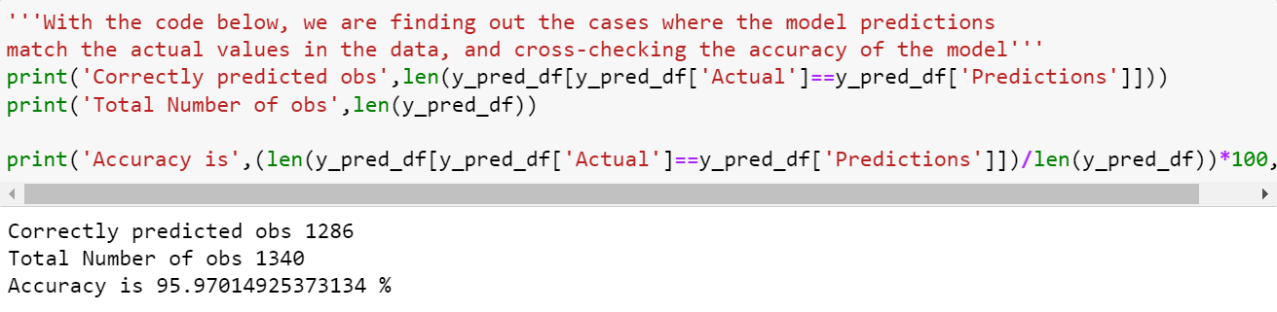
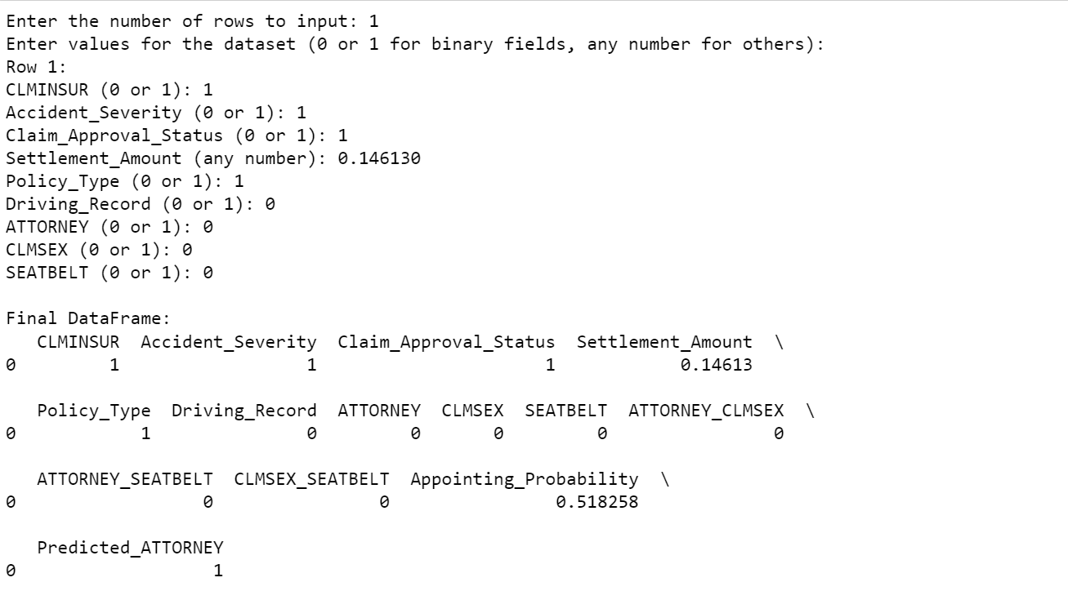
Continue….

Slide 14
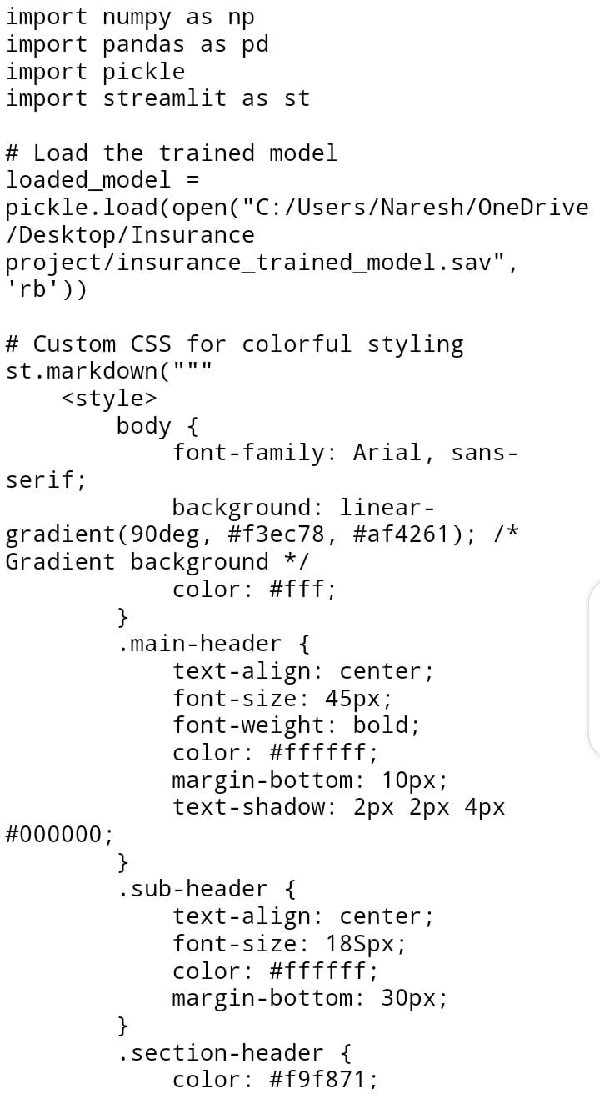
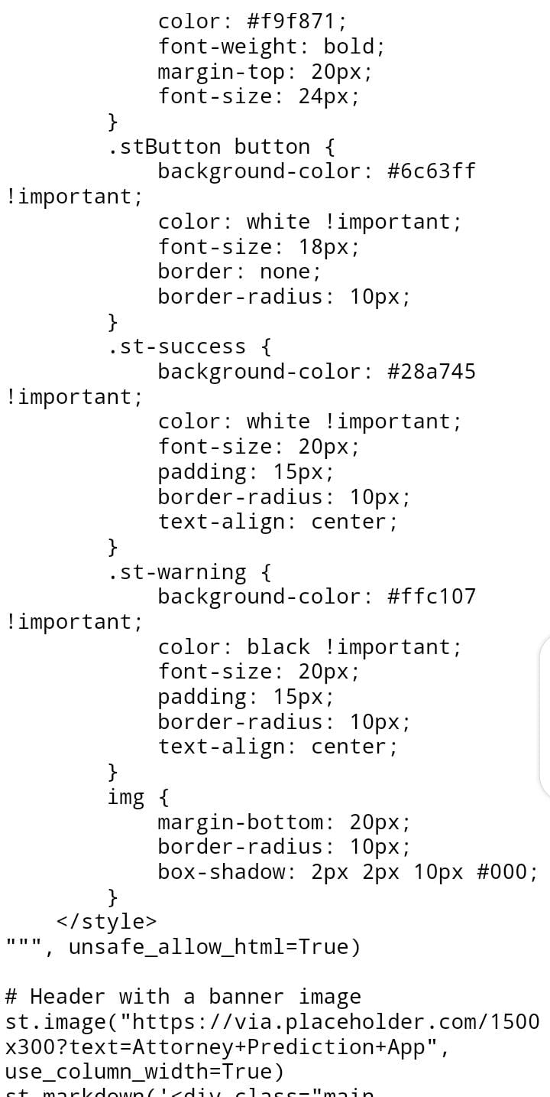
Continue….

Slide 15
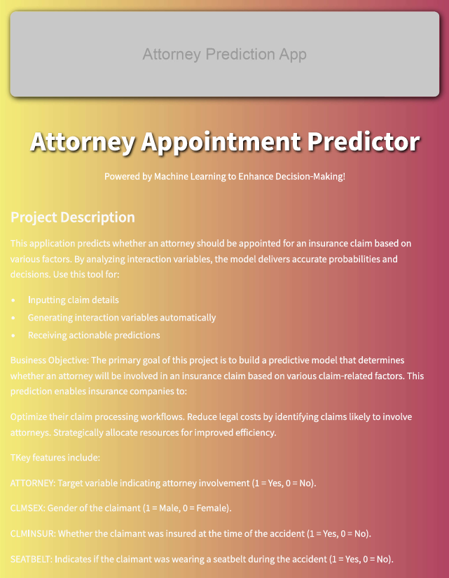
Output

Slide 16
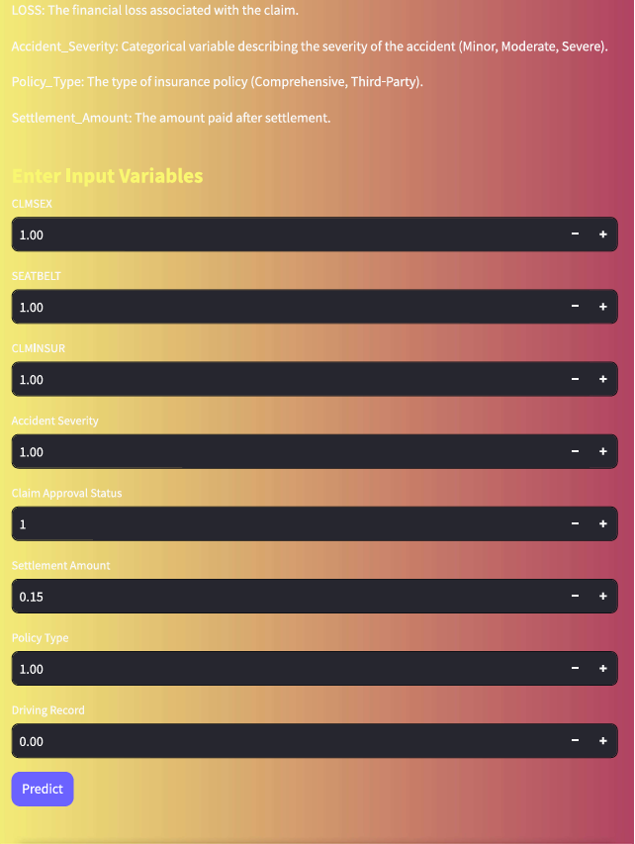
Continue….

Slide 17
Conclusion
This project successfully developed a predictive model to determine the likelihood of attorney involvement in insurance claims. By leveraging machine learning techniques and a structured approach, the model identifies high-risk claims based on various claim-related factors, such as accident severity, financial loss, and claimant demographics.
The predictive insights enable insurance companies to optimize resource allocation, reduce legal costs, and streamline claim processing.
The deployment of the model through a user-friendly Streamlit application further enhances its practical utility, allowing real-time predictions and informed decision-making.
This solution not only improves operational efficiency but also accelerates claim settlements and enhances customer satisfaction.
By adopting a data-driven approach, insurance companies can proactively manage claims and achieve significant cost savings while maintaining high service standards.

