Slide 1



SMART INDIA HACKATHON 2026
Problem Statement ID - 26231
Problem Statement Title - Digital Companion for Field Drug Testing
Theme - MedTech / BioTech / HealthTech
PS Category - Software
Team ID - K26234
Team Name - HexTech

Slide 2


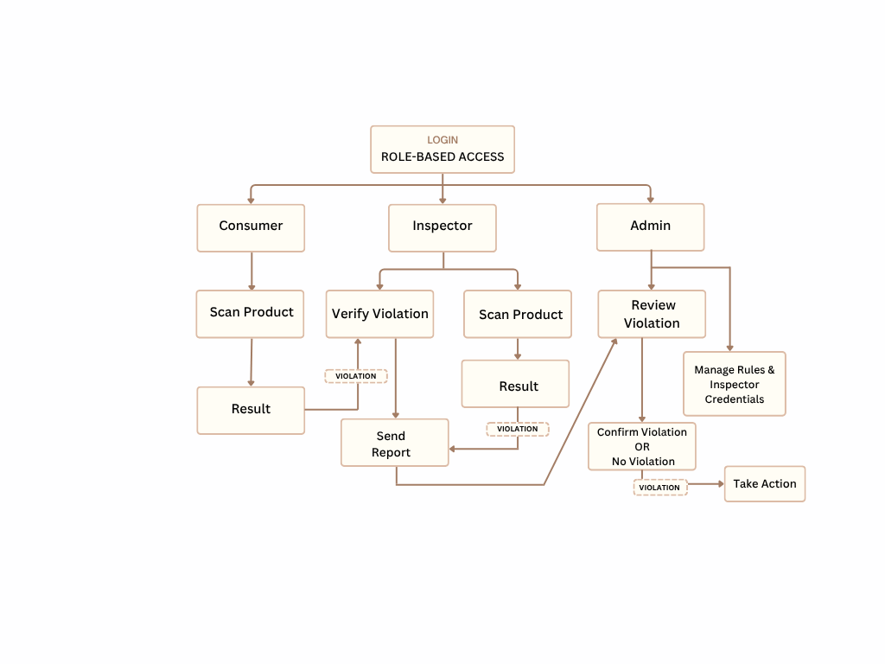
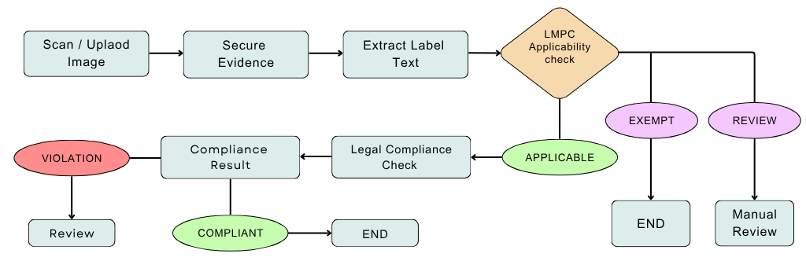
Proposed Solution
HexTech
Problem:
Innovation & Uniqueness (what is new):
Today, police check the drug-test kit colour with their own eyes. Different officer or different light = different answer.
There is no proof of when, where and by whom the test was done. So the result cannot be used as evidence in court.
App reads the colour, not the eye - a ₹10 printed colour card fixes the light, and the app gives a colour score.
Honestly says "Not Sure" - blurry photo, shine or unclear colour → INCONCLUSIVE with the reason; a senior officer checks.
Proof that cannot be faked - photo fingerprint + GPS + internet time + officer ID, digitally signed; check by scanning QR.
Works with any test kit - new kits are added from the website with their colours. No app update needed.
WHO DOES WHAT (ROLE-BASED WORKFLOW)
LOGIN
Each person sees only their own work
HOW THE APP DECIDES THE RESULT
Compare with
Kit Colours
Take Photo
(card in frame)
Photo Check
(blur / shine)
Find Card &
Fix Colours
Field Officer
Senior Officer
Admin
fail → NOT SURE
fail → NOT SURE
Choose the
Test Kit
Check the
"Not Sure" results
Add / Edit
Test Kits
RESULT SCREEN (what the officer sees)
POSITIVE
NEGATIVE
INCONCLUSIVE
(not sure)
POSITIVE · opium-type drug · 91% sure
Take Photo
(with colour card)
Approve or
Ask to Retest
Add Officers
& Logins
Colour difference = 4.2 (small number = close match)
Sealed Record
photo fingerprint + GPS + time + signature
Senior Officer
Checks
Photo colour
(fixed)
Kit colour:
Positive
Kit colour:
Negative
Get Result +
Sealed Record
Final Signed
Report
See All Tests
on Map + Excel
This is a first-level field result. The final answer always comes from the lab.
NOT SURE
Saved in Test Log · Map · PDF with QR
@SIH Idea submission- Template
2

Slide 3

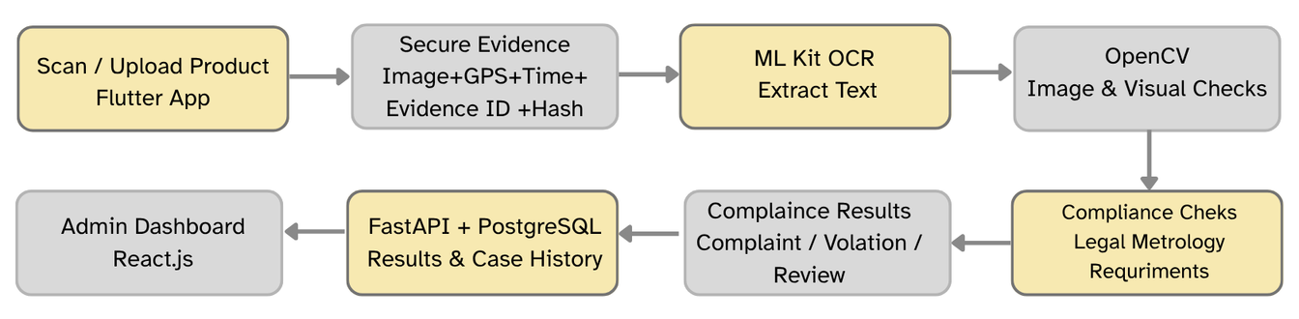

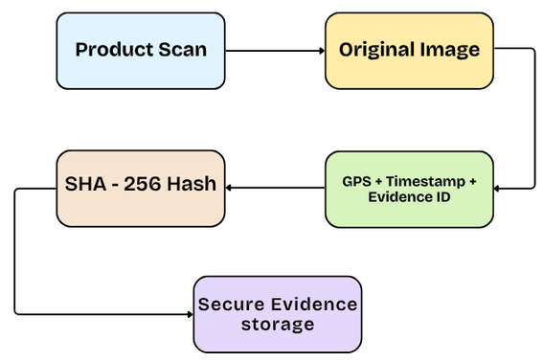
TECHNICAL APPROACH
HexTech
Technology Workflow (step by step)
How the App Decides
1. Take Photo
Flutter mobile app
(guide + timer)
2. Photo Check
OpenCV checks
blur / shine
3. Find the Card
4 corner markers
(ArUco)
4. Fix the Colours
using the card's
known colours
POSITIVE / NEGATIVE: colour clearly matches one kit result
NOT SURE: colour card not found in the photo
NOT SURE: photo is blurry or shiny
NOT SURE: colour does not match any result
NOT SURE: colour is in between two results
"% sure": how clearly it matches the best result
8. Officer Website
React + map
+ PDF / Excel
7. Save on Server
FastAPI +
PostgreSQL
6. Seal the Record
fingerprint + GPS
+ time + signature
5. Decide Result
colour difference
score (ΔE)
How the ₹10 Colour Card Works
Proof That Cannot Be Faked
Printed Colour Card
Add Any Test Kit
Take Photo
Original Photo
4 corner markers - app finds and straightens the card
24 boxes of known colours - app learns how the light changed colours
Test window - app fixes the kit colour and gives a score
Admin adds a kit with its result colours from the website. No app update needed.
Photo Fingerprint
(SHA-256) + Signature
GPS + Internet Time
+ Officer + Phone ID
Admin
Adds Kit
Enter Result
Colours
Set Match
Limit
Ready in
App
Chained Test Log
QR Check Page
Any phone, any light → same fixed colour | Card not read properly → NOT SURE
Change even 1 byte → QR page shows TAMPERED
@SIH Idea submission- Template
3

Slide 4
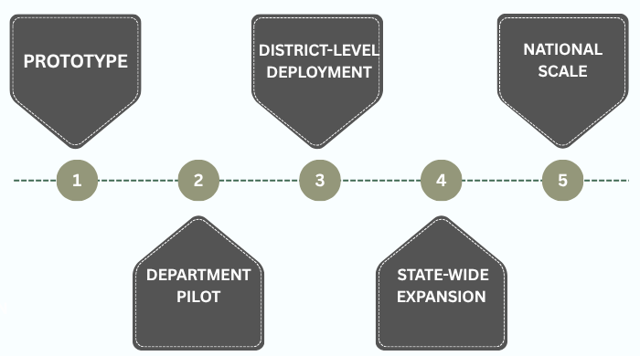
FEASIBILITY AND VIABILITY
HexTech
Feasibility (can we really do it?)
Phased Implementation & Scalability
Technical - built on our old project's tested code + OpenCV for colours.
Easy to use - officer takes one photo, gets the result in seconds.
Low cost - phone + ₹10 printed card + free software. No new machine.
Scalable - add any new kit from the website; works on any Android phone.
Potential Challenges & Strategies
Real-world problem | What our app does
Bad light (street lamp / torch) | Colour card fixes the colours
Shiny or blurry photo, card missing | Says NOT SURE and asks to retake
Colour is in between two results | Says NOT SURE; senior officer checks
Fake photo or edited record | In-app camera only + photo fingerprint
Different kits and phones | Kit settings + colours fixed every photo
Our Goals for the Prototype
Accuracy: 90%+ correct on our demo colour samples in 4 types of light
Speed: result + sealed record in 10 seconds or less
Tamper check: change even 1 byte → check fails
Honesty: never guesses - unclear means NOT SURE
@SIH Idea submission- Template
4

Slide 5
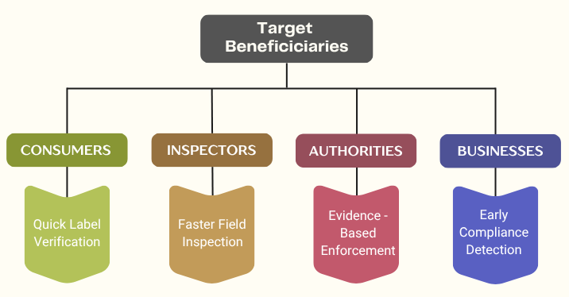
IMPACT AND BENEFITS
HexTech
Benefits
Who Gets
Helped?
Same result, whoever does the test
Proof of every test: time, place, officer, photo
Fewer wrong cases - app says "not sure" instead of guessing
No paperwork: PDF with QR, Excel, search and map
Follows new laws: BNSS Sec 105 and BSA Sec 63
FIELD OFFICERS
NCB & POLICE
COURTS & LABS
CITIZENS
No colour
guessing
All tests in
one place
Easy to
verify
Fewer wrong
arrests
Expected Impact
Future Scope (next steps)
Field Officer - quick and confident, no colour guessing
NCB / Police - every test saved, searchable, on a map
Courts / Labs - scan QR to check the record is real
Common people - less chance of wrong arrest
Works offline - at highways / borders, sends data later
Phone security chip - phone also signs every test
Link with police systems - e-Sakshya and CCTNS
Match with lab results - find which kits are most accurate
Hindi + regional languages - with voice help
@SIH Idea submission- Template
5

Slide 6
HexTech
RESEARCH AND REFERENCES
# | Research (click the title to open) | What they found | How we use it
1 | IEEE EMBC 2016 Illumination and device independence for colorimetric detection with smartphone (Karisen & Dong) | Phone camera colours change with light and phone model; a reference fixes this | Our ₹10 colour card fixes colours in every photo
2 | IEEE TPS-ISA 2024 Digital Evidence Chain of Custody: Navigating New Realities of Digital Forensics (Nath et al.) | Digital evidence must prove it was never changed, and who handled it | Photo fingerprint + signature + chained log
3 | Forensic Science International 2014 Real-time quantitative colourimetric test for methamphetamine using mobile phone technology (Choodum et al.) | A phone camera can measure drug-test colours as numbers | Our app reads the test colour as a number
4 | Analytical Chemistry 2016 Objective presumptive field-testing of illicit drugs using smartphone analysis (Krauss et al.) | Reading test colours by eye is a personal guess | App gives POSITIVE / NEGATIVE / NOT SURE
5 | Digital Discovery 2023 Teaching old presumptive tests new digital tricks with computer vision | Different people describe the same colour differently | App shows photo colour next to kit colours
6 | Analytical & Bioanalytical Chemistry 2025 RGB colour correction and gamut limitations in smartphone-based analysis (Fyfe et al.) | Light and camera angle change colours; colour correction fixes most of it | Colour fixing + NOT SURE if fixing fails
7 | Forensic Science International 2005 False positives and false negatives with a cocaine-specific field test (Tsumura et al.) | Field colour tests can give wrong results | App says NOT SURE; final answer from the lab
Official Sources
NDPS Act (drug law) & Sampling Rules 2022 https://www.indiacode.nic.in/handle/123456789/1791
NCB Field Officers' Handbook https://narcoticsindia.nic.in/DLEA/1.pdf
UNODC Drug Field-Testing Manual https://www.unodc.org/documents/scientific/Rapid_Testing_Methods_of_Drugs_of_Abuse_E.pdf
Prototype Demo Video:
Prototype Video Link
Take photo → Fix colour → Get result → Keep proof
@SIH Idea submission- Template
6

