Slide 1


SMART INDIA HACKATHON 2026
Problem Statement ID - 26231
Problem Statement Title -Digital Companion for Field Drug Testing
Theme - MedTech / BioTech / HealthTech
PS Category - Software
Team ID - K26234
Team Name - HexTech

Slide 2

Proposed Solution
HexTech
Problem
Officers check the colour change of drug-test kits by eye. Different officers or lighting can lead to different results. There is no fixed reference or number to compare the colour against. Every officer decides on their own.
There is no proper digital record of when, where, and by whom the test was done, making the result difficult to verify later.
Our Approach
Novelty
App reads the colour, not the eye – A low-cost colour card helps handle lighting, and the app gives a colour-based result.
Honestly says “Not Sure” – Blurry, shiny, or unclear images give an INCONCLUSIVE result with a reason instead of guessing.
Secure proof of the test – Photo hash, GPS, internet time, and Inspector ID are digitally signed and can be verified using a QR code.
Works with different test kits – New kit colour profiles can be added from the Admin website without updating the app.
Solution
Mobile app captures the colour change and checks the test result automatically.
Records the result, time, location, and Inspector ID for future verification.
The admin dashboard manages Inspectors, test records, evidence, and reports.

Slide 3
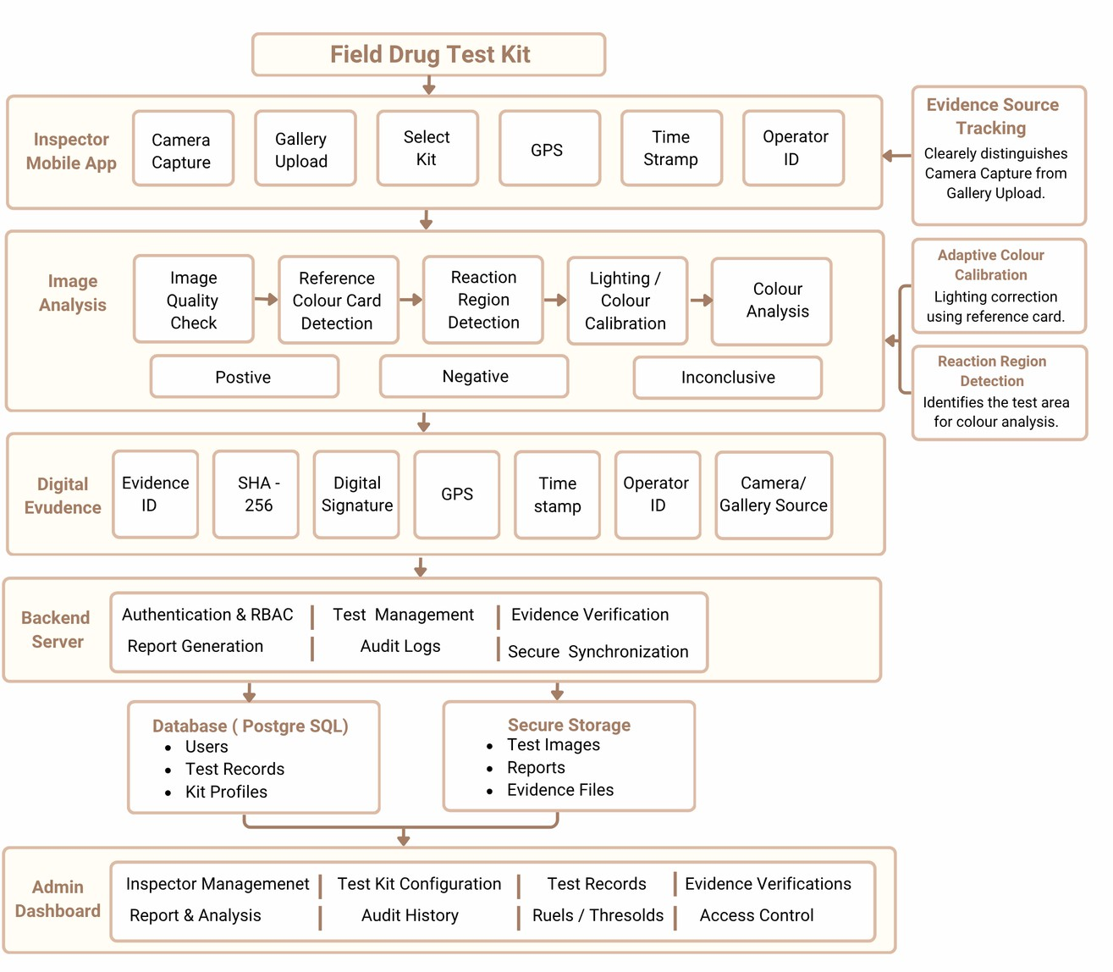
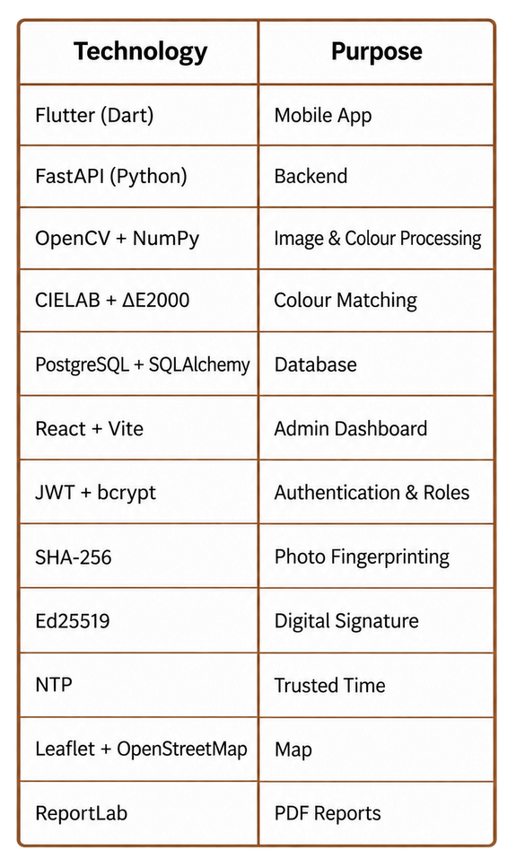
TECHNICAL APPROACH
HexTech
System Architecture
Data Security & Legal Evidence
Technology Stack
Test Data & Photo
Encrypted Storage
SHA-256 Hash + Digital Signature
GPS + Time + Inspector ID
Tamper-Evident Digital Record
QR Verification
Supports Legal Evidence Requirements

Slide 4

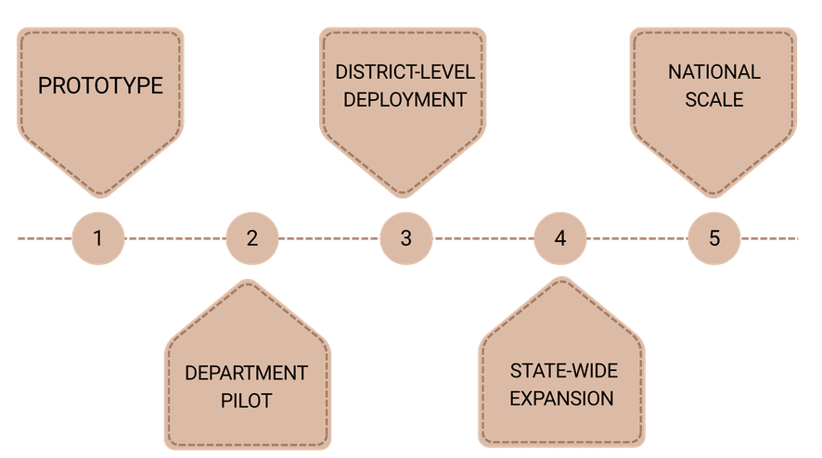
FEASIBILITY AND VIABILITY
HexTech
Feasibility
Technical - built on our old project's tested code + OpenCV for colours.
Easy to use - an officer takes one photo and gets the result in seconds. Low cost - phone + ₹10 printed card + free software. No new machine. Scalable - add any new kit from the website; works on any Android phone.
Potential Challenges & Strategies
Phased Implementation & Scalability
Real-world problem | What our app does
Bad light (street lamp / torch) | Colour card fixes the colours
Shiny or blurry photo, card missing | Says NOT SURE and asks to retake
Colour is in between two results | Says NOT SURE; senior officer checks
Fake photo or edited record | n-app camera only + photo fingerprint
Different kits and phones | Kit settings + colours fixed every photo
Our Goals for the Prototype
Accuracy: Target ≥90% on demo colour samples under 4 lighting conditions
Speed: Target ≤10 seconds for result + sealed record Tamper Check: Modified record should fail verification
Unclear Cases: Unclear images → INCONCLUSIVE, never guessed Testing: Compare app results with known reference results

Slide 5
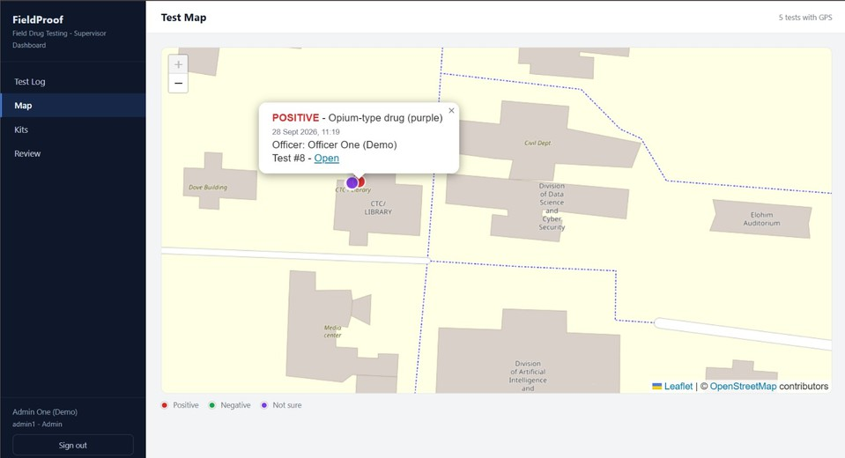
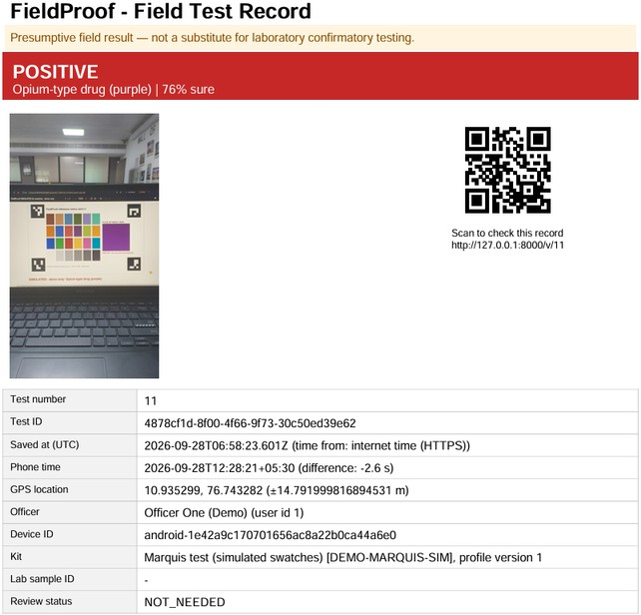
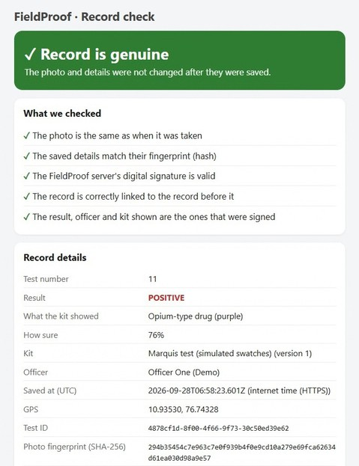
IMPACT AND BENEFITS
HexTech
Map - Geo-Tagged test result
Organisation Benefits
Proof of every test: time, place, officer & photo Secure and verifiable records
Less paperwork with PDF & QR Easy search, reports and monitoring Better field-test documentation
Inspector Benefits Faster, more consistent testing Less manual colour checking INCONCLUSIVE when unclear Easy digital test records
Quick access to past test records
QR-Based Record Verification
Future Scope
Works offline - at highways / borders, sends data later Phone security chip - phone also signs every test
Link with police systems - e-Sakshya and CCTNS
Match with lab results - find which kits are most accurate Hindi + regional languages - with voice help

Slide 6
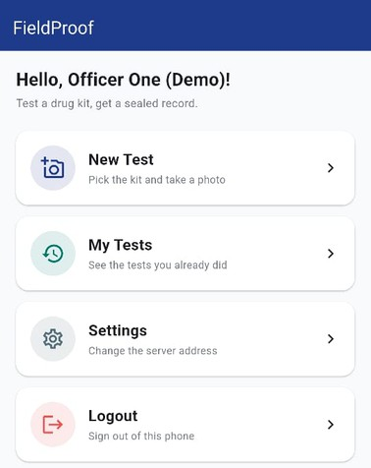

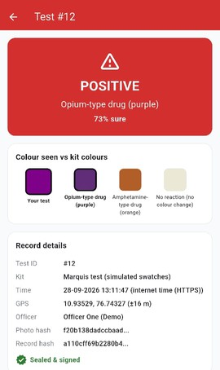

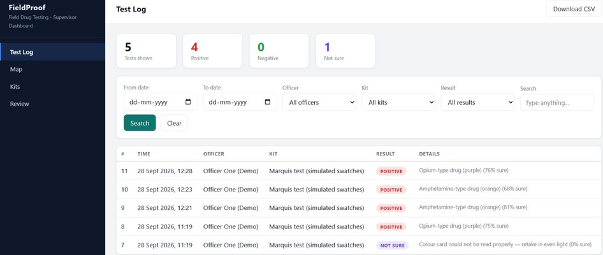
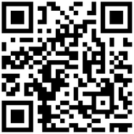
RESEARCH AND REFERENCES
HexTech
Prototype Flow
Research | What they found | How we use it
IEEE EMBC 2016 IEEE EMBC 2016 – Illumination and device independence for colorimetric detection of urinary biomarkers with smartphone | Phone camera colours change with light and phone model; reference colours can help handle this. | Our ₹10 colour card fixes colours in every test
IEEE TPS-ISA 2024 IEEE TPS-ISA 2024 – Digital Evidence Chain of Custody : Navigating New Realities of Digital Forensics | Digital evidence must maintain integrity and show how it was handled. | Photo fingerprint + signature + chained log
Forensic Science International 2014 Forensic Science International 2014 – Real-time quantitative colorimetric test for methamphetamine detection using digital and mobile phone technology | A mobile phone camera can measure drug-test colours using RGB values. | Our app reads the test colour as a number
Analytical Chemistry 2016 Analytical Chemistry 2016 – Objective Method for Presumptive Field-Testing of Illicit Drug Possession Using Centrifugal Microdevices and Smartphone Analysis | By-eye colour interpretation is subjective; smartphone image analysis can provide objective analysis. | App gives POSITIVE / NEGATIVE / NOT SURE
Digital Discovery 2023 Digital Discovery 2023 – Teaching old presumptive tests new digital tricks with computer vision | Computer vision can quantify and compare colour changes that may look similar by eye. | App shows photo colour next to kit colours
Prototype Demo Video:
Prototype Video Link

