Slide 1



SMART INDIA HACKATHON 2026
Problem Statement ID - 26231
Problem Statement Title -Digital Companion for Field Drug Testing
Theme - MedTech / BioTech / HealthTech
PS Category - Software
Team ID - K26234
Team Name - HexTech

Slide 2








PROPOSED SOLUTION
HexTech
Problem
India: 1,20,010 NDPS cases in 2023 (NCRB) - each one needs a field test.
Our Approach
  Officers mainly judge the kit’s colour change by looking at it, so lighting and personal judgement can affect the result.
  There is no standard colour value to compare the test result with.
  The test does not always leave a clear digital record of who performed it, where, and when, making it harder to verify later.
Prototype Flow - real screenshots of our working prototype
Solution
  Check the Test - The mobile app captures the colour change and helps check the result.
  Record the Test - Saves the result along with the time, location, and Inspector ID.
  Manage the Records - The admin dashboard manages Inspectors, test records, evidence, and reports.
Test Log (right side): search and filter by date, officer, kit, result. Download as CSV, PDF with QR.
Novelty
Eye check: guesswork, no record · Lab: accurate but slow · FieldProof: on the spot, ₹10, with proof
User Experience
  Handles Lighting Variations - Uses a low-cost colour card to improve colour detection under different lighting.
  Handles Unclear Results - Blurry, shiny, or unclear images are marked INCONCLUSIVE instead of giving a wrong result.
  Creates Verifiable Evidence - Securely records the photo, GPS, time, and Inspector ID, with QR-based verification.
  Supports Multiple Kits - New kit colour profiles can be added from the Admin website without changing the app.
  4 steps - pick kit → take photo in the box → see result → saved. We timed it: ~16 s per test (19 scans).
  Bad photo? - App says NOT SURE, tells why (blurry, shiny, card not seen) and asks to take again.
  Easy to read - big result word with colour, simple English. Next: we will time 10 officers using it.
Prototype Demo Video:
Prototype Video Link
2

Slide 3


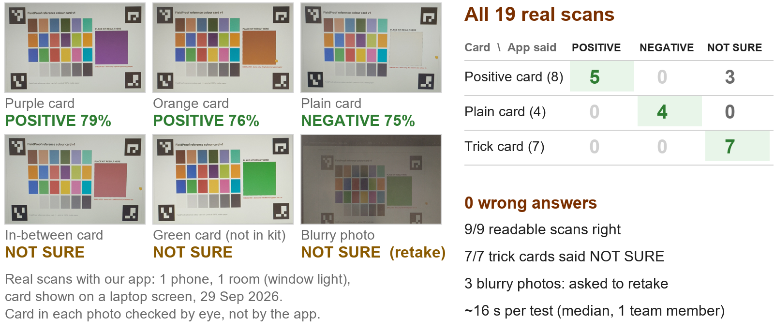


TECHNICAL APPROACH
HexTech
System Architecture
Our Goals - Measured Results
  Testing: 37 computer-made photos + 25 real phone scans.
  Accuracy: 25/25 computer-made right; 25 real scans: 0 wrong (14 right, rest NOT SURE).
  Colour Check: Used ΔE ≤ 14, 4-point colour matching, card-fit and glare thresholds.
  Speed: Result secured in 2.5 s typically, 5 s maximum.
  Tamper Test: All 4/4 modified records were detected successfully.
Technology Stack
Kit colours are simulated swatches (test photos + card on a screen), real kits need an FSL calibration trial.
Now: TRL 4 lab prototype, 1 phone. Next: FSL real kits, more phones.
Proof: Real Phone Scans (29 Sep 2026)
3

Slide 4

FEASIBILITY AND VIABILITY
HexTech
Feasibility & Sustainability
Potential Challenges & Strategies
  Technical - Core app tested with OpenCV-based colour analysis.
  User-Friendly - Capture one photo and get a result within seconds.
  Low Cost - Uses an existing Android phone, a reusable ~₹10 colour card, and open-source tools.
  Operational - Simple photo-based workflow with minimal training required.
  Scalable - Add new test-kit colour profiles through the Admin website without updating the app.
  Sustainable - Government-cloud hosting, regular profile updates, and secure data storage support long-term use.
Real-world problem | What our app does
Bad light (street lamp / torch) | Colour card fixes the colours
Shiny or blurry photo, card missing | Says NOT SURE and asks to retake
Colour is in between two results | Says NOT SURE; senior officer checks
Fake photo or edited record | In-app camera only + photo fingerprint
Different kits and phones | Kit settings + colours fixed every photo
Phased Implementation & Scalability
Pilot Plan (proposed)
  Where - 1 district in Tamil Nadu, with local police + nearest FSL
  Who - 20 officers, for 3 months
  Check - every field result is checked again in the FSL lab
  Success - 95%+ same as lab, NOT SURE below 10%, every record passes the check
  Then - district → state → whole country (phases on the left)
  Cost - around ₹10,000 for 3 months: cards ₹200 + server ~₹3,000/month (rough estimate)
Cost & Deployment Plan
After pilot: paid from the state police / NCB IT budget.
Open-source, no licence fee, so running cost stays low.
COST
HOSTING
MAINTENANCE
DEPLOYMENT
SCALE
Uses an existing phone, ₹10 reusable colour card, and open-source software.
Runs on government cloud for the app, database, and admin dashboard.
Regular security updates and easy kit-profile updates as needed.
Start with a pilot, test in the field, then expand deployment.
New test kits can be added through the website without updating the app.
4

Slide 5



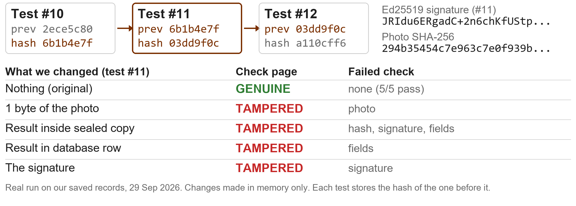

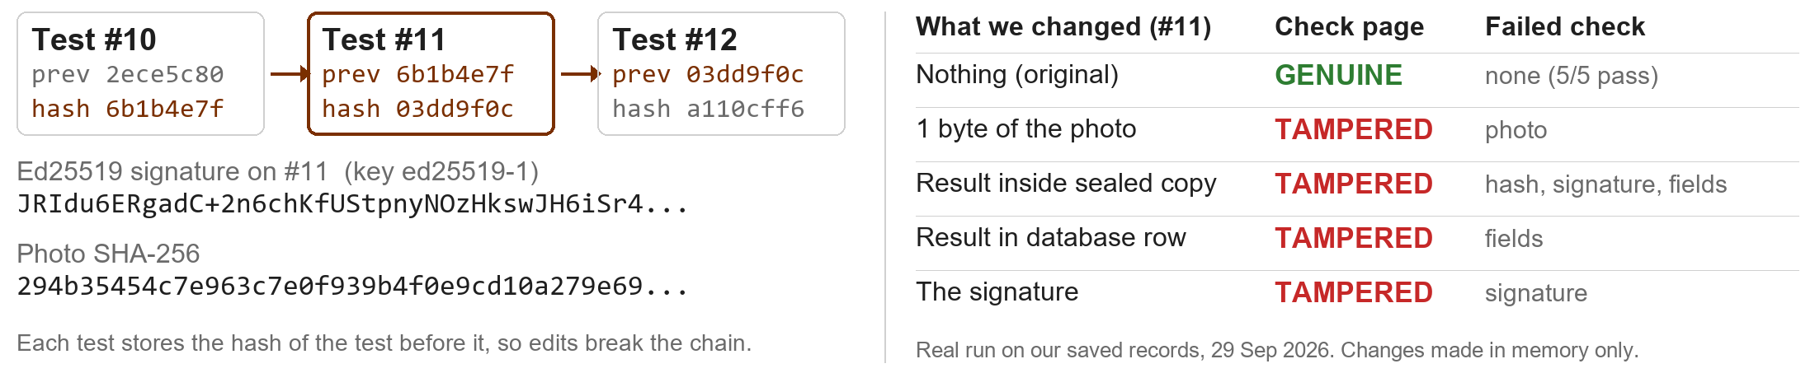
IMPACT AND BENEFITS
HexTech
Inspector Benefits
Organisation Benefits
Map -
Geo-Tagged test result
  Faster, more consistent testing
  Less manual colour checking
  INCONCLUSIVE when unclear
  Easy digital test records
  Quick access to past test records
  Proof of every test: time, place, officer & photo
  Secure and verifiable records
  Less paperwork with PDF & QR
  Easy search, reports and monitoring
  Better field-test documentation
QR-Based Record Verification
Tamper Test -
real test on our saved records
Future Scope
  Offline Mode - Test even without internet and sync data later.
  Phone Security - Use the phone’s security chip to sign each test.
  Police System Integration - our CSV export (time, GPS, officer, result, photo hash, verify link) is ready to map to e-Sakshya / CCTNS; the link needs NIC/MHA approval.
  Lab Comparison - Compare field results with lab results to improve accuracy.
  Regional Languages - Support Hindi and regional languages with voice assistance.
5
Notes:
Q&A NOTES (not on slide)
Privacy & How Long We Keep Data
Data - no fingerprint or face data, no suspect name (only a sample code). Officer ID, GPS, time kept as proof.
Who sees - officer: only own tests; supervisor/admin: all tests; public QR: only the check page (hiding officer name: planned).
Law - police work does not need consent (DPDP s.7(c), s.17(1)(c)), but data must be kept safe (s.8(5)).
Keep - till the case and appeal are over, then photo is deleted (planned).
Chain of Custody (safe for court)
Key - secret key only on our server, never in the app; anyone can check using the public key. Next: hardware key box (HSM) + officer's own DSC.
Check - QR page checks the photo and record again, plus the signature and chain link (see Tamper Test).
Court - gives the SHA-256 hash needed for the court certificate (BSA 2023 s.63). e-Sakshya / CCTNS link: planned.
Offline (design) - no network? Test saved on phone with its hash, sent later; sent twice = saved once; phone lost = admin blocks the login (planned).

Slide 6

RESEARCH AND REFERENCES
HexTech
What they found | How we use it | Research
IEEE EMBC 2016 Phone camera colours change with light and phone model; reference colours can help handle this. | Our ₹10 colour card fixes colours in every test | IEEE EMBC 2016 – Illumination and device independence for colorimetric detection of urinary biomarkers with smartphone
IEEE TPS-ISA 2024 Digital evidence must maintain integrity and show how it was handled. | Photo fingerprint + signature + chained log | IEEE TPS-ISA 2024 – Digital Evidence Chain of Custody: Navigating New Realities of Digital Forensics
Forensic Science International 2014 A mobile phone camera can measure drug-test colours using RGB values. | Our app reads the test colour as a number | Forensic Science International 2014 – Real-time quantitative colorimetric test for methamphetamine detection using digital and mobile phone technology
Analytical Chemistry 2016 By-eye colour interpretation is subjective; smartphone image analysis can provide objective analysis. | App gives POSITIVE / NEGATIVE / NOT SURE | Analytical Chemistry 2016 – Objective Method for Presumptive Field-Testing of Illicit Drug Possession Using Centrifugal Microdevices and Smartphone Analysis
Digital Discovery 2023 Computer vision can quantify and compare colour changes that may look similar by eye. | App shows photo colour next to kit colours | Digital Discovery 2023 – Teaching old presumptive tests new digital tricks with computer vision
6

