Slide 1


SMART INDIA HACKATHON 2026
Problem Statement ID - 26231
Problem Statement Title -Digital Companion for Field Drug Testing
Theme - MedTech / BioTech / HealthTech
PS Category - Software
Team ID - K26234
Team Name - HexTech

Slide 2







PROPOSED SOLUTION
HexTech
Problem
India: 1,20,010 NDPS cases in 2023 (source: NCRB, Crime in India 2023)
Our Approach
  Officers mainly judge the kit’s colour change by looking at it, so lighting and personal judgement can affect the result.
  There is no standard colour value to compare the test result with.
  The test does not always leave a clear digital record of who performed it, where, and when, making it harder to verify later.
Prototype Flow - real screenshots of our working prototype
Solution
  Check the Test - The mobile app captures the colour change and helps check the result.
  Record the Test - Saves the result along with the time, location, and Inspector ID.
  Manage the Records - The admin dashboard manages Inspectors, test records, evidence, and reports.
Result screen shown in Tamil. Test Log (right) can search and filter by date, officer, kit and result, and download CSV or PDF with QR.
Novelty
Eye check is guesswork, lab is slow, FieldProof gives result on the spot for ₹10 with proof
User Experience
  Handles Lighting Variations - Uses a low-cost colour card to improve colour detection under different lighting.
  Handles Unclear Results - Blurry, shiny, or unclear images are marked INCONCLUSIVE instead of guessing a result.
  Creates Verifiable Evidence - Securely records the photo, GPS, time, and Inspector ID, with QR-based verification.
  Supports Multiple Kits - New kit colour profiles can be added from the Admin website without changing the app.
  4 steps - choose kit, take photo inside the box, see result, it gets saved. One test takes around 16 seconds (we checked in 19 scans).
  Bad photo? - the phone checks for blur right after the photo and asks to take it again. The server also says NOT SURE with the reason.
  Easy to read - Result is shown in big coloured letters, so anyone can read it easily. Works in Tamil too.
Prototype Demo Video:
Prototype Video Link
2

Slide 3


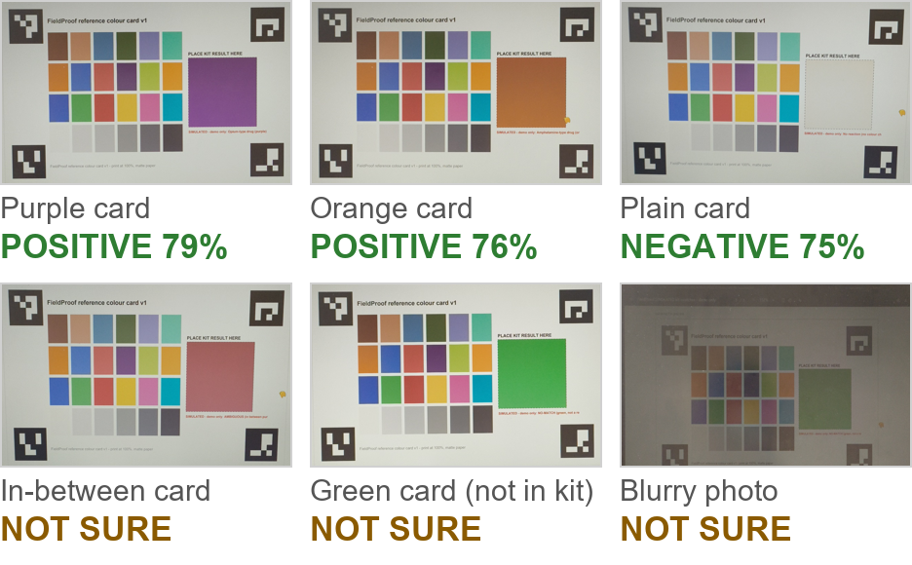


TECHNICAL APPROACH
HexTech
System Architecture
Our Goals - Measured Results
Technology Stack
  Testing: 37 computer made photos and 25 real phone scans.
  Accuracy: 25 computer made photos matched. Real scans: 14 of 25 matched, 11 said NOT SURE (7 were trick cards).
  Colour Check: Used ΔE ≤ 14, 4-point colour matching, card-fit and glare thresholds.
  Speed: Result secured in 2.5 s typically, 5 s maximum.
  Tamper Test: we changed 4 saved records on purpose, and the check page caught them.
Kit colours are simulated swatches (test photos + card on a screen), real kits need an FSL calibration trial.
Right now it is a lab prototype (TRL 4) tested on 1 phone. Next we test real kits with FSL on more phones.
Proof from Real Phone Scans (29 Sep 2026)
Card \ App | POSITIVE | NEGATIVE | NOT SURE
Positive card | 40 | 0 | 32
Plain card | 0 | 30 | 6
Trick card | 0 | 0 | 63
171 checks: 19 real photos, each as taken and with 8 computer-made changes.
Offline Design
No network? The phone keeps the photo and its hash in a queue.
Network back: it sends them in the background.
Server checks the hash, then seals the record.
(design ready, we build it next)
Stress test, 171 checks: 70 matched the card, 101 said NOT SURE (63 were trick cards). Every NOT SURE on a clear card came from a blurry photo.
Colour gap (Delta E), limit 14: right colour 4.7 to 8.9, others 34 to 42, trick cards 16 to 31.
New in the app: the phone checks blur right after the photo. On these photos it caught 36 of 38 blurry ones and stopped 3 of 70 good ones (officer can still send). Small test on 1 phone, real kits can still give wrong results.
3

Slide 4

FEASIBILITY AND VIABILITY
HexTech
Feasibility & Sustainability
Legal: the app gives a first check only, the FSL lab confirms it.
Potential Challenges & Strategies
  Technical - Core app tested with OpenCV-based colour analysis.
  User-Friendly - Capture one photo and get a result within seconds.
  Low Cost - Uses an existing Android phone, a reusable ~₹10 colour card, and open-source tools.
  Operational - Simple photo-based workflow with minimal training required.
  Scalable - Add new test-kit colour profiles through the Admin website without updating the app.
  Sustainable - Government-cloud hosting, regular profile updates, and secure data storage support long-term use.
Real-world problem | What our app does
Bad light (street lamp / torch) | Colour card fixes the colours
Shiny or blurry photo, card missing | Says NOT SURE and asks to retake
Colour is in between two results | Says NOT SURE; senior officer checks
Fake photo or edited record | In-app camera only + photo fingerprint
Different kits and phones | Kit settings + colours fixed every photo
Privacy and data: no face or suspect name is stored, only a sample code. In real use, data stays on government cloud in India. Officer sees only own tests, supervisor and admin see all. Photos are deleted after the case and appeal end (planned).
Scale (estimate): India had 1,20,010 NDPS cases in 2023 (NCRB), about 330 a day.
Our colour check takes 0.12 s per photo, so one small server can check thousands of photos an hour. Each photo is about 0.85 MB, so all of India needs about 100 GB a year.
Phased Implementation & Scalability
Pilot Plan (proposed)
After the pilot: police or NCB IT budget, server about ₹36,000 a year (estimate).
Owner: state police IT cell runs the app, the FSL keeps kit colours correct.
Upkeep: security update every 3 months. MoU with police and FSL is planned.
  Where - 1 district in Tamil Nadu, with local police and the nearest FSL
  Who - 20 officers, for 3 months
  Check - every field result is checked again in the FSL lab
  Success - 95% or more same as lab, NOT SURE below 10%, every record passes the check
  Cost - 20 cards at ₹10 = ₹200, server ₹3,000 a month for 3 months = ₹9,000. Total about ₹9,200 (estimate)
Cost & Deployment Plan
COST
HOSTING
MAINTENANCE
DEPLOYMENT
SCALE
Uses an existing phone, ₹10 reusable colour card, and open-source software.
Runs on government cloud for the app, database, and admin dashboard.
Regular security updates and easy kit-profile updates as needed.
Start with a pilot, test in the field, then expand deployment.
New test kits can be added through the website without updating the app.
4

Slide 5



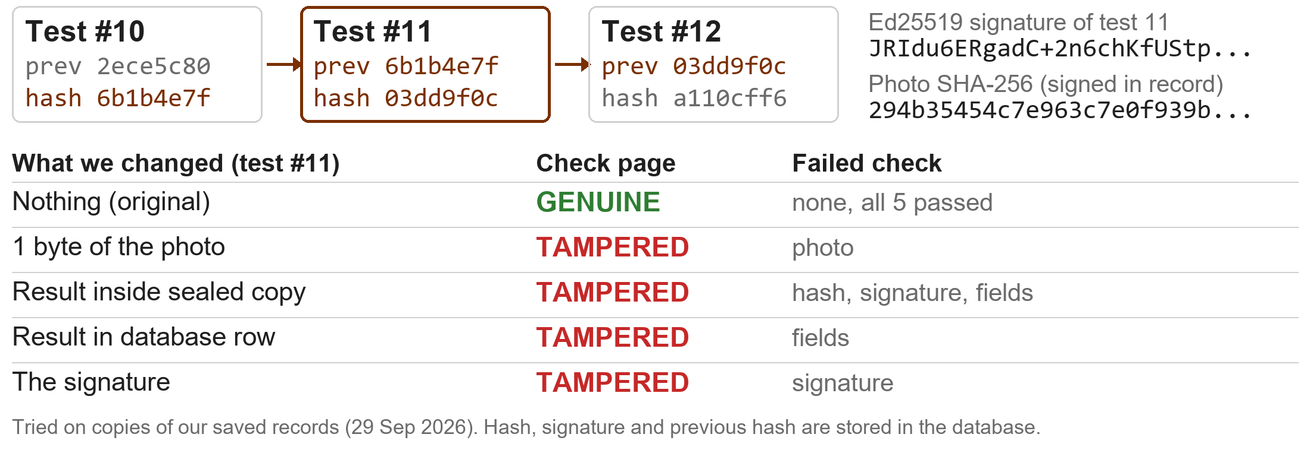


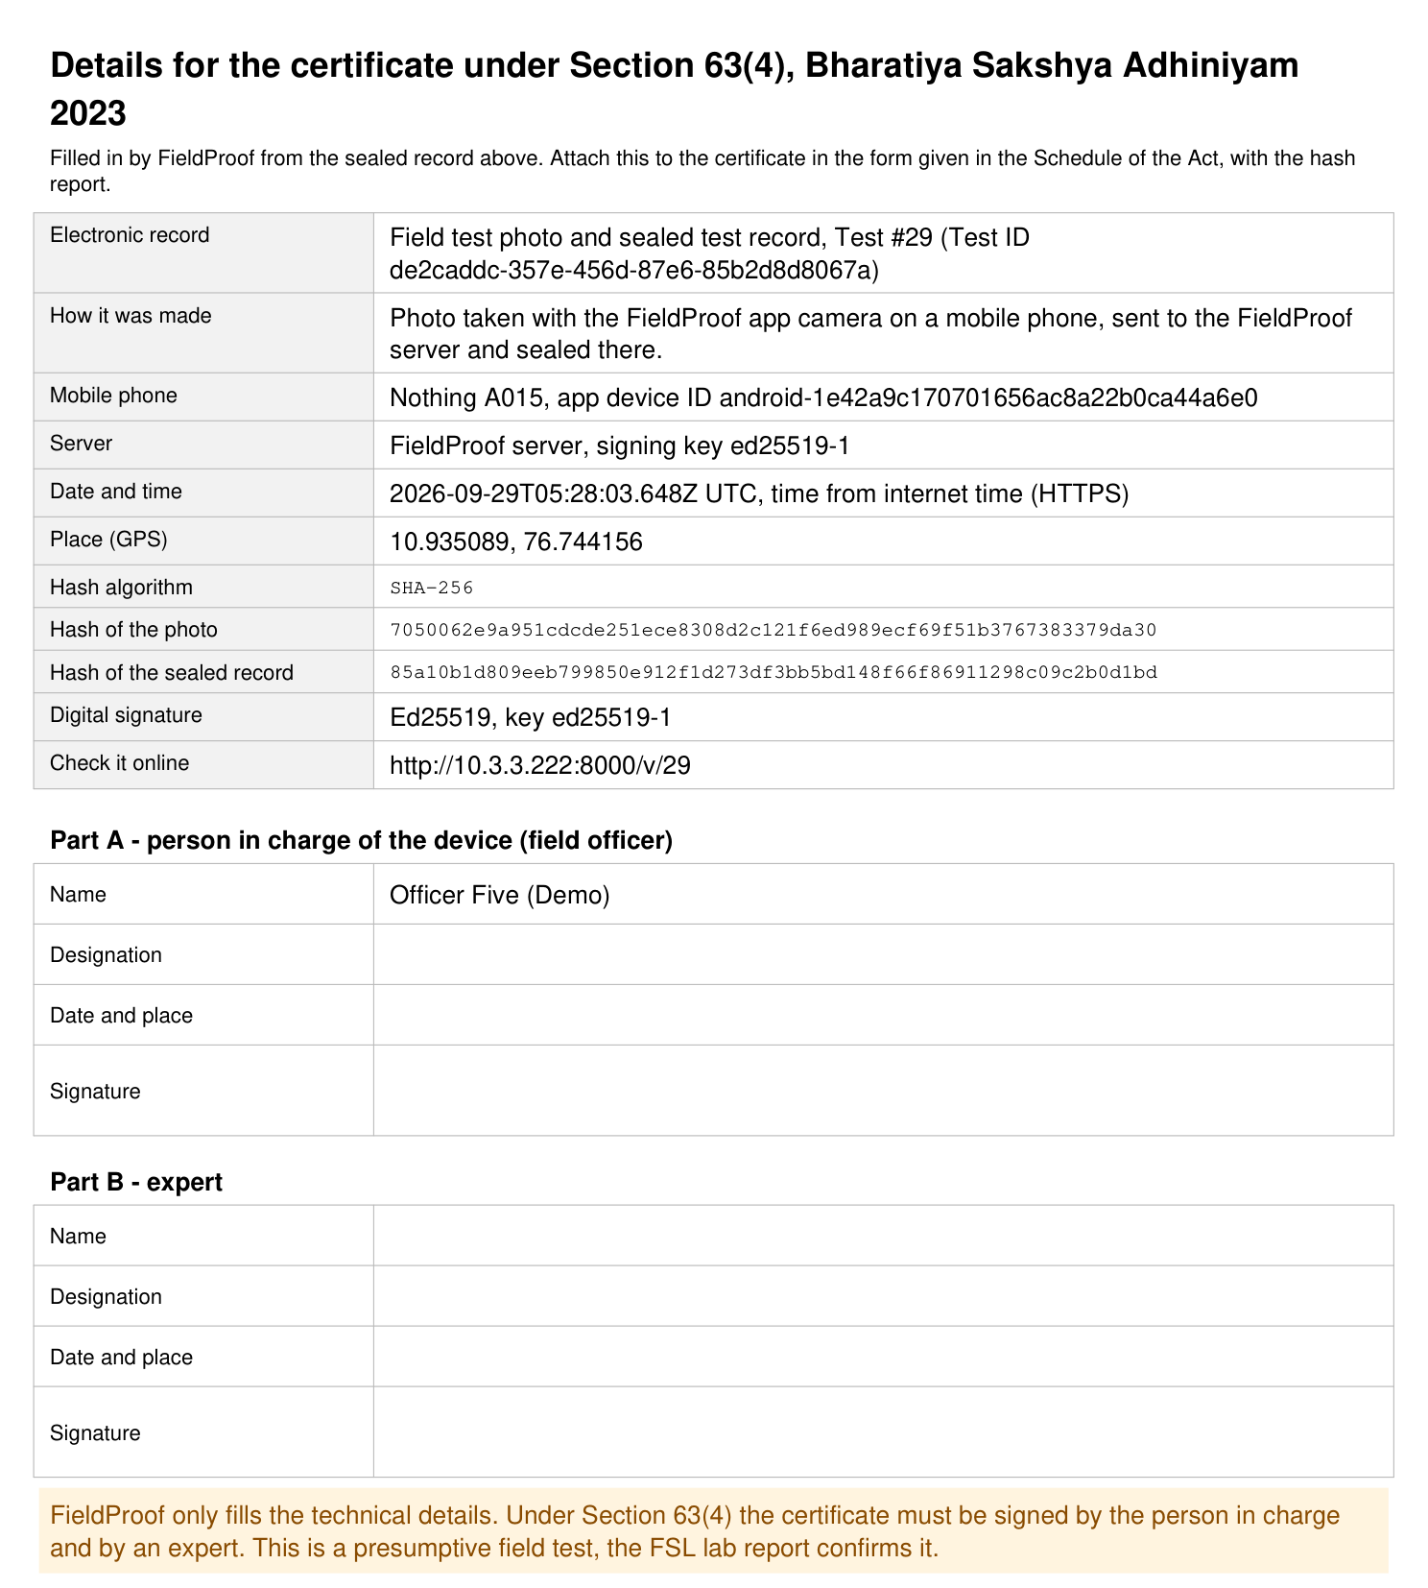
IMPACT AND BENEFITS
HexTech
Inspector Benefits
Organisation Benefits
Map -
Geo-Tagged test result
  Faster, more consistent testing
  Less manual colour checking
  INCONCLUSIVE when unclear
  Easy digital test records
  Quick access to past test records
  Proof of every test: time, place, officer & photo
  Secure and verifiable records
  Less paperwork with PDF & QR
  Easy search, reports and monitoring
  Better field-test documentation
Court Certificate: every PDF report now has a filled BSA section 63 page (photo hash, phone, time, GPS) for the officer and expert to sign. Open a full sample report (PDF, 2 pages)
QR-Based Record Verification
Tamper Test -
the photo hash is signed inside each record
Future Scope (our plan after SIH)
  Offline Mode (month 1) - build the offline design shown on slide 3.
  Phone Security (month 2) - sign each test with the phone's security chip.
  Police System Integration - match our fields to e-Sakshya, get NIC or MHA approval, then send each sealed record with its photo hash.
  Lab Comparison (during pilot) - compare field results with FSL lab results.
  Regional Languages - Tamil is done in the app. Hindi and voice help in month 3.
5

Slide 6
RESEARCH AND REFERENCES
HexTech
What they found | How we use it | Research
IEEE EMBC 2016 Phone camera colours change with light and phone model; reference colours can help handle this. | Our ₹10 colour card fixes colours in every test | [1] H. Karisen and T. Dong, "Illumination and device independence for colorimetric detection of urinary biomarkers with smartphone," in Proc. 38th Annu. Int. Conf. IEEE Eng. Med. Biol. Soc. (EMBC), Orlando, FL, USA, 2016, pp. 5184-5187, doi: 10.1109/EMBC.2016.7591895.
IEEE TPS-ISA 2024 Digital evidence must maintain integrity and show how it was handled. | Photo fingerprint + signature + chained log | [2] S. Nath, K. Summers, J. Baek, and G.-J. Ahn, "Digital evidence chain of custody: Navigating new realities of digital forensics," in Proc. IEEE 6th Int. Conf. Trust, Privacy Secur. Intell. Syst. Appl. (TPS-ISA), Washington, DC, USA, 2024, pp. 11-20, doi: 10.1109/TPS-ISA62245.2024.00012.
Forensic Science International 2014 A mobile phone camera can measure drug-test colours using RGB values. | Our app reads the test colour as a number | [3] A. Choodum, K. Parabun, N. Klawach, N. Nic Daeid, P. Kanatharana, and W. Wongniramaikul, "Real time quantitative colourimetric test for methamphetamine detection using digital and mobile phone technology," Forensic Sci. Int., vol. 235, pp. 8-13, Feb. 2014, doi: 10.1016/j.forsciint.2013.11.018.
Analytical Chemistry 2016 By-eye colour interpretation is subjective; smartphone image analysis can provide objective analysis. | App gives POSITIVE / NEGATIVE / NOT SURE | [4] S. T. Krauss et al., "Objective method for presumptive field-testing of illicit drug possession using centrifugal microdevices and smartphone analysis," Anal. Chem., vol. 88, no. 17, pp. 8689-8697, Sep. 2016, doi: 10.1021/acs.analchem.6b01982.
Digital Discovery 2023 Computer vision can quantify and compare colour changes that may look similar by eye. | App shows photo colour next to kit colours | [5] N. Bugeja et al., "Teaching old presumptive tests new digital tricks with computer vision for forensic applications," Digital Discovery, vol. 2, no. 4, pp. 1143-1151, 2023, doi: 10.1039/D3DD00066D.
6

