Slide 1
MAJOR PROJECT PRESENTATION
NexFolio: An Explainable AI (XAI) Framework for Intelligent Portfolio Risk Profiling, Real-Time Market Analytics, and Institutional Tax Optimization
Department of Computer Science and Engineering | CBIT
Presented By:
Madupu Lokesh Reddy - 160122733047
Patil Tejas - 160123733321
Project Supervisor:
Mr. Banothu Sai Kumar
Assistant Professor, Dept. of CSE

Slide 2
TITLE JUSTIFICATION
“Explainable AI (XAI)”
“Portfolio Risk Profiling”
Replaces opaque 'black-box' predictions with game-theoretic TreeSHAP feature attributions. Translates complex mathematical weights into human-understandable risk drivers.
Multi-dimensional evaluation beyond simple P&L using 36 quantitative features across return momentum, annualized volatility, downside semi-variance, Sharpe/Sortino ratios, and market Beta.
“Real-Time Market Analytics”
“Institutional Tax Optimization”
Decouples sub-millisecond in-memory valuation from heavy analytics using a Dual-Loop architecture and a 5-state Market Data Pedigree state machine (Live, Delayed, Reference).
Implements native statutory compliance with the new Income-tax Act, 2025 (Tax Year 2026–27), modeling STCG @ 20%, LTCG @ 12.5%, buyback taxation, and an 8-year loss carryforward bank.

Slide 3
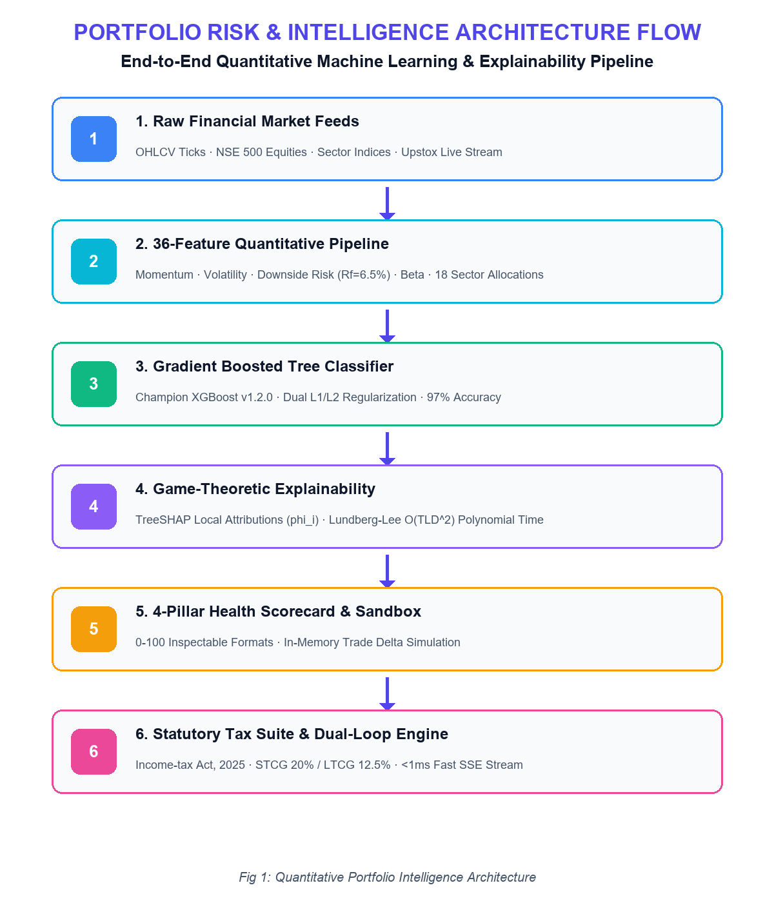
BACKGROUND
Quantitative Portfolio Management & AI
• Modern Portfolio Theory (MPT) & Multi-Factor Models
• Exponential growth of retail investors (160M+ Demat accounts)
• Shift from simple P&L tracking to risk-adjusted metrics
• Supervised ML classification for portfolio risk tiers
• Statutory transition to Income-tax Act, 2025 (TY 2026–27)

Slide 4
MOTIVATION
Retail Capital Exposure
Black-Box AI Distrust
Budget 2026-27 Tax Overhaul
Cross-Sector Market Volatility
High-Latency System Freezes
Audit & Regulatory Filings

Slide 5
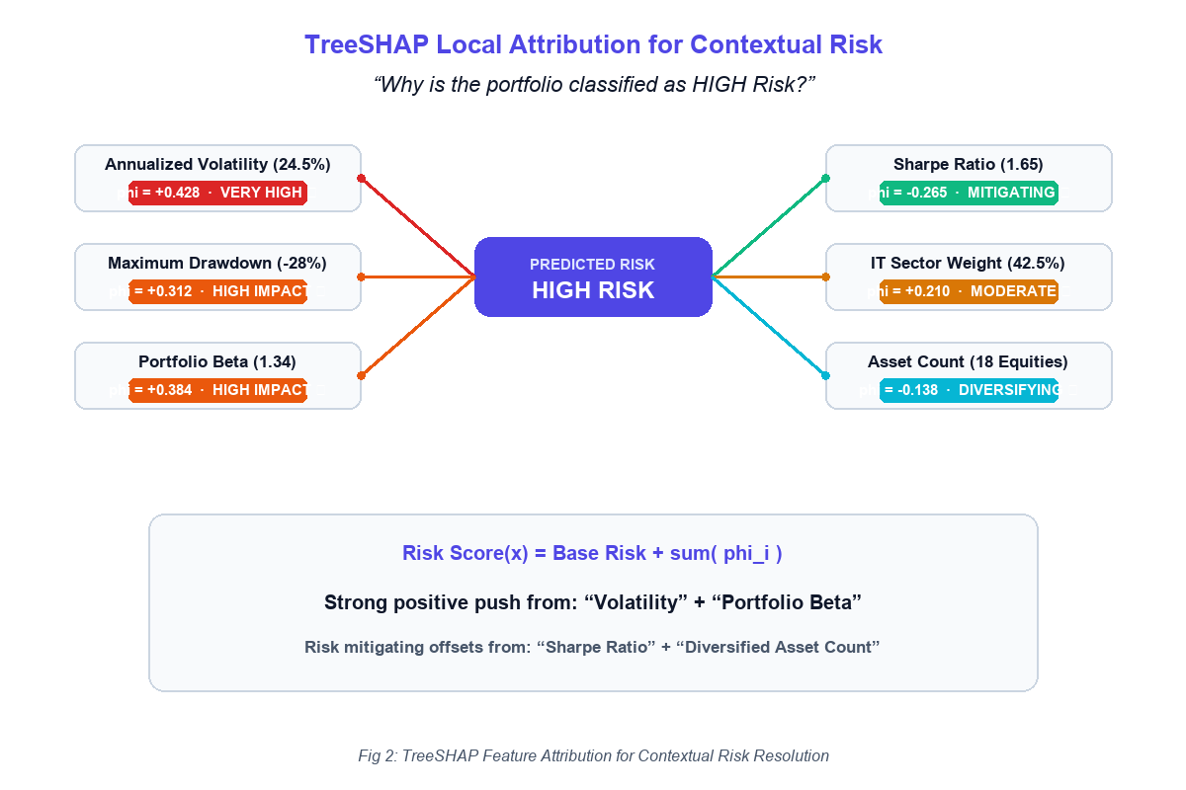
EXPLAINABLE AI & SHAP MECHANISM

Slide 6
THE PORTFOLIO RISK & BLACK-BOX CHALLENGE
• Model Opacity in deep neural networks
• High feature multi-collinearity & noise
• Inference latency bottlenecks (>40ms)
• Outdated 365-day tax approximations
Accuracy vs. Explainability Benchmark
• Logistic Regression
Explainable, but Low Accuracy (78.5%)
• Deep CNN-LSTM
Moderate Accuracy, but Black-Box & High Latency (~45ms)
• NexFolio (XGBoost + SHAP)
High Accuracy (97.0%) + Sub-second XAI (<1ms)

Slide 7
LITERATURE SURVEY
Authors | Title | Methods | Advantages | Disadvantages
P. Singh et al. (IEEE Access) [Base Paper] | Harnessing a Hybrid CNN-LSTM Model for Portfolio Performance | CNN-LSTM, spatial feature extraction, temporal modeling | Captures temporal dependencies; multi-scale extraction | Black-box nature; high compute latency (~45ms); no tax math.
I. Aruleba, Y. Sun (IEEE Access, 2024) | Effective Credit Risk Prediction Using Ensemble Classifiers | Random Forest, XGBoost, TreeSHAP | Ensemble superiority on tabular data; feature explainability | Binary credit focus; lacks multi-class calibration & streaming.
I. Aruleba, Y. Sun (IEEE Access, 2024) | Improved Ensemble Method With Data Resampling | SMOTE-ENN, Cross-Validation, Stratified Partitioning | Mitigates class imbalance; prevents data leakage | Static dataset focus; lacks live streaming & pedigree fallback.
Vijayanand, Smrithy (2024) | Explainable AI in Financial Transaction Systems | XGBoost, SHAP, feature attribution | Provides regulatory trust; demystifies model weights | Limited to fraud detection; no portfolio scoring or tax math.

Slide 8
RESEARCH GAP
Black-Box Risk Models
TreeSHAP Attribution Layer
Sub-second game-theoretic risk drivers for every prediction
→
→
Feature Collinearity
Dual L1 + L2 Regularization
Prevents overfitting on correlated ratios, achieving 97% accuracy
→
→
Analytical Latency
Dual-Loop Engine (<1ms SSE)
Decouples live quote streaming from heavy persistence
→
→
Outdated Tax Engines
Income-tax Act, 2025 Suite
Exact calendar-month rules, buybacks, and 8-year loss bank
→
→

Slide 9
PROBLEM STATEMENT
Modern portfolio platforms fail to provide transparent risk diagnostics, relying on superficial P&L summaries or opaque 'black-box' ML models that lack interpretability, suffer from high latency, and ignore the new Income-tax Act, 2025 regulations.
Our goal is to design an explainable AI (XAI) framework combining 36-feature quantitative modeling, sub-second TreeSHAP risk attributions, a deterministic 4-pillar health scorecard, sub-millisecond dual-loop valuation, and an institutional tax suite.

Slide 10
PROBLEM STATEMENT
Modern portfolio platforms fail to provide transparent risk diagnostics, relying on superficial P&L summaries or opaque 'black-box' ML models that lack interpretability, suffer from high latency, and ignore the new Income-tax Act, 2025 regulations.
Our goal is to design an explainable AI (XAI) framework combining 36-feature quantitative modeling, sub-second TreeSHAP risk attributions, a deterministic 4-pillar health scorecard, sub-millisecond dual-loop valuation, and an institutional tax suite.

Slide 11
OBJECTIVES
01
36-Feature Pipeline
Capture return momentum, volatility, downside risk, Beta, and 18 sector weights.
04
What-If Sandbox
Enable in-memory trade simulations with instant delta calculations without database writes.
02
XGBoost & TreeSHAP
Train regularized gradient-boosted trees (>95% accuracy) with sub-second SHAP attributions.
05
Dual-Loop Engine
Decouple <1ms live quote streaming from slow persistence with a 5-state Pedigree FSM.
03
4-Pillar Scorecard
Formulate an inspectable 0–100 score across Diversification, Volatility, Efficiency, and Drawdown.
06
Statutory Tax Suite
Implement Income-tax Act, 2025 STCG @ 20%, LTCG @ 12.5%, Buybacks, and 8-Year Loss Bank.

Slide 12
CONCLUSION
• Investigate black-box limitations in portfolio risk models and formulate an explainable 36-feature quantitative pipeline.
• Develop an institutional ML architecture combining regularized XGBoost with TreeSHAP for sub-second risk attributions.
• Formulate a deterministic 4-pillar health scorecard (0–100) and an in-memory What-If trade simulation sandbox.
• Implement a Dual-Loop valuation architecture to decouple <1ms live quote streaming from background analytics.
• Implement statutory tax compliance for the Income-tax Act, 2025 featuring STCG 20%, LTCG 12.5%, and an 8-year Loss Bank.

Slide 13
REFERENCES
[1] P. Singh et al., 'Harnessing a Hybrid CNN-LSTM Model for Portfolio Performance and Risk Management,' IEEE Access, vol. 11, pp. 45120–45132, 2023, doi: 10.1109/ACCESS.2023.3289012.
[2] I. Aruleba and Y. Sun, 'Effective Credit Risk Prediction Using Ensemble Classifiers with Model Explanation,' IEEE Access, vol. 12, pp. 115015–115025, 2024, doi: 10.1109/ACCESS.2024.3445612.
[3] I. Aruleba and Y. Sun, 'Improved Ensemble Method With Data Resampling for Credit Risk Prediction,' IEEE Access, vol. 12, pp. 128940–128952, 2024, doi: 10.1109/ACCESS.2024.3458901.
[4] Vijayanand and Smrithy, 'Explainable AI-Enhanced Ensemble Learning for Financial Fraud Detection in Mobile Money Transactions,' 2024.
[5] S. M. Lundberg and S.-I. Lee, 'A Unified Approach to Interpreting Model Predictions,' in Advances in Neural Information Processing Systems (NeurIPS), 2017.
[6] Ministry of Finance, Government of India, 'The Income-tax Act, 2025 and Union Budget 2026–27 Statutory Provisions,' New Delhi, 2026.

Slide 14
THANK YOU

