Slide 1

Optimizing Efﬁciency: The Role of a Sports Event Cleanup Coordinator

Slide 2
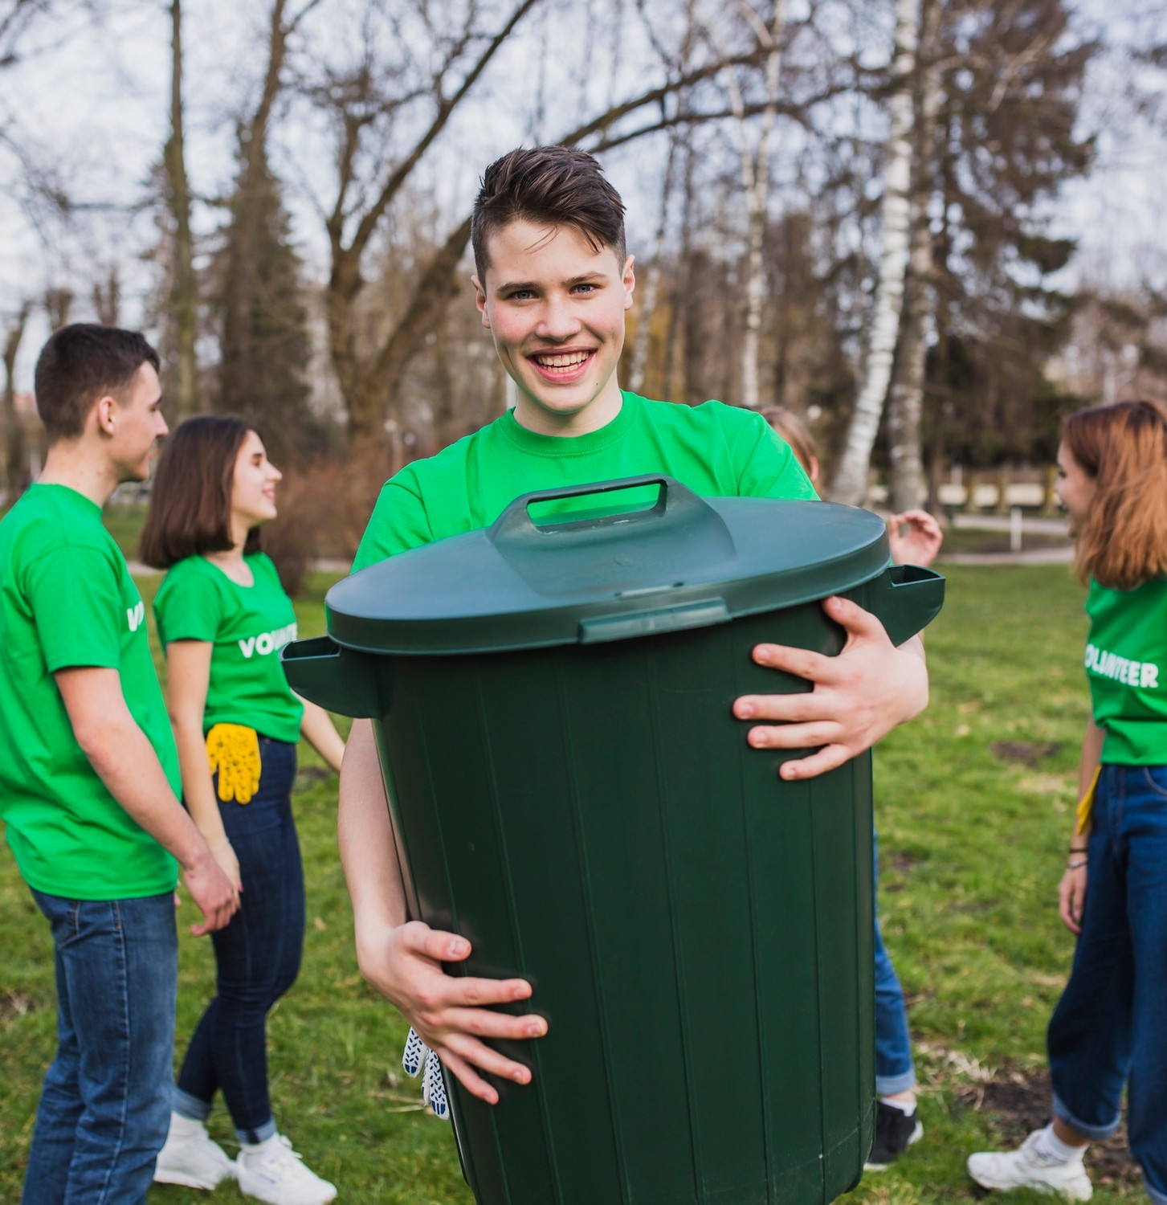
Introduction to Cleanup Coordination
In the world of sports events, a cleanup coordinator plays a crucial role. Their responsibilities include ensuring that venues are cleaned efﬁciently and that waste management is handled effectively. This presentation will explore how optimizing these processes contributes to overall event success.

Slide 3
Importance of Cleanup Coordination
The role of a cleanup coordinator is essential for maintaining the aesthetic appeal of an event. A clean environment enhances the experience for attendees and reﬂects positively on the event organizers. Effective coordination leads to a smoother operation and a better reputation.

Slide 4

Key Responsibilities
A cleanup coordinator must manage staff assignments, oversee waste disposal, and ensure compliance with environmental regulations. They also coordinate with vendors to provide necessary supplies and ensure that the cleanup process is completed in a timely manner.

Slide 5

Strategies for Efﬁciency
To optimize efﬁciency, a cleanup coordinator should implement strategic planning. This includes scheduling cleanup crews, utilizing technology for tracking waste, and conducting post- event evaluations to identify areas for improvement. These strategies enhance the overall effectiveness of cleanup efforts.

Slide 6
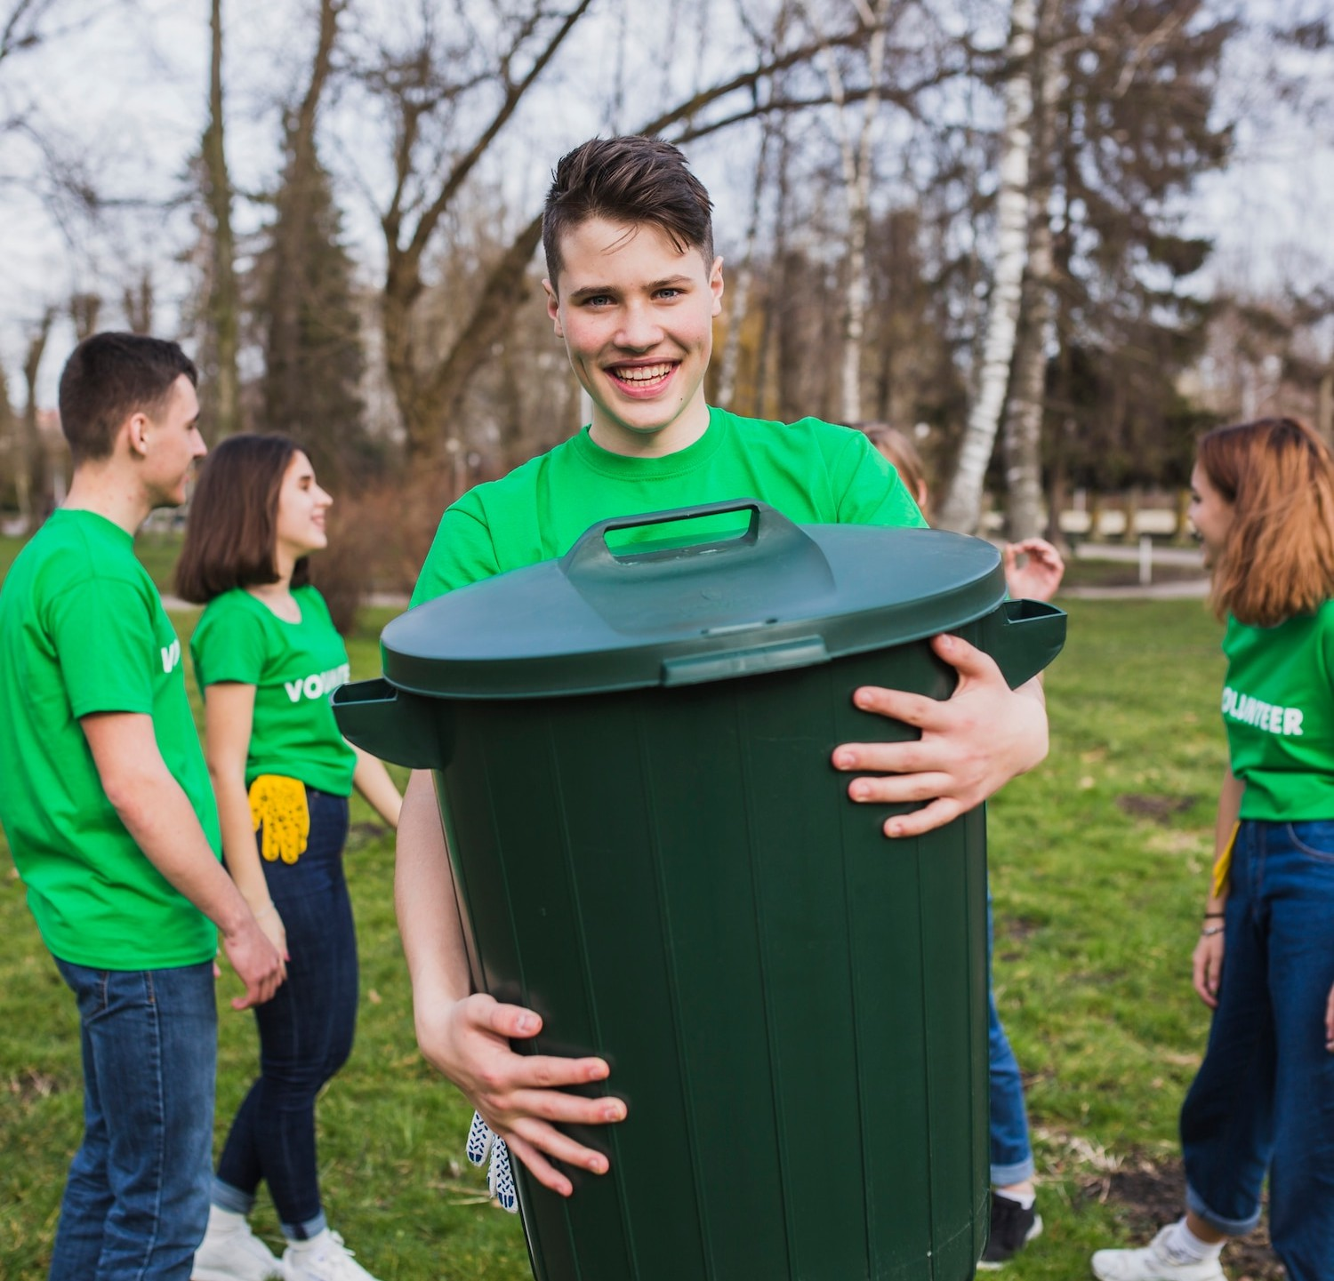
Team Management Techniques
Effective team management is vital for a successful cleanup operation. The coordinator must communicate clearly, provide training, and motivate the team to work efﬁciently. Recognizing and rewarding efforts can lead to a more dedicated workforce.

Slide 7

Waste Management Best Practices
Implementing best practices in
waste management is critical. This includes sorting recyclables, composting organic waste, and ensuring proper disposal of hazardous materials. Training staff on these practices promotes sustainability and reduces the event's environmental impact.

Slide 8
Cleanup coordinators often face challenges such as limited time, unexpected weather conditions, and varying waste volumes.
Developing contingency plans and adapting to changing circumstances are essential skills for overcoming these obstacles and ensuring a successful cleanup.
Challenges Faced

Slide 9

Conclusion and Future Outlook
In conclusion, the role of a sports event cleanup coordinator is pivotal in optimizing efﬁciency.
By implementing effective
strategies and embracing best practices, coordinators can enhance the event experience while promoting sustainability. The future of event cleanup lies in continuous improvement and innovation.

