Slide 1
FINANCE & RISK ANALYTICS CAPSTONE PROJECT
By
LOGESHWARAN V

Slide 2
Business Requirement and Goal
Being a portfolio manager, the task is to provide consultation to two different investors, considered as Private Clients, i.e Mr Patrick Jyenger and Mr Peter Jyenger based on their requirements and financial objectives
The primary goal of this Case Study:
To Suggest a Portfolio of stocks to Mr Patrick Jyenger based on his risk profile to meet his goal on doubling the amount of 500K Dollars in five years of timespan to buy a minoruty stake in Naturo.
To provide a High risk stock to Mr Peter Jyenger based on his risk profile to accomplish his goal on earning greater returns for the invested amount of 1 Million Dollars over a five years of timeframe to use it for the expansion of JWW.

Slide 3
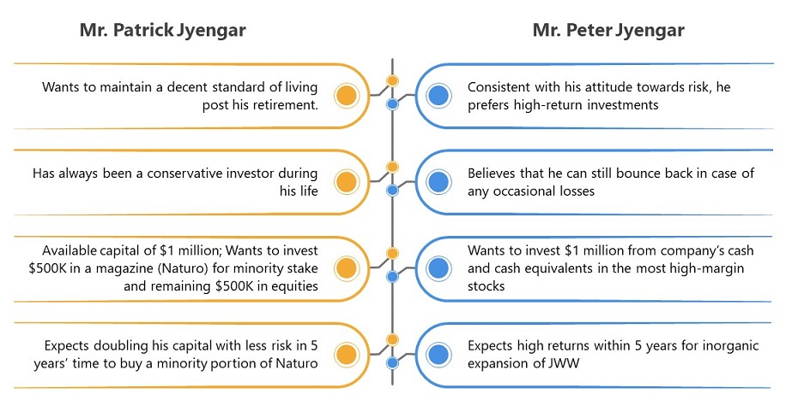
INVESTOR PROFILES:

Slide 4
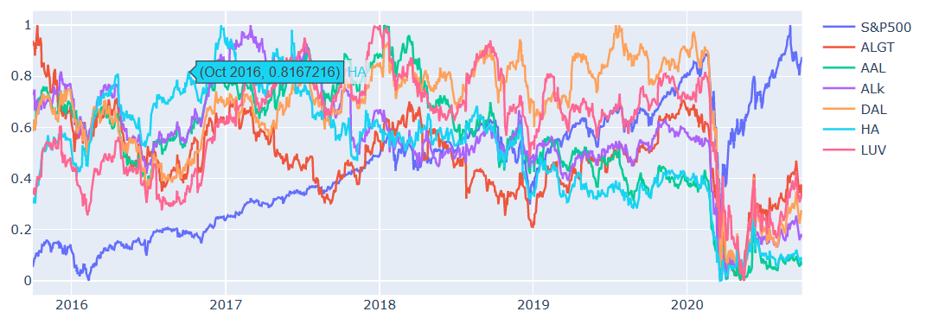
Sector Wise Analysis
Aviation Sector
Due to Corona Pandemic hit in March 2020 Aviation sector has faced a major crisis and the sector has not recovered there after even though the market index has gone up.

Slide 5
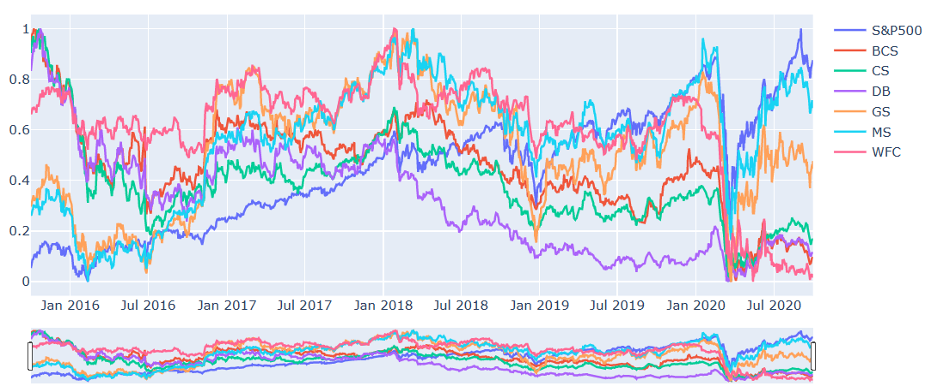
Sector Wise Analysis
Finance Sector
Due to Corona Pandemic hit in March 2020 Finance sector has also faced a major crisis and the sector has recovered a bit although majority of stocks has been hit.
Morgan Stanley & Goldman Sachs have performed well when compared to other stocks.

Slide 6
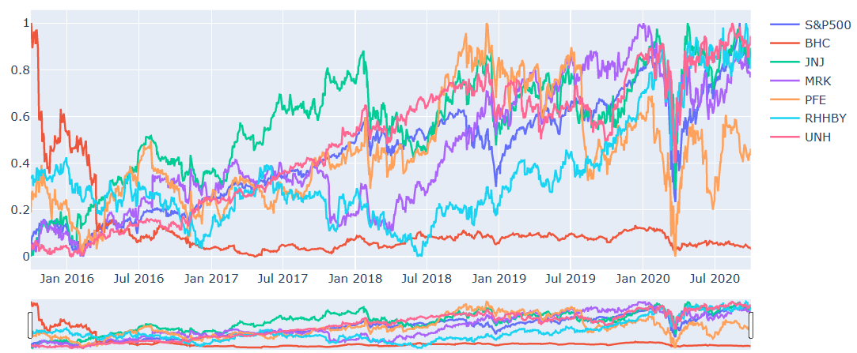
Sector Wise Analysis
Pharma Sector
Due to Corona Pandemic hit in March 2020 Pharma & Health care sector has also faced a major crisis and the recovery rate shown by this sector is commendable.
United Health, Johnson & Johsnson have performed well when compared to S&P Index.
Bausch Health is consistently performed very badly over the years when compared to other stocks in the same sector.

Slide 7
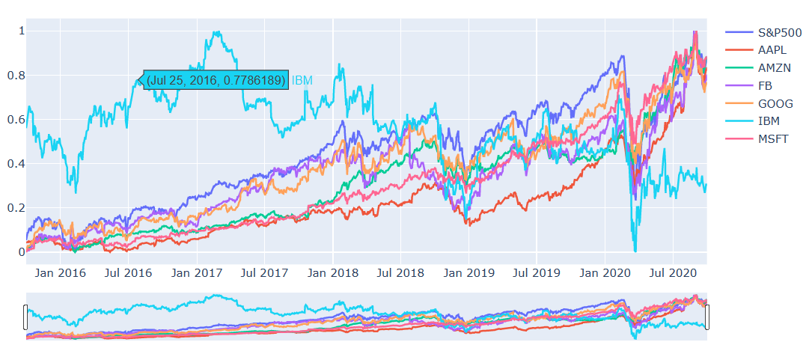
Sector Wise Analysis
Technology Sector
Due to Covid Pandemic hit in March 2020 Technology Sector has also faced crisis but the recovery rate shown by this sector is commendable.
Microsoft, Amazon, Apple, Facebook & Google have performed well along with Market index.
The stock performed very badly over the years when compared to other stocks in the same sector is IBM.

Slide 8
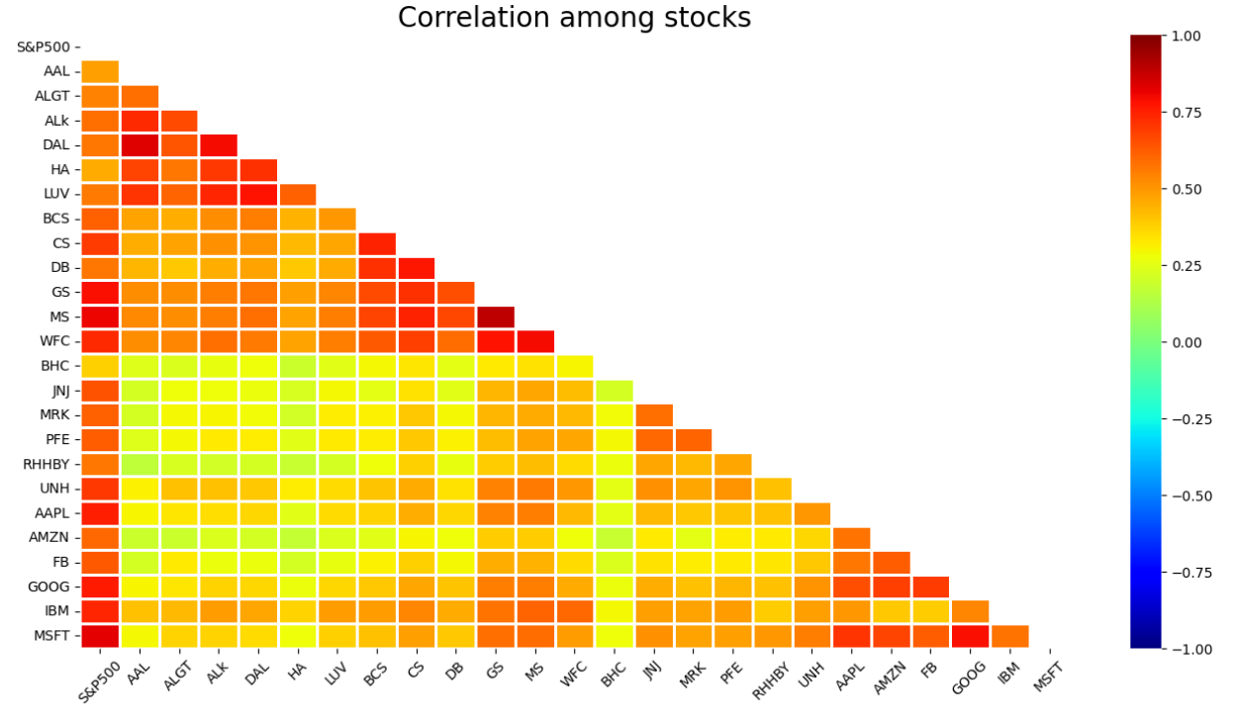
Correlation among stocks
Microsoft & Google stocks are highly correlated in the Technology sector Stocks.
Goldman Sachs, Morgan Stanley & Wells Fargo are correlated in the Finance sector Stocks.
American Airlines & Delta Airlines are more correlated than Alaska Air Group in the Aviation sector stocks.
Pharma sector stocks are less correlated when compared to any other sector stocks.

Slide 9
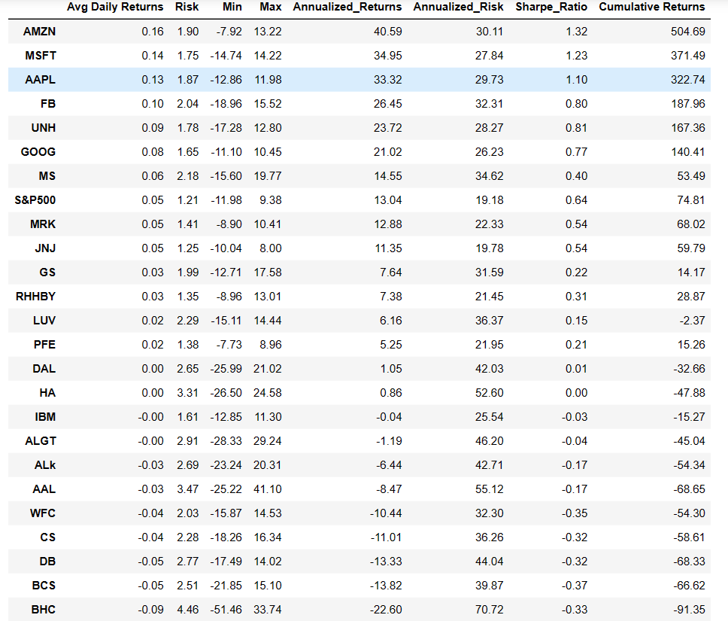
stocks performance predictions
At the end of 5 years we can see that the top 8 stocks having returns of greater than 80% are as follows
AMZN gives 40.59% annual returns
MSFT gives 34.95% annual returns
AAPL gives 33.32% annual returns
FB gives 26.45% annual returns
UNH gives 23.72% annual returns
GOOG gives 21.02% annual returns
MS gives 14.55% annual returns
S&P500 gives 13.04% annual returns

Slide 10
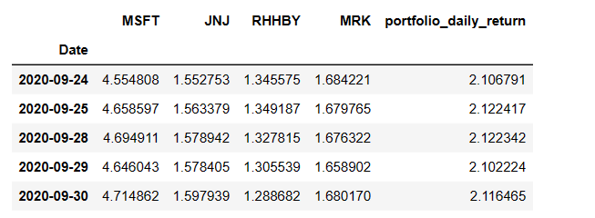
Portfolio Analysis
Patrick Jyengar Portfolio
As per his profile Low risk stocks like JNJ,RHHBY and MRK is suitable to invest on. But overall returns with these three stocks wouldn't reach the target what Mr.Patrick is investing for. So one portion of his wealth can be invested on MSFT to gain the desired returns.
Cumulative Return from the Portfolio
After calculating various factors like ROI, Risk and Sharp ratio, we can say that if Mr.Patrick jyengar invests 500 Thousand Dollar in equities i.e the above Portfolio. Returns that he would fetch after 5 years is 1.05 Million Dollar with 558.23 Thousand dollar of gain on investment.

Slide 11
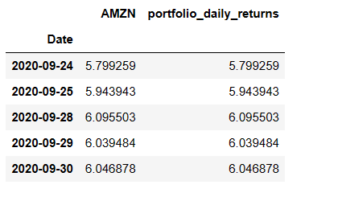
Portfolio Analysis
Peter Jyengar Portfolio
Mr. Peter Jyengar on the other hand Consistent with his attitude towards risk, he prefers high-return investments. Believes that he can still bounce back in case of any occasional losses. He Wants to invest $1 million from company's cash and cash equivalents in the most high-margin stocks Expects high returns within 5 years for inorganic expansion of his company. As per his profile High risk/High Returns stocks like AMZN is suitable to invest on. Overall returns with these stocks would fetch him Maximum returns and also cater the Risk.
Cumulative Return from the Portfolio
The cumulative returns suggests that the portfolio has achieved a cumulative return of 5.04% in the given period. After calculating various factors like ROI, Risk and Sharp ratio, Mr.Peter jyengar invests 1 Million Dollar on equities i.e the above Portfolio. Returns that he would fetch after 5 years is more than 6 Million Dollars with 5+ Million dollars of gain on investment.

Slide 12
THANK YOU

