Slide 1
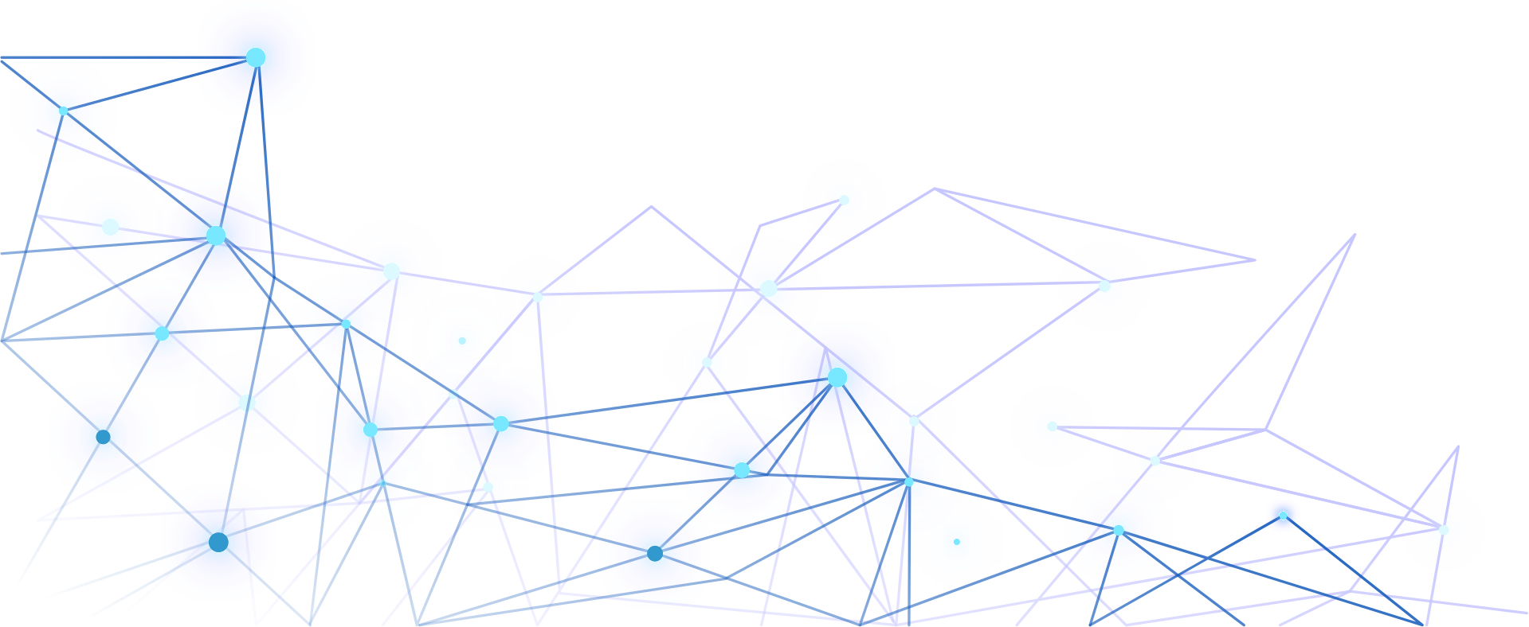


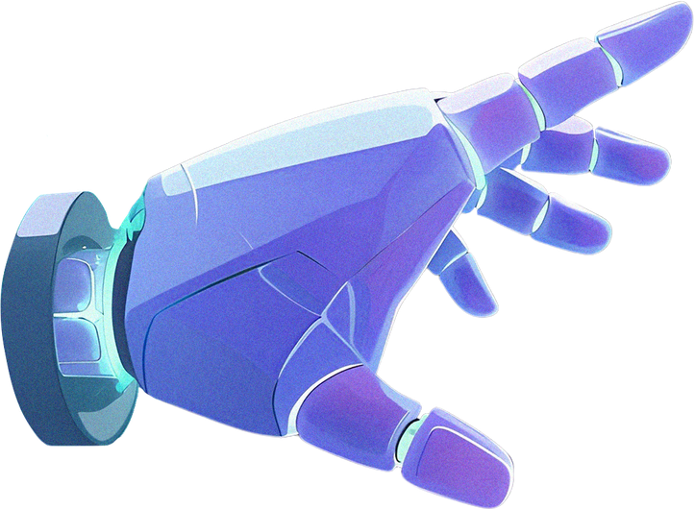
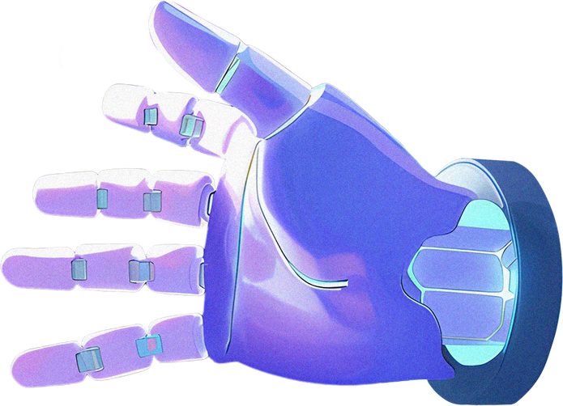
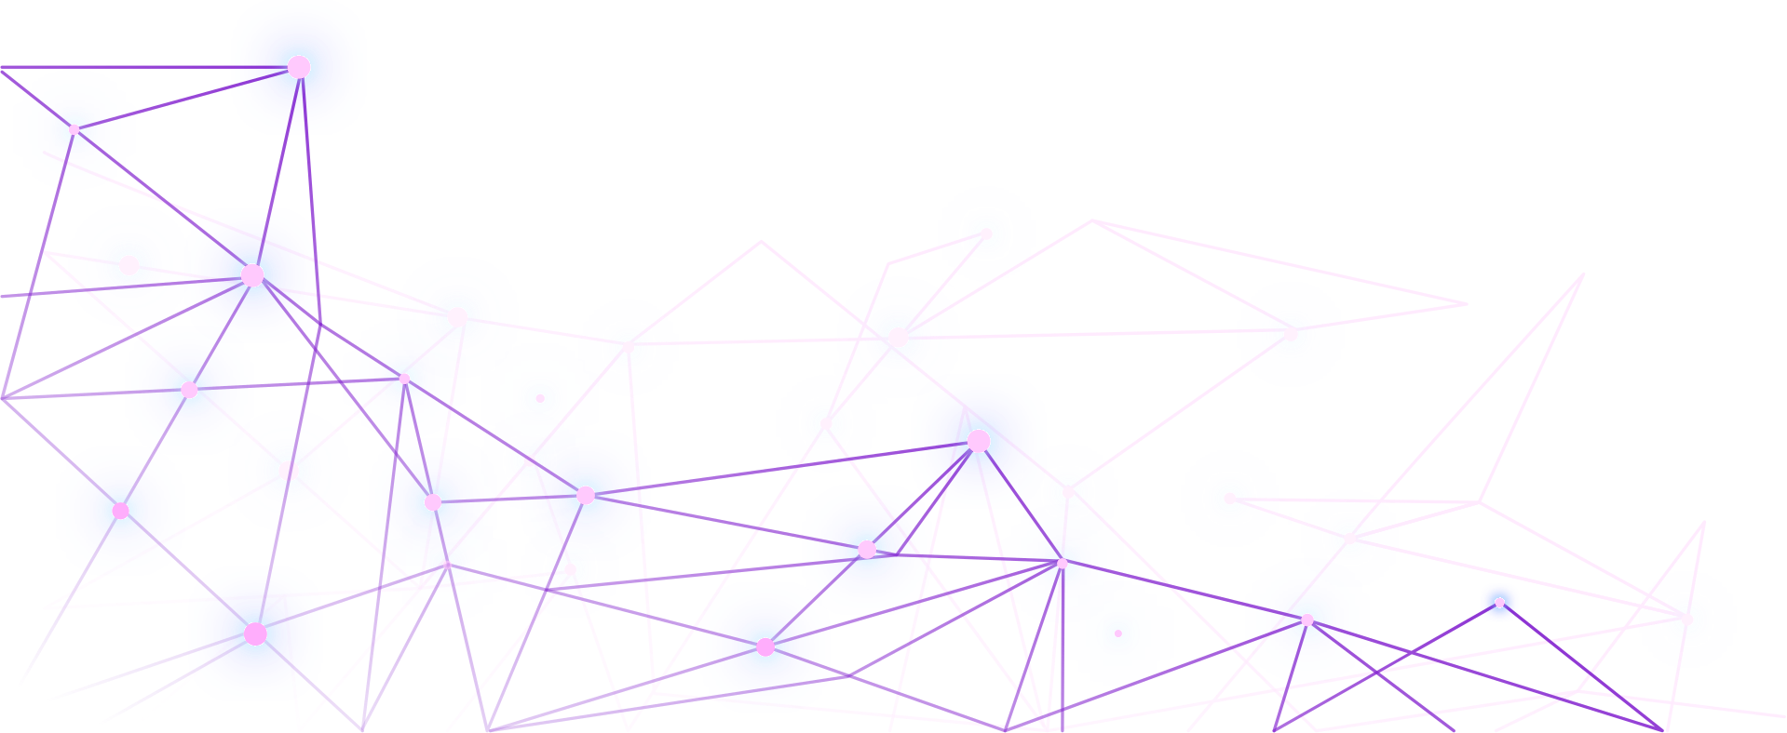
AI Concept Explainer: One Topic at Three Levels
Topic: Artificial Neural Networks (ANN)

Slide 2


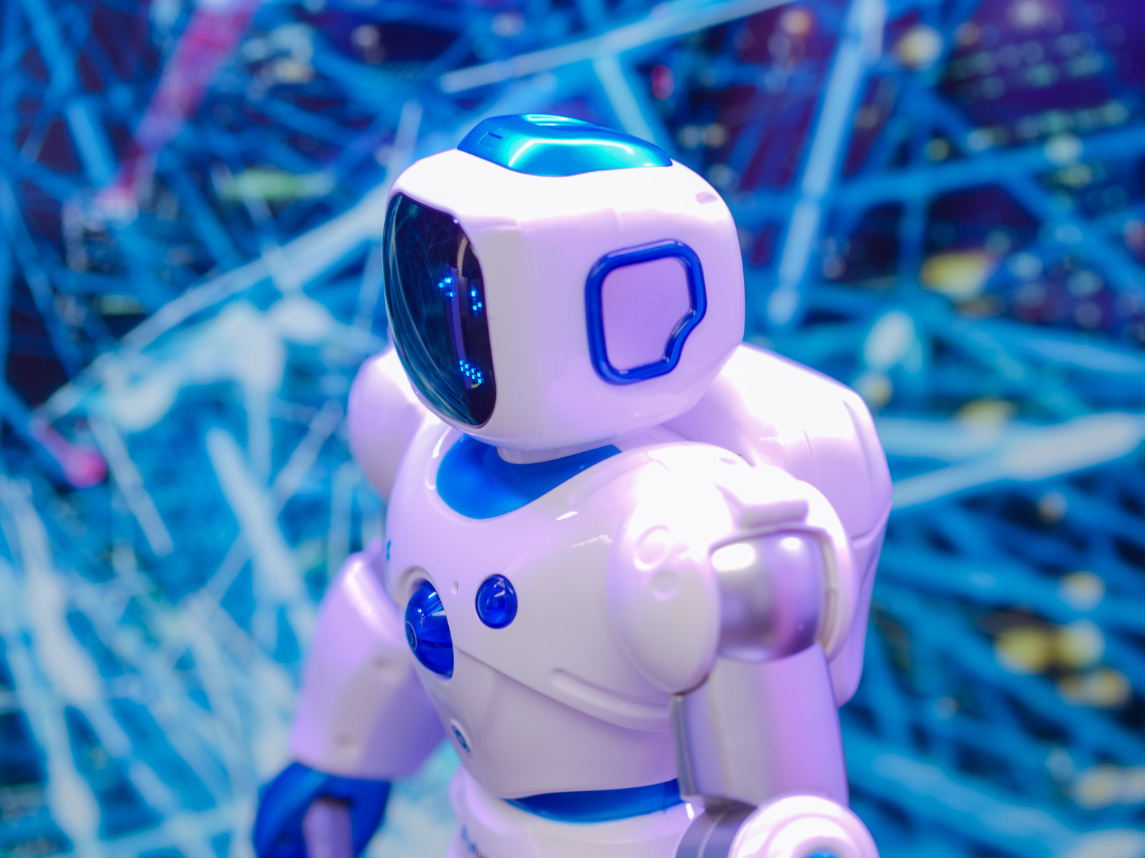

Problem Statement
One Concept, Different Learners
  Artificial Neural Networks can be difficult for beginners
to understand.
  School students need simple explanations and familiar
examples.
  Undergraduate students need technical concepts and
practical understanding.
  Experts need mathematical explanations and limitations.

Slide 3
Project Objectives
  Explain Artificial Neural Networks at three learning
levels.
  Generate simple and technical explanations using
AI tools.
  Create suitable visuals and learning materials.
  Verify explanations using reliable educational sources.
  Assess understanding through a quiz.
Goal: Make complex AI concepts easier to understand.

Slide 4
Child-Level Explanation
What Is an Artificial Neural Network?
An Artificial Neural Network (ANN) is a computer
system that learns patterns from examples to make predictions.
Example: Learning to Recognise Cats 🐱
  See many pictures of cats.
  Identify common patterns.
  Learn from examples.
  Predict whether a new picture contains a cat.
Simple Workflow:
Examples → Learning Patterns → Prediction
Note: Computers learn numerical patterns differently from humans.

Slide 5
Undergraduate-Level Explanation
How Does an Artificial Neural Network Work?
1. Neurons: Computational units that process numerical inputs.
2. Weights: Determine the influence of inputs.
3. Biases: Additional parameters that adjust calculations.
4. Activation Function: Introduces non-linearity into the network.
5. Training: Adjusts parameters to reduce prediction errors.
Workflow:
Input → Hidden Layers → Output → Loss Calculation → Parameter Updates

Slide 6
Expert-Level Explanation
Mathematical Foundations and Limitations
Forward Propagation
Where:
  x = Input , W = Weights
  b = Biases , f = Activation function , a = Output activation
Training Process
  Loss functions measure prediction errors.
  Backpropagation calculates gradients using the chain rule.
  Optimizers use gradients to update parameters.
Limitations
  Overfitting
  Data dependency
  Computational cost
  Limited interpretability
z = Wx+b a=f(z)

Slide 7
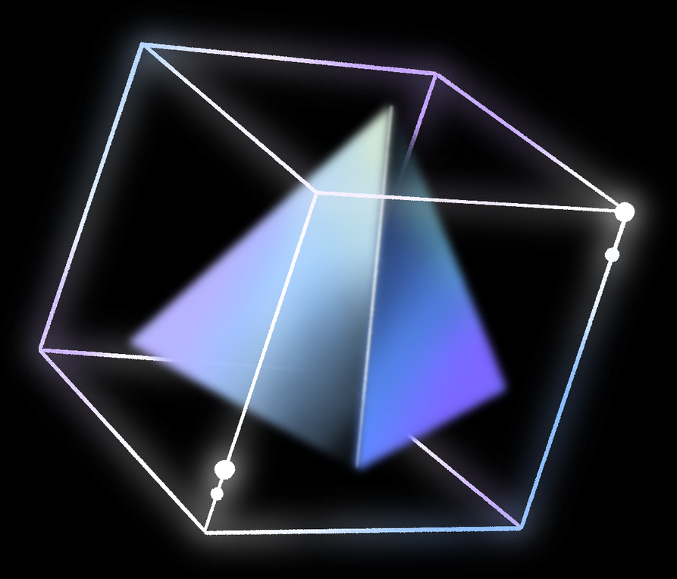


Research and Verification
Sources Consulted
  Deep Learning textbook
  Google Machine Learning Crash Course
  Stanford CS231n
Claims Investigated
  Neural network architecture
  Parameter learning during training
  Gradients and backpropagation
  Overfitting and generalization
  Artificial versus biological neural networks
Important Correction:
Artificial Neural Networks are inspired by aspects of biological neural systems but are not identical to human brains.

Slide 8
AI Tools and Workflow
Tools Used in the Project
  ChatGPT: Generate explanations at three learning levels.
  Canva: Design presentation slides and visuals.
  Perplexity: Find research sources.
  Google Slides or Canva: Organise presentation content.
  Quiz tool: Assess learner understanding.
Workflow:
Prompt Design → Explanation Generation → Visual Creation → Research Verification → Quiz → Final Presentation

Slide 9
Quiz and Comparison
Child | UG | Expert
Simple analogy | Technical concepts | Mathematical formulation
Visual examples | Network structure | Gradients and loss
Basic understanding | Working principles | Limitations and assumptions
Learning Activities
  Explain the concept at three levels.
  Conduct a short quiz.
  Compare understanding before and after learning, if measured.

Slide 10
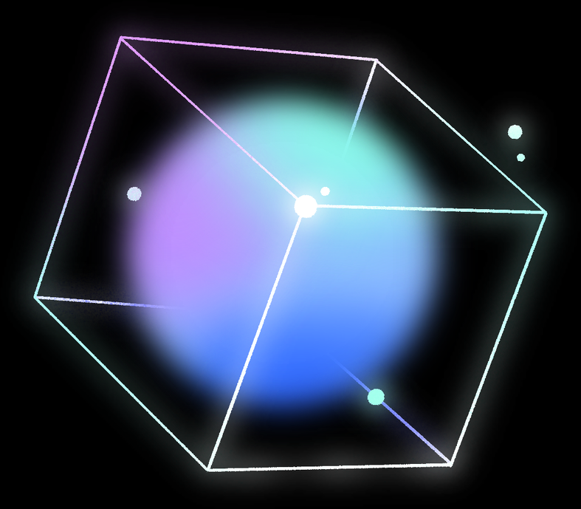
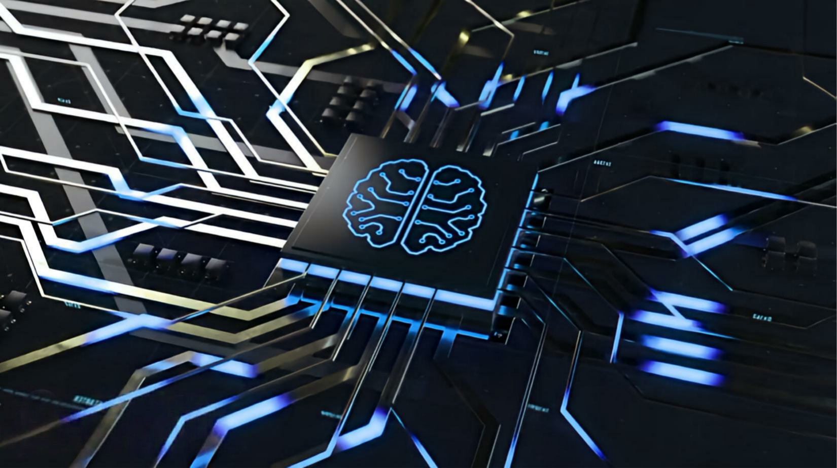


Verification and Conclusion
Key Findings
  Complex AI concepts can be explained at different learning levels.
  Analogies and visuals help introduce unfamiliar ideas.
  Technical explanations provide mathematical depth.
  Research verification helps identify inaccurate claims.
Limitations
  Simplified explanations may omit technical details.
  Quiz results may not fully measure understanding.
  Neural networks can make incorrect predictions.
Future Improvements
  Add interactive demonstrations.
  Test explanations with more learners.
  Improve the quiz using learner feedback.

