Slide 1
EDUBRIDGE COURSE Certified Java Full Stack Professional PROJECT NAME INVENTORY MANAGEMENT SYSTEM
Under the Guidence of
Trainer Mrs. Indrakka Mali Mam
Presented By
Ms.Deepika S
Ms.Lokeshwari S
Mrs.Renugadevi R
Ms.Shipra Mahato
Mrs.Sri Vidhya C

Slide 2
AGENDA
Introduction
Objectives
Modules Description
CRUD Operation
Annotation
Screenshot
Conclusion

Slide 3
Introduction
Inventory management System
An inventory management system is the process by which you track your goods throughout your entire supply chain, from purchasing to production to end sales. In our project we can implement the shopkeeper module maintain the product details and store all the information of customer on the database.
Functions of Inventory Management System
Increase productivity: An inventory management system enhances the productivity of the company to a greater extent. Avoid stock-outs and over-stocks: An inventory management system assists companies with avoiding over-stocks and stock-out scenarios. So, the company never stops functioning.
Manage quality and Inspect products: This system is responsible for quality inspection and management of the product.

Slide 4
Objectives
It provides “better and efficient” service”.
Faster way to get details about the product and customer information.
Provide facility for proper monitoring and reduce paper work.
All details will be available on a click.
System View
The Inventory management system will be automated the traditional system.
There is no need to use paper and pen. Checking a product details is very easy.
Adding new customer record is very easy. Creating, Updating, or Deleting a product and customer field is very to implement using some certain methods.

Slide 5
MODULE DESCRIPTION
Shopkeeper Module
In this class we implement the information of product details, and create the join column to combine the customer class to view the details of product to buy the customer. Shopkeeper class using variables are total stock, product id, product name, product type, product brand, product quality, product price, current stock and total amount.
Details of product will be stored on the database will be viewed using the postman get the details of stock description.
Using GET method to view the all details of customer details.

Slide 6
MODULE DESCRIPTION
Customer Module
▪ In Customer Class used to define the customer details and product brought by customer.
▪ Custom variables are customer id, customer name, customer mobile number and customer address are used on this class connection to shopkeeper class.
▪ Fetch the details of product brought by customer using foreign key reference get the product details of customer

Slide 7
CRUD OPERTION
CRUD stands for Create, Read/Retrieve, Update and Delete and these are the four basic operations that we perform on persistence storage.CRUD is data-oriented and the standardized use of HTTP methods.
So, standard CRUD Operations is as follows:
• POST: Creates a new resource
• GET: Reads/Retrieve a resource
• PUT: Updates an existing resource
• DELETE: Deletes a resource
As the name suggests
• CREATE Operation: Performs the INSERT statement to create a new record. READ Operation: Reads table records based on the input parameter. UPDATE Operation: Executes an update statement on the table. It is based on the input parameter. DELETE Operation: Deletes a specified row in the table. It is also based on the input parameter

Slide 8
ANNOTATIONS
1.@entity: The @Entity annotation specifies that the class is an entity and is mapped to a database table.
2.@Table: annotation specifies the name of the database table to be used for mapping.
3. @Id : annotation used for the primary key in database
4.@NotNull : content is not null on the table.
5.@NotBlank : used to content is not empty on the table
6.@length: used to specify the length of content placed on the table.

Slide 9
ANNOTATION
7.@Service: We mark beans with @Service to indicate that they're holding the business logic.
8. @Repository: To catch persistence-specific exceptions and re-throw them as one of spring’s unified unchecked exceptions.
9. @Autowired: The spring framework enables automatic dependency injection
10.@RestController:This annotation is used at the class level and allows the class to handle the requests made by the client.

Slide 10
ANNOTATION
11.@GetMapping: is a specialized version of @RequestMapping annotation that acts as a shortcut for @RequestMapping(method = RequestMethod.GET).
12. @PostMapping: The methods in the @Controller annotated classes handle the HTTP POST requests matched with given URI expression.
13. @DeleteMapping: maps HTTP DELETE requests onto specific handler methods.
14. @RequestBody: annotation maps the HttpRequest body to a transfer or domain object, enabling automatic deserialization of the inbound HTTP Request body onto a Java object.

Slide 11
ANNOTATIONS
15. @OneToMany: A one-to-many relationship between two entities is defined by using the @OneToMany annotation in Spring Data JPA.
16. @generatedValue: Marking a field with the annotation specifies that a value will be automatically generated for that field.
17. @SequenceGenerator :The defines a primary key generator that may be referenced by name when a generator element is specified for the GeneratedValue annotation.
18.@JoinColumn: Used to combine the foreign key column on this table.

Slide 12
ANNOTATIONS
19.@SpringBootApplication :annotation is used to mark a configuration class that declares one or more @Bean methods and also triggers auto-configuration .
20.@ComponentScan annotation: is used with the @Configuration annotation to tell Spring the packages to scan for annotated components.
21.@ResponseStatus: marks a method or exception class with the status code and reason message that should be returned.

Slide 13
ANNOTATIONS
22.@ExceptionHandler: The annotation is used to annotate the method(s) in the controller class for handling the exceptions raised during the execution of the controller methods.
23.@Column: Annotation is used to change the table name on database.
24.@PathVariable: Spring annotation which indicates that a method parameter should be bound to a URI template variable.

Slide 14
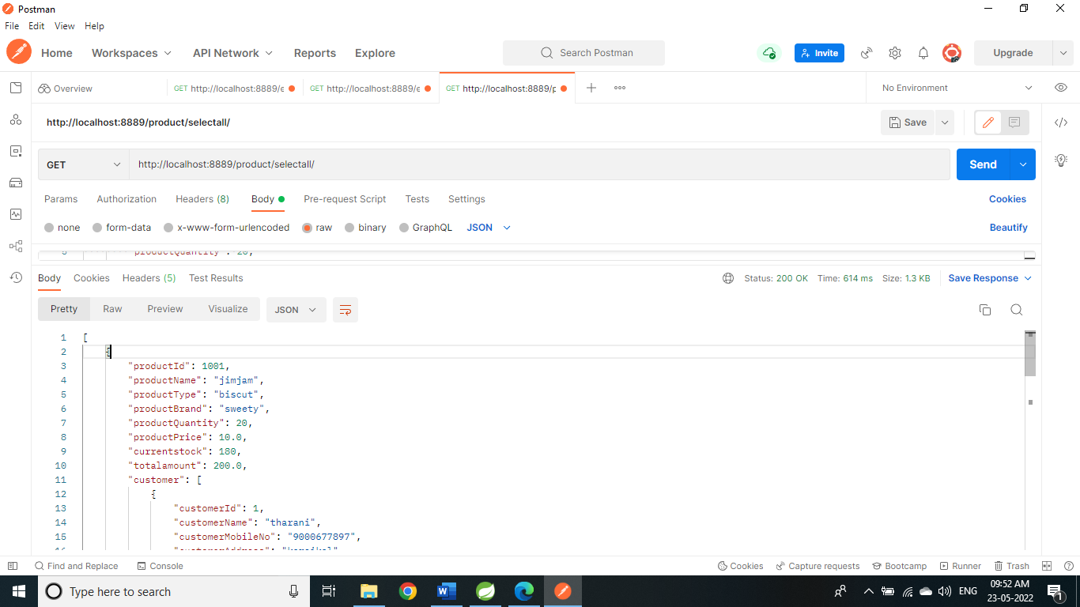
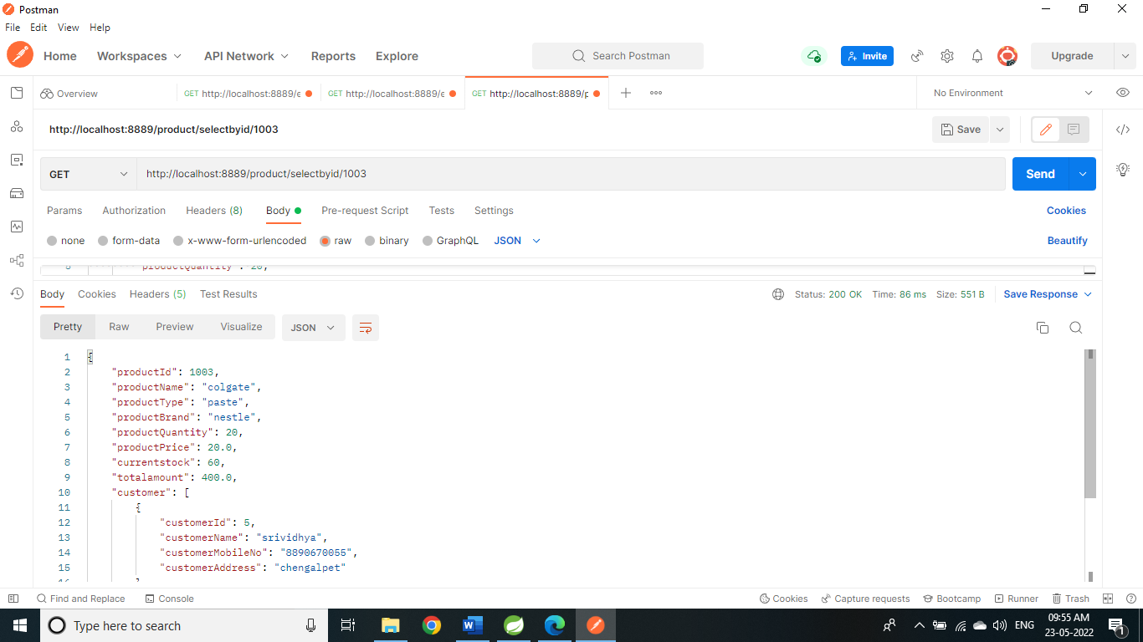
SCREENSHOT
Get: select all products
http://localhost:8889/product/selectall/
Get: select product by id:
http://localhost:8889/product/selectbyid/1003

Slide 15


SCREENSHOT
Get: select product by name
http://localhost:8889/product/selectbyname/dove
Select product by type: Get:
http://localhost:8889/product/selectbytype/chocolate

Slide 16


SCREENSHOT
Select product by brand:
http://localhost:8889/product/selectbybrand/naturally
Select product by quantity:
http://localhost:8889/product/selectbyquantity/50

Slide 17


SCREENSHOT
Select by price:
http://localhost:8889/product/selectbyprice/40
Post: insertion
http://localhost:8889/product/insertion/

Slide 18


SCREENSHOT
Update product by id:
Put: http://localhost:8889/product/updatebyid/1002
Delete product by id:
http://localhost:8889/product/deletebyid/1004

Slide 19


SCREENSHOT
Not found display:
Delete: http://localhost:8889/product/deletebyid/1004
Get : http://localhost:8889/product/selectbyid/7

Slide 20

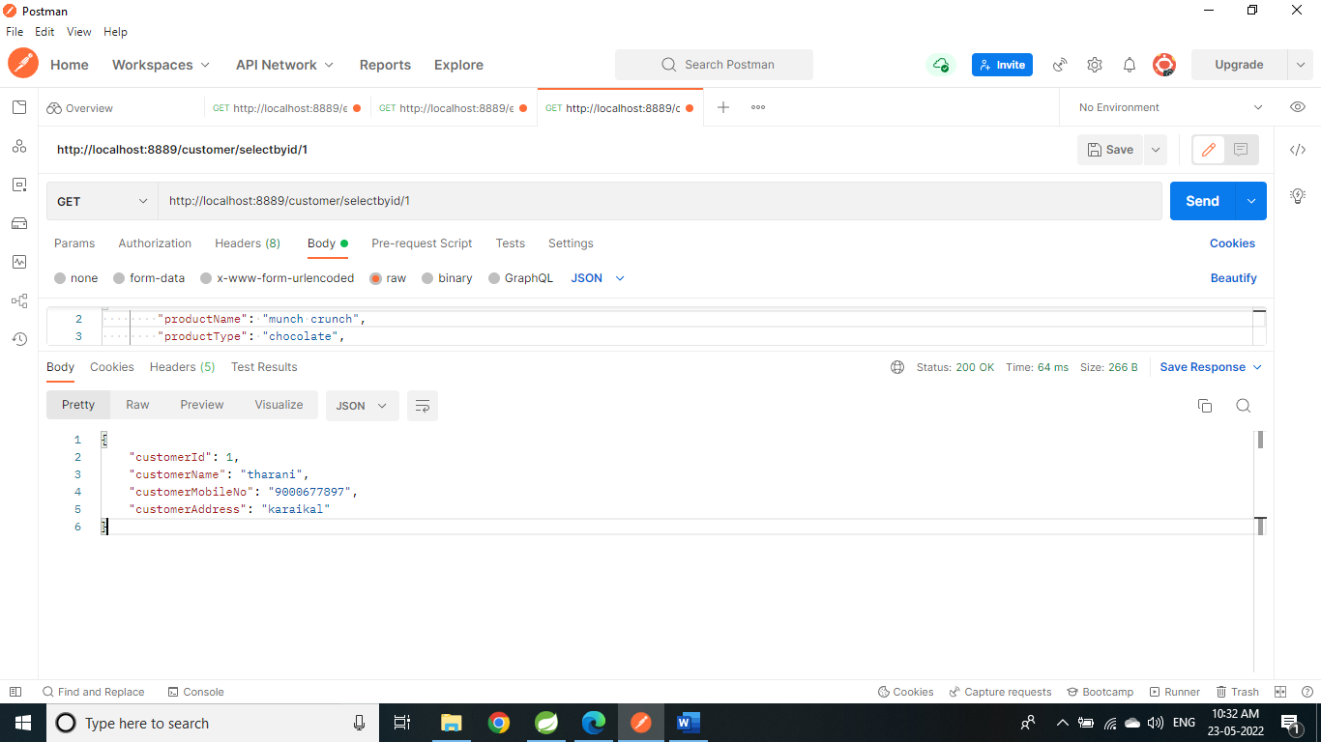
SCREENSHOT
Customer screen shot:
Get: http://localhost:8889/customer/selectbyid/1
Update: http://localhost:8889/product/updatebyid/9

Slide 21


SCREENSHOT
Update by id: http://localhost:8889/customer/updatebyid/2
Delete by id: http://localhost:8889/customer/deletebyid/6

Slide 22


SCREENSHOT
Select by id: http://localhost:8889/customer/selectbyid/6
Update: http://localhost:8889/customer/updatebyid/7

Slide 23

Input format:
{"productName": "jimjam",
"productType": "biscuit",
"productBrand": "sweety",
"productQuantity": 20,
"productPrice": 10.0,
"customer": [ {
"customerName": "tharani",
"customerMobileNo": "9000677897",
"customerAddress": "karaikal"
}, {
"customerName": "thilaksha",
"customerMobileNo": "9900677897",
"customerAddress": "karaikal"
}
] }
SCREENSHOT
Delete: http://localhost:8889/customer/deletebyid/7

Slide 24
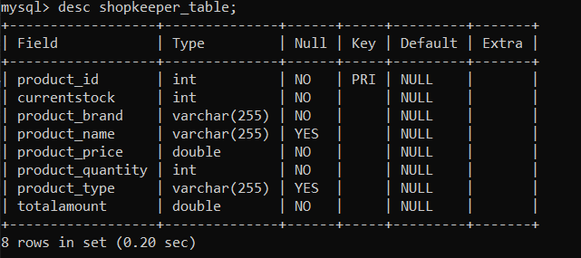
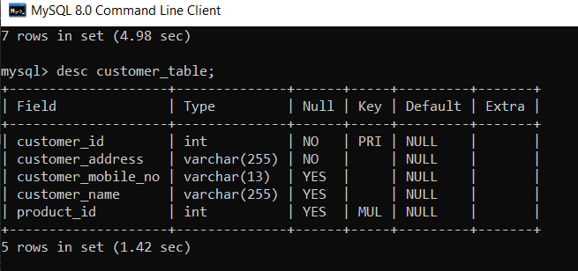
SCREENSHOT
Shopkeeper_table
Customer_table

Slide 25
CONCLUSION
In Inventory management system we implement using spring boot to build the program in very easy way and using postman to run the program and database to store all the information of the product and customer details. Fetching details are very easy on this system.

Slide 26
THANK YOU

