Slide 1


REAL-TIME CHAT APPLICATION WITH ON-THE-FLY TEXT COMPRESSION SUPPORTING EMOJI AND MULTILINGUAL MESSAGES
DONE BY :
22MID0033 – LOKESHWARI G
22MID0257 – ANU SWATHI V R
22MID0269 – SUBASHREE S

Slide 2
Abstract
Overview of the chat compression system
This project introduces a real-time multilingual chat application integrated with an optimised data compression system. Traditional algorithms like Gzip and Huffman coding work well for simple text but show reduced efficiency when handling dynamic, multilingual chat data.
To overcome this, the system uses Zstandard (Zstd) enhanced with a custom-trained dictionary tailored to multilingual chat patterns. The architecture includes:
  A dictionary training module
  Real-time compression engine
  A live web interface to view compression results instantly
  A persistent chat archive for session-level comparison
The system evaluates compression ratios across Zstd, Gzip, and Huffman for every session.
Experimental results show that dictionary-assisted Zstd achieves the highest compression ratio, reduced storage usage, and faster decompression, especially in multilingual environments where redundancy patterns vary across languages.

Slide 3
Introduction – Background
Rapid growth in digital communication generates massive volumes of text data every second.
Messaging apps and multilingual chat platforms require efficient storage, transmission, and processing.
Data compression has become essential to overcome:
  Storage limitations
  Bandwidth constraints
  Real-time communication demands

Slide 4
Existing Approach
Traditional algorithms:
  Huffman → symbol-based
  LZW → dynamic dictionary
  Gzip → DEFLATE-based
Limitations:
  No linguistic awareness
  Poor handling of mixed-language messages
  Inefficient for short or emoji-heavy text
  No cross-message pattern optimisation

Slide 5
Limitations of Traditional Compression
Common Algorithms :
  Huffman Coding
  Run-Length Encoding (RLE)
  Lempel-Ziv family (LZ77, LZW)
Issues :
  Designed primarily for monolingual or uniform datasets.
  Reduced efficiency with multilingual chat data mixing English, Hindi, Tamil, etc.
  Lack of repetitive patterns across languages leads to:
    Lower compression ratios
    Ineffective redundancy detection
Project Goal:
To demonstrate how the algorithms Huffman, Gzip, Zstandard wprks for real time Data Streaming and to store for the backup data.

Slide 6
Need for a Multilingual-Aware Solution
Multilingual data introduces diverse linguistic structures.
General compression algorithms fail to capture cross-language patterns.
Requires a customized, adaptive compression approach that learns multilingual text behavior.

Slide 7
Proposed Solution – Overview
Goal: Develop a compression system optimised for multilingual chat data.
Approach:
Use Zstandard (Zstd) for its speed and high compression capability.
Enhance Zstd with a custom-trained dictionary built from multilingual chat samples.
Capture common words, phrases, and patterns across languages.

Slide 8
System Architecture – Key Modules
1.Dictionary Training Module
  Trains multilingual dictionary
  Captures frequent words, emojis, patterns
2.Compression/Decompression Module
  Performs fast, lossless compression using Zstd + Dict
3.User Interface
  Web-based real-time chat
  Shows size, ratio & comparison results

Slide 9
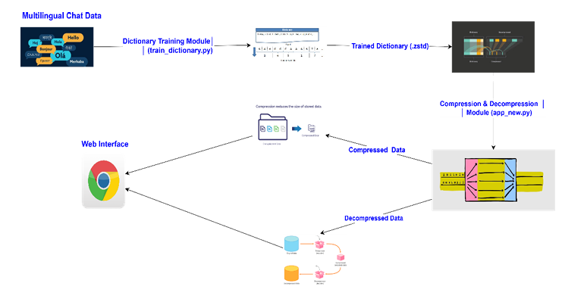
System Architecture of how the Process will be done

Slide 10
Overall Strategy
Combine the strength of general-purpose compression (Zstd) with
specialized multilingual pattern learning.
Bridges the gap between:
  Traditional algorithms
  Real-world multilingual communication needs
Improves:
  Compression ratio
  Storage efficiency
  Transmission speed

Slide 11
Detailed Workflow
Collect multilingual chat data
Train Zstd dictionary (multilingual_chat_dict.zstd)
Integrate dictionary with Flask-SocketIO chat app
For each message:
  Compress using Zstd + Dict, Gzip, Huffman
  Calculate size & ratio
Display compression results live in console

Slide 12
Cont..
6. Store chat in:
  chat_history.json (raw text)
  chat_archive.zst (compressed stream)
7. On disconnect, finalise compression
8. Show final summary table
9. Automatic reloading of previous history
10. Dictionary improves over time with more data

Slide 13
Benefits of Proposed System
Higher compression ratios for multilingual data
Faster decompression
Real-time analytics for each message
Supports emojis & code-mixed text
Persistent storage with reduced size
Scalable & adaptive with continuous dictionary training
Lossless recovery of all messages

Slide 14
Comparison of Algorithms
Gzip
Huffman
Zstd + Dictionary
Best for short messages
Very high savings for single messages
Moderate performance
Good for longer messages
Initially moderate for short texts
Best for entire multilingual chat session
Achieved 64.8% overall savings

Slide 15
Results & Discussion
Huffman performs best on individual short messages
Gzip is balanced but limited
Zstd + Dict achieves highest overall compression
Captures cross-language redundancy
Performance improves with chat length
Ideal for real-time multilingual communication systems

Slide 16
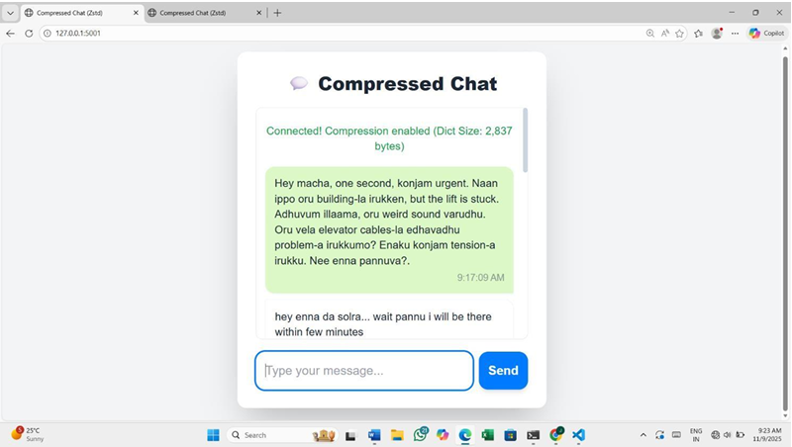
SCREENSHOTS OF THE IMPLEMENTATION
Message from the sender side

Slide 17
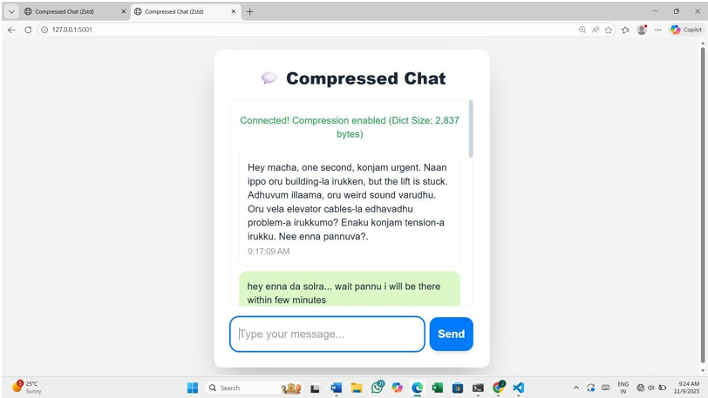
Message from the Receiver side

Slide 18
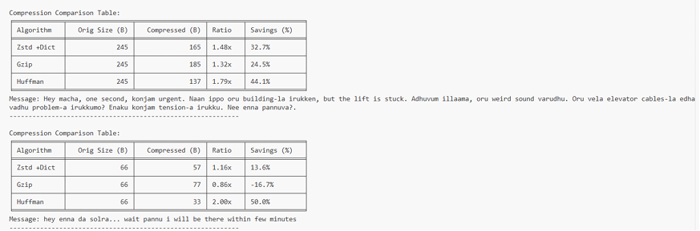
Compression Table for the Messages
Compression Ratio for every message (in the terminal):

Slide 19
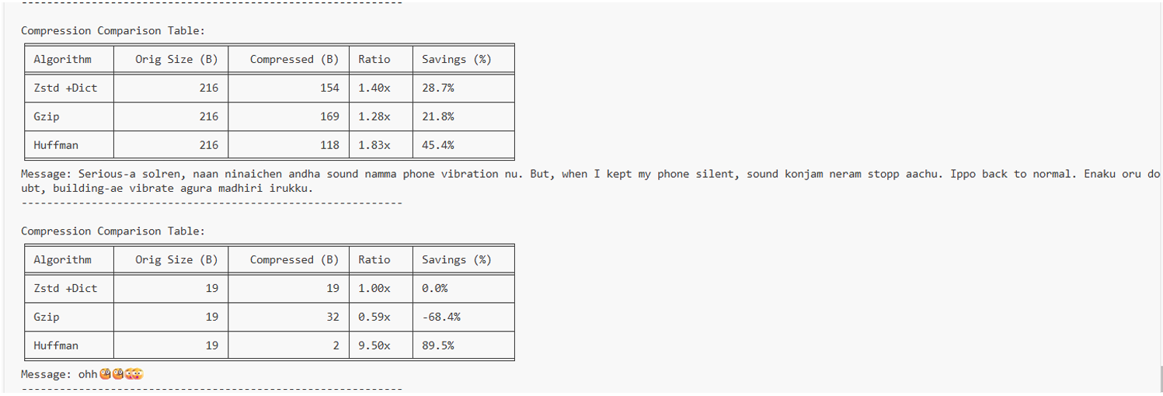
Compression Table for each of the Messages

Slide 20
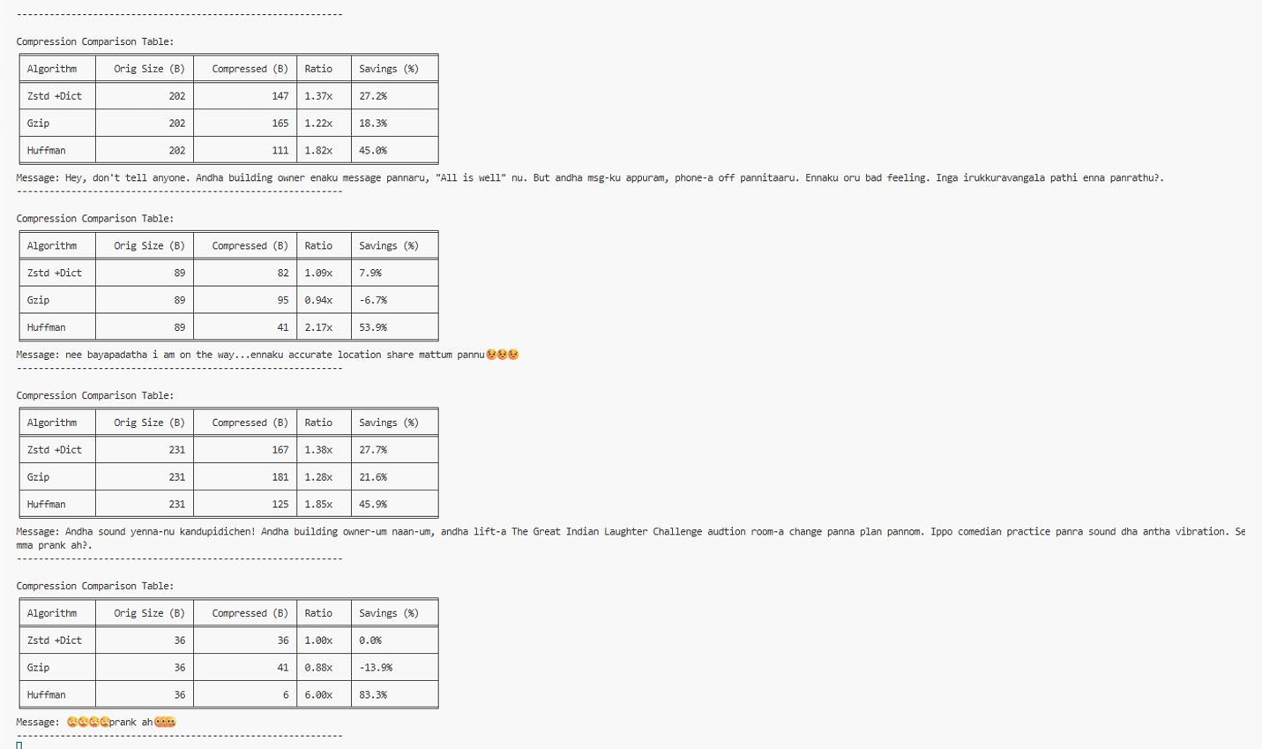
Compression Table for every message in the chat

Slide 21
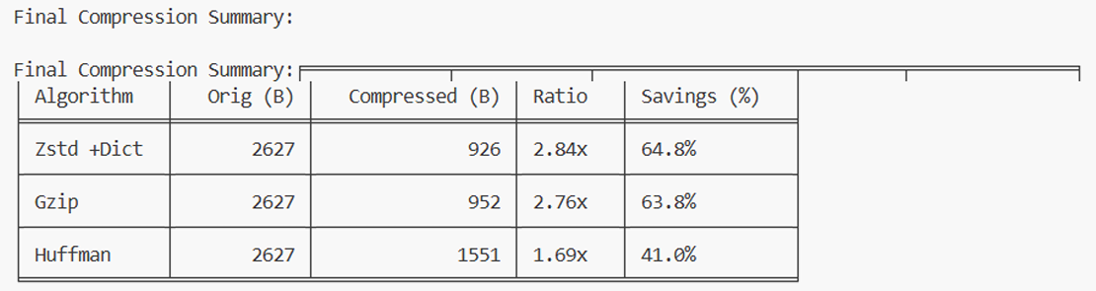
Overall Summary of the Whole chat Messages

Slide 22
Conclusion
Zstd with a trained dictionary outperforms Huffman & Gzip
Efficient for multilingual and emoji-rich chat messages
Integrates smoothly with real-time Flask-SocketIO application
Ensures:
  High compression
  Low storage
  Fast decompression
  Lossless recovery
Dictionary retraining makes system adaptive & scalable

Slide 23


Thank You!

