Slide 1
REAL-TIME CHAT APPLICATION WITH ON-THE-FLY TEXT COMPRESSION SUPPORTING EMOJI AND MULTILINGUAL MESSAGES
CSI3019 – ADVANCED DATA COMPRESSION TECHNIQUES
TEAM MEMBERS:
LOKESHWARI G – 22MID0033
ANU SWATHI V R – 22MID0257
SUBASHREE S – 22MID0269

Slide 2
ABSTRACT
This project proposes a hybrid text compression system combining a persistent JSON-based dictionary with adaptive algorithms like RLE, Huffman, LZW and arithmetic coding. The system first checks for a dictionary matches to replace frequent words, and then applies adaptive methods for remaining data. Unlike traditional approaches, the dictionary persists across sessions, improving compression efficiency for repetitive datasets such as chat logs and documents. The design enhances storage optimization, transmission speed, and long-term compression performance, making it suitable for applications in real-time messaging, archival storage and for efficient message transfer and communication.

Slide 3
EXISTING METHODOLOGY
TRADITIONAL AND RESEARCH METHODS:
Most of the research papers explored with one single for compression the texts. Many of them explored only with normal text with single Language without emoji’s. But our project is to explore texts with emoji’s which supports multiple languages.
  RLE (Run Length Encoding): Compresses repeated symbols but inefficient for natural text.
  Huffman Coding: Variable-length encoding, widely used but not adaptive to dynamic data
  LZW (Lempel-Ziv-Welch): Dictionary-based, effective for repeated sequences but resets every session.
LIMITATIONS:
  No persistence: Dictionaries reset after each session.
  Classification-centric: Focus on accuracy; not compression efficiency
  Not real-time: Limited applicability to streaming data like chats/logs.
  Lack in Multiple Language Compression with Emoji’s.

Slide 4
PROPOSED METHODOLOGY
Hybrid Dictionary + Adaptive Compression
Persistent JSON-based Dictionary
  Stores frequently used words across sessions.
  Ensures continuity and efficiency for repetitive text (e.g., chats, logs).
Adaptive Compression Algorithms
  RLE, Huffman, LZW, Arithmetic coding applied after dictionary lookup.
  Balances compression ratio and processing speed.
Hybrid Workflow
  Step 1: Check input against persistent dictionary.
  Step 2: Replace matches with compact codes.
  Step 3: Apply adaptive compression on remaining data.
Advantages Over Existing Methods
Persistence: Dictionary retained across multiple sessions.
Efficiency: Combines dictionary + adaptive methods for better compression.
Real-Time Ready: Optimized for chat, documents, and streaming text.
Balanced Performance: Improves both compression ratio and speed.

Slide 5
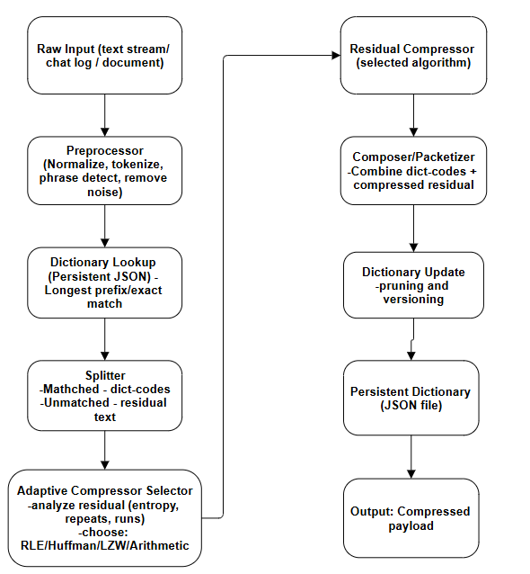
FLOW OF THE PROJECT

Slide 6
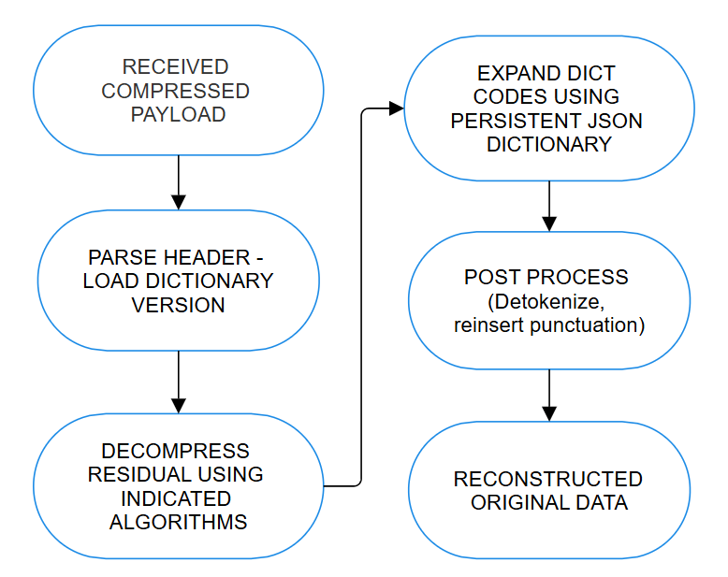
DECOMPRESSION (REVERSE FLOW)

Slide 7
THANK YOU

