Slide 1
TN MARGINAL WORKERS
ASSESSMENT
(A Socioeconomic Analysis)

Slide 2
PROBLEM DEFINITION:
The project involves analyzing the demographic characteristics of marginal workers in Tamil Nadu based on their age, industrial category, and sex. The objective is to perform a socioeconomic analysis and create visualizations to represent the distribution of marginal workers across different categories. This project includes defining objectives, designing the analysis approach, selecting appropriate visualization types, and performing the analysis using Python and data visualization libraries.

Slide 3
OBJECTIVE:
Analysis objective:
The objective of analyzing the demographic characteristics of marginal workers in Tamil Nadu is likely multifaceted. It could include understanding the distribution of marginal workers across age groups, industrial sectors, and gender to inform targeted policies and interventions. The analysis aims to provide a nuanced socioeconomic picture, enabling policymakers to address specific challenges faced by different segments of this workforce effectively.

Slide 4
ANALYSIS APPROACH:
For analyzing marginal workers in Tamil Nadu, adopt a mixed-methods approach. Combine quantitative data, such as surveys and statistical analysis, to quantify demographic patterns. Additionally, use qualitative methods like interviews or focus groups to gain deeper insights into their experiences. This hybrid approach ensures a comprehensive understanding of the socioeconomic landscape, capturing both statistical trends and personal narratives

Slide 5
VISUALIZATION SELECTION:
BAR CHART
PIE CHART
HISTOGRAM
CORRELATION
HEAT MAP

Slide 6
BAR CHART:
In a dataset on marginal workers, a bar chart could help represent categorical information such as types of employment, educational levels, or industries. It provides a visual way to compare the distribution of different factors among marginal workers, offering insights into patterns or disparities within the data.
PIE CHART:
pie chart could be useful in a marginal workers dataset to illustrate the proportional distribution of various employment types or categories within the dataset. It provides a clear visual representation of how different segments contribute to the whole, making it easier to grasp the composition of marginal workers based on specific criteria.

Slide 7
HISTOGRAM:
A histogram chart in a marginal workers dataset could help depict the distribution of a continuous variable, such as age or income, among the workers. It provides a visual representation of the frequency or density of values within specified ranges, allowing you to identify patterns and trends in the distribution of key variables within the dataset.
CORRELATION:
Correlation analysis in a marginal workers dataset could reveal relationships between different variables. For example, you could explore if there's a correlation between education levels and income, or between age and types of employment. Understanding these correlations helps identify potential associations and factors that may influence the characteristics of marginal workers in the dataset.

Slide 8
HEAT MAP:
A heatmap in a marginal workers dataset could be employed to visualize the intensity of relationships between two categorical variables. For instance, you could use it to show the distribution of education levels across different types of employment. The color intensity would represent the frequency or percentage, allowing for a quick understanding of patterns and concentrations within the dataset.

Slide 9
ANALYSING THE DATASET:
LOAD THE DATASET:
Import the necessary libraries (e.g., Pandas, NumPy) in Python.
Load your dataset into a data structure (e.g., a Pandas DataFrame)
import pandas as pd
data = pd.read_csv('your_dataset.csv')
MISSING VALIES:
Identify and handle missing values in your dataset. You can drop rows with missing values, impute values, or use other strategies depending on the context.
print(data.head())
print(data.info())
print(data.describe())

Slide 10
DUPLICATE DATA:
Check for and remove duplicate rows if necessary.
data.dropna() # To remove rows with missing values
data.fillna(value) # To fill missing values with a specific value
OUTLIER:
Identify and handle outliers in your data. You can use statistical methods or visualization techniques to detect outliers.
# Example using Z-score for outlier detection
from scipy import stats
z_scores = stats.zscore(data)
data_no_outliers = data[(z_scores < 3).all(axis=1)]

Slide 11
DATA TRANSFORMATION:
Transform data if needed, such as converting data types, encoding categorical variables, or scaling numerical features.
# Example: Encoding categorical variables
data = pd.get_dummies(data, columns=['categorical_column'])
FEATURE ENGINEERING:
Create new features from existing ones to improve model performance.
data['new_feature'] = data['feature1'] + data['feature2']

Slide 12
DATA SPLITTING:
Split your dataset into training, validation, and test sets for model development and evaluation.
from sklearn.model_selection import train_test_split
X_train, X_test, y_train, y_test = train_test_split(X, y, test_size=0.2, random_state=42)
SACLING AND NORMALISATION:
Scale or normalize numerical features to ensure that they have a similar scale and distribution.
from sklearn.preprocessing import StandardScaler
scaler = StandardScaler()
X_train = scaler.fit_transform(X_train)
X_test = scaler.transform(X_test)

Slide 13
STEPS INVOLVED IN PREPROCESSING:
import pandas as pd
import scipy
import numpy as np
from sklearn.preprocessing import MinMaxScaler
import seaborn as sns
import matplotlib.pyplot as plt
df=pd.read_csv("C:\\Users\poovi\Downloads\Tnmarginalworkers.csv")
Print(df.head())
OUTPUT:
Table Code ... Industrial Category - R to U - Non HHI - Females
0 B0806SC ... 66287
1 B0806SC ... 9531
2 B0806SC ... 36126
3 B0806SC ... 16823
4 B0806SC ... 3671
[5 rows x 69 columns]

Slide 14
USING AGGREGATE FUNCTION:
print(df.describe())
OUTPUT:
Worked for 3 months or more but less than 6 months - Persons ... Industrial Category - R to U - Non HHI - Females
count 5.940000e+02 ... 594.000000
mean 1.617277e+04 ... 892.754209
std 7.607172e+04 ... 3988.125301
min 0.000000e+00 ... 0.000000
25% 2.872500e+02 ... 30.500000
50% 2.225500e+03 ... 135.000000
75% 9.628500e+03 ... 500.000000
max 1.200828e+06 ... 66287.000000
[8 rows x 63 columns]

Slide 15
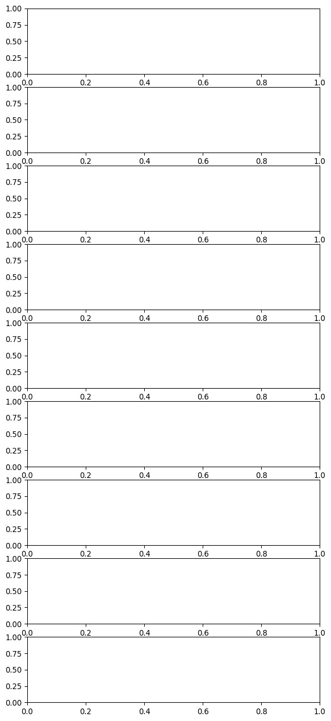
CHECK THE OUTLIER:
fig, axs = plt.subplots(9,1,dpi=95, figsize=(7,17))
i = 0
for col in df.columns:
axs[i].boxplot(df[col], vert=False)
axs[i].set_ylabel(col)
i+=1
plt.show()

Slide 16
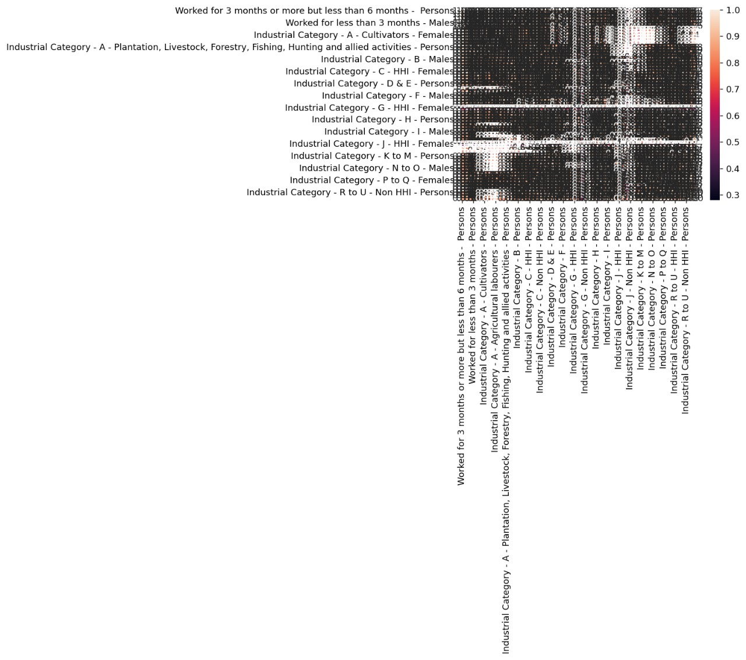
FINDING THE CORRECTION:
corr = df.corr()
plt.figure(dpi=130)
sns.heatmap(df.corr(), annot=True, fmt= '.2f')
plt.show()

Slide 17
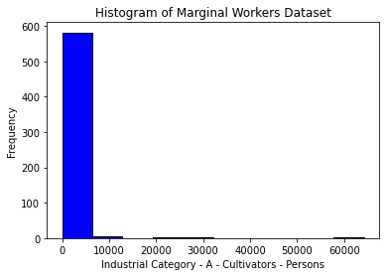
marginal_workers_data = df['Industrial Category - A - Cultivators - Persons']
plt.hist(marginal_workers_data, bins=10, color='blue', edgecolor='black')
plt.xlabel('Industrial Category - A - Cultivators - Persons')
plt.ylabel('Frequency')
plt.title('Histogram of Marginal Workers Dataset')
plt.show()

Slide 18
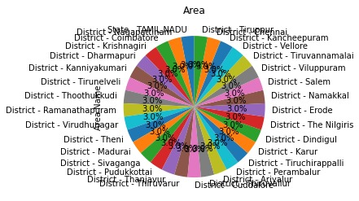
USING PIE CHART TO ANALYSE THE DATASET:
selected_column = df['Area Name']
value_counts = selected_column.value_counts()
value_counts.plot(kind='pie', autopct='%1.1f%%', startangle=90)
plt.title('Area')
plt.show()

Slide 19
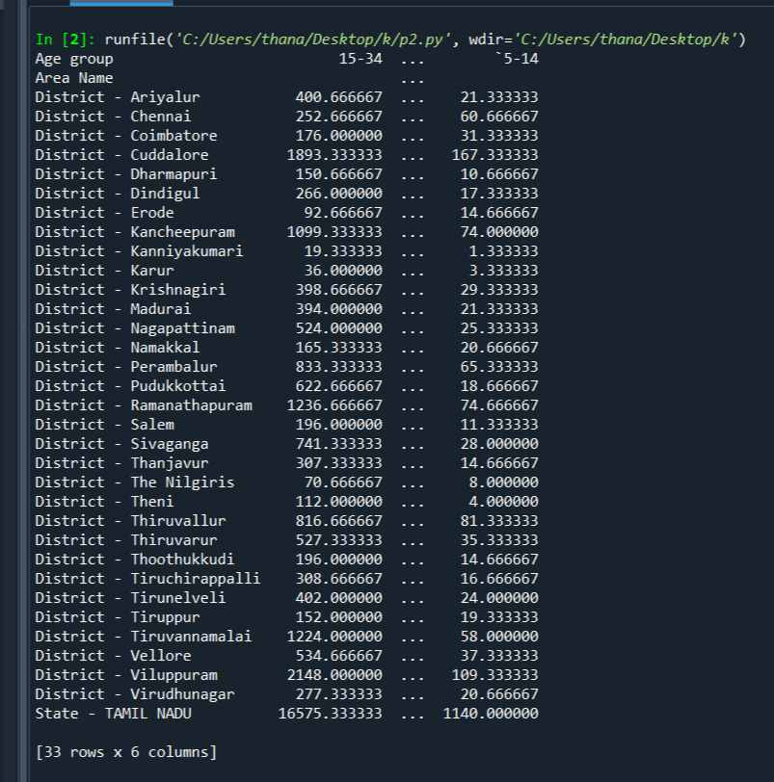
Finding the frequency of people based on age and their district for particular industrial Category using aggregate function:
import pandas as pd
impor matplotlib.pyplot as plt
data=pd.read_csv(“marginal-workers.csv”)
d=data.groupby([“Area Name” ,”Age group “])[“Industrial Category -A-Cultivators-Persons”].mean().unstack()
print(d)

Slide 20
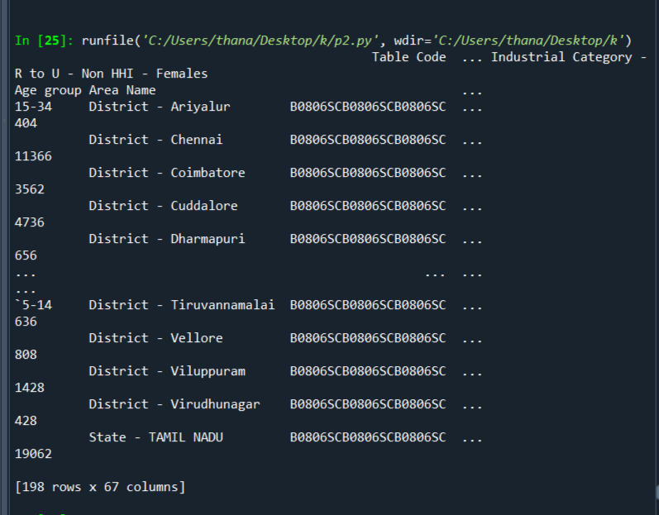
FINDING THE TOTAL NUMBER OF MARGINAL WORKERS BASED ON AGE AND DISTRICT:
import pandas as pd
impor matplotlib.pyplot as plt
data=pd.read_csv(“marginal-workers.csv”)
d=data.groupby([“Age group”,”Area Name”])
print(d.sum())

Slide 21
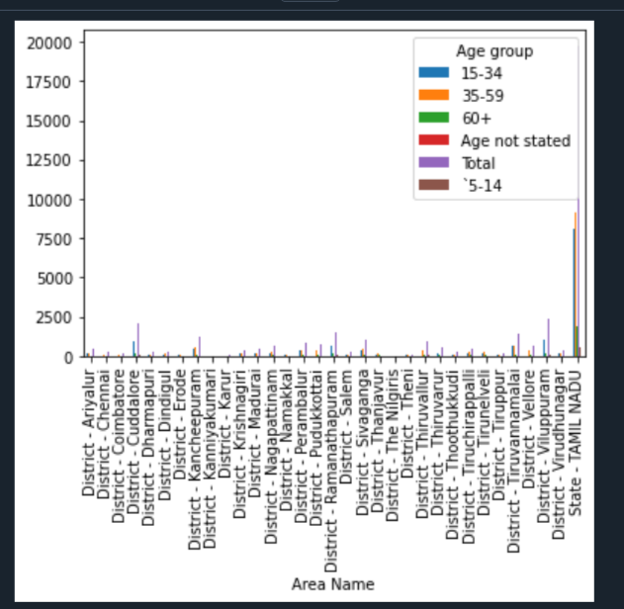
Finding the frequency of people based on age and their district for particular industrial Category :
import pandas as pd
impor matplotlib.pyplot as plt
data=pd.read_csv(“marginal-workers.csv”)
d=data.groupby([“Area Name” ,”Age group “])[“Industrial Category -A-Cultivators-Persons”].mean().unstack()
d.plot(kind=’bar’)
Plt show()

Slide 22
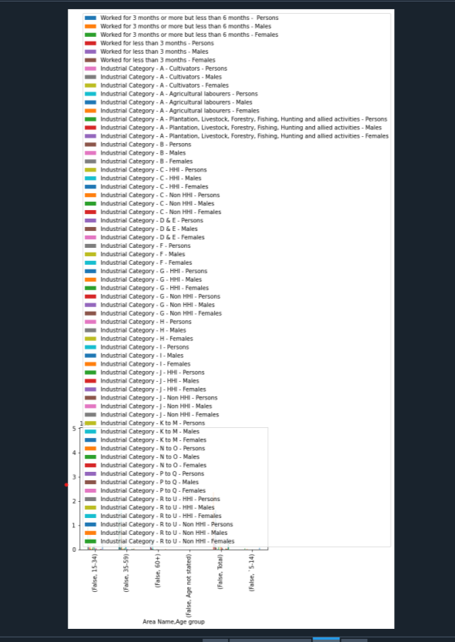
TOTAL NUMBER OF MARGINAL WORKERS BASED ON AGE AND IN A PARTICULAR DISTRICT:
import pandas as pd
impor matplotlib.pyplot as plt
data=pd.read_csv(“marginal-workers.csv”)
d=data.groupby([data[“Area Name”]==”District-Ariyalur”,”Age group”])
d.plot(kind=’bar’
Plt.show()

Slide 23
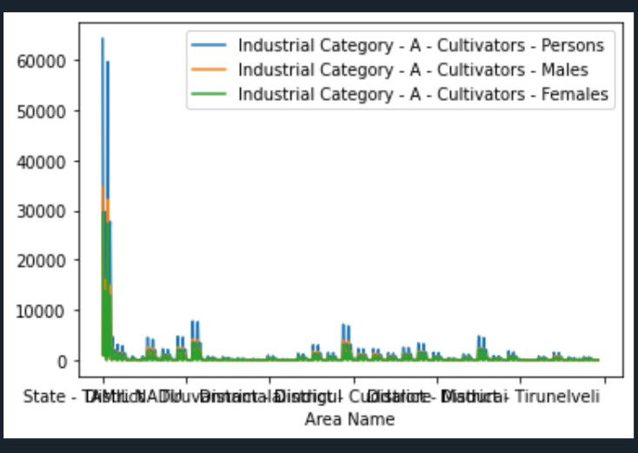
DISTRIBUTION OF MARGINAL WORKERS BASED ON SEX BY THEIR DISTRICT IN PARTICULAR INDUSTRIAL CATEGORY:
import pandas as pd
impor matplotlib.pyplot as plt
data=pd.read_csv(“marginal-workers.csv”)
data.plot(x=”Area Name”,y=[“Industrial Category -A-Cultivators-Persons”, Industrial Category -A-Cultivators-Males”,”Industrial Category -A-Cultivators-Females”])
Plt.show()

Slide 24
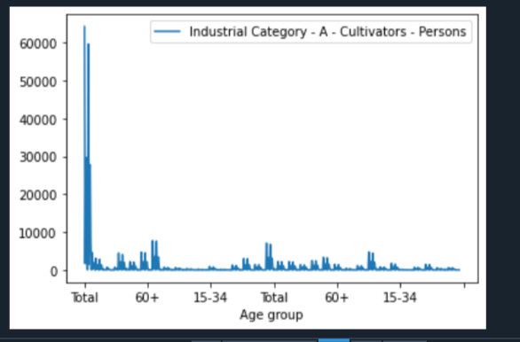
NUMBER OF MARGINAL WORKERS IN PARTICULAR CATEGORY BASED ON AGE:
import pandas as pd
impor matplotlib.pyplot as plt
data=pd.read_csv(“marginal-workers.csv”)
data.plot(x=”Age group”,y=”Industrial Category -A-Cultivators-Females”)
plt.show()

Slide 25
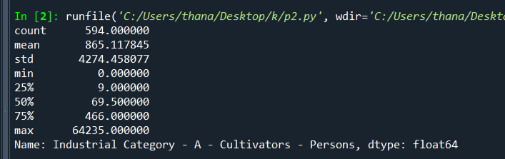
USING AGGREGATE FUNCTION IN INDUSTRIAL CATEGORY:
import pandas as pd
import matplotlib.pyplot as plt
data=pd.read_csv(“marginal -workers”)
Print(data[“Industrial Category -A-Cultivators-Persons”]. describe ())

Slide 26
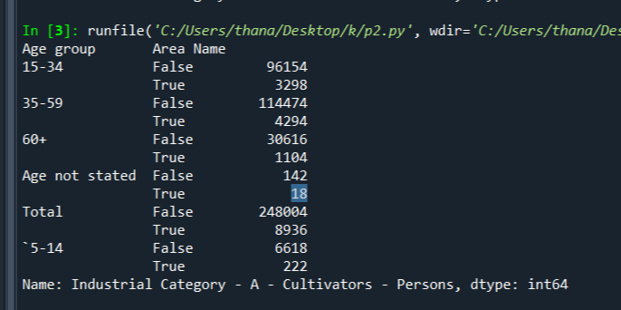
USING DESCRIBE FUNCTION FOR PARTICULAR INDUSTRIAL CATEGORY IN PARTICULAR DISTRICT:
import pandas as pd
import matplotlib.pyplot as plt
data=pd.read_csv(“marginal -workers”)
d=data.groupby([“Age group”],data[“Area Name”]==”District -Kancheepuram”])[“Industrial Category -A-Cultivators-Persons”].sum()
print (d)

Slide 27
CONCLUSION:
In summary, analyzing the marginal dataset reveals valuable insights into the nuanced patterns and trends at the edges of the data, providing a more comprehensive understanding of the variables involved.
Examining marginal data allows for a closer examination of outliers and exceptions, shedding light on potential anomalies or unique cases that might be crucial for a thorough analysis. This detailed exploration enhances the overall robustness of your findings and contributes to a more nuanced interpretation of the dataset.

Slide 28
THANK YOU…..

