Slide 1
DevOps Assignment - Application - Python/flask-based API
Tool-Stack used to Automate Application
GitHub/GitLab : Source Code Repository
Docker : Containerization
Docker-Compose : Deployment strategy
GitLab CI-CD : Continuous Integration and Continuous Deployment
Artifacotry : Artifact repository/Docker registry

Slide 2
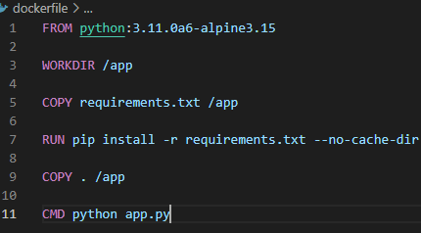
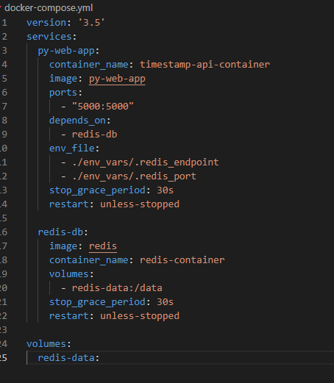
APPLICATION CONTAINERIZATION AND CONTAINER ORCHESTRATION
Application is containerized using docker. Deployment definitions is written in the form of docker-compose.
Dockerfile:
Built using “python:3.11.0a6-alpine3.15” base image.
Pre-requisites for app mentioned in requirements.txt file is installed using pip and then python application is copied and started.
Docker-compose.yml:
Includes 2 services, py-web-app and redis-db
Spins up 2 containers named timestamp-api-container and redis-container
“timestamp-api-container” refers to image: py-web-app which is built using above mentioned dockerfile and is mapped to port 5000 on the host.
“redis-container” is official redis image that was pulled from docker hub
“timestamp-api-container” is dependent on “redis-container”
redis-data: volume is used by the redis-db service to persist its data outside of the container's filesystem incase of recreation of service or restart
Used environment files to pass details of endopints and endpoint ports.
Restart policy is set to “unless-stopped” to ensure that the containers are always running unless stopped manually

Slide 3
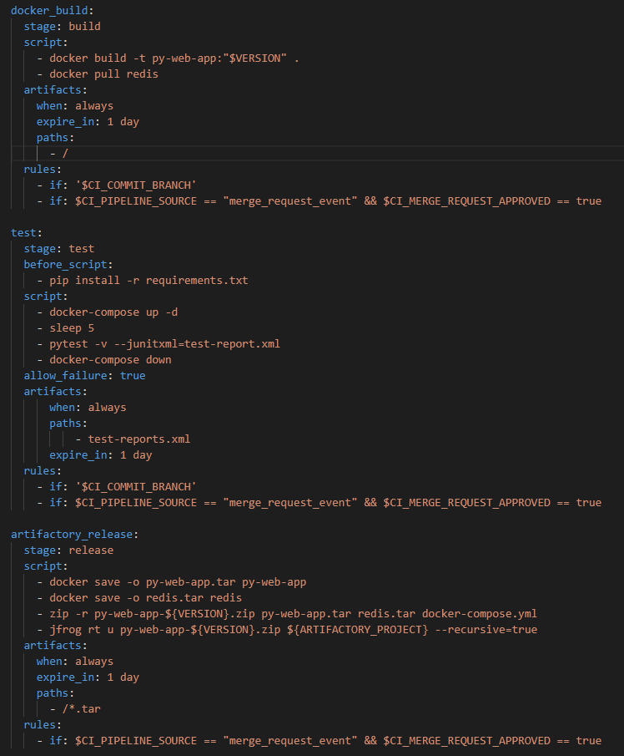
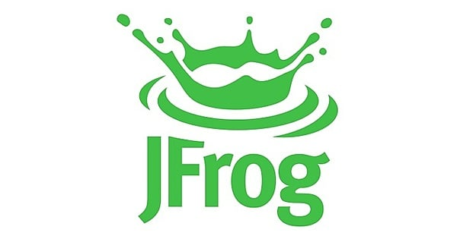

BUILD AND DEPLOYMENT STRATEGY
CI Pipeline
Changes are made to the application and pushed to a branch
CI Build triggers, builds docker image, provisions containers, runs pytest and destroys the containers
Test reports are saved as artifacts. These results can also be published if required to artifacotry or gitreports.
MR is created to merge to Master. When MR is approved, images are zipped and uploaded to Release repo in artifactory.
Release includes py-web-app.tar, redis.tar and docker-compose.yml
Using custom docker image which includes all pre-requisites like python, docker, jfrog cli etc to build, test and deploy.
Stages build and test will run when we commit to a branch
Only if the merger request is approved, the artifact will be released to artifactory. We can also include sonar cube analysis to analyze the quality of the code and provide create a gate before it is merged and released.
Symantic Versioning of the release is included as gitlab-ci variable, which is incremented with every major, minor and patch releases. Same version is added as a tag to the py-web-app image build. Version is also appended to the zip file that will be used to deploy the application to target environment. Changelog.md file should be updated for every change that will be released.
Docker Build Pytest Docker Save
Jfrog upload
Image Registry Release Repository

Slide 4
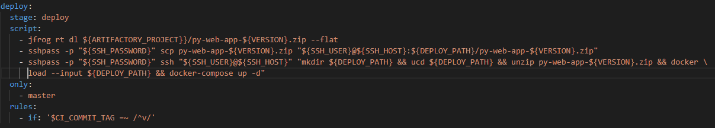
BUILD AND DEPLOYMENT STRATEGY
CD Pipeline
Release package is downloaded from the antifactory. Version variable is used to specify the target package. Jfrog cli is used to download
Deploy stage is run only when tagged with version on master branch
Artifacts are pushed to target environment through SSH
Docker compose is run on the target machine through SSH
We can also include IAC tool terraform for provisioning of infrastructure before deployment.
Deploy to target Environment
Image Registry Release Repo
Pull Release

Slide 5
Talking Points
1. Execution of different types of tests
There are different types of tests for python-based web app like load test, acceptance test, unit and integration tests etc. Unit and Integration pytest is executed as part of the CI pipeline, test reports reports can be found on gitlab UI.
2. Branching strategy
Development of feature and fixes are carried out on branches. Master/origin consists of changes/features that is ready for deployment or already deployed. Once the development is complete, Merge request is opened to master. Once the MR is approved it will be merged to master and ready for deployment. If, an appropriate tag is created on the master branch then the deployment pipeline gets triggered, and the application will be deployed to the target environment
3. Deployment Strategy
We can provision the environment using IaC terraform tool. Once the environment is provisioned, docker swarm is used to deploy the containerized application. This form of deployment enables us to provision consistent environment, reducing the risk of issues or errors caused by configuration drift. In our current gilab-ci pipeline we can create a stage ‘terraform provision’ to provision the infrastructure before the deployment.
4. Environment Configuration
Target environment can be set as a gitlab variable or we can also create stages for deployment like ‘staging deploy’, ‘pre-prod deploy’ , ‘prod deploy’ etc.

