Slide 1
Provision Elastic Cluster
Amazon OpenSearch Service (Formerly known as Elasticsearch Service):
It is fully managed service that makes it easy to deploy, secure, and operate Elasticsearch clusters at scale
OpenSearch Serverless option is available
Elastic Cloud on Azure/GCP:
Elastic Cloud is a service provided by Elastic
Control over configurations and integrations with other Elastic products.
Self-Managed Elasticsearch on instances:
Provision Elasticsearch clusters on EC2/azure/VM instances.
You have full control over the Elasticsearch configuration and can customize it according to your specific needs.
Elasticsearch cluster on Kubernetes:
You can run Elasticsearch in containers using services like Amazon Elastic Container Service (ECS), Amazon Elastic Kubernetes Service (EKS)

Slide 2
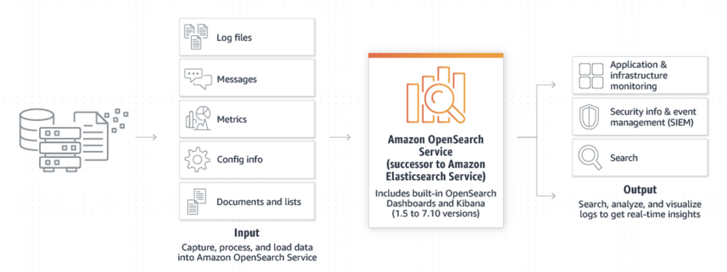
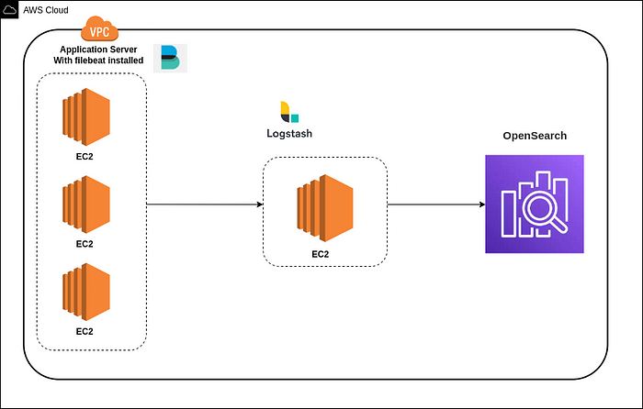
AWS Opensearch with logstash and filebeat for log processing

Slide 3
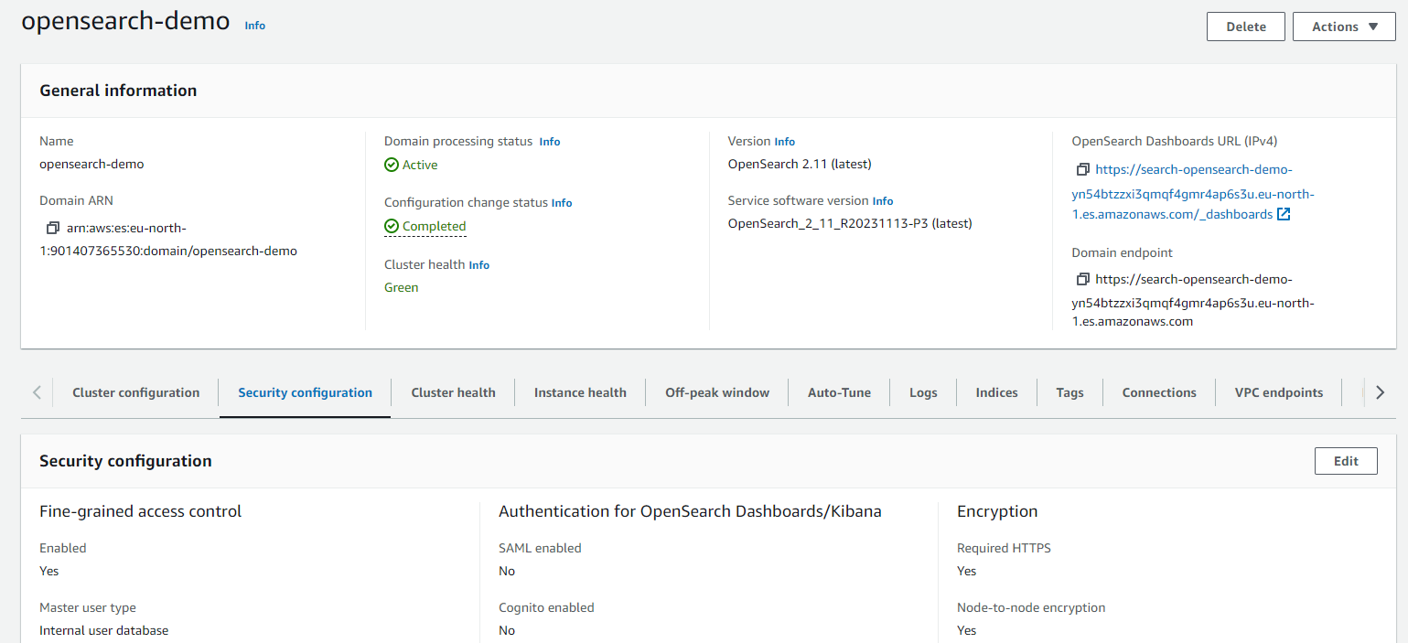
AWS Opensource Infrastructure with Terraform
Opensearch cluster is provisioned with EBS storage, node to node encryption and fine grained access control
Endpoint – public and is provisioned in 1-AZ. It can also be provisioned in dedicated VPC (AZ and subnets)

Slide 4
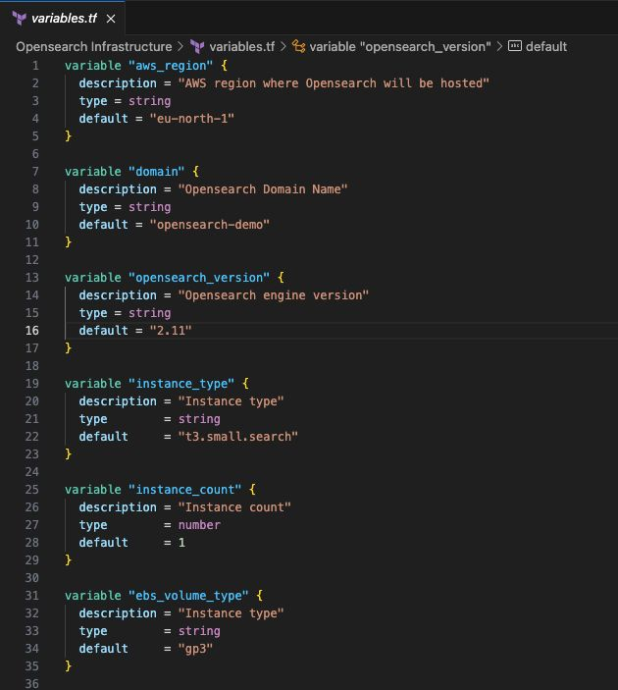
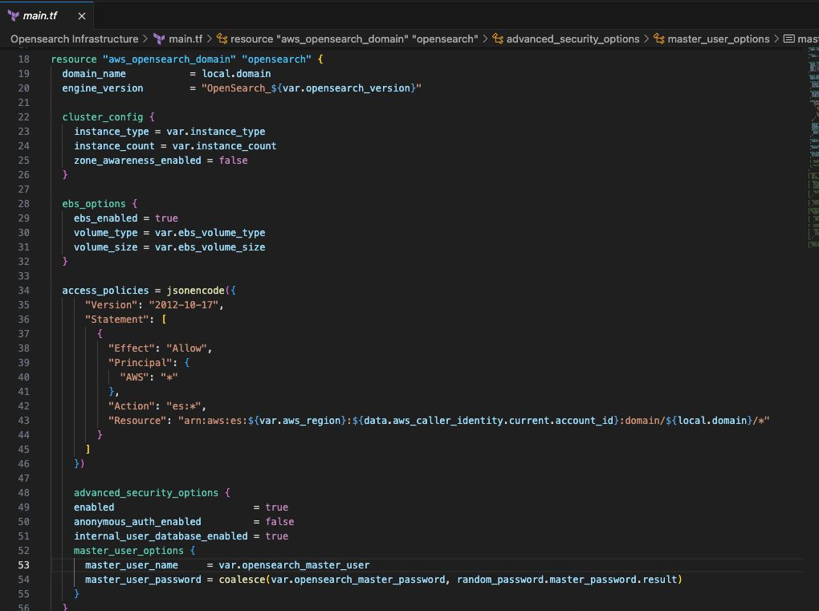
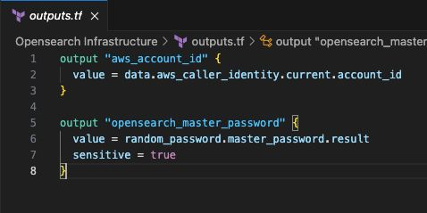
Terraform module for Opensearch
Re-usable modules where most of the attributes are defined as variables and can be provided either during runtime or by overriding the existing variables file
Data resources are seperated
Access policy is set open to access opensource on inetnet for demo purpose. It can also be provisioned in dedicated VPC.
Random password generation, which can be further secured in vault.
Outputs are captured in secured way

Slide 5
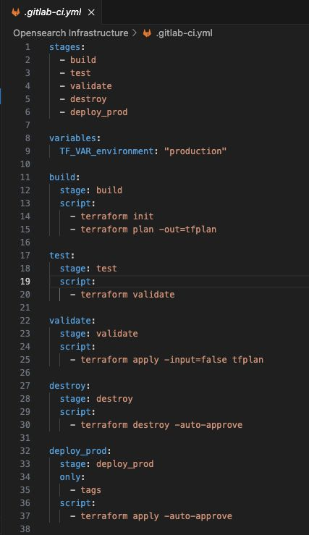
CI-CD pipeliens can be used for build , test, validate and release terraform changes to the production. We can also track the hostory of changes introduces by introducing versions

Slide 6
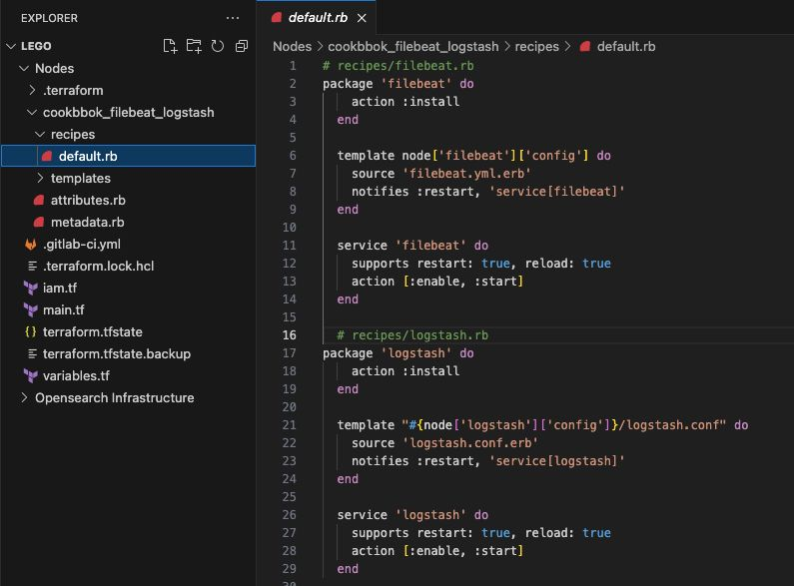
Node Infrastructure
Node instances provisioned with terraform module
Filebeat and logstash are used to searching, analyzing, and visualizing data in real-time
Filebeat is a lightweight shipper for forwarding and centralizing log data. It's designed to collect log events from various sources and send them to Logstash for indexing and analysis.
Logstash is a powerful data processing pipeline that ingests, transforms, and enriches data before sending it to a Opensearch
Filebeat and openstash can be installed and configured using configuration management tools like ansible, chef or puppet

Slide 7
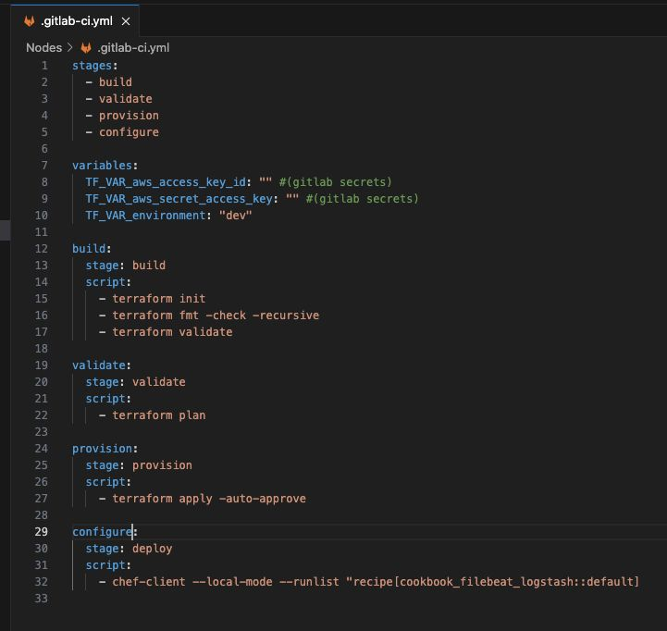
CI-CD pipeliens can be used to provision the infrastructure and bring the node to the desired state using config management. Which in turn also adds it as a data source to Opensearch

Slide 8
OpenSearch Alerting
Automated dalerting system can be setup by configuring the monitor on data ingested on index
We can create a monitor using the Alerting UI in OpenSearch Dashboards or the REST API.
Monitors are run as periodic jobs on OpenSearch data nodes. When a problem is detected, you can send an alert to external systems like Slack, email, and more
Goals achieved within SRE framework
Application monitoring
Automation
Monitoring and Alerting

