Slide 1

InsureYours

Slide 2

Business Problem
The Healthcare industry faces a critical challenge of varying insurance costs for patients with identical medical conditions.
Inconsistencies in billing and insurance coverage have led to financial strain on patients.
Patients often pay different amounts for same medical procedures, leading to confusion and dissatisfaction.
Lack of personalized insurance recommendations contributes to the challenge of making informed decisions.

Slide 3

Objective Of Our Company
Our aim to address this challenge by providing a sophisticated platform for patients have autonomy in ensuring the receive the most optimal choices of insurance for their designated injuries
There has been a concern amongst patients in the United States about visiting hospitals partially due to the absorbent cost of medical bills.
Through our approach, we believe we could revolutionize patients outlook insurance bills.

Slide 4
Entities
Patient
Admission
Doctor
Hospital
InsuranceProvider
Medication
Test

Slide 5
Attributes
Patient: Name, Age, Gender, BloodType
Admission: AdmissionID (Identifier), DateOfAdmission, RoomNumber, AdmissionType,DischargeDate, BillingAmount, MedicationID (Foreign Key), TestID (Foreign Key)
Doctor: DoctorID (Identifier), Name
Hospital: HospitalID (Identifier), Name
InsuranceProvider: InsuranceID (Identifier), Name
Medication: MedicationID (Identifier), Name
Test: TestID (Identifier), Name

Slide 6
Relationships Between Entities
Patient to Admission
Admission to Doctor
Admission to Hospital
Admission to InsuranceProvider
Admission to Medication
Admission to Test

Slide 7
Data Dictionary
Patient:
Name (VARCHAR)
Age (INTEGER)
Gender (VARCHAR)
BloodType (VARCHAR)
Admission:
AdmissionID (INTEGER, Primary Key)
DateOfAdmission (DATE)
RoomNumber (INTEGER)
AdmissionType (VARCHAR)
DischargeDate (DATE)
BillingAmount (FLOAT)
MedicationID (INTEGER, Foreign Key)
TestID (INTEGER, Foreign Key)

Slide 8
Data Dictionary
Doctor:
DoctorID (INTEGER, Primary Key)
Name (VARCHAR)
Hospital:
HospitalID (INTEGER, Primary Key)
Name (VARCHAR)
InsuranceProvider:
InsuranceID (INTEGER, Primary Key)
Name (VARCHAR)
Medication:
MedicationID (INTEGER, Primary Key)
Name (VARCHAR)
Test:
TestID (INTEGER, Primary Key)
Name (VARCHAR)

Slide 9
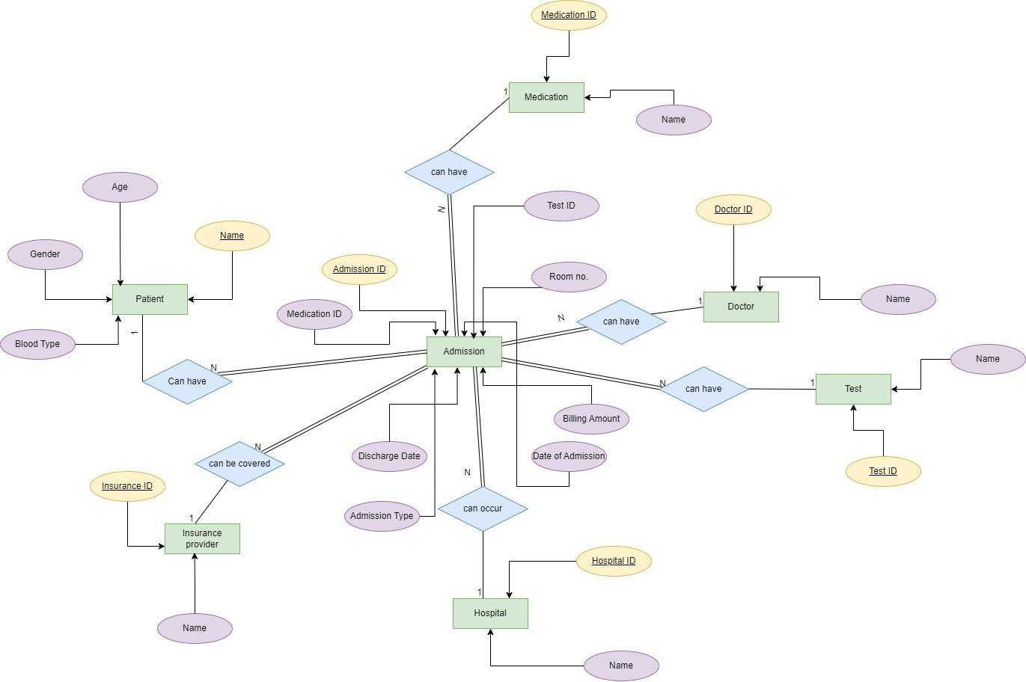
ER Diagram

Slide 10
Cost Estimation Analysis
How are we going to manage this data
Microsoft SQL Server Virtual Machine
What types of Features will this database have
20 Cores, 80 GB RAM, 160 GB of Temporary storage
The total cost will be $5942.46 per month which is $71,309.52 per year

Slide 11
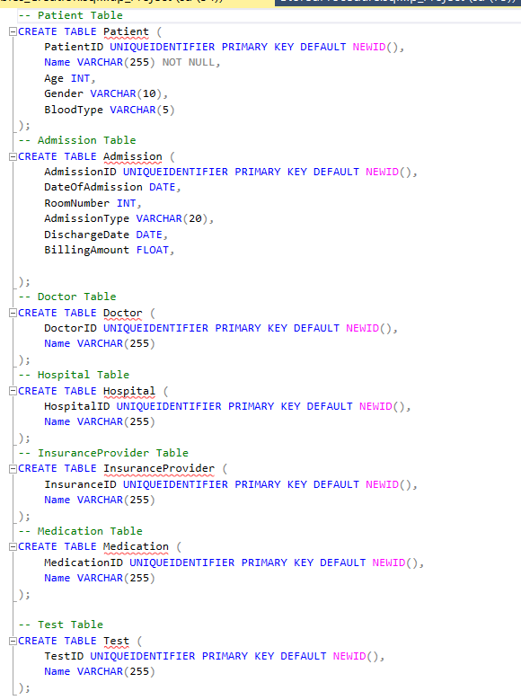
Creating Tables:
Established the necessary tables by employing SQL commands and specifying the corresponding data types.

Slide 12
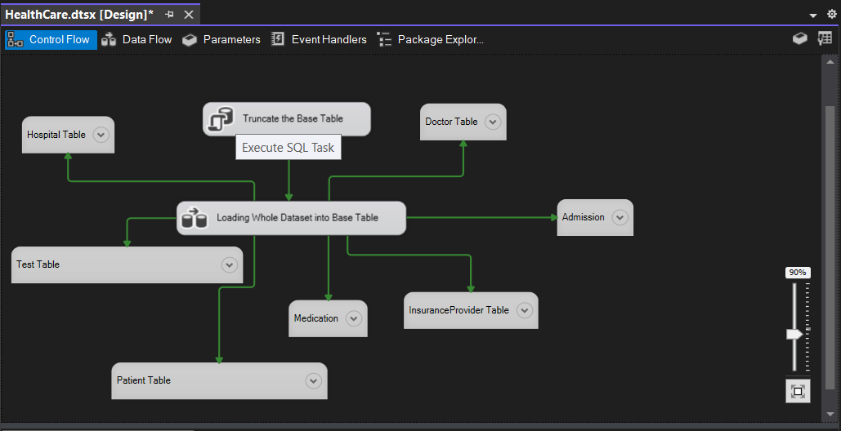
Loading Data into Database:
Utilized Visual Studio SSIS to perform the data loading process into the appropriate tables.

Slide 13
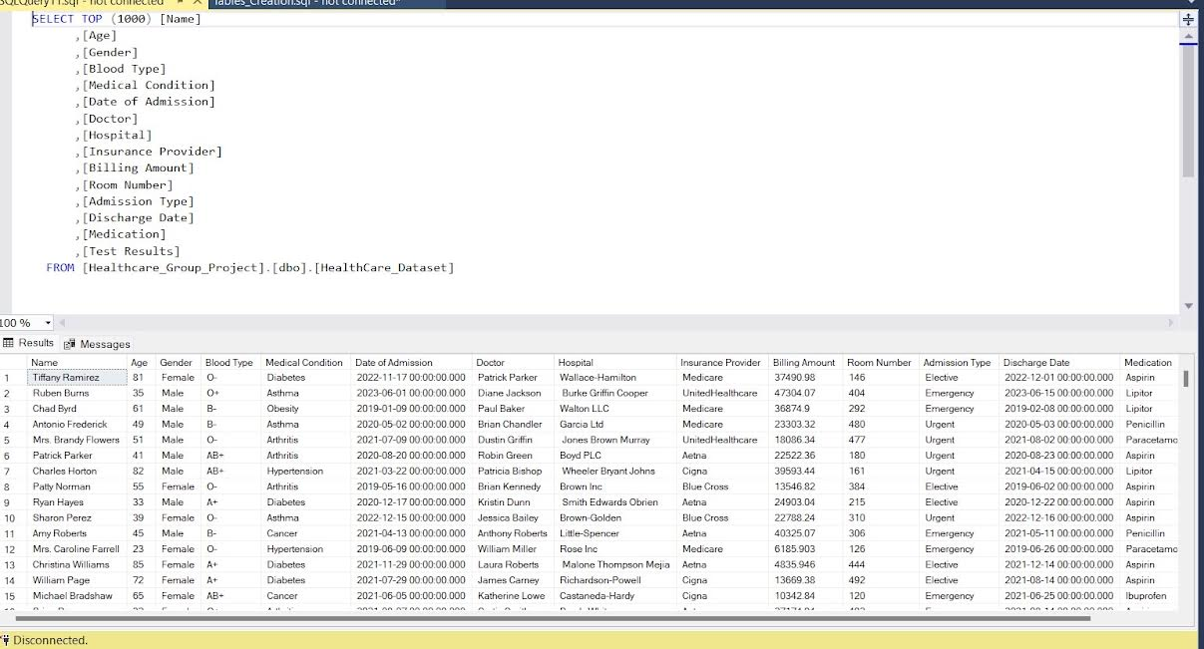
Rows within a Database

Slide 14
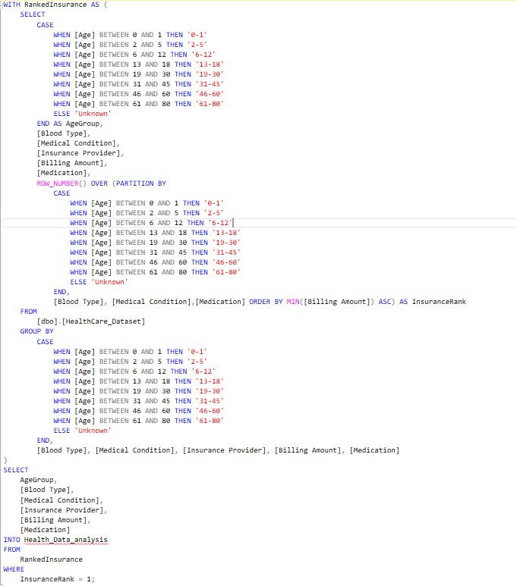
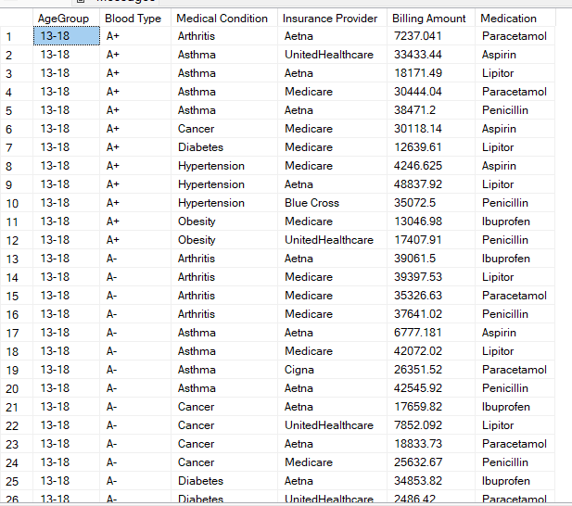
Data Analysis:
Fig. Unique combination of Age, Blood Type, and Medical Condition, Medication the insurance provider with the lowest total billing amount.

Slide 15
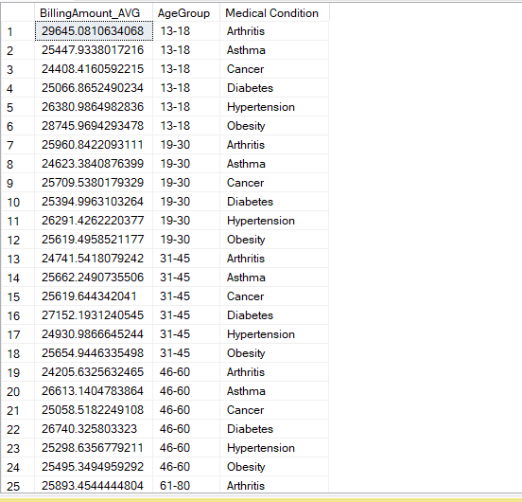
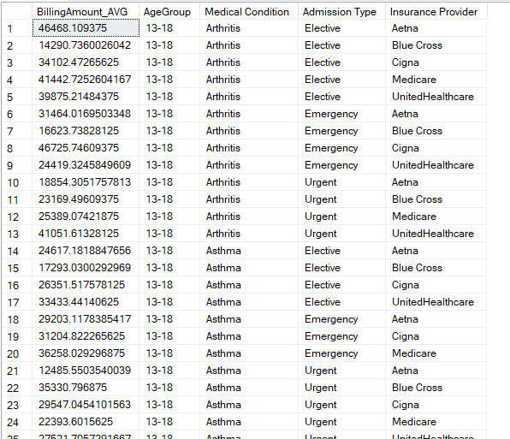
Stored Procedures
Fig1. Avg_BillingAmount_Per_AgeGroup_MedicalCondition
Fig2. Avg_Cost_Per_Condition_For_Insurance

Slide 16
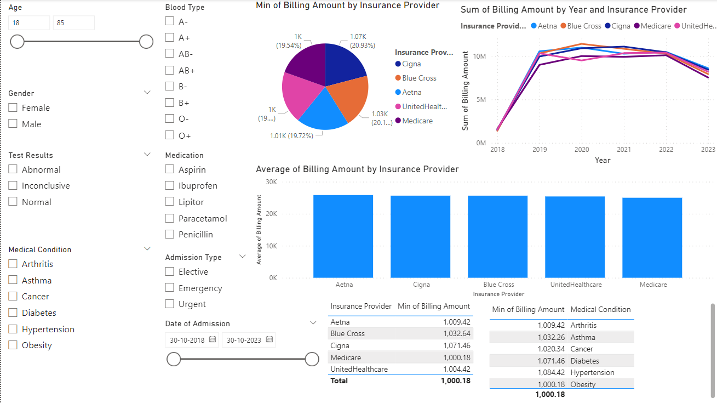
Power BI Dashboard:

Slide 17

THANK YOU
HAPPY HOLIDAYS!

