Slide 1
Group 6 Presentation

Slide 2
Member
NAME | NAME
LOK HON YONG | 241UC240L4
IVAN LIM ZHE MIN | 241UC2411S
MUHAMMAD AMMAR AJWAD BIN MUHAMMAD RUSHDAN | I211303991

Slide 3


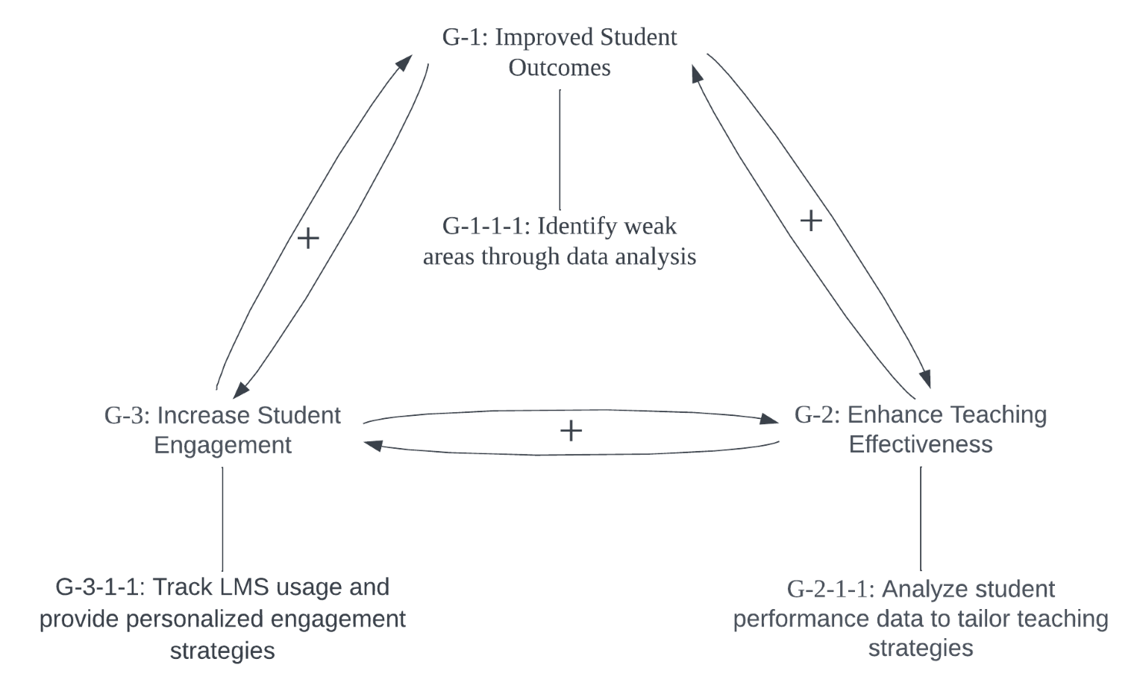
Scope
The system able integrates data on student interactions, submissions, and participation to analyze performance and engagement, providing real-time and historical reports through a user-friendly, multi-device accessible interface, with dashboards highlighting key indicators for educators to inform interventions and teaching strategies.
Goal
The system identifies areas where students need additional support, helping them improve academically while providing lecturers with actionable insights to adjust teaching strategies and interventions, and monitoring student engagement by analyzing Learning Management System interactions to recommend ways to increase participation.

Slide 4
Key Context Object
Student: Interacts with materials, assignments, and discussions.
Lecturer: Manages courses, assignments, and tracks student progress.
Web Administrator: Ensures system security and performance.
Course: A set of structured learning materials.
Assignment: Tasks for student evaluation.
Gradebook: Tracks student progress and grades.

Slide 5
System Features
Learning Resource: Videos, quizzes, and readings for learning.
Discussion Forum: Platform for student and lecturer interactions.
Quiz: Assessment of student knowledge.
Certificate: Awarded after course completion.
Single Sign-On (SSO): Access with one set of credentials.
Mobile App: Access the system via mobile devices.

Slide 6
Development Context
Project Manager: Oversees project timelines and deliverables.
Software Engineer: Develops and implements system features.
Agile Development Process: Iterative development methodology.
Project Milestones: Key goals for system development.
Go-Live Date: Planned system launch.
JavaScript, CSS, PHP, MySQL: Frontend and Backend.

Slide 7
Elicitation Plan
Using Kano Model

Slide 8
Elicitation for Dissatisfiers
Interviews: Conduct one-on-one interviews with stakeholders, students and developers, to identify essential features that the Learning Analytics System (LAS) must include, such as system stability, basic navigation, and security features.
Observation: Analyze competitor Learning Analytics System (LAS) products to identify potential dissatisfiers that could differentiate the system. Look for features that are not expected but could add significant value to the user experience.

Slide 9
Elicitation for Satisfiers
Interviews: Continue conducting interviews to understand the performance-related features expected by users. Such interviews shall aim at aspects like ease of operation, speed, and flexibility, which are crucial determinants of user satisfaction.

Slide 10
Elicitation for Delighters
Interview: After that, provide a few open questions to the interviewer to elicit delighters.

Slide 11
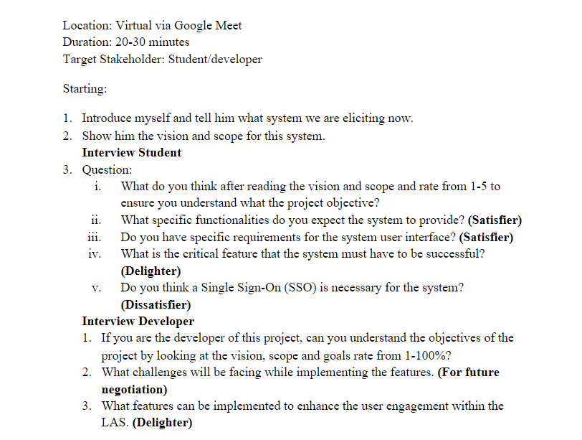
Interview question and scenario

Slide 12
Elicitation Execution

Slide 13
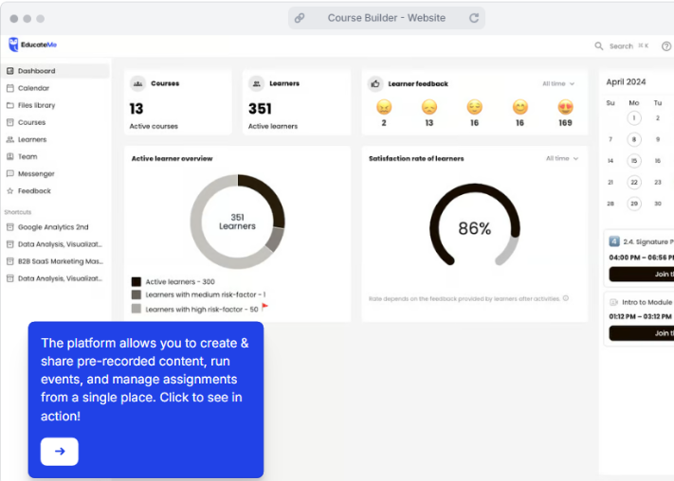
Observation
This research on a competitor's Learning Analytics System (EducateMe) identifies key areas for improvement in user experience, including the need for customizable dashboards to reduce information overload, more interactive and dynamic data visualizations for advanced users, and detailed feedback mechanisms that provide deeper insights for educators. Additionally, the system could benefit from enhanced learner tracking, with features like progress monitoring, intervention suggestions, and customizable performance metrics. Improving navigation through customizable or collapsible shortcut areas, as well as integrating reminders and summaries in the calendar module, would also enhance functionality and user satisfaction.

Slide 14
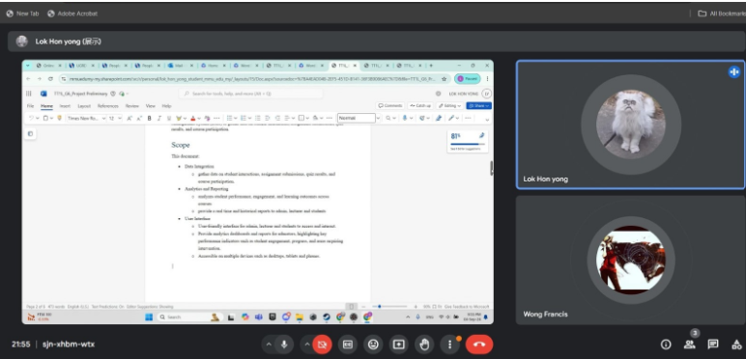
Interview (Participant Profile)
Gender: Male
Occupation: Student at a private local university, part-time developer

Slide 15
Interview (Student perspective)
Question 1: After reviewing the vision and scope of the project, how well do you understand the project objectives? Please rate from 1 to 5.
Response: Rating: 4/5
Question 2: What specific functionalities do you expect the system to provide?
Response: As a student, I expect the system to provide analytic reports that are visually represented through graphs or charts.
Question 3: Do you have specific requirements for the system’s user interface?
Response: The system should have a user-friendly navigation bar that allows for easy navigation. For example, the navigation bar should be intuitive and accessible.

Slide 16
Interview (Student perspective)
Question 4: What is the critical feature that the system must have to be successful?
Response: The system must be accessible on multiple devices and provide accurate data of the reports to ensure success. Other than that, Real-time chat may include also when the lecturer found the student that seriously lack behind lecturer able to conduct the student directly via the chat box.
Question 5: Do you think a Single Sign-On (SSO) is necessary for the system?
Response: Yes, SSO is absolutely necessary.

Slide 17
Interview (Developer perspective)
Question 1: If you were the developer of this project, would you be able to understand the project objectives by reviewing the vision, scope, and goals? Please rate from 1 to 100%.
Response: Rating: 80%
Question 2: What challenges do you foresee while implementing the features?
Response: Implementing the system across multiple devices could present challenges due to the differences in operating systems. Ensuring the accuracy of data could be another challenge, as human error in coding can result in miscalculations or interaction issues. This will require extensive testing and trial-and-error.
Question 3: What features could be implemented to enhance user engagement within the Learning Analytics System (LAS)?
Response: To increase user engagement, incorporating an attractive user interface with elements such as animations could be beneficial.

Slide 18
Software Requirements Specification
Purpose: This SRS outlines the requirements needed for the LAS in development. The following document shall be to the benefit of the development team, project stakeholders, and all involved in this project. This is aimed at ensuring that all requirements are understood and met to successfully deliver the LAS.
Scope: This LAS shall be utilized as a virtual platform by the educational institutions to administer and deliver the courses. General system features will include user management, course creation, assignment submissions, grading, and reporting. The system is intended for students, lecturers, and administrators. Integration with existing systems shall include SIS and LTI providers. Development of new tools for content creation is out of scope.

Slide 19
Definitions, Acronyms, and Abbreviations
LAS: Learning Analytics System
SIS: Student Information System
API: Application Programming Interface
LTI: Learning Tools Interoperability

Slide 20
Product Perspective
The LAS is part of a broader educational ecosystem.
Integrates with SIS and other LTI-compliant tools for a seamless user experience.
Web-based with support for mobile devices using responsive design.

Slide 21
Product Features
User Management:
Manages accounts for students, lecturers, and administrators.
Course Management:
Create, modify, and delete courses within the system.
Assignment Submission:
Allows students to submit assignments online.
Grading System:
Lecturers can grade assignments and exams.
Reporting:
Generates reports on student performance and course progress.
Notifications:
Alerts users about due dates, grades, and other important updates.

Slide 22
User Characteristics
Students:
Major users who can view materials, submit assignments, and check grades.
Lecturers:
Lead course creation, content distribution, and student grading.
Administrators:
Manage user accounts and ensure system integrity.

Slide 23
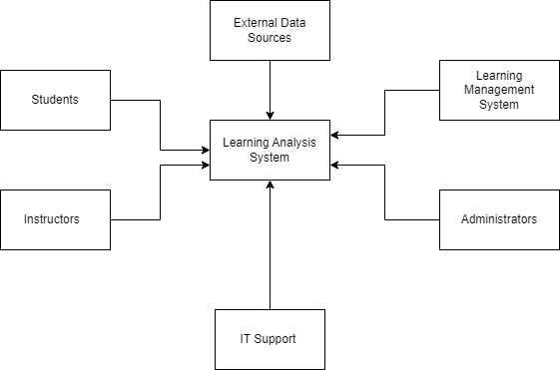
Context Diagram

Slide 24
Functional Requirements
Login/Registration Function:
Register: Provides users with a Student/Lecturer ID and password.
Login: Prompts users to log in with their credentials.
Forgot Password: Allows users to securely reset their passwords.
Data Integration Function:
Gathers data on student interactions, submissions, quiz results, and participation.
Analytics and Reporting Function:
Analyzes performance, engagement, and learning outcomes.
Provides real-time and historical reports for admins, lecturers, and students.
Dashboard Function:
Offers lecturers actionable insights for teaching strategies and targeted interventions.
Real-Time Chat Function:
Might allow students and lecturers to communicate via chat.
Feedback Function:
Might enable students to provide feedback tied directly to course elements.

Slide 25
Quality Requirements
Performance:
Loading time should not exceed 2 seconds.
Codebase:
Should be modular and well-documented for quick onboarding of new developers.
Data Exchange:
System must exchange data using JSON format.
Uptime:
System must have 99.9% uptime, with no downtime exceeding 10 minutes.

Slide 26
Constraints
MMU Users Only:
System is restricted to MMU students and staff.
Authentication:
Requires login and registration tied to the MMU student/staff database.

Slide 27
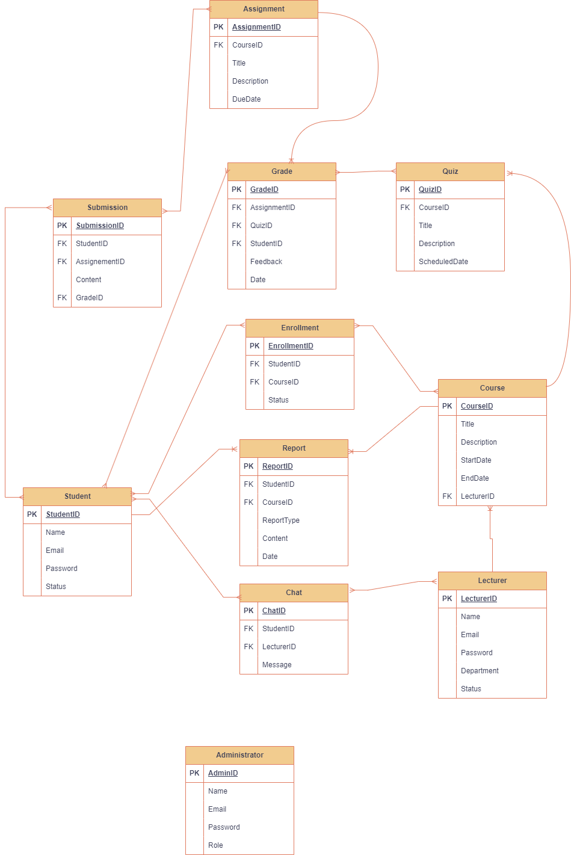
Entity Relationship Diagram (ERD)

Slide 28
Use Cases
Register user
Login user
Integrate data
Analytics data and Reporting
Dashboard posting
Real-time Chatting
Provide Feedback on Course Elements

Slide 29
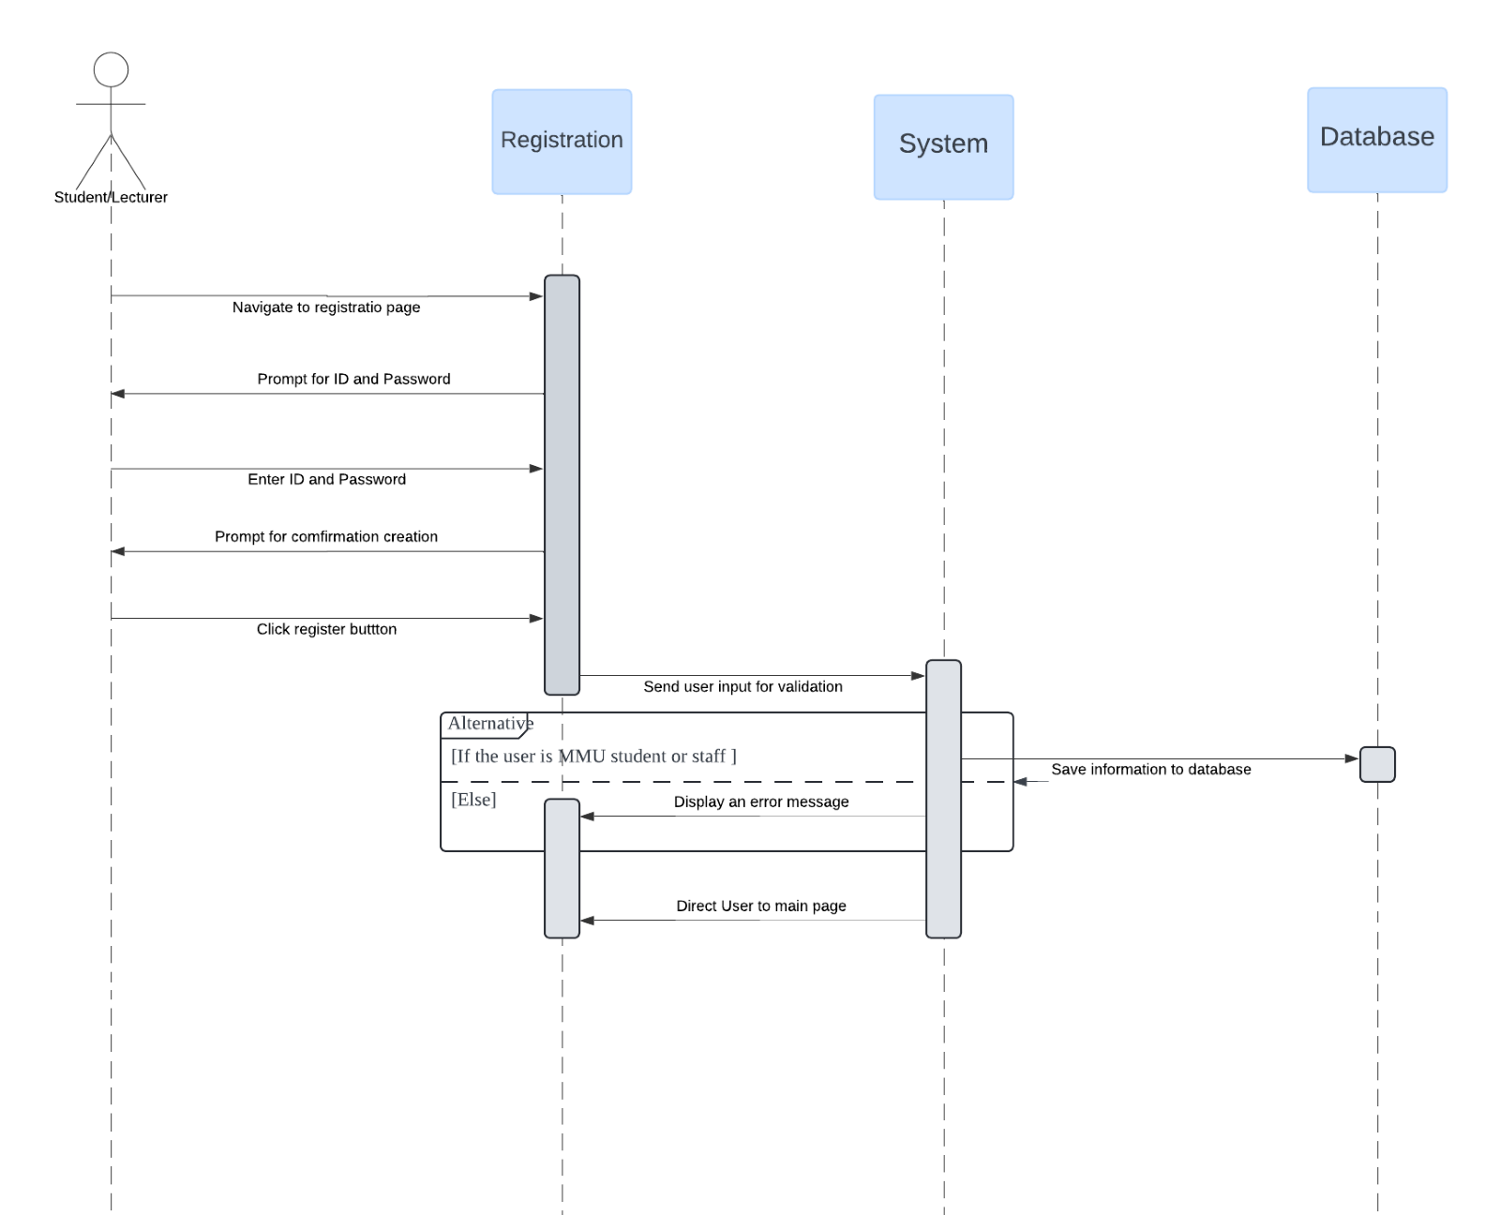
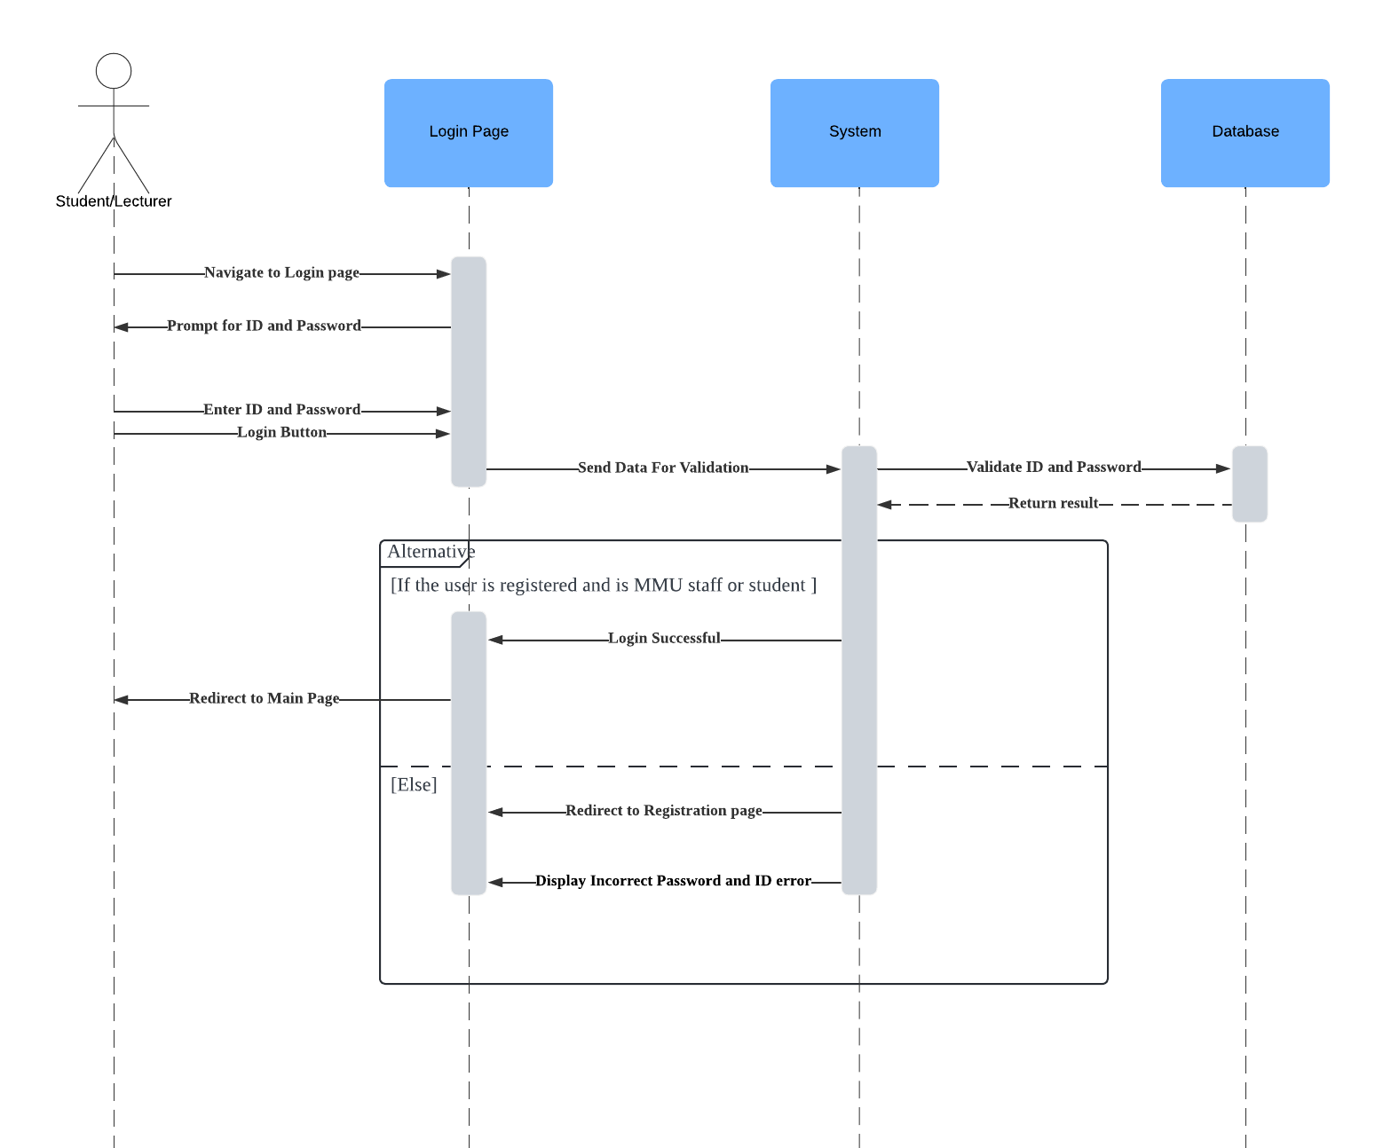
Sequence Diagram
Register user
Login user

Slide 30
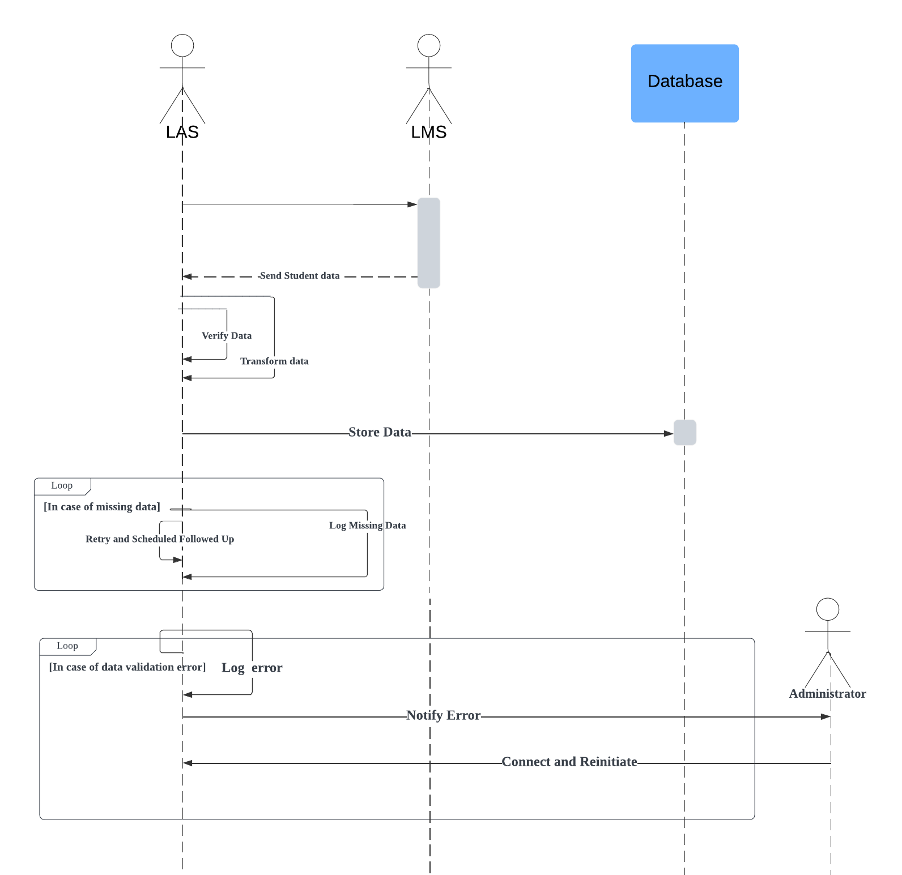
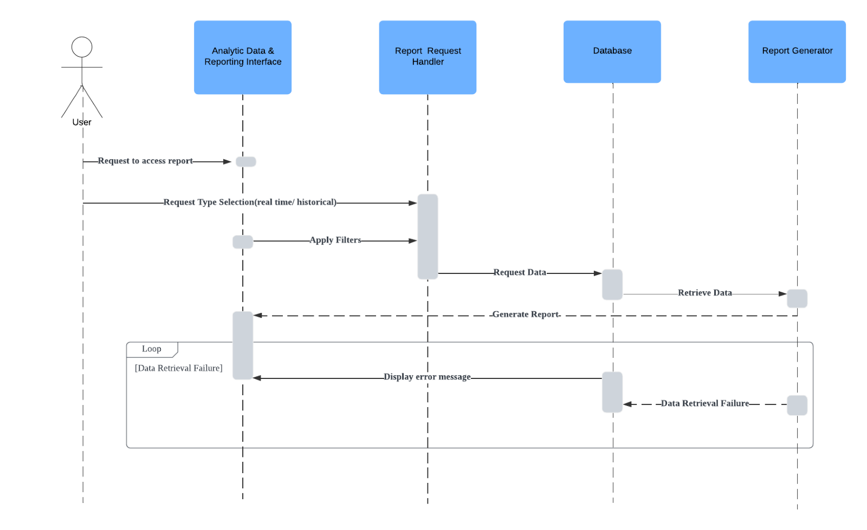
Sequence Diagram
Integrate Data
Analytics data and Reporting

Slide 31
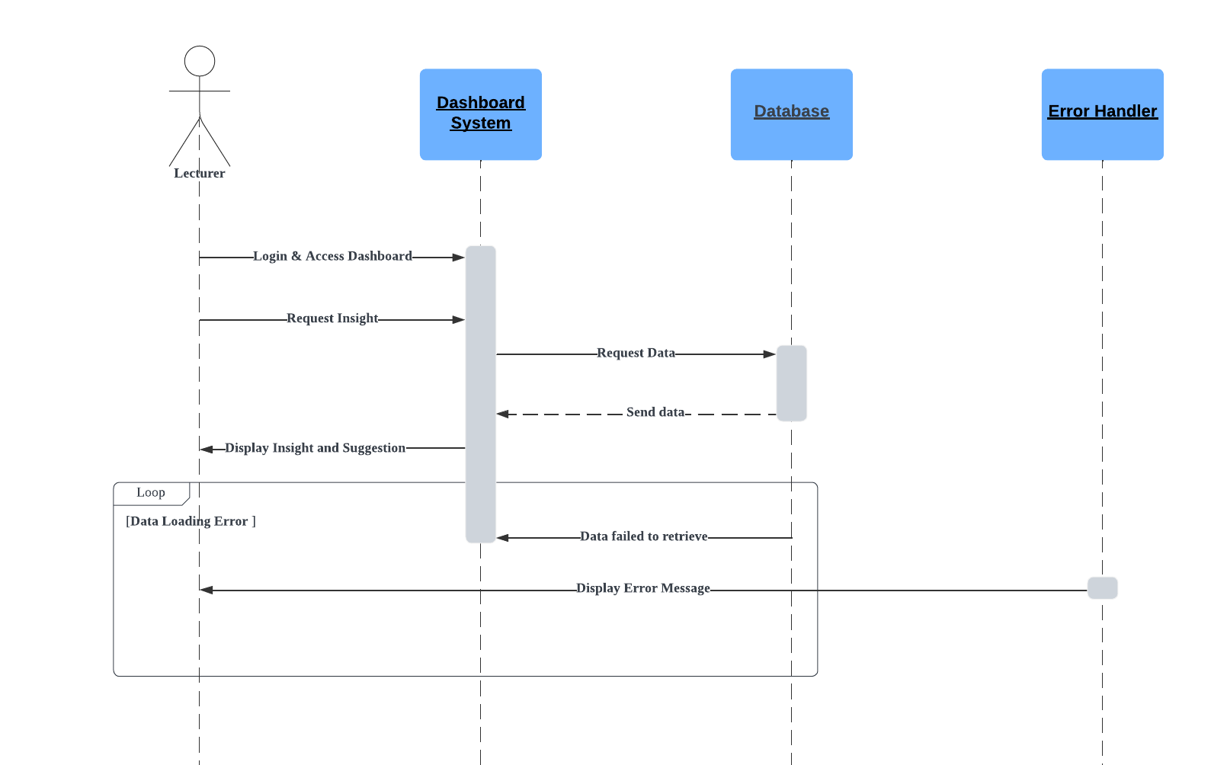
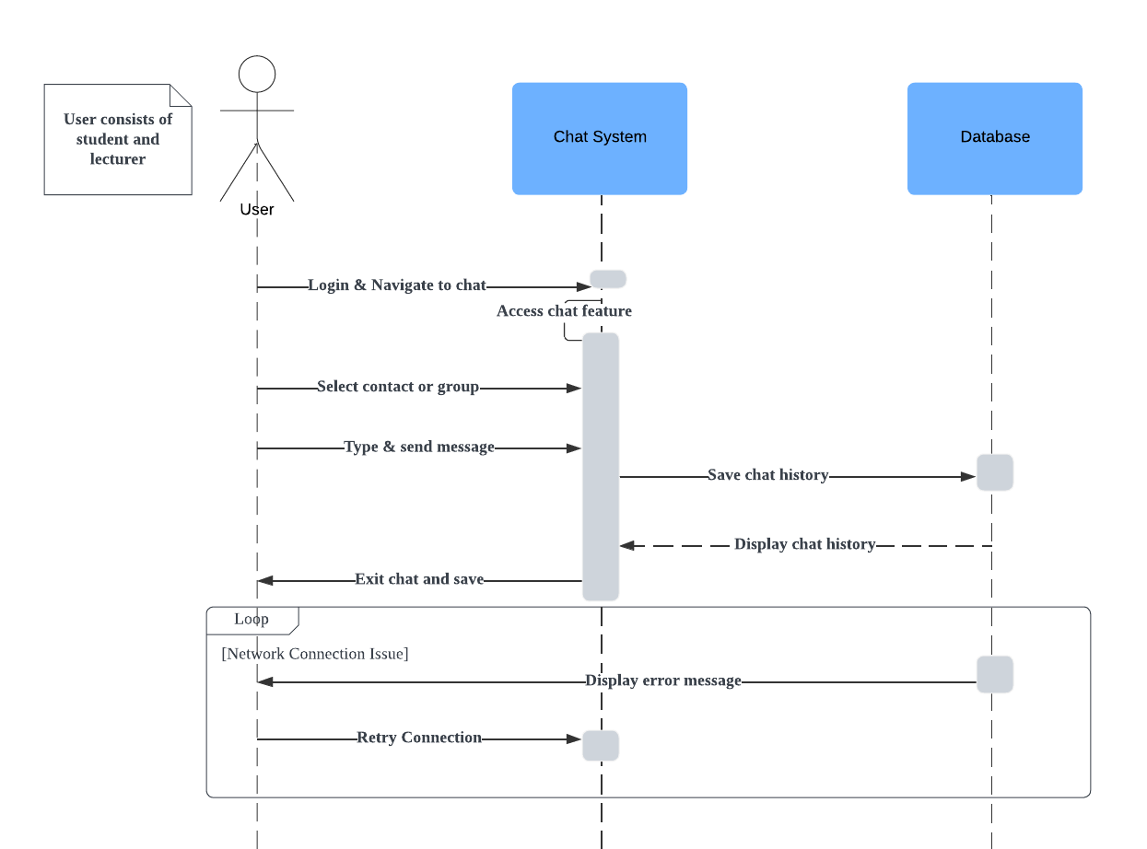
Sequence Diagram
Dashboard posting
Real-time chatting

Slide 32
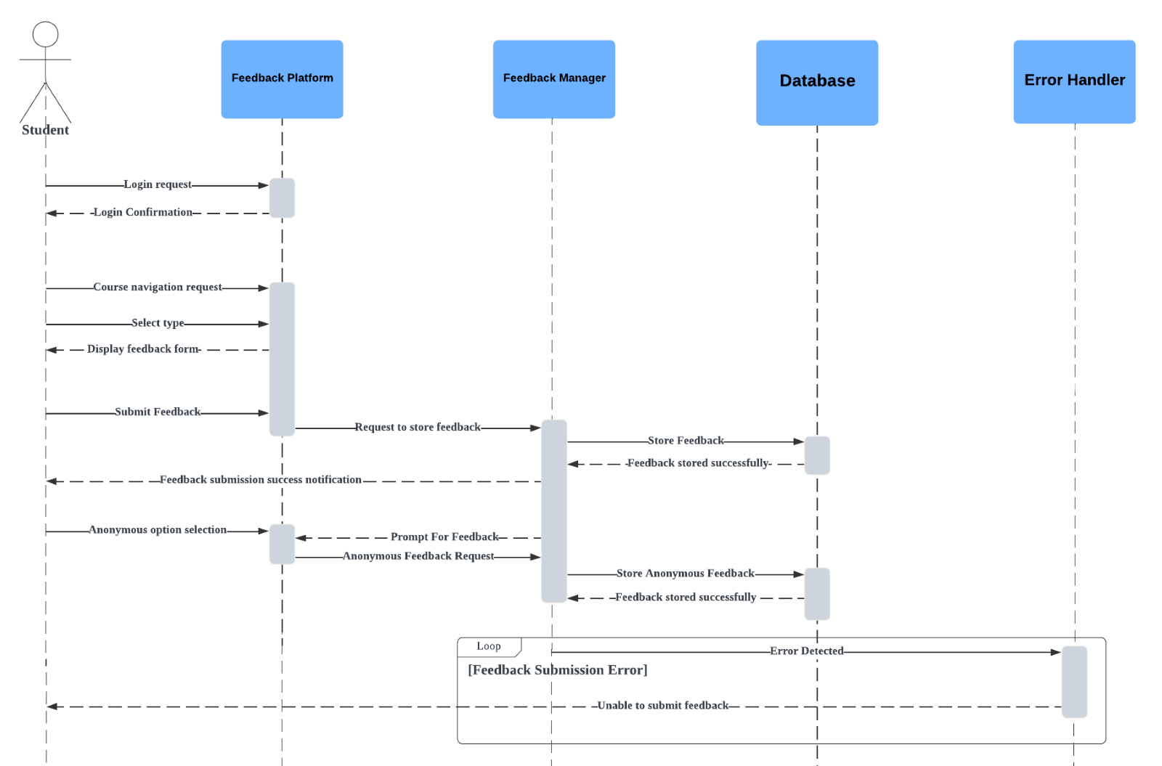
Sequence Diagram
Provide Feedback on Course Elements

Slide 33
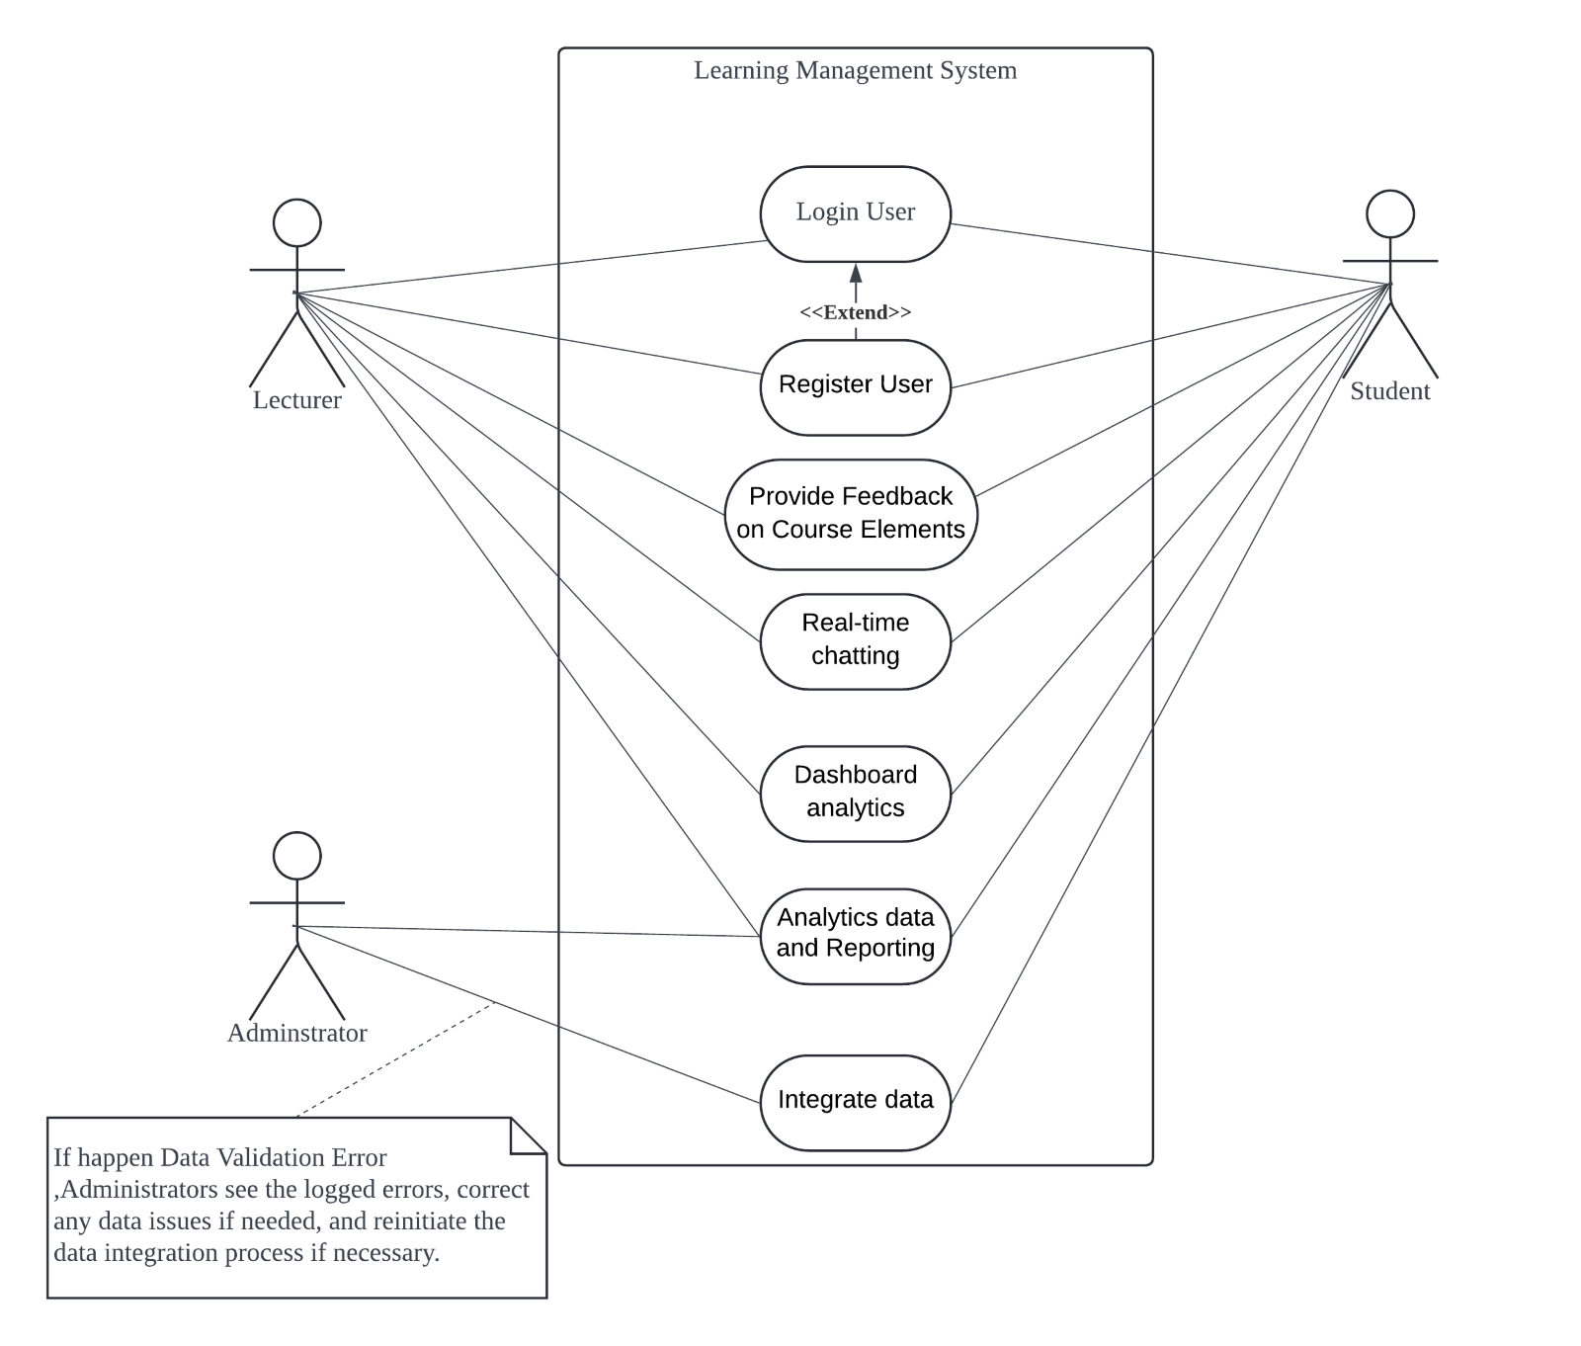
Use Case Diagram

Slide 34
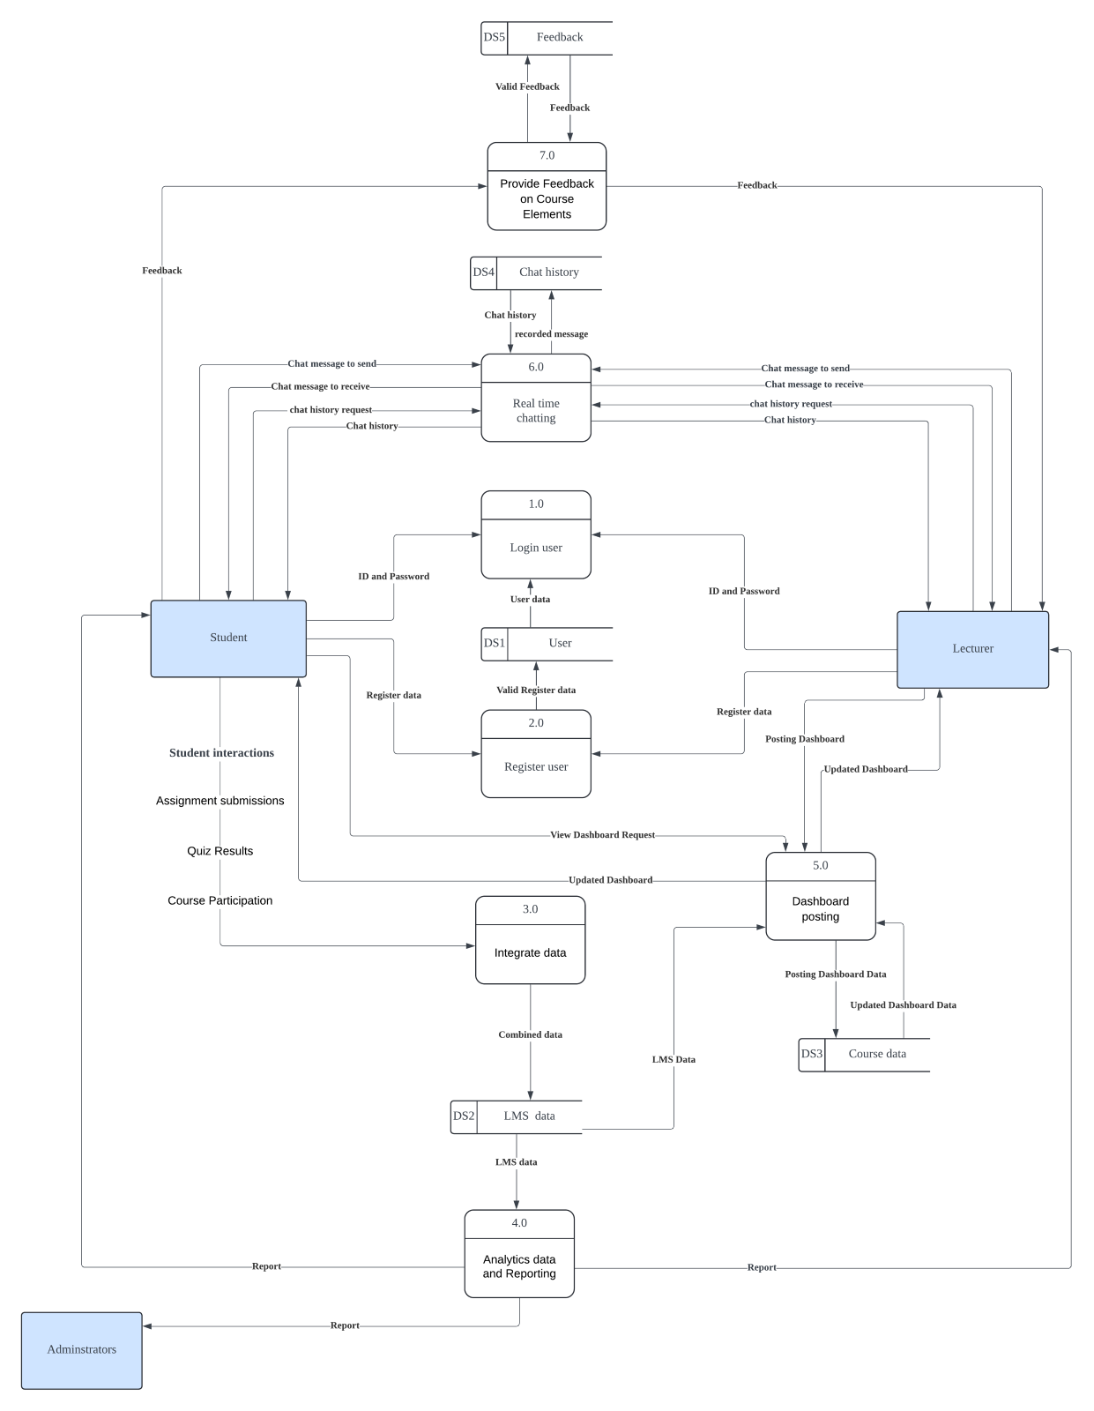
Dataflow Diagram

Slide 35
Thank you

