Slide 1
Hospitality (Hotel) -Have a good time
Team members: Group-3
-Jayakumar Gopal Shetasanadi
-Karisubbannagari lokeshwari

Slide 2
Table of contents
1. Team’s Goal
2. KPI: Weekly Occupancy rate in hotel
3. KPI: Weekly Trends in hotel
4. Why These KPIs Matters
5. Dashboards (Excel, Power BI and Tableau)
6. Challenges
7. Conclusion

Slide 3

Team’s Goal
Creating a comprehensive
dashboard covering multiple
KPIs using Excel, Tableau,
Power BI, and MySQL

Slide 4
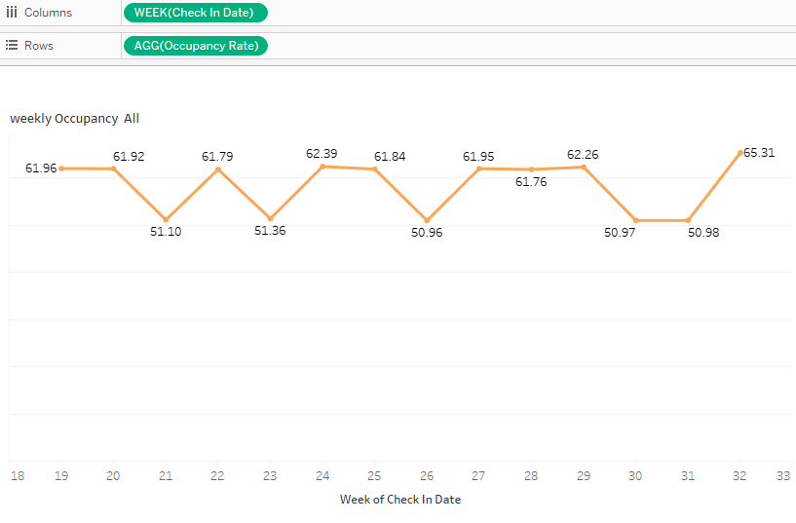
KPI: Weekly Occupancy rate in hotel

Slide 5
KPI: Weekly Occupancy rate in hotel
This KPI tracks the percentage of rooms occupied weekly, providing critical insights into operational performance and demand trends.
Key Observations:
1. Overall Trend: The weekly occupancy rates for May, June, and July show an average performance, with an overall rate hovering around 58-59%.
2. Fluctuations in Openings:
The highest occupancy rate was recorded in Week 32 (65.31%), showing a peak in July.
The lowest rate was observed in Week 26 (50.96%), reflecting potential seasonal or operational challenges.
Similar dips were noted in Weeks 21, 23, 30, and 31, all hovering near 51%, suggesting recurring patterns.

Slide 6
KPI: Weekly Occupancy rate in hotel
Importance of the KPI:
Operational Planning : Helps adjust staff allocation and service levels to match demand.
Revenue Management: Supports dynamic pricing strategies during high-occupancy periods.
Strategic Decision-Making: Assists in identifying opportunities for promotion or improvement during low-performing weeks.

Slide 7
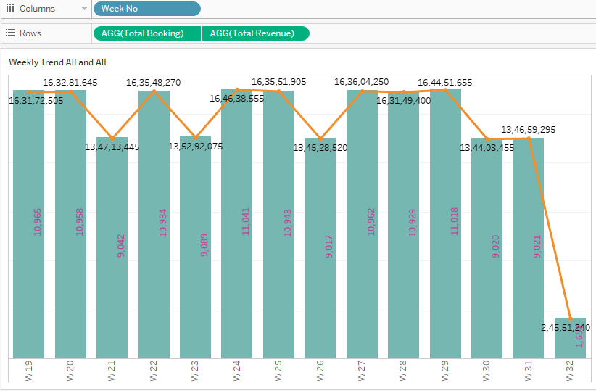
KPI: Weekly Trends in hotel :Total Bookings and Revenue

Slide 8
KPI: Weekly Trends in hotel : Total Bookings and Revenue
Overview: The data highlights variations in weekly bookings and revenue trends, analyzing performance across a total of 15 weeks.
Peak Months: Weeks 24 and 29 showed the highest bookings (11,041 and 11,018, respectively) and revenues (164,638,555 and 164,451,655, respectively), reflecting strong market activity during these periods.
Low Activity Months: Weeks 21 and 32 recorded the lowest bookings (9,042 and 1,651, respectively) and revenues (134,713,445 and 24,551,240, respectively), potentially indicating off-peak demand or external factors like seasonality.
Insights:
A relatively steady trend is observed between W19 to W31, with fluctuations aligning to consistent demand periods.
Week 32's significant drop may indicate an anomaly, signaling a need for further investigation into external events or market changes.
Seasonal trends and travel patterns likely influence the weekly demand, highlighting the importance of targeted promotions during low-performing weeks.

Slide 9
Why These KPIs Matters
Strategic Planning: These KPIs help businesses identify patterns in booking and revenue over time, which is crucial for making informed decisions about opening new hotels or expanding existing ones. Understanding when demand peaks enables companies to plan better.
Resource Allocation: By tracking weekly trends in occupancy rates, bookings, and revenue, businesses can ensure they have the right amount of staff, supplies, and infrastructure in place during peak demand weeks. This ensures efficiency and prevents disruptions.
Seasonal Insights: These KPIs provide insights into how consumer behavior changes throughout the year. By aligning business strategies with high-demand periods (e.g., holiday seasons or specific weeks), restaurants can optimize marketing, promotions, and customer engagement strategies.

Slide 10
Challenges Faced During Project
Coordination Issues
Uneven Workload
Low Engagement among team members
Monitoring of progress of project
Time management

Slide 11
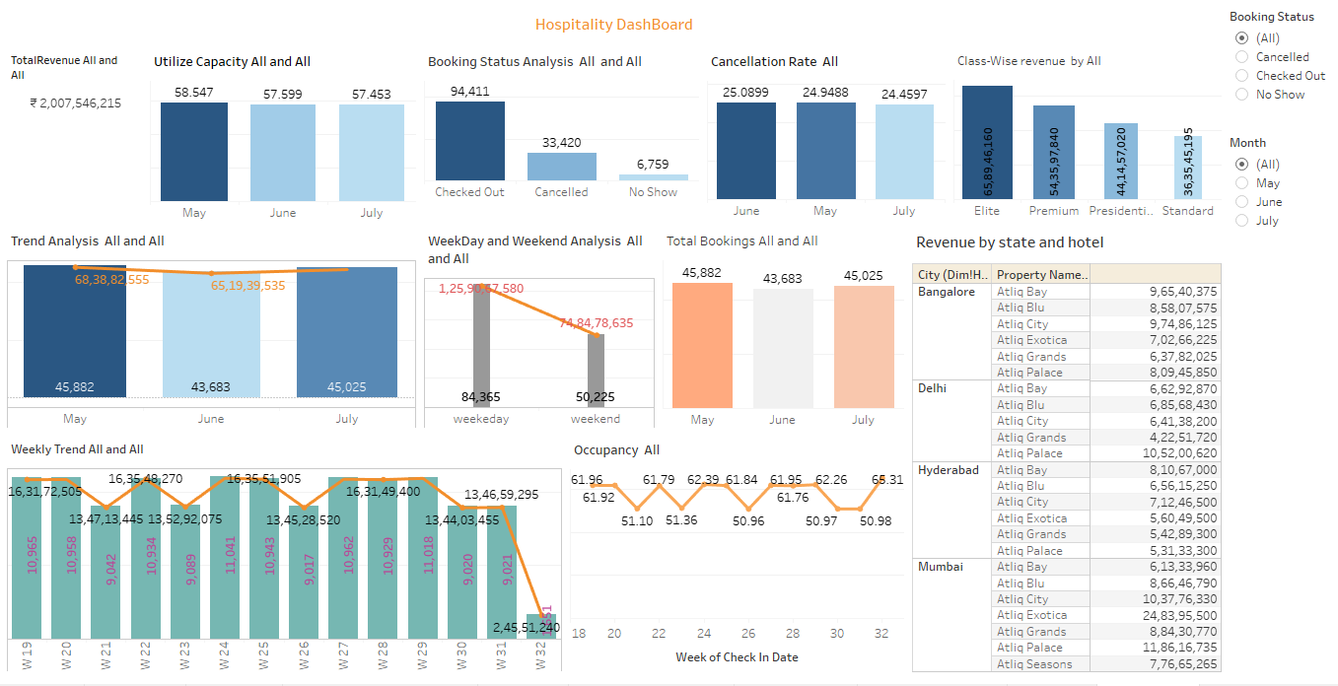
Dashboard

Slide 12
Conclusion
The presentation concludes that developing a comprehensive dashboard to monitor key performance indicators (KPIs) like weekly occupancy rates, bookings, and revenue trends is essential for effective operational planning, revenue management, and strategic decision-making in the hospitality industry. The project faced challenges such as coordination issues, uneven workloads, and time management, but emphasized the value of these KPIs in identifying seasonal trends, optimizing resource allocation, and improving business performance.

Slide 13
THANK YOU

