Slide 1
AI-Powered Market Trend & Consumer Sentiment Forecaster
Lokesh K
AI Developer
Sri krishna college of engineering and technology

Slide 2
Introduction & Problem Statement
The Challenge:
  Consumer opinions spread across social media, product reviews, and news platforms
  Businesses struggle to manually analyze massive, unstructured data in real time
  Delayed responses to market trends lead to customer dissatisfaction
  Need for automated, intelligent analysis of consumer sentiment
Our Solution:
  AI-powered system that aggregates multi-source data and provides real-time sentiment and trend insights

Slide 3
Project Objectives
Collect and aggregate consumer opinions from multiple channels
Analyze sentiment and emerging topics using LLMs
Provide contextual insights using RAG pipelines
Help marketing and product teams make data-driven decisions
Enable real-time monitoring and automated alerts

Slide 4
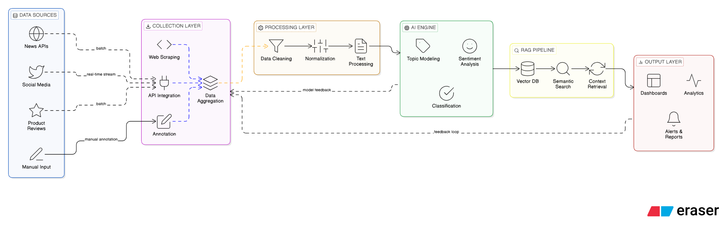
System Architecture

Slide 5
System Modules
1. Data Collection & Scraping
  Fetches data using APIs/scrapers from social media, reviews, and news
2. Data Cleaning & Normalization
  Removes noise, formats text, standardizes dates and categories
3. LLM Sentiment & Topic Modeling
  Classifies sentiment (Positive/Neutral/Negative) and extracts key topics
4. RAG Pipeline
  Retrieves relevant data using vector search for contextual insights
5. Visualization & Analytics
  Displays trends, comparisons, and sentiment shifts
6. Alerts & Reporting
  Sends alerts for sentiment spikes and trend changes

Slide 6
Project Milestones
Milestone 1 (Week 2)
  Data scraping operational; cleaned dataset available
Milestone 2 (Week 4)
  LLM sentiment & topic models functional
Milestone 3 (Week 6)
  Dashboards live; RAG pipeline integrated
Milestone 4 (Week 8)
  Alerts/reports generated; system deployed successfully

Slide 7
Technology Stack
Language: Python 3.x
Core Libraries: pandas, numpy, scikit-learn
AI/ML Libraries: transformers, langchain, sentence-transformers
LLM Models: Gemini, Groq (Llama), BERT
Topic Modeling: LDA, BERTopic
Vector Database: FAISS
Dashboard: Streamlit, Plotly, Matplotlib
Development Tools: VS Code, Git, GitHub
APIs: RapidAPI, News API, Reddit API

Slide 8
RAG & LLM Integration
How it Works:
  LLMs analyze sentiment and extract topics from consumer data
  RAG ensures insights are based on actual data, not hallucinations
  Vector search retrieves relevant opinions before generating insights
  FAISS enables fast semantic search across consumer feedback
Example Query:
  "Why is sentiment declining for Product X?"
  Response: "Negative sentiment increased by 25% due to delivery delays mentioned in 157 recent reviews."

Slide 9
Results & Key Outputs
Deliverables:
  ✓ Interactive dashboards with real-time sentiment trends
  ✓ Sentiment spike detection and visualization
  ✓ Topic modeling with category-wise analysis
  ✓ Automated alert system (Email/Slack notifications)
  ✓ RAG-powered question answering system
  ✓ Historical trend analysis and comparisons
Example Insight:
  "Negative sentiment increased 30% for Electronics category due to delivery delays and product quality issues"

Slide 10
Testing & Challenges
🧪 Testing:
  Tested with historical and real-time data
  Simulated sentiment spikes and trend changes
  Validated RAG pipeline accuracy
  Performance testing with large datasets
⚠️ Challenges:
  Handling noisy social media text and slang
  Topic overlap in unsupervised models
  Sentiment imbalance across categories
  Performance optimization for large datasets
  API rate limits and data collection constraints

Slide 11
Future Enhancements
🌍 Multilingual sentiment analysis
📈 Predictive trend forecasting using time series
⚖️ Real-time brand comparison analytics
🎤 Voice-of-customer analytics
🔗 Integration with CRM tools (Salesforce, HubSpot)
🤖 Advanced NLP models (GPT-4, Claude)
📱 Mobile app for on-the-go insights
🔔 Custom alert rules and thresholds

Slide 12
Conclusion
Key Takeaways:
  Transforms unstructured consumer data into actionable intelligence
  Enables businesses to track sentiment and identify emerging trends
  Provides real-time, AI-driven insights for proactive decision-making
  Combines multiple data sources for comprehensive market understanding
  Reduces manual analysis time and improves response speed
Impact:
  Empowers businesses to stay ahead of market changes and respond quickly to customer needs using cutting-edge AI technology.

Slide 13
Thank You!

