Slide 1
Student Attendance Lookup System
HTML • CSS • JavaScript • JSON • GitHub Pages
Project overview, technical workflow, testing, privacy and future improvements
Project documentation | October 2026

Slide 2
1. Project Overview
• Static web attendance lookup
• Registration number + DOB form
• JSON record lookup
• Attendance percentage calculation
• Popup result and image handling
• Hosted using GitHub Pages
Current status
The owner reports that the deployed attendance lookup works. Edge cases still need systematic testing.

Slide 3
2. Problem and Objectives
Problem
Provide a simple browser-based way to look up an attendance summary from sample records.
Objectives
• Validate input
• Match a student record
• Calculate percentage
• Display result clearly
• Support responsive layout

Slide 4
3. Technology Stack
HTML
Form and page structure
CSS
Responsive layout, colours, buttons and popup
JavaScript
Lookup, calculation, UI and browser storage
JSON
Static sample student data
GitHub Pages
Static website hosting

Slide 5
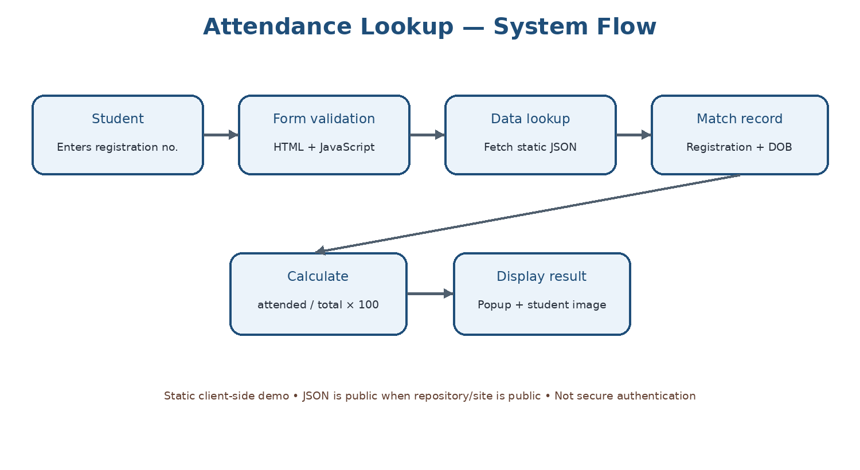
4. System Flow

Slide 6
5. Attendance Calculation
Attendance % = (attended classes ÷ total classes) × 100
The implementation should handle missing, non-numeric, and zero-total values safely. Stored percentages should be checked against the calculated value.

Slide 7
6. Repository Structure
Attendance/
├── data/users.json
├── 404.html
├── index.html
├── scripts.js
├── styles.css
├── README.md
└── docs/README.md
Documentation diagrams and reports are prepared separately in the documentation pack.

Slide 8
7. Testing Status
Reported by owner: deployed site and attendance lookup work.
Suggested tests not independently verified:
• Unknown registration / mismatched DOB
• Missing inputs
• 0% and 100% attendance
• Total classes = 0
• Missing image
• Mobile layout and regression after commits

Slide 9
8. Privacy and Security
• A public JSON file is readable by site visitors.
• DOB-based client-side matching is not secure authentication.
• The inspected HTML stores registration number and DOB in localStorage.
• Use fictional sample records only in public repositories.
• Real records require a backend, server-side authorization and appropriate safeguards.

Slide 10
9. Future Upgrades
Phase 1 — calculation validation and clearer errors
Phase 2 — accessibility and responsive improvements
Phase 3 — reduce localStorage of identifiers
Phase 4 — automated tests and data schema validation
Phase 5 — secure backend/database if real data is required
Phase 6 — admin workflow, audit logging and access controls
These are proposals, not existing features.

Slide 11
10. Conclusion
The project demonstrates a basic frontend workflow from form input to JSON lookup, attendance calculation and result display.
Recommended next step: verify edge cases and ensure the public repository contains only fictional sample data.
Repository: https://github.com/Loki1413/Attendance

