Slide 1
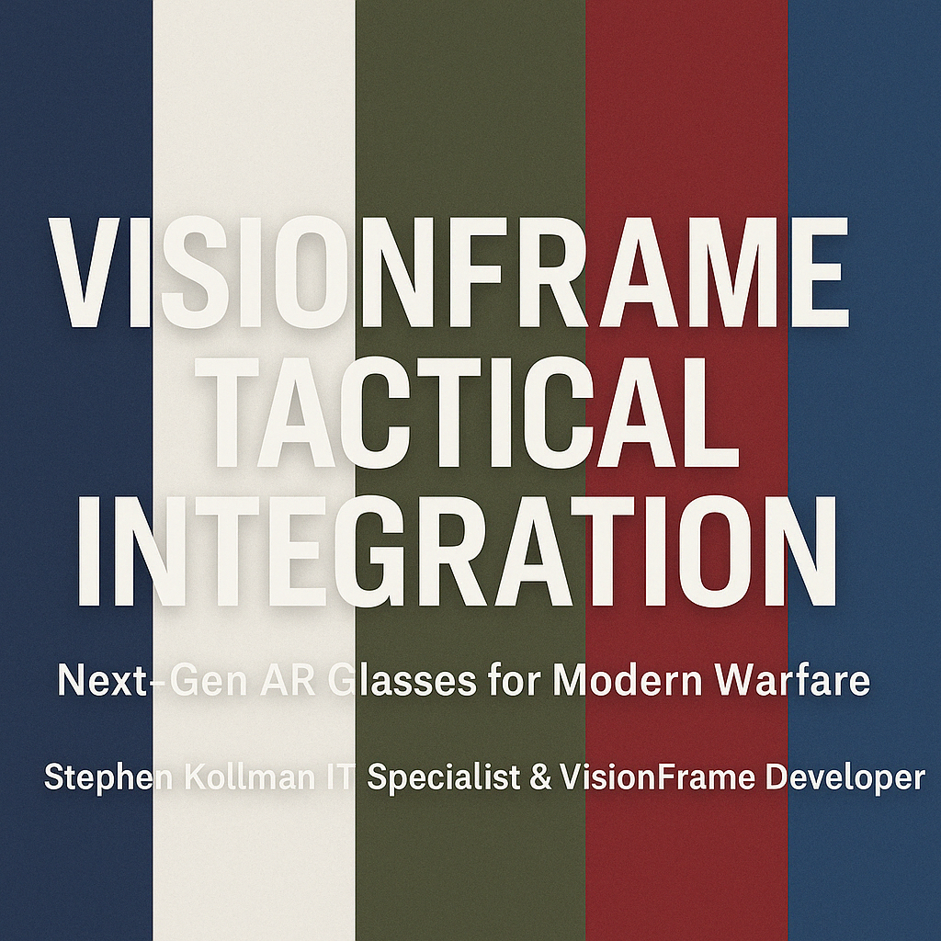

Slide 2
VisionFrame Tactical Integration
Next-Gen AR Glasses for Modern Warfare
Stephen Kollman | IT Specialist & VisionFrame Developer

Slide 3
Mission Overview
Empowering U.S. Armed Forces with next-gen AR smart glasses
Real-time battlefield awareness
Hands-free operations
Lightweight, wearable alternative to radios, binoculars, and HUDs
Designed for all branches of the military

Slide 4
Core Tactical Capabilities
AI-assisted visual targeting + terrain overlays
Silent bone conduction + subvocal communications
Eye + gesture controls (no hands needed)
Squad health + command sync in real time
Adaptive overlays with zero central FOV obstruction

Slide 5
Silent Communication & Encryption
Subvocal microphones capture throat vibrations without audible speech
Pure bone conduction audio ensures stealth — inaudible to enemy forces
Encrypted team mesh network with zero cloud dependency
Anti-logging protocols and real-time command sync
Emergency fallback to signal-based gestures and visual codes

Slide 6
Battlefield Awareness & Navigation
Real-time GPS overlays with waypoint marking
Live terrain manipulation (toggle tree/building transparency)
Rangefinding with exact meters/yards to targets
Environmental data: wind speed, temperature, barometric pressure
Eye-tracked compass and squad position minimap

Slide 7
Health & Threat Monitoring
Real-time biometric vitals for all team members
Auto-alerts for critical injuries or status loss
Visual threat tagging with color-coded threat levels
AI-powered motion + gunfire detection
Immediate tactical data sharing with command

Slide 8
Cross-Branch Applications
Designed for use across Army, Navy, Air Force, Marines, Space Force
Scalable for infantry, aircrew, special ops, medics, and logistics
Modular software for mission-specific configurations
Rugged, weather-resistant, and adaptable to standard gear
Seamless integration with military networks and protocols

Slide 9
Call to Action
Seeking:
DoD pilot program or R&D collaboration
White House innovation review
Defense sponsorship or manufacturing partnerships
Contact:Stephen Kollman IT Specialist & VisionFrame Developer
Stephen.Kollman.Pro@outlook.com

