Slide 1
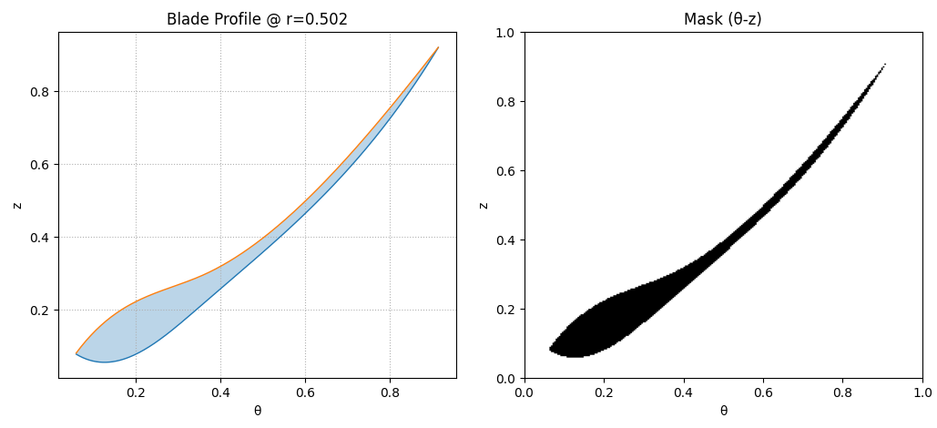
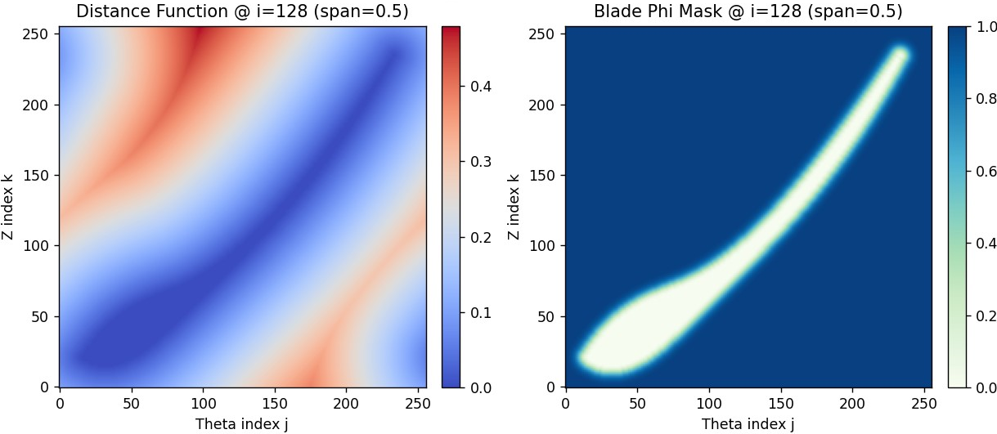
Verified the boundary mask of the blade in the document (We upgraded the z distance to, more isotropic Eulerian distance)

Slide 2
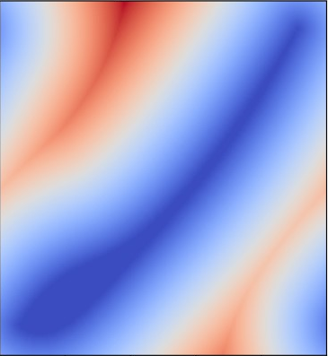
We verified the effectiveness of periodic boundary conditions in Theta direction.

Slide 3
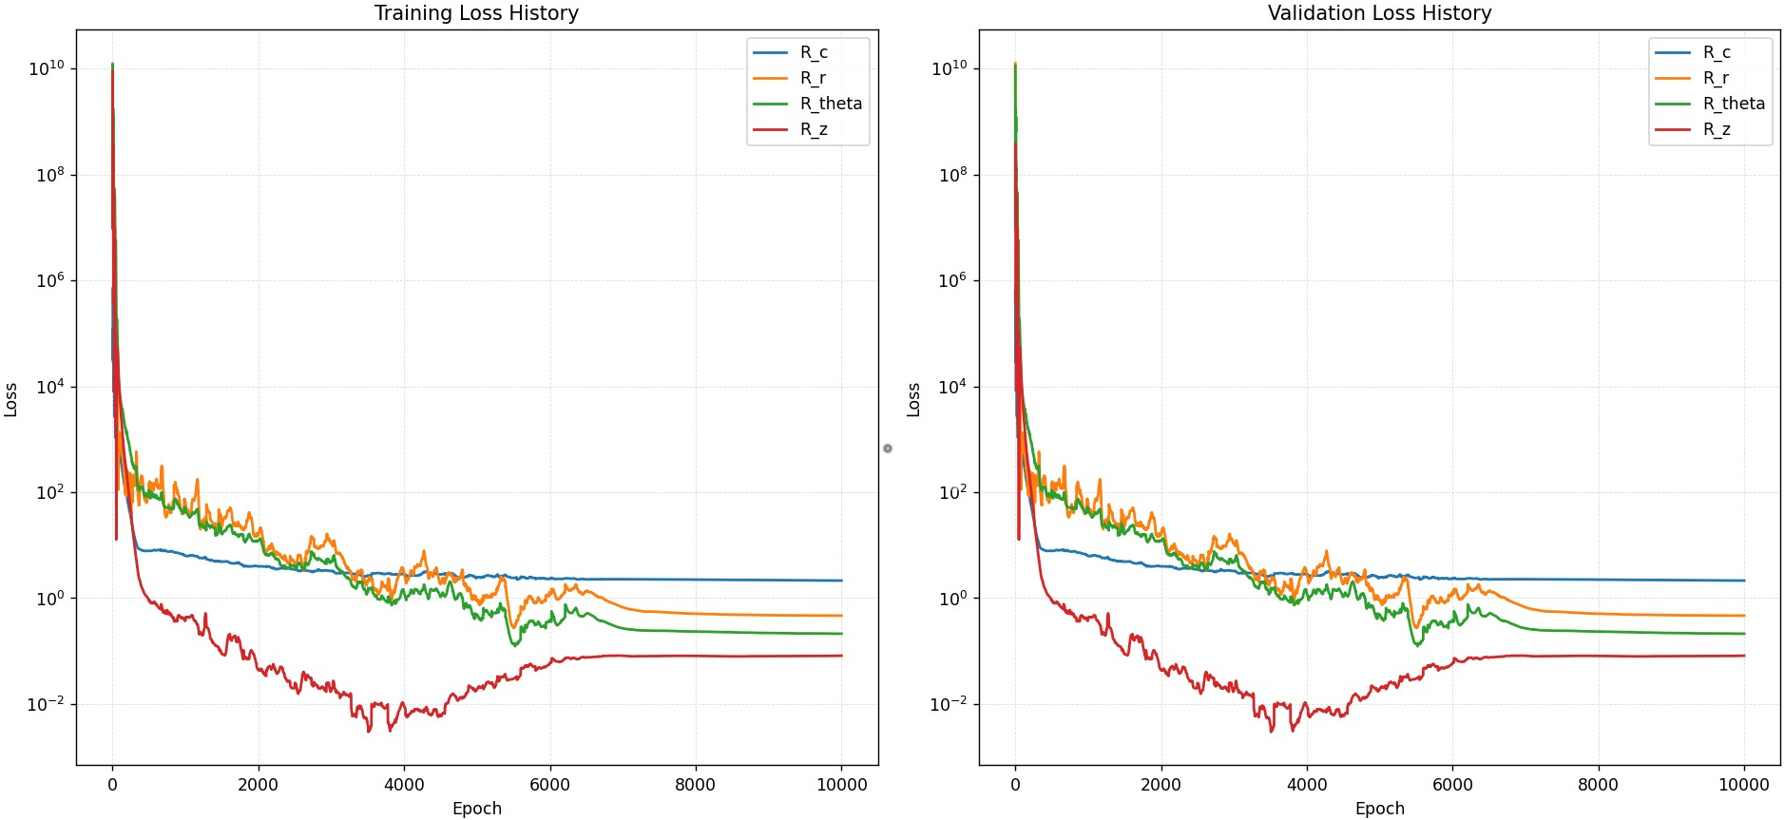
FNO Trained with only Physics Constraints

Slide 4
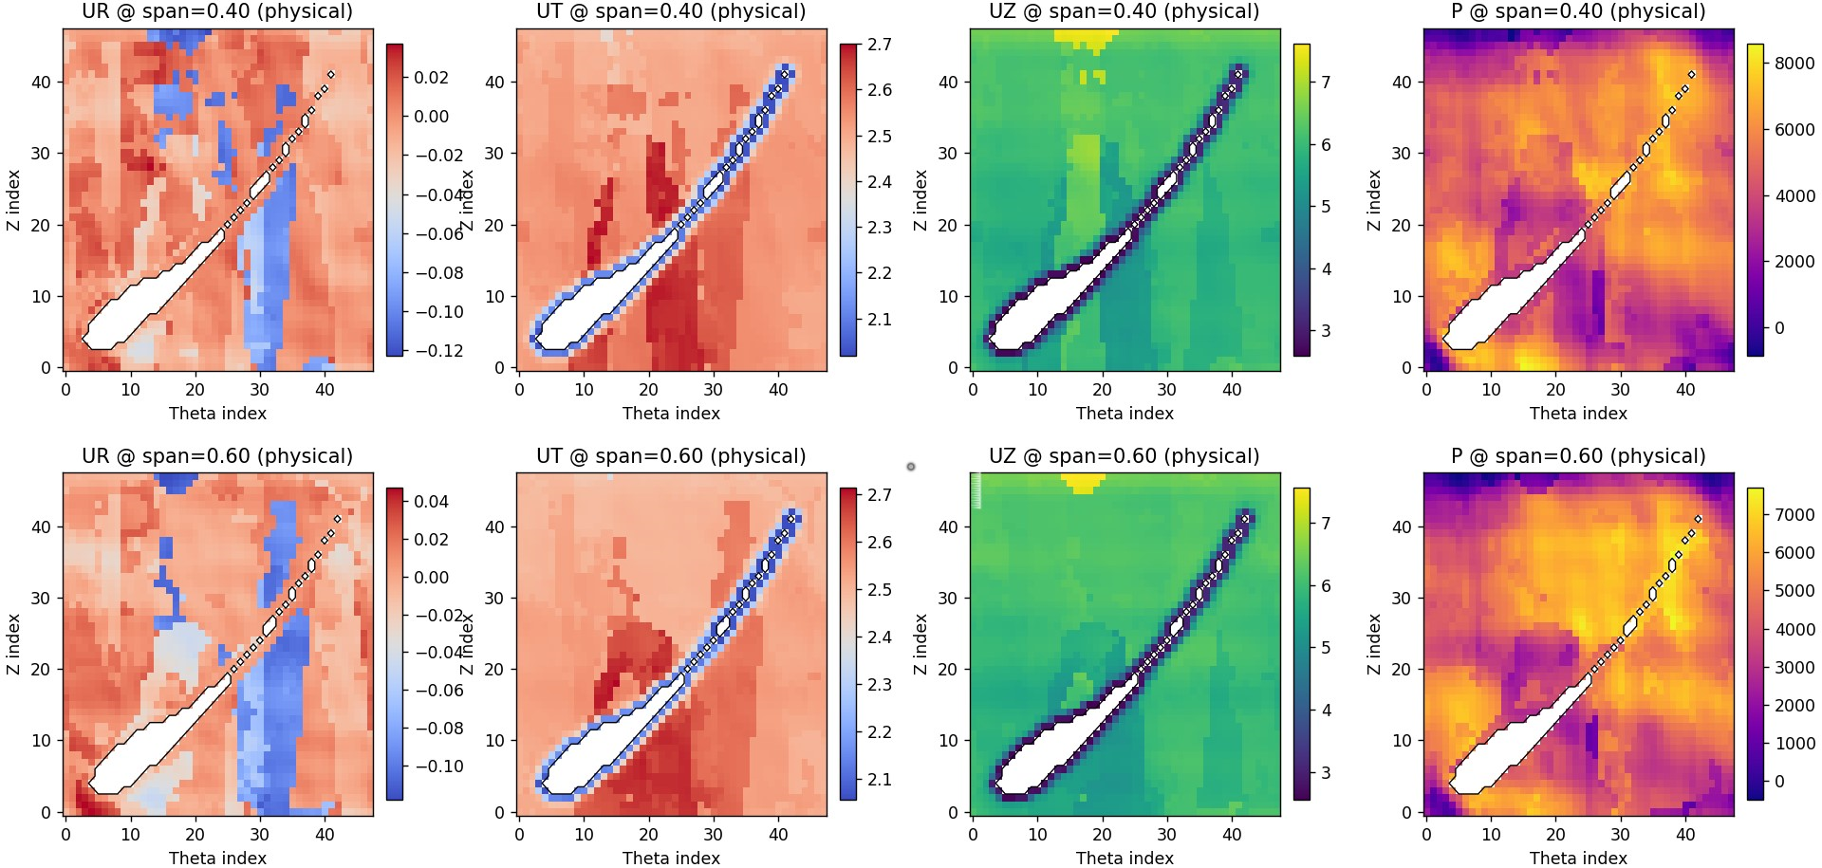
FNO Trained with only Physics Constraints

Slide 5
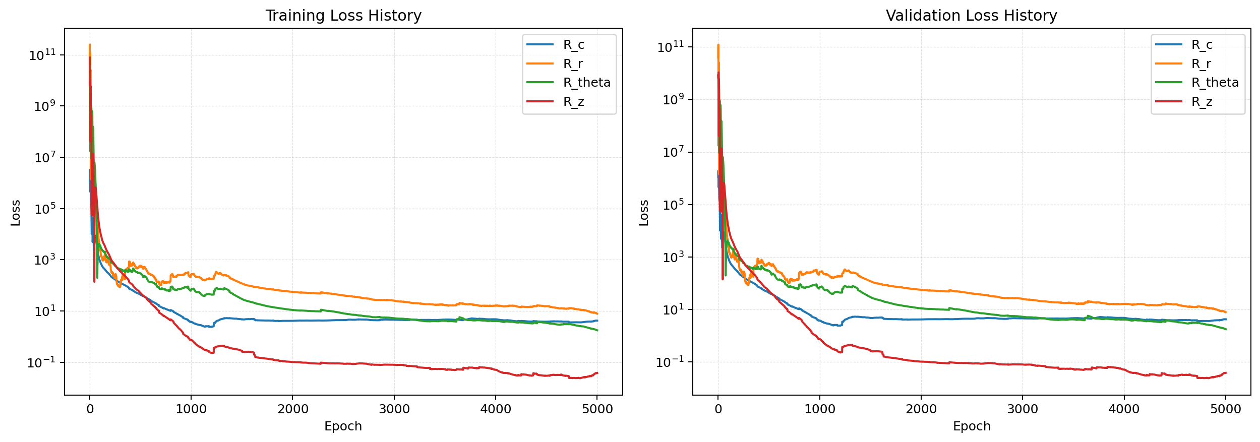
CFNO Trained with only Physics Constraints

Slide 6
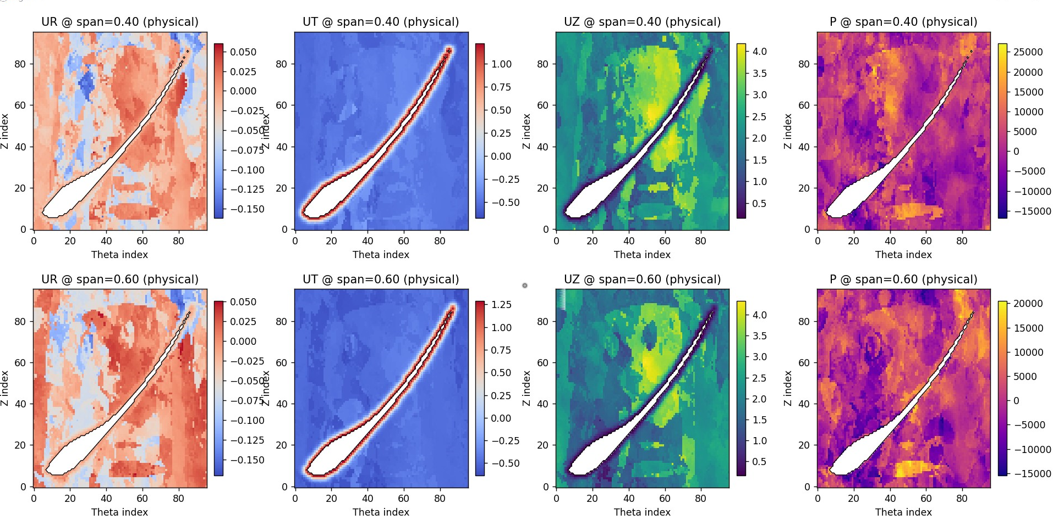
CFNO Trained with only Physics Constraints

