Slide 1

y
u=U
v=0
A
B
x
？
？
网络输出: $\hat{u}\left(x,y\right),\hat{v}\left(x,y\right),p\left(x,y\right)$
完全无约束，前期收敛方向混乱，浪费网络capacity和迭代次数
u=0
v=0
u=0
v=0
因此方法是通过一个C2函数作为乘子，保证不失去二阶导数的情况下对网络输出进行约束
u=0
v=0

Slide 2
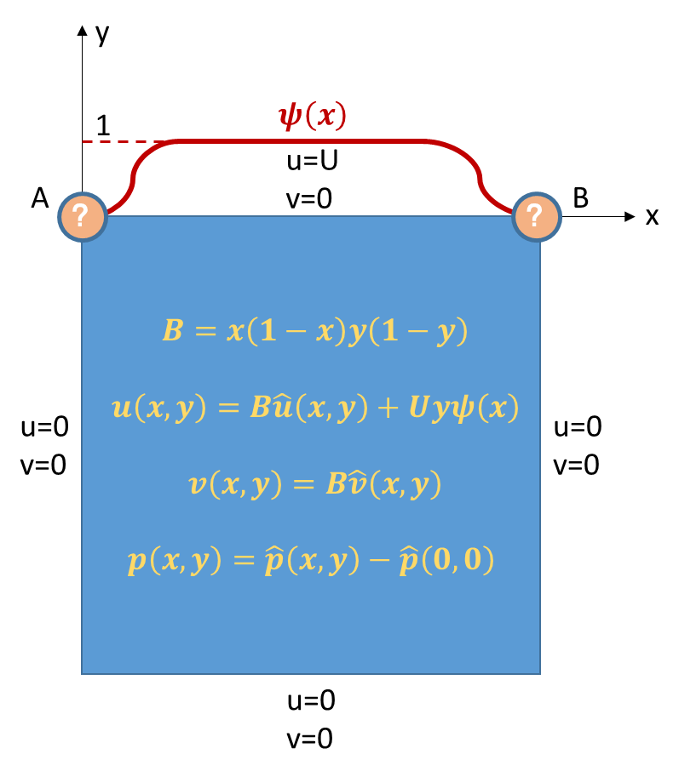

Slide 3
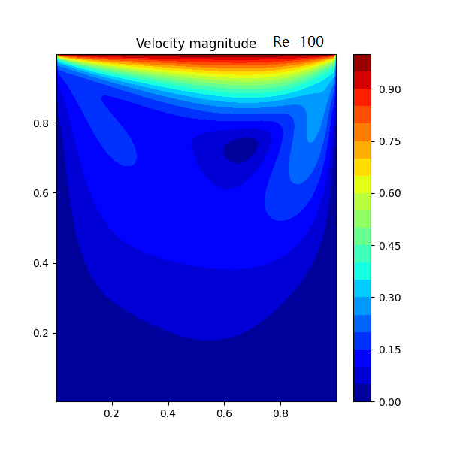
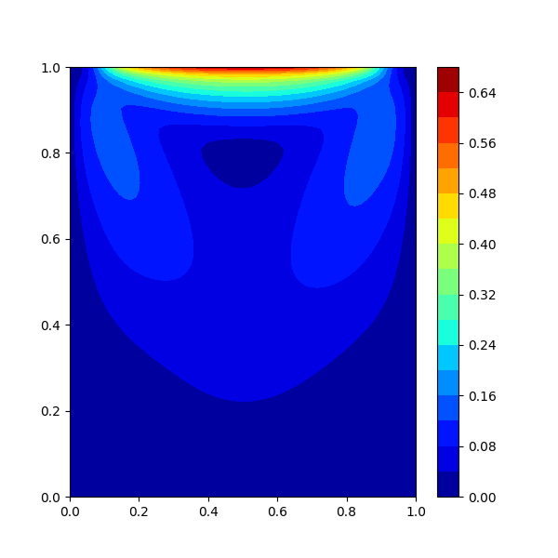
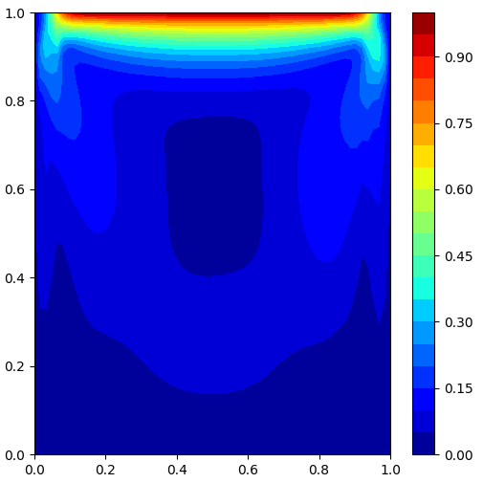
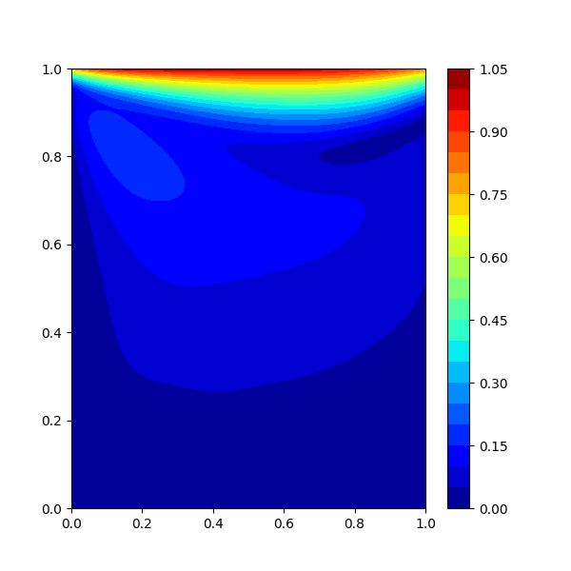
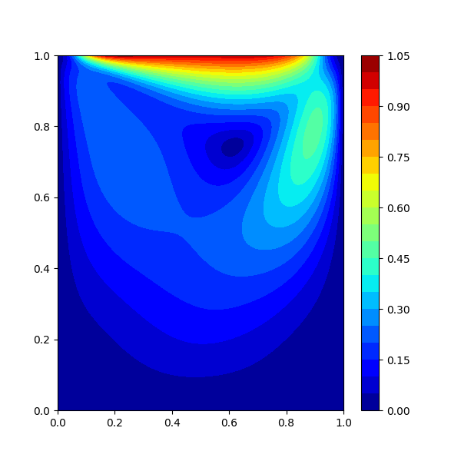
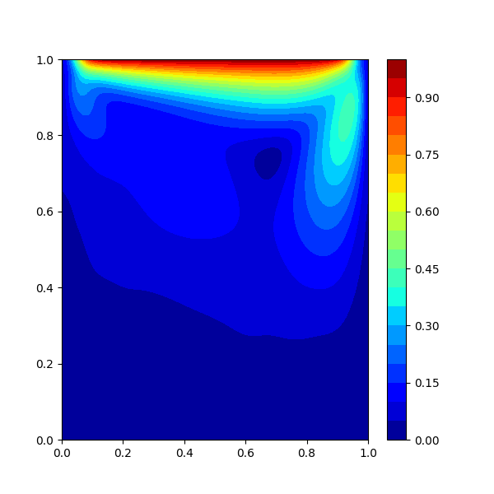
SIMPLE Result
(baseline)
Velocity Only Weak PINN
(homogeneous constraints)
Velocity Only Weak PINN
(full constraints)
Coupled PINN
(naked)
Coupled PINN
(homogeneous constraints)
Coupled PINN
(full constraints)
Notes:
Non-supervision learning results, 5000 epoch, Re=100

