Slide 1
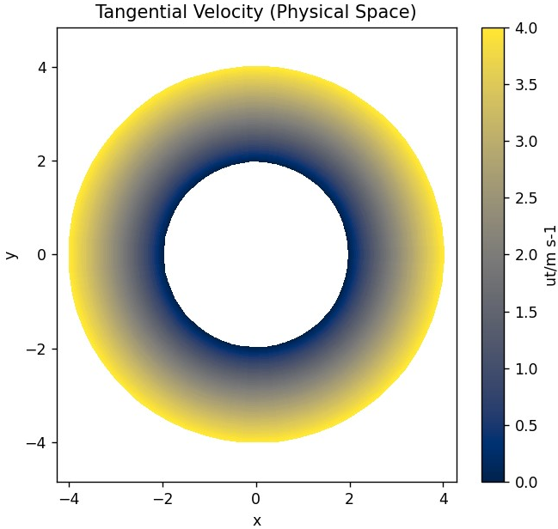
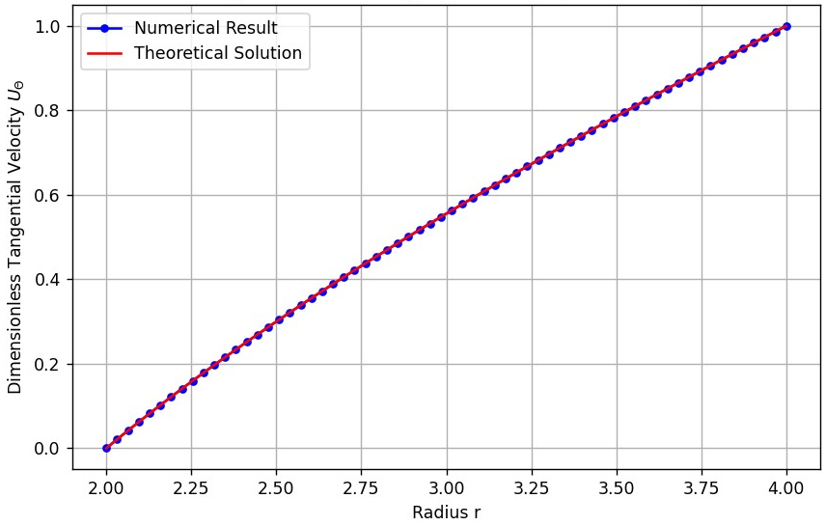

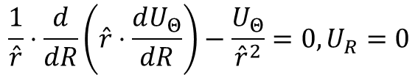


Debug 1D Result
Solves 1D Annular Coette (Dimensionless) Directly
$$\frac{1}{\hat{r}}⋅\frac{d}{dR}\left(\hat{r}⋅\frac{dU_{Θ}}{dR}\right)−\frac{U_{Θ}}{{\hat{r}}^{2}}=0,U_{R}=0$$
Tangential Only
to verify $U_{Θ}$ if FVM coefficient and De-dimensional Operation is correct
$$U_{Θ,TH}=\frac{c_{1}}{\hat{r}}+c_{2}\hat{r}$$
$$c_{1}=\frac{ΔRR_{s}}{R_{s}^{2}−R_{h}^{2}}$$
$$c_{2}=\frac{1}{ΔR}\frac{R_{s}R_{h}^{2}}{R_{s}^{2}−R_{h}^{2}}$$
Run at n=64 max_iter=50000 tol=1e-6 u_relax=0.3 p_relax=0.3

Slide 2
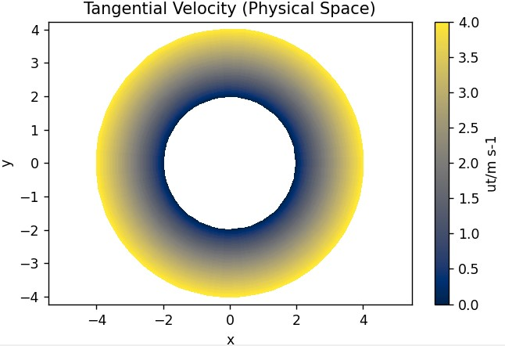
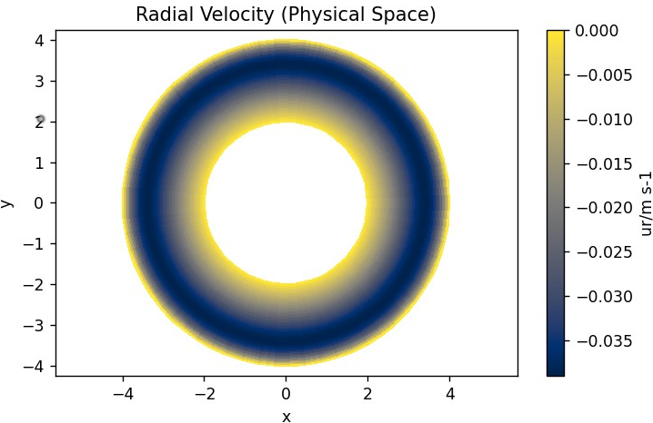
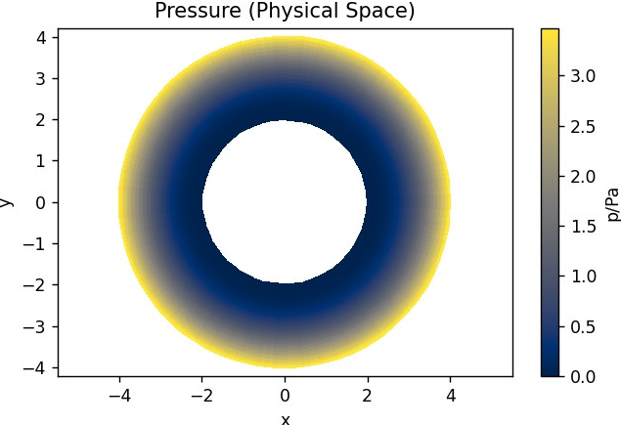
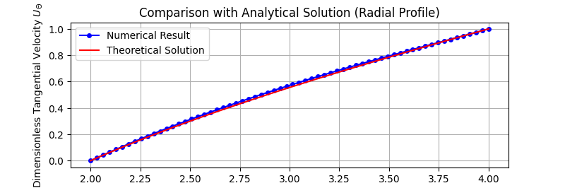




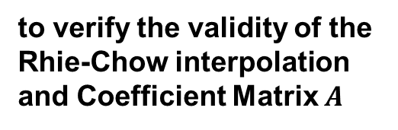

Debug 2D Result
Solves Annular Coette (Dimensionless) Momentum Equation under theoretical P
$$U=momentum\left(P_{TH}\right)$$
Momentum Only
to verify the validity of the Rhie-Chow interpolation and Coefficient Matrix $A$
$u_{R}$ Supposed to be 0
$$U_{Θ,TH}=\frac{c_{1}}{\hat{r}}+c_{2}\hat{r}$$
$$c_{1}=\frac{ΔRR_{s}}{R_{s}^{2}−R_{h}^{2}}$$
$$c_{2}=\frac{1}{ΔR}\frac{R_{s}R_{h}^{2}}{R_{s}^{2}−R_{h}^{2}}$$
Run at n=64 max_iter=50000 tol=1e-6 u_relax=0.3 p_relax=0.3

Slide 3

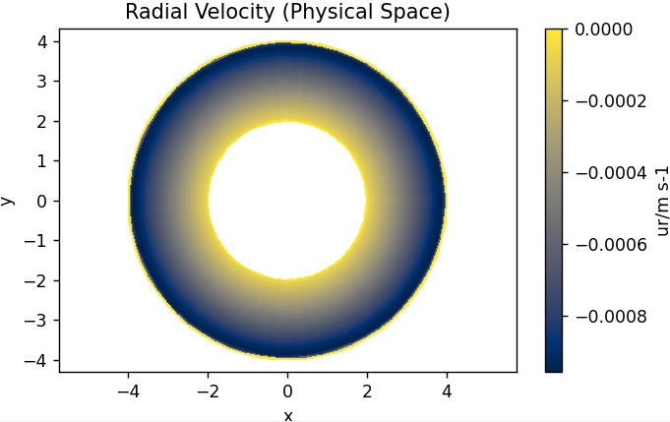
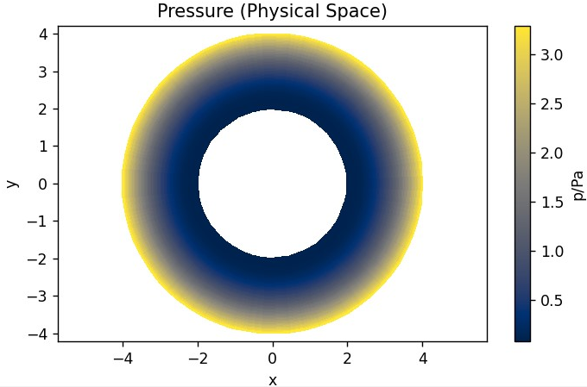
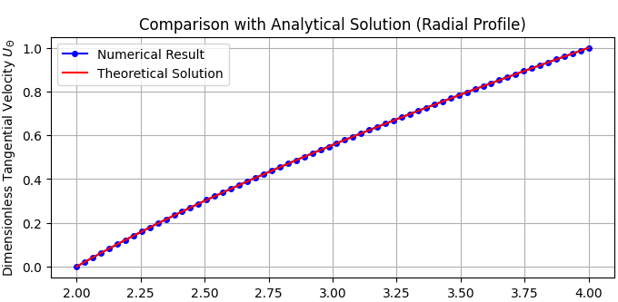




Debug 2P Result
Solves Annular Coette (Dimensionless) Momentum Equation under theoretical P
$$\tilde{U}=momentum\left(P_{TH}^{∗}\right)→P^{′}, U^{′}=pressure\left(\tilde{U}\right)→P=P_{TH}^{∗}+P^{′},U=\tilde{U}+U^{′}$$
Momentum + Pressure
to verify the validity of the whole DNS process, including the document and the script, except the solution of P’ Poisson eq.
$u_{R}$ Almost 0
$$U_{Θ,TH}=\frac{c_{1}}{\hat{r}}+c_{2}\hat{r}$$
$$c_{1}=\frac{ΔRR_{s}}{R_{s}^{2}−R_{h}^{2}}$$
$$c_{2}=\frac{1}{ΔR}\frac{R_{s}R_{h}^{2}}{R_{s}^{2}−R_{h}^{2}}$$
Run at n=64 max_iter=50000 tol=1e-6 u_relax=0.3 p_relax=0.3

Slide 4
Now, time for developing more powerful pressure update schemes

Slide 5
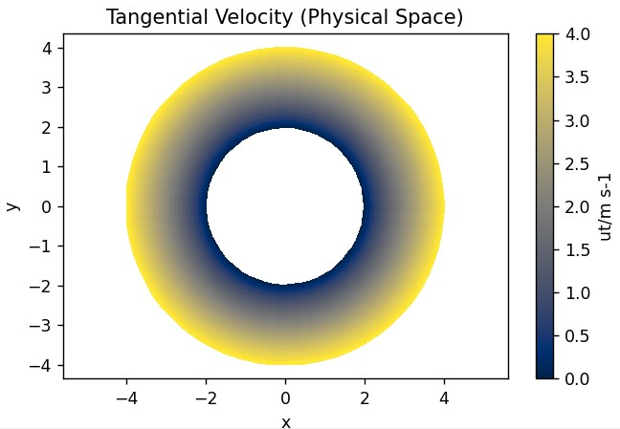
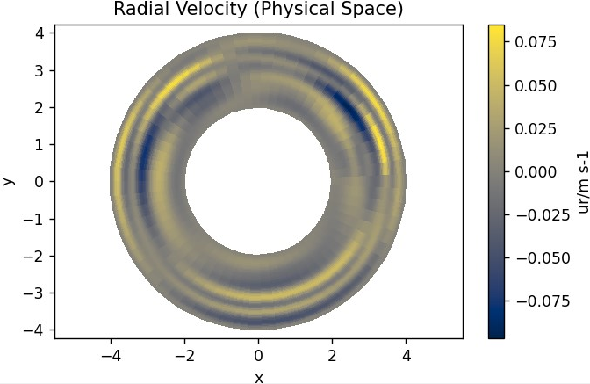
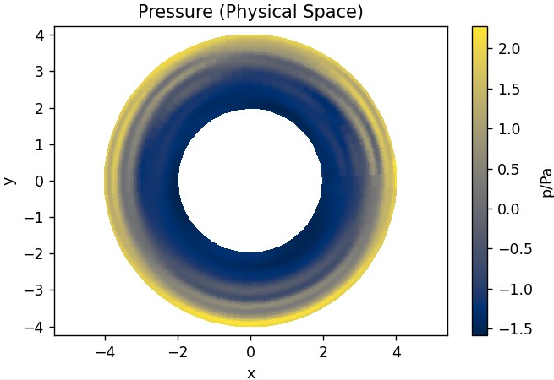
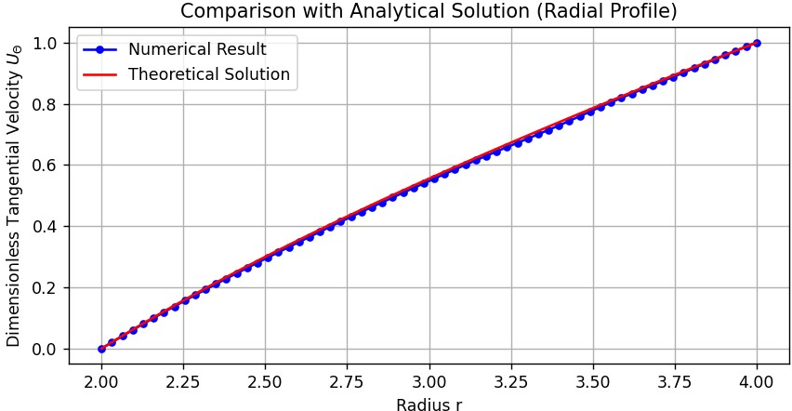



Formal Result: Jacobi Preconditioner + BiCG Pressure Solver
$$U_{Θ,TH}=\frac{c_{1}}{\hat{r}}+c_{2}\hat{r}$$
$$c_{1}=\frac{ΔRR_{s}}{R_{s}^{2}−R_{h}^{2}}$$
$$c_{2}=\frac{1}{ΔR}\frac{R_{s}R_{h}^{2}}{R_{s}^{2}−R_{h}^{2}}$$

Slide 6
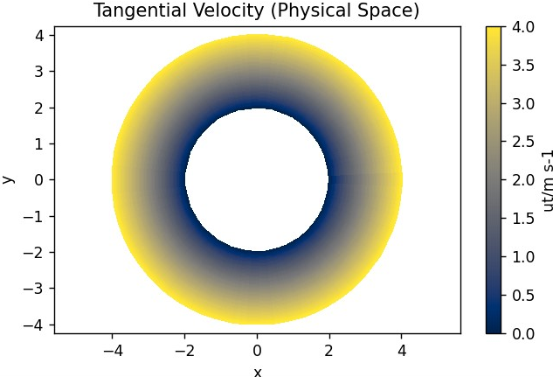
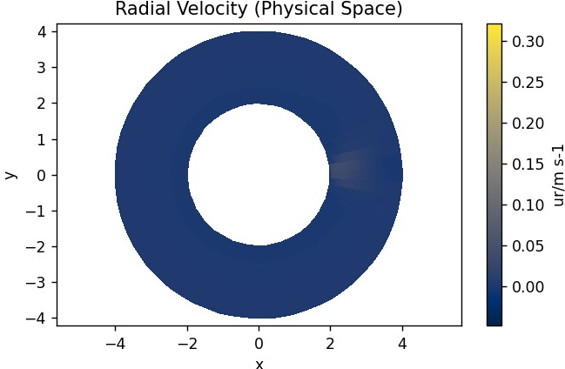
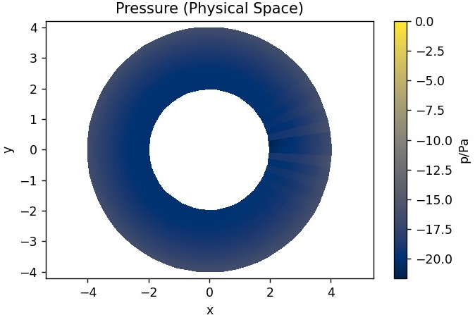
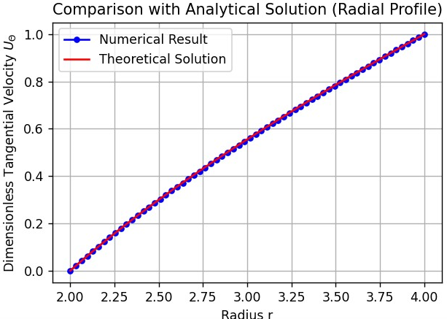
Formal Result: Jacobi Preconditioner + GMG Pressure Solver
Notes:
Due to in the Annular Coette Flow the pressure and velocities are decoupled, sometimes the pressure converge to a constant trivial solution.

