Slide 1



HOUSING SERVICE WEB APPLICATION
TEAM LEADER: Jenesha Malar S (22ADR043)
TEAM MEMBERS: Lokitha R (22ADR058)
Aishwariya SK (22ADR002)
PROJECT GUIDE:
Kayalvili S

Slide 2
PROBLEM STATEMENT
An important problem for homeowners is ineffective and inconsistent access to necessary house services such as plumbers, carpenters, painters, and electricians.
It's challenging to quickly locate reliable experts with the current solutions' lack of accessibility.
To properly handle these issues, a comprehensive digital solution that provides simple access to verified specialists, clear pricing, effective booking and tracking, and dependable customer service is desperately needed.

Slide 3
UNIQUE IDEA
The establishment of user accounts, service provider profile management, and a powerful location-based search functionality are all included.
It will function flawlessly on the web and Android devices, making usage widespread and straightforward.
The objective is to improve the effectiveness, dependability, and transparency of housing services by facilitating the connection between homeowners and dependable experts.

Slide 4
FEATURES OFFERED
Nearby Service Providers: Based on their location, users may quickly find local service providers including painters, carpenters, electricians, and plumbers.
Worker Updates: By allowing service providers to update their finished projects, users may follow their progress in real time and with transparency.

Slide 5
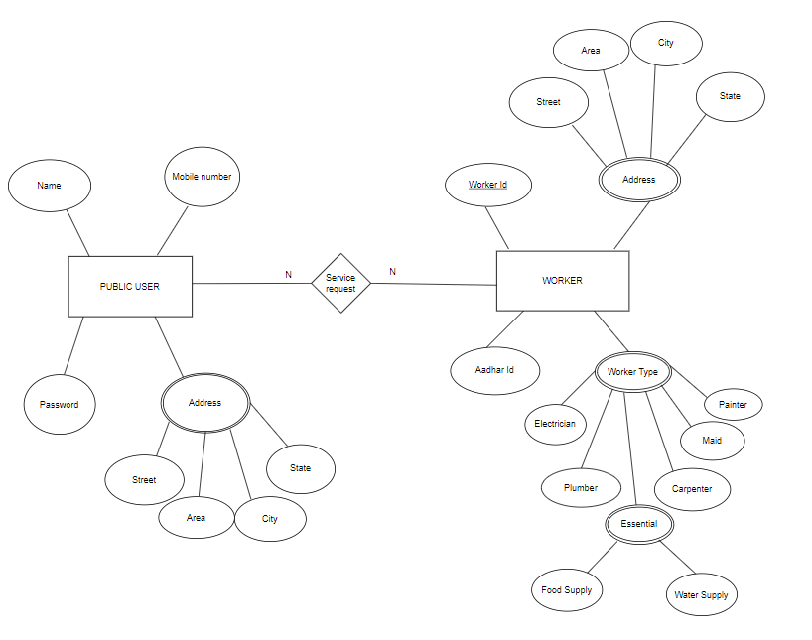
ARCHITECTURE DIAGRAM

Slide 6
TECHNOLOGIES USED
MongoDB: A NoSQL database with scalability and flexibility that stores data in documents like JSON.
Express.js: It is a Node.js online application framework that makes it easier to create reliable server-side apps and APIs.
React: It is a JavaScript user interface framework that is well-known for its effective rendering and component-based design.
Node.js: A JavaScript runtime environment that is frequently used to create server-side apps and APIs, allowing JavaScript code to be executed outside of a web browser.

Slide 7
TEAM CONTRIBUTION
We worked as a team on this project, with one team member handling the initial data collecting. We equally divided the project into modules and each member contributed to their assigned module.
Each team member contributed their own talents and knowledge to their assigned responsibilities, providing an extensive approach to growth.
Our mentor gave us invaluable assistance and direction during the process, which enabled us to overcome obstacles and maximize our solutions.
Our project objectives were successfully met thanks to the organized and cooperative approach that facilitated the effective development of our strong housing services application.

Slide 8
CONCLUSION
In conclusion, the creation of an Android or web-based application targeted at resolving typical housing service demands has effectively closed the communication gap between service providers and customers.
The software has shown to be successful in making necessary services like electricians, plumbers, carpenters, and painters more accessible, which has greatly increased users' convenience and productivity.
Furthermore, it has given service providers a stage on which to exhibit their abilities and grow their customers. In the housing services sector, this innovative approach has increased the standards for reliability and effectiveness.

