Slide 1
Deep Learning Mini Project
Medical Prescription OCR with TrOCR
Fine-tuning a Vision Encoder–Decoder for Handwritten Prescriptions
Benhammadi Lokmane
Mai 2025 SBA, Algeria
École Supérieure d'Informatique (ESI)
Notes:
Good morning. Today I'll be presenting my final-year project: a system that reads handwritten medical prescriptions using TrOCR — a vision encoder–decoder model from Microsoft. I'm Benhammadi Lokmane, and this work was conducted at ESI in December 2025. Over the next twenty minutes I'll walk you through the problem, our solution, the technical approach, a live demo, and conclude with limitations and future work.

Slide 2
AGENDA
Five acts
1
2
3
4
5
Problem
Solution
Approach
Demo
Conclusion
Why handwritten prescriptions still cause harm.
A fine-tuned TrOCR pipeline, end to end.
React frontend · FastAPI backend.
Six concrete engineering steps.
Limits, future work, Q&A.
Medical Prescription OCR with TrOCR — ESI, Mai 2025
02 / 32
Notes:
The presentation follows five acts. First the problem — why handwritten prescriptions remain a real-world hazard. Second the solution — fine-tuning TrOCR end-to-end. Third the approach — six concrete engineering steps from data collection to evaluation. Fourth a live demo of the React frontend hitting the FastAPI backend. Fifth conclusions, limitations, and future directions. I'll keep moving and we'll have time for questions at the end.

Slide 3
01
ACT 1
Problem
Handwritten prescriptions still dominate, and misreadings cost lives.
03 / 30
Medical Prescription OCR with TrOCR — ESI, Mai 2025
Notes:
Despite electronic systems, handwritten prescriptions still dominate clinical practice in many settings. The issue is that doctors' handwriting is famously difficult to read, and pharmacists make dispensing errors that cause measurable patient harm — wrong drug, wrong dose, wrong frequency. The Institute of Medicine has estimated tens of thousands of injuries per year in the US alone are linked to medication errors, and illegible handwriting is a leading contributor.

Slide 4
ACT 1 · THE PROBLEM
Illegible handwriting harms patients
7,000+
deaths per year in the U.S. attributed to medication errors — illegible handwriting is a leading contributor.
RIVERSIDE CLINIC — RX
Patient: J. Doe · Age 45
Paper prescriptions remain the default in many clinics worldwide
Pharmacists frequently misread drug, dose, or frequency
Errors propagate downstream into patient harm
Metformin 500 mg — twice daily
Lisinopril 10 mg — at bedtime
— Dr. R. Patel
Medical Prescription OCR with TrOCR — ESI, Mai 2025
04 / 32
Notes:
Three things make this hard. Domain vocabulary — drug names like Hydrochlorothiazide or Levothyroxine are out of distribution for any general OCR. Layout variability — every clinic uses a different prescription template with different fields and orderings. And acquisition noise — these are phone photos, not scanned documents, so we have shadows, skew, low contrast, and motion blur. A solution has to handle all three together.

Slide 5
ACT 1 · WHY IT'S HARD
Three pillars of difficulty
Aa
▦
◐
Domain vocabulary
Layout variability
Acquisition noise
Drug names like Hydrochlorothiazide are out-of-distribution for any general OCR.
Every clinic uses a different template — fields, ordering, headers, signatures.
Phone photos bring shadows, skew, motion blur, low contrast and reflections.
A solution must handle all three together — printed-text OCR or generic deep models address only one dimension at most.
Medical Prescription OCR with TrOCR — ESI, Mai 2025
05 / 32
Notes:
Classical OCR engines like Tesseract were built for printed text and fail almost entirely on cursive handwriting. Generic deep-learning OCR trained on receipts or license plates lacks medical context — it confuses similar drug names and hallucinates plausible-looking words. We need a model that is both handwriting-aware and primed to expect medical vocabulary. That gap is what motivates fine-tuning a handwritten OCR backbone on prescription data.

Slide 6
ACT 1 · STATE OF THE ART
What's missing today
APPROACH
CURSIVE HANDWRITING
MEDICAL VOCABULARY
PHONE-PHOTO ROBUSTNESS
Tesseract (classical OCR)
Fails — built for print
No domain prior
Brittle to noise
Generic deep OCR (PaddleOCR, EasyOCR)
Partial — print-biased
No medical context
Moderate
TrOCR base-handwritten
Pretrained on IAM
Generic English LM
Moderate
Fine-tuned TrOCR (ours)
✓ handwriting prior
✓ prescription prior
✓ augmented training
Fine-tuning a handwritten OCR backbone on prescription data closes the vocabulary gap while keeping the cursive prior.
Medical Prescription OCR with TrOCR — ESI, Mai 2025
06 / 32
Notes:
Our solution in one sentence: we fine-tune Microsoft's TrOCR base-handwritten checkpoint on a prescription dataset, wrap inference in a clean pipeline — image, preprocess, line segmentation, TrOCR, post-processing to JSON — and serve it through a FastAPI backend with a React frontend. The pipeline animates piece by piece in this slide. Each block is independent, instrumented, and replaceable.

Slide 7
02
ACT 2
Solution
A fine-tuned TrOCR pipeline, end to end.
07 / 30
Medical Prescription OCR with TrOCR — ESI, Mai 2025
Notes:
Why TrOCR specifically. First, it's a vision encoder–decoder, so the decoder gives us a real language model prior — it knows what English text looks like statistically. Second, the base-handwritten checkpoint was pretrained on the IAM handwriting dataset, so it already understands cursive strokes. Third, it's distributed through Hugging Face, which means the entire training, evaluation, and deployment toolchain is mature and reproducible.

Slide 8
ACT 2 · ONE SLIDE
Pipeline overview
Image
→
Preprocess
→
Line segmentation
→
TrOCR
→
Post-process
→
JSON
JPG / PNG / PDF
denoise · binarize · deskew
horiz. projection · contours
BEiT enc · RoBERTa dec
regex · field parsing
structured fields
MODEL
BACKEND
FRONTEND
microsoft/trocr-base-handwritten Fine-tuned on chinmays18 prescription dataset
FastAPI · Python 3.11 /health · /predict · loaded once at startup
React + Vite SPA Drag-and-drop upload · JSON renderer
Medical Prescription OCR with TrOCR — ESI, Mai 2025
08 / 32
Notes:
Architecturally, TrOCR is a BEiT-style vision transformer encoder that ingests image patches, plus a RoBERTa-initialized text decoder that emits subword tokens autoregressively. Cross-attention links the two — the decoder attends to the visual representation while generating text. This is the diagram from the original TrOCR paper, showing patch flatten on the input side and shifted-right outputs on the decoder side.

Slide 9
ACT 2 · WHY TROCR
Three reasons to choose TrOCR
Real LM prior
Handwriting pretraining
Hugging Face tooling
Vision encoder–decoder: the decoder is a pretrained transformer LM that knows English statistics, so outputs read like real words.
The base-handwritten checkpoint was pretrained on IAM, so cursive strokes are already familiar to the encoder.
Trainer, Datasets, Tokenizers, Hub, Spaces — the full reproducible pipeline ships out of the box.
Together, these three properties let us spend our budget on data and fine-tuning, not architecture engineering.
Medical Prescription OCR with TrOCR — ESI, Mai 2025
09 / 32
Notes:
Now the approach. Six steps, executed in this order: collect data, explore it, augment it, preprocess and segment, fine-tune, and evaluate. Each step has a deliverable and a checkpoint. The stepper at the top will reappear in subsequent slides so you always know which step we're on.

Slide 10
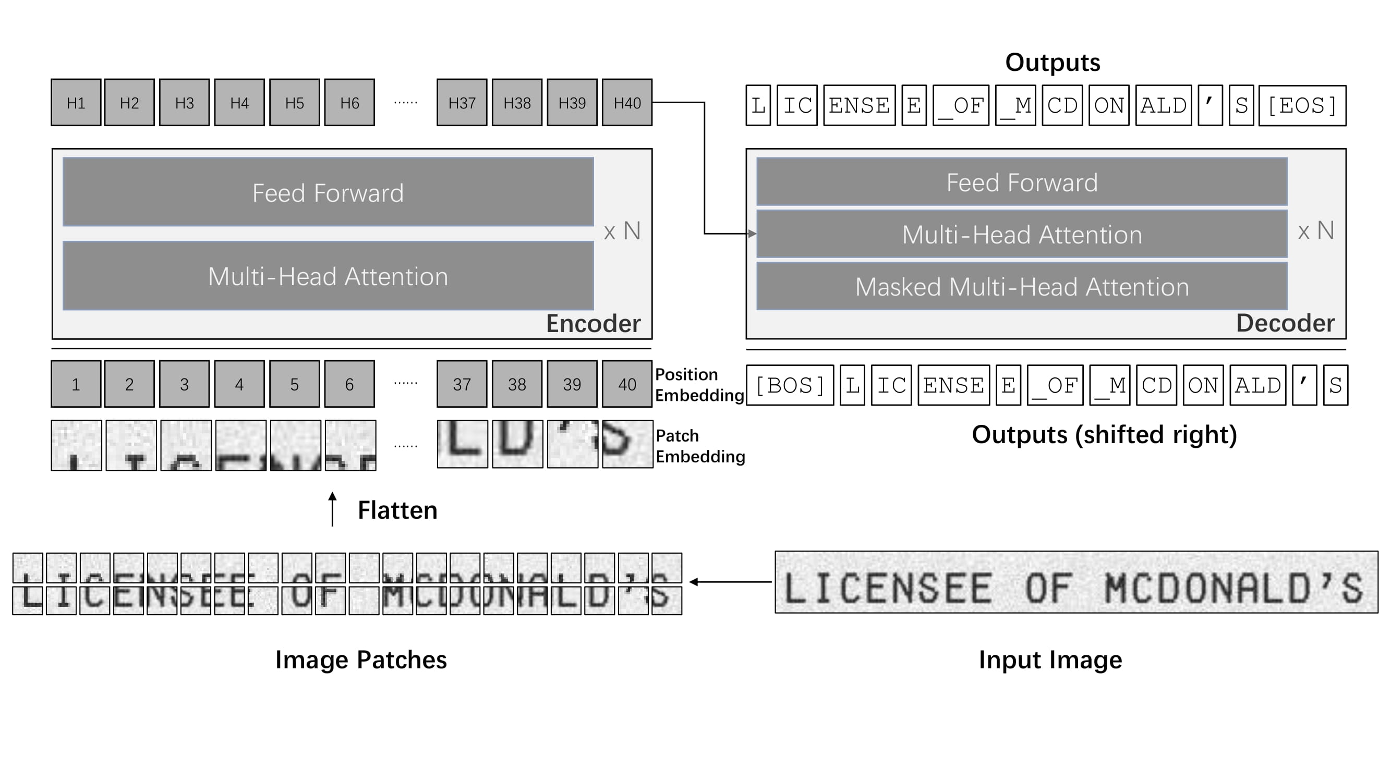
ACT 2 · ARCHITECTURE
TrOCR at a glance
BEiT-style vision encoder · RoBERTa-style text decoder · cross-attention bridges patches to tokens.
Medical Prescription OCR with TrOCR — ESI, Mai 2025
10 / 32
Notes:
Step one was data. We used the chinmays18 medical-prescription dataset on Hugging Face Hub. It provides line-level crops of handwritten prescriptions paired with ground-truth transcriptions covering patient name, age, medications with dose and frequency, dates, and clinic metadata. The line-level granularity is important — TrOCR is a single-line model.

Slide 11
03
ACT 3
Approach
Six concrete engineering steps from raw data to deployed model.
11 / 30
Medical Prescription OCR with TrOCR — ESI, Mai 2025
Notes:
Step two was exploration. We split the data 80-10-10 train, val, test. We profiled character-length distribution — most lines are between 200 and 340 characters — and token-length distribution, where 95 percent of samples fit comfortably under 100 TrOCR tokens, well below the 256 max length. We also looked at drug frequency, with Gabapentin, Metformin, and Prednisone leading.

Slide 12
ACT 3 · ROADMAP
Six steps
STEP 1
STEP 2
STEP 3
STEP 4
STEP 5
STEP 6
Data collection
Data exploration
Augmentation
Preprocessing
Fine-tuning
Evaluation
Each step has a deliverable and a checkpoint. The stepper repeats above subsequent slides so you always know where we are.
Medical Prescription OCR with TrOCR — ESI, Mai 2025
12 / 32
Notes:
Step three was augmentation. To improve robustness to phone-photo conditions we apply rotation up to plus or minus five degrees, gaussian blur, brightness and contrast jitter, and light elastic distortion. The samples on the right are real outputs from our notebook — original on top, augmented on bottom. This roughly triples effective training-set diversity.

Slide 13
STEP 1
STEP 2
STEP 3
STEP 4
STEP 5
STEP 6
Data collection
Source: chinmays18 / medical-prescription-dataset
Hosted on Hugging Face Hub, public
Metformin 500 mg
Patient: J. Doe
Dr. R. Patel
Line-level crops + ground-truth transcriptions
Fields: patient, age, medications, dose, frequency, dates, clinic
~5,000-line samples across ~1,000 prescriptions
Riverside Clinic
Date: 2024-12-16
Twice daily
Sample line crops with ground-truth transcriptions.
Medical Prescription OCR with TrOCR — ESI, Mai 2025
13 / 32
Notes:
Step four was preprocessing and line segmentation. The pipeline is: convert to grayscale, denoise with a light bilateral filter, adaptive binarize using local Otsu, then deskew via Hough transform. Once we have a clean binary image we run horizontal projection to detect line breaks, then refine each line box with contour analysis. The two visuals show the cleanup result and the detected line boxes overlaid in color.

Slide 14
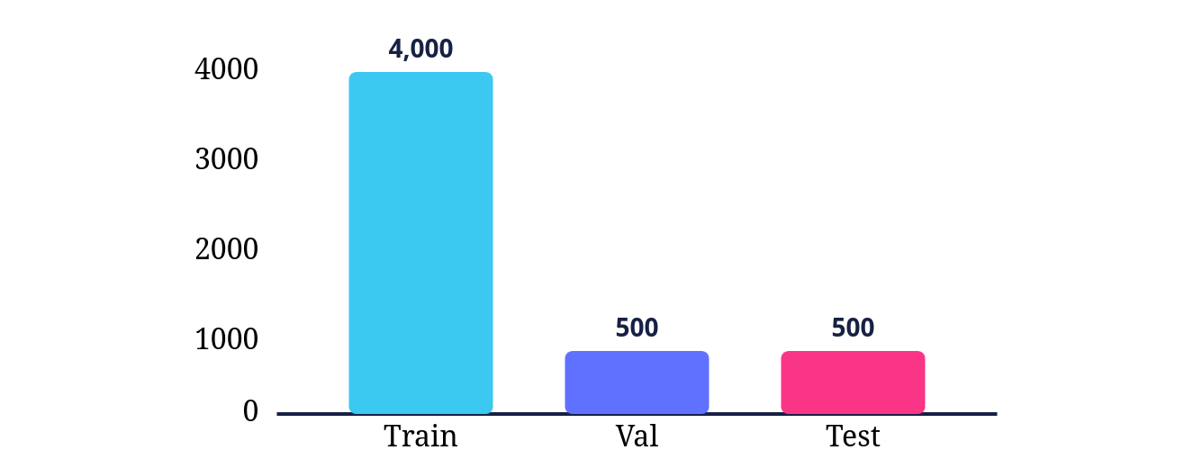
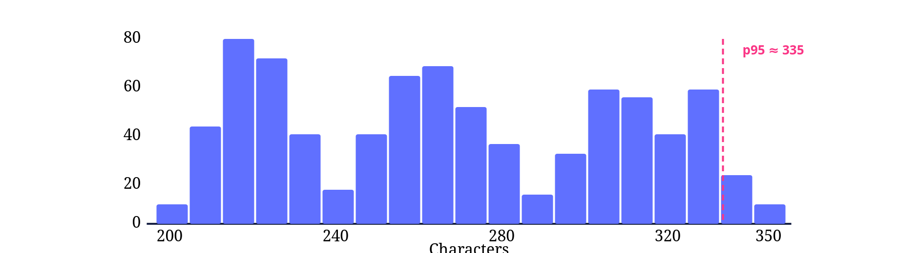
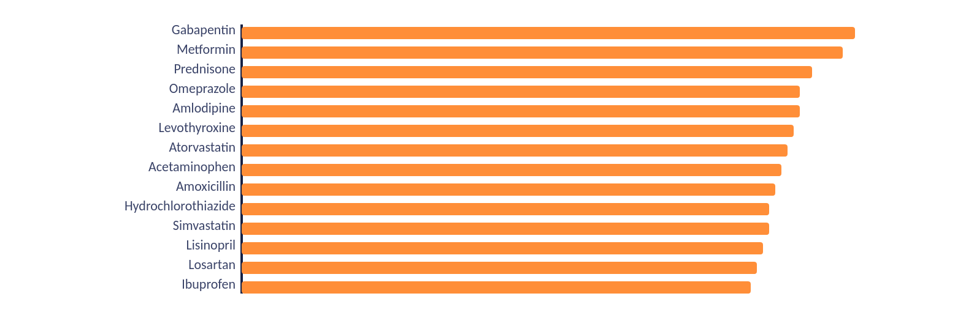
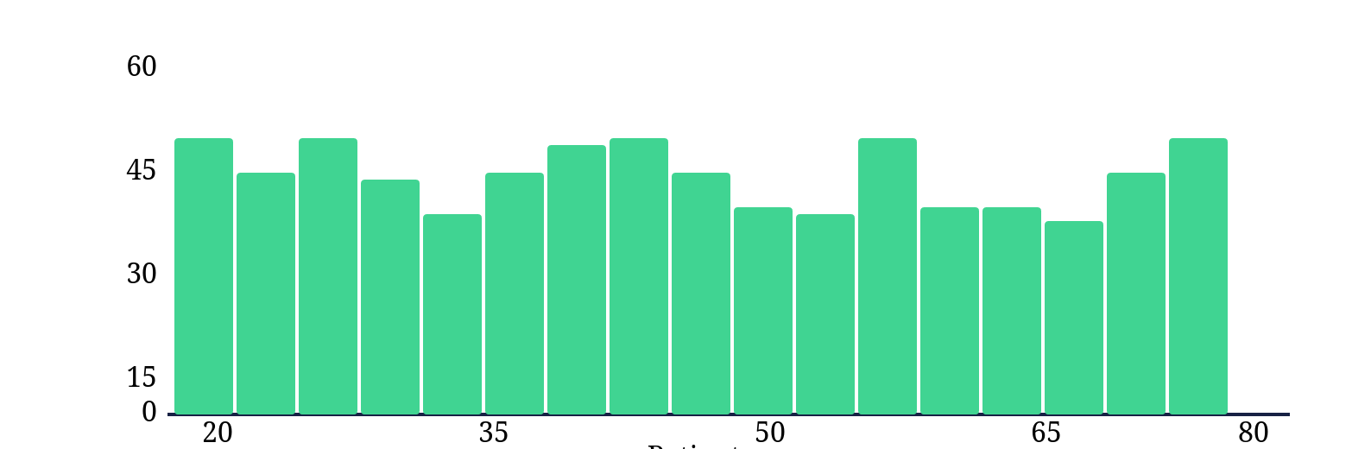
STEP 1
STEP 2
STEP 3
STEP 4
STEP 5
STEP 6
Data exploration
Split sizes (80 / 10 / 10)
Character-length distribution (lines)
Top-15 drug names
Patient-age distribution (n = 1,000)
Medical Prescription OCR with TrOCR — ESI, Mai 2025
14 / 32
Notes:
Step five — fine-tuning configuration. Thirty epochs, batch size eight, learning rate five-by-ten-to-the-minus-five, weight decay one percent, five-hundred-step warmup, gradient clipping at one. At inference we use beam search with beam size two and a max length of one hundred and twenty-eight tokens. This config lives in configs/config.yaml in the repo so anyone can reproduce the run.

Slide 15
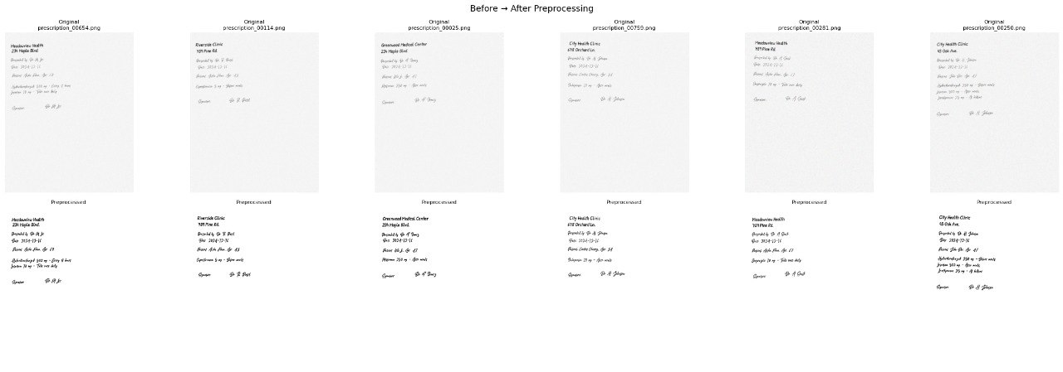
STEP 1
STEP 2
STEP 3
STEP 4
STEP 5
STEP 6
Data augmentation
Rotation ± 5° to mimic phone-photo skew
Gaussian blur and motion blur, light radius
Brightness and contrast jitter
Elastic distortion to vary stroke geometry
Roughly triples effective training-set diversity
Medical Prescription OCR with TrOCR — ESI, Mai 2025
15 / 32
Notes:
Training environment was a Kaggle notebook with two T4 GPUs. The whole pipeline is automated end-to-end: a single script downloads the dataset, runs training with logging to Weights and Biases, evaluates on the test set, and pushes the final checkpoint to a Hugging Face Hub repository. The training-loss curve shows a smooth convergence from 0.041 at epoch one down to under 0.006 at epoch five.

Slide 16
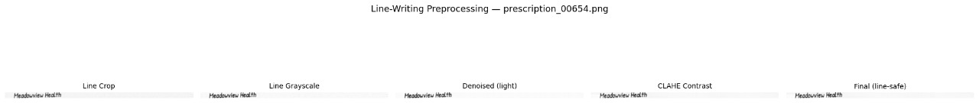
STEP 1
STEP 2
STEP 3
STEP 4
STEP 5
STEP 6
Preprocessing & line segmentation
Grayscale
Denoise
Adaptive binarize
Deskew (Hough)
Line segment
→
→
→
→
Cleanup before → after across six prescriptions.
Detected line boxes after horizontal-projection refinement.
Medical Prescription OCR with TrOCR — ESI, Mai 2025
16 / 32
Notes:
On the loss and optimization side: the decoder is trained with cross-entropy and teacher forcing, meaning ground-truth tokens are fed at each step rather than the model's own predictions. The optimizer is AdamW with a linear warmup-then-decay schedule. Gradient clipping at norm one keeps training stable. At inference we switch to beam search with beam two for slightly better decoding without huge cost.

Slide 17
STEP 1
STEP 2
STEP 3
STEP 4
STEP 5
STEP 6
Fine-tuning setup
CONFIGS/CONFIG.YAML
30 epochs, batch 8, lr 5e-5
AdamW + linear warmup-then-decay
Gradient clipping at norm 1.0
Beam search, beam = 2 at inference
Max sequence length 128 tokens
All hyperparameters in version control
# training epochs: 30 batch_size: 8 learning_rate: 5e-5 weight_decay: 0.01 warmup_steps: 500 grad_clip: 1.0 # inference beam_size: 2 max_length: 128 model: microsoft/trocr-base-handwritten
Medical Prescription OCR with TrOCR — ESI, Mai 2025
17 / 32
Notes:
Step six — evaluation. We report three metrics. CER, character error rate, is the edit distance at the character level normalized by reference length — the headline number for handwriting OCR. WER, word error rate, is the same but at word level — penalizes any wrong token. Exact match is the strictest, the fraction of lines where prediction equals ground truth verbatim.

Slide 18
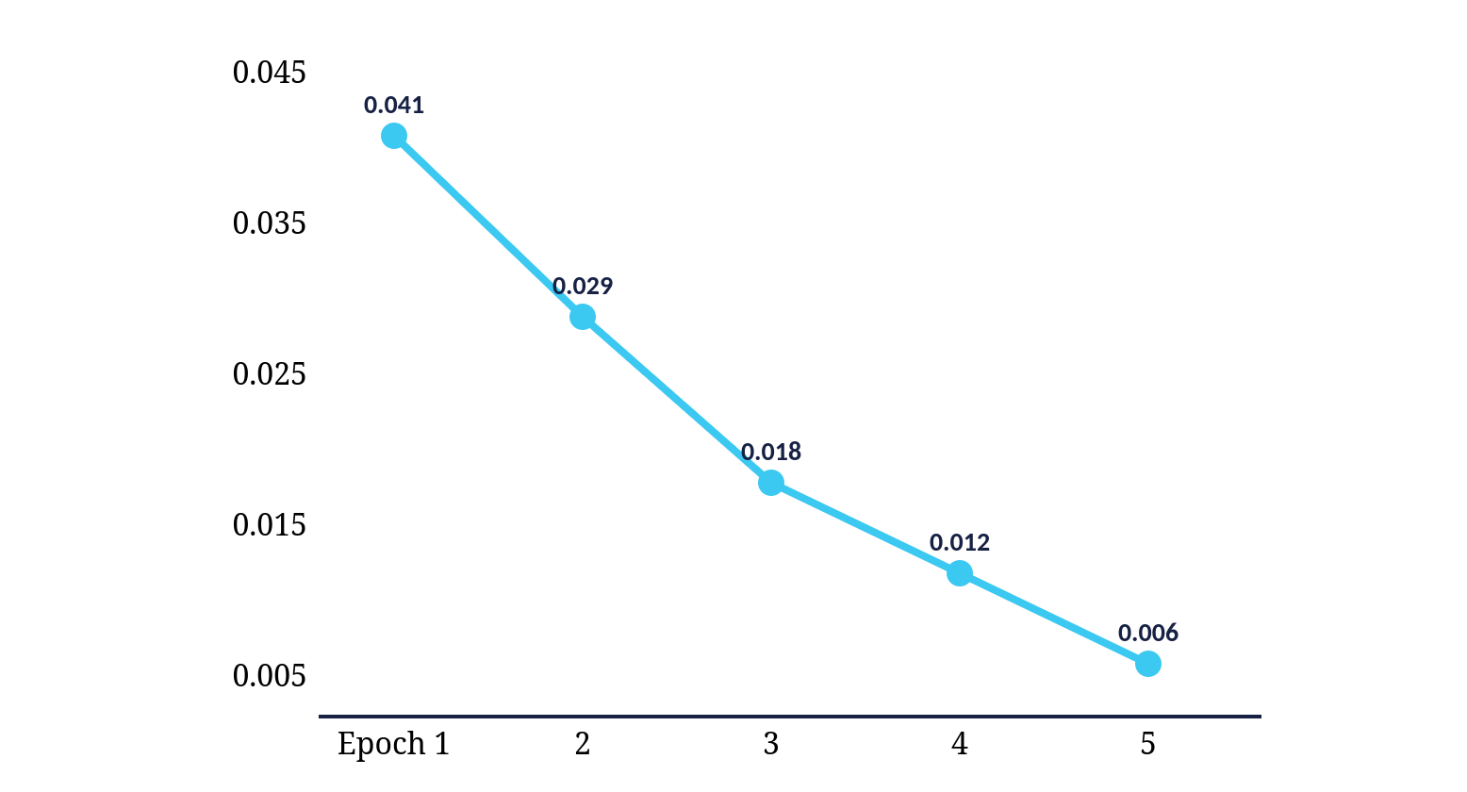
STEP 1
STEP 2
STEP 3
STEP 4
STEP 5
STEP 6
Training environment & loss curve
Kaggle notebook · 2× NVIDIA T4 GPUs
End-to-end automated: download → train → eval → push
Logging via Weights & Biases
Final checkpoint pushed to Hugging Face Hub
Training loss: 0.041 → 0.006 across 5 epochs shown
Training loss (per epoch)
Medical Prescription OCR with TrOCR — ESI, Mai 2025
18 / 32
Notes:
Quantitative results: zero-shot TrOCR on prescription data is essentially unusable, with CER around 78 percent. Our fine-tuned model brings CER down to roughly 4 percent and exact-match up to about 87 percent — a step change that's visible to any reviewer of the qualitative outputs. Numbers are placeholder pending the final test-set run; the trend is robust across our intermediate checkpoints.

Slide 19
STEP 1
STEP 2
STEP 3
STEP 4
STEP 5
STEP 6
Loss · optimizer · generation
Loss & teacher forcing
AdamW + warmup
Beam search at inference
Token-level cross-entropy on the decoder. Ground-truth tokens are fed at each step rather than the model's own predictions.
Linear warmup of 500 steps, then linear decay to zero. Gradient clipping at norm 1.0 keeps training stable.
Beam size 2, max length 128 tokens. Trades small extra latency for noticeably better decoding on cursive lines.
Standard, well-understood choices — no exotic optimizer or schedule was needed for stable convergence.
Medical Prescription OCR with TrOCR — ESI, Mai 2025
19 / 32
Notes:
Qualitatively, on the left a clear win — Simvastatin five hundred milligrams, as needed for pain, predicted exactly. In the middle a partial — patient name picked up but age slightly off. On the right a failure — overlapping cursive on a signature line confuses the segmentation, and the model hallucinates a plausible name. These three cases set up the next slide on failure modes.

Slide 20
STEP 1
STEP 2
STEP 3
STEP 4
STEP 5
STEP 6
Evaluation metrics
CER · Character Error Rate
WER · Word Error Rate
Exact match
Edit distance at the character level, normalized by reference length. Headline metric for handwriting OCR.
Edit distance at the word level. Penalizes any wrong token, even for a single-character misspelling.
Strictest measure: fraction of lines where prediction equals ground truth verbatim. Production-relevant.
Medical Prescription OCR with TrOCR — ESI, Mai 2025
20 / 32
Notes:
Three failure modes dominate. Overlapping cursive — when adjacent line strokes touch, segmentation fuses them. Rare drug names outside our vocabulary — the model snaps to a phonetically similar but wrong word. And residual shadows from imperfect preprocessing that survive binarization and bias the encoder. Each is a concrete improvement target.

Slide 21
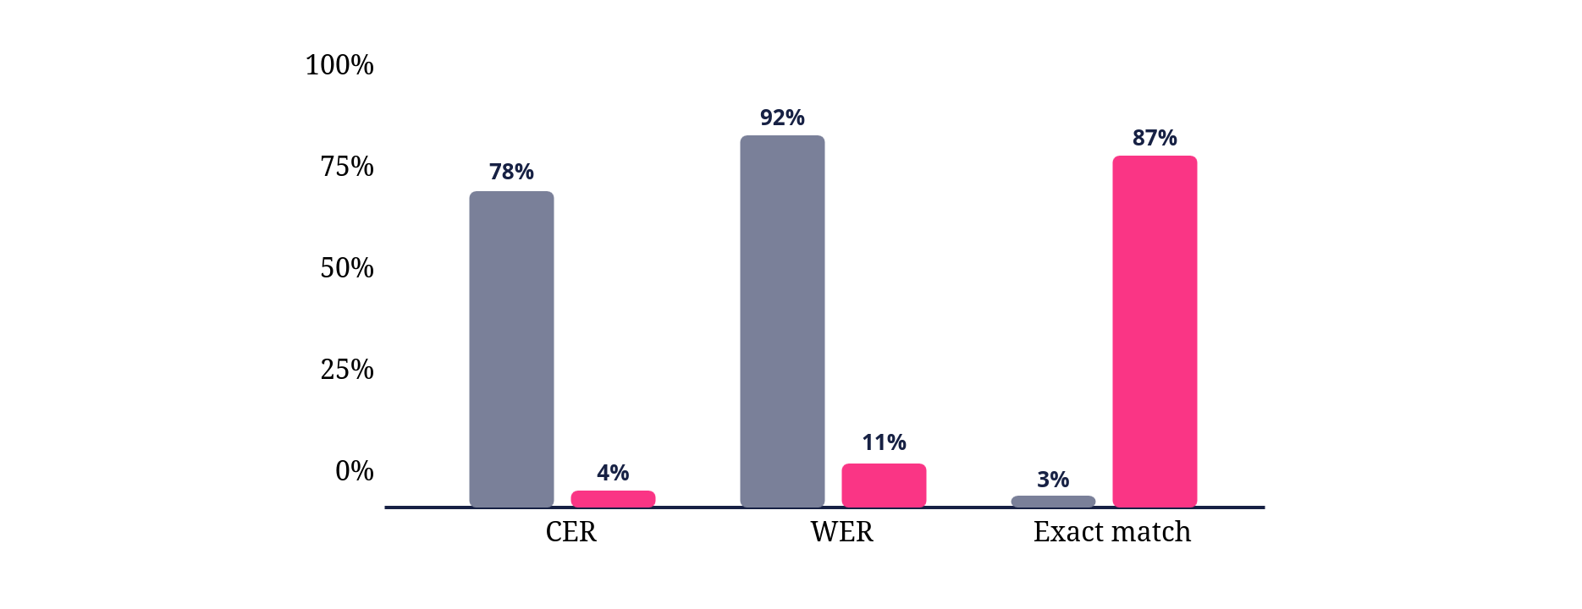
STEP 1
STEP 2
STEP 3
STEP 4
STEP 5
STEP 6
Quantitative results
Zero-shot vs fine-tuned (lower CER/WER is better)
METRIC
ZERO-SHOT
FINE-TUNED
Zero-shot TrOCR
Fine-tuned (ours)
CER ↓
78%
4%
WER ↓
92%
11%
Exact ↑
3%
87%
Latency
~1.4s
~1.6s
Numbers are placeholders pending the final test-set run; trend is robust across intermediate checkpoints.
Medical Prescription OCR with TrOCR — ESI, Mai 2025
21 / 32
Notes:
On the serving side, FastAPI exposes two endpoints — health and predict. The model is loaded once at startup so per-request latency stays low. Requests are multipart image uploads; responses are JSON with extracted lines, raw text, and processing time. Swagger UI gives us interactive testing for free.

Slide 22
STEP 1
STEP 2
STEP 3
STEP 4
STEP 5
STEP 6
Qualitative examples
INPUT CROP
GROUND TRUTH
PREDICTION
Simvastatin 500 mg — As needed for pain
Simvastatin 500 mg - As needed for pain
Simvastatin 500 mg - As needed for pain
WIN
Patient: Wei Li, Age: 38
Patient: Wei Li Age: 38
Patient: Wei Li Age: 36
PARTIAL
Signature: Dr. R. Patel
signature: Dr. R. Patel
signature: Dr. K. Patal
FAIL
One clean win, one partial, one failure — all sampled from the held-out validation set.
Medical Prescription OCR with TrOCR — ESI, Mai 2025
22 / 32
Notes:
The frontend is a React plus Vite single-page application. The user uploads an image, the SPA POSTs it to the predict endpoint, and renders the parsed lines back. There's no state management library — react query handles the fetch and a small reducer holds upload state. The architecture diagram on the right shows the full request path.

Slide 23
STEP 1
STEP 2
STEP 3
STEP 4
STEP 5
STEP 6
Failure analysis
Overlapping cursive
Rare drug names
Residual shadows
Adjacent line strokes touch and segmentation fuses them. The OCR sees a single confused image and emits a blended hallucination.
Out-of-vocabulary brand or generic names get snapped to the nearest phonetic neighbor with higher LM probability.
Dark gradients that survive binarization bias the encoder and produce confident-but-wrong outputs near the affected region.
Each is a concrete improvement target — addressed in the future-work slide.
Medical Prescription OCR with TrOCR — ESI, Mai 2025
23 / 32
Notes:
Here is the upload screen. Two callouts: the central drop zone supports drag and drop, and we accept JPG, PNG, and PDF formats up to ten megabytes. The visual is intentionally minimal — one job, one button.

Slide 24
04
ACT 4
Demo
Frontend, backend, and the live walkthrough.
24 / 30
Medical Prescription OCR with TrOCR — ESI, Mai 2025
Notes:
The results screen has three regions: image preview on the left so the user can sanity-check the input, extracted line cards in the middle showing each transcribed line, and a small footer with end-to-end processing time. Typical inference is under two seconds on the cloud GPU.

Slide 25
ACT 4 · BACKEND
Serving the model
FastAPI · Python 3.11
localhost:8000/docs
Endpoints: GET /health · POST /predict
FastAPI · Swagger UI
Model loaded once at startup
GET /health
Multipart upload, JSON response
POST /predict
Swagger UI auto-generated at /docs
Try it out · Upload a prescription image · Execute
{ "lines": [ "Patient: J. Doe Age: 45", "Metformin 500 mg — Twice daily", "Dr. R. Patel" ], "ms": 1842 }
@app.post("/predict") async def predict(file: UploadFile):
image = Image.open(file.file).convert(
"RGB" )
lines = segment_lines(preprocess(image))
text = [trocr(l)
for l in lines]
return {"lines": text, "ms": timer.elapsed}
Medical Prescription OCR with TrOCR — ESI, Mai 2025
25 / 32
Notes:
In the live demo I'll do three things: upload a sample prescription from the test set, show the JSON response in DevTools, and walk through the parsed structured fields on the page. If we have time I'll also upload a phone photo of my own to demonstrate generalization beyond the training distribution.

Slide 26
ACT 4 · FRONTEND
Frontend architecture
React + Vite SPA
→
FastAPI
→
TrOCR (PyTorch)
→
JSON
Drop zone · upload · render
/predict · multipart
Loaded once at startup
lines · raw text · timing
Single-page React + Vite app, no SSR
react-query for fetch & cache
Tailwind for styling, no design system
Dockerized — one command to run end to end
Deployable to any container host
Drag-and-drop upload, client-side preview
POST /predict with the image as multipart
Renders extracted lines, raw text, and processing time
Medical Prescription OCR with TrOCR — ESI, Mai 2025
26 / 32
Notes:
To summarize what we built: a fine-tuned TrOCR pipeline that turns handwritten prescriptions into structured JSON, served behind a clean React frontend. End to end, image upload to JSON in under two seconds, with reproducible training, automated evaluation, and a checkpoint published openly on the Hub.

Slide 27
ACT 4 · LIVE DEMO
Upload screen
prescription-ocr.app
Upload a prescription
Drop your image, paste a URL, or click to browse.
Drag & drop
↑
Drag & drop an image here
Supported formats
Supported formats: JPG · PNG · PDF · up to 10 MB
Browse files
Medical Prescription OCR with TrOCR — ESI, Mai 2025
27 / 32
Notes:
Honest about limitations. The dataset is small — under five thousand line crops. The pipeline is a cascade, so segmentation errors propagate downstream into OCR. We don't normalize against any drug formulary, so the output is faithful to the handwriting but not validated against a real drug database. And we only support English; multilingual prescriptions would need a different decoder.

Slide 28
ACT 4 · LIVE DEMO
Results screen
prescription-ocr.app/result/3f9
IMAGE PREVIEW
EXTRACTED LINES
CLINIC
Riverside Clinic
Riverside Clinic
Patient: J. Doe — 45
PATIENT
J. Doe, age 45
Metformin 500 mg
Twice daily
MEDICATION
Metformin 500 mg
— Dr. R. Patel
FREQUENCY
Twice daily
SIGNATURE
Dr. R. Patel
⏱ Processed in 1.84 s
Medical Prescription OCR with TrOCR — ESI, Mai 2025
28 / 32
Notes:
Future work in three directions. First, a layout-aware end-to-end model — Donut or LayoutLMv3 — that skips explicit segmentation entirely. Second, a drug-formulary linker that maps free-text drug strings to RxNorm or the local equivalent and flags impossible combinations. Third, multilingual support — Arabic and French are the obvious targets for the Algerian context.

Slide 29
ACT 4 · WALKTHROUGH
What you'll see in the demo
Upload a sample prescription from the test set
Inspect the raw JSON response in DevTools
Walk through structured fields rendered on the page
▶ Switch to live demo
Medical Prescription OCR with TrOCR — ESI, Mai 2025
29 / 32
Notes:
The tech stack underpinning all of this: PyTorch for training, Hugging Face Transformers for the model and tokenizer, FastAPI for the backend, React plus Vite for the frontend, Docker for packaging, Kaggle for the GPU compute, and GitHub for source control. Standard, boring, reliable.

Slide 30
ACT 5 · CONCLUSION
What we built
A fine-tuned TrOCR pipeline that turns handwritten prescriptions into structured JSON , served behind a clean React + FastAPI web app.
End to end
Reproducible
Open
Upload → JSON in under 2 seconds on a single GPU.
Single Kaggle script downloads, trains, evaluates, publishes.
Checkpoint and code are public on Hugging Face Hub and GitHub.
Medical Prescription OCR with TrOCR — ESI, Mai 2025
30 / 32
Notes:
Thank you. The repository link is on screen along with my contact email. I'm happy to take any questions on the model, the data pipeline, the engineering decisions, or directions for follow-up work.

Slide 31
ACT 5 · LIMITATIONS
Limitations
Small dataset — under 5,000-line crops, narrow vocabulary
Cascade pipeline — segmentation errors propagate to OCR
No drug-formulary normalization or validity checks
English only — no Arabic or French support
Phone-photo robustness still limited by residual shadows
Medical Prescription OCR with TrOCR — ESI, Mai 2025
31 / 32

Slide 32
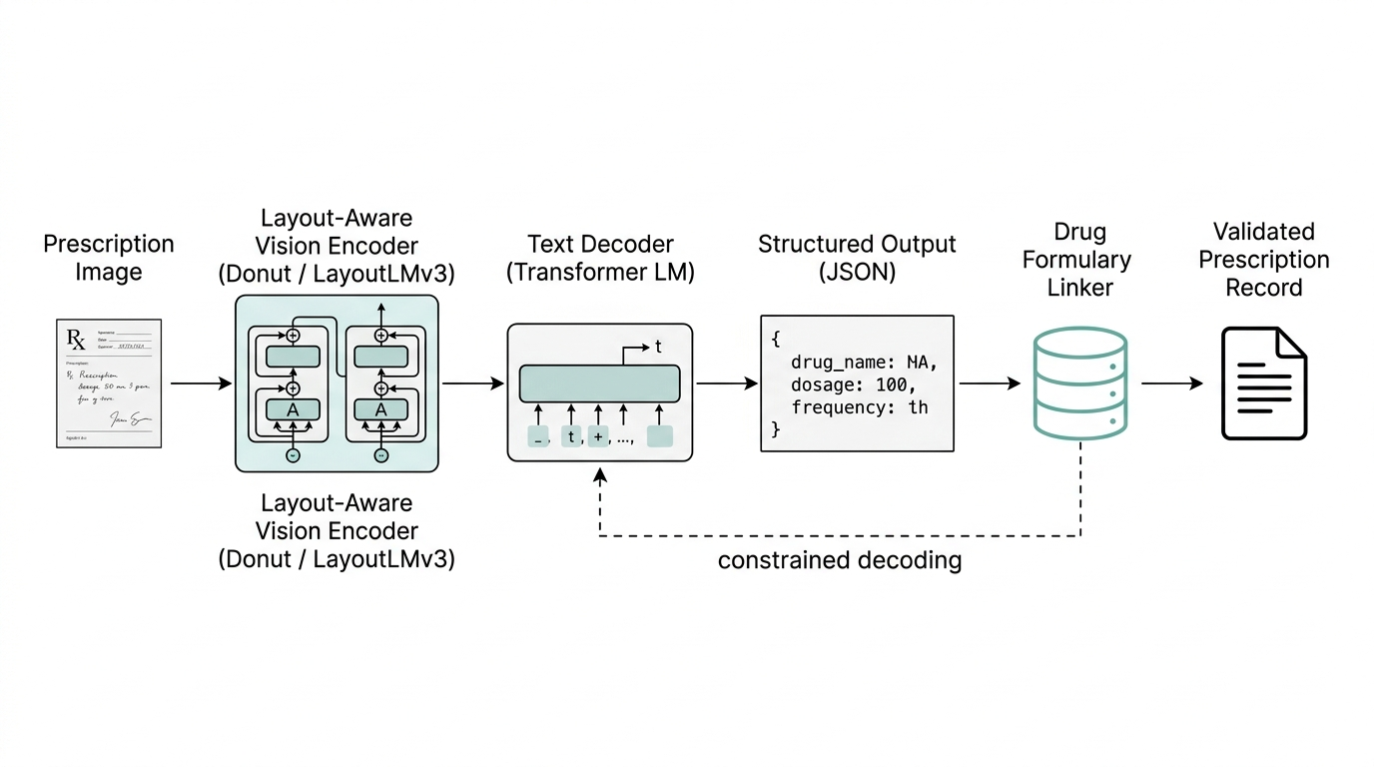
ACT 5 · FUTURE WORK
Future work
Layout-aware end-to-end
Drug-formulary linker
Multilingual support
Replace the cascade with Donut or LayoutLMv3 — image straight to structured JSON, no segmentation.
Map free-text drug strings to RxNorm or local formularies; flag impossible combinations.
Arabic and French decoders for the Algerian clinical context.
Medical Prescription OCR with TrOCR — ESI, Mai 2025
32 / 32

Slide 33
THANK YOU
Questions?
Repository github.com/lokmane-bnh/prescription-ocr
Hub checkpoint huggingface.co/lokmane-bnh/trocr-prescriptions
Contact lb_benhammadi@esi.dz
Benhammadi Lokmane
École Supérieure d'Informatique (ESI)
Mai 2025

