Slide 1
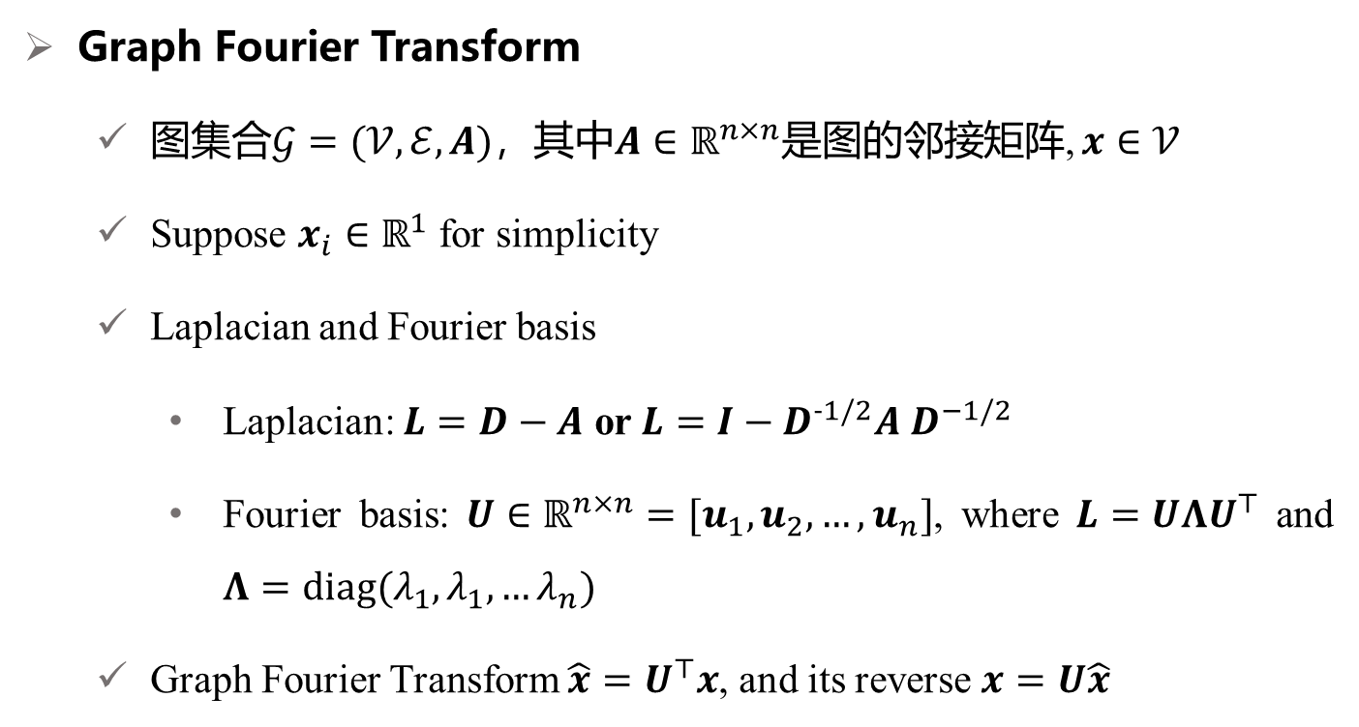
回顾图卷积
Graph Fourier Transform
图集合$𝒢=(𝒱,ℰ,A)$，其中$A∈ℝ^{n×n}$是图的邻接矩阵, $x∈𝒱$
Suppose $x_{i}∈ℝ^{1}$ for simplicity
Laplacian and Fourier basis
Laplacian: $L=D−A$ or $L=I−D^{−1/2}A$ $D^{−1/2}$
Fourier basis: $U∈ℝ^{n×n}=[u_{1},u_{2},…,u_{n}]$, where $L=UΛU^{⊤}$ and $Λ=diag(λ_{1},λ_{1},…λ_{n})$
Graph Fourier Transform $\hat{x}=U^{⊤}x$, and its reverse $x=U\hat{x}$
Defferrard, Michaël, Xavier Bresson, and Pierre Vandergheynst. "Convolutional neural networks on graphs with fast localized spectral filtering." Advances in neural information processing systems 29 (2016).
Notes:
Someone may want to ask what salient object detection means and how to define the salient object. The saliency detection is to find clear foreground objects that are significantly different from the surrounding background in the image. The differences can be reflected in the color, texture and object shape. Let‘s see the first row in the figure. The input of the salient object detection is a digitized image and the output is a saliency probability map as in the second row. Each pixel of the input image has a calculated probability value in the probability map. The probability value is bigger, the probability is
higher that the pixel belongs to the salient object. Otherwise , if the probability value is small, it indicates a higher probability that the pixel belongs to the background. Generally, in the practical application, we apply a constant value in the probability map to separate the salient object from the input image. Just like the third row in the figure. Salient object detection can be used in many fields, like visual tracking, video matting and robot navigation.

Slide 2
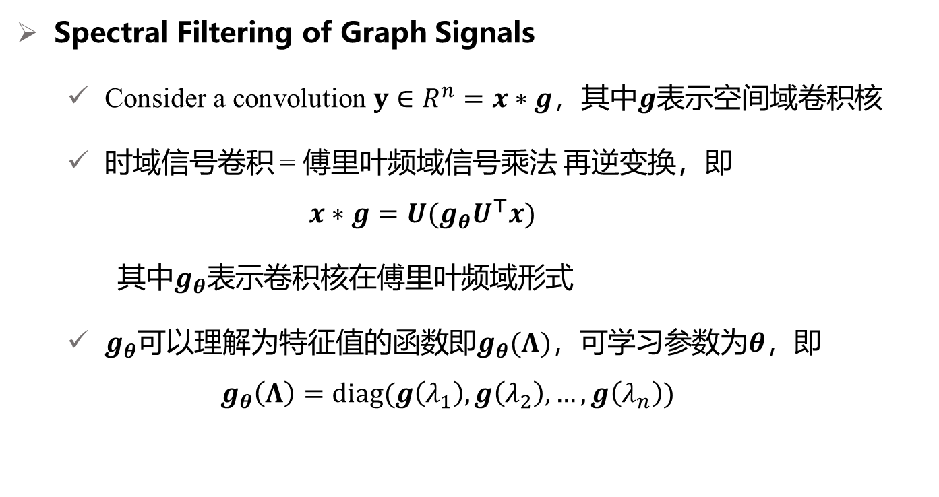
回顾图卷积
Spectral Filtering of Graph Signals
Consider a convolution $y∈R^{n}=x∗g$，其中$g$表示空间域卷积核
时域信号卷积 = 傅里叶频域信号乘法 再逆变换，即
$$x∗g=U(g_{θ}U^{⊤}x)$$
其中$g_{θ}$表示卷积核在傅里叶频域形式
$g_{θ}$可以理解为特征值的函数即$g_{θ}(Λ)$，可学习参数为$θ$，即
$$g_{θ}\left(Λ\right)=diag(g\left(λ_{1}\right),g\left(λ_{2}\right),…,g\left(λ_{n}\right))$$
Defferrard, Michaël, Xavier Bresson, and Pierre Vandergheynst. "Convolutional neural networks on graphs with fast localized spectral filtering." Advances in neural information processing systems 29 (2016).
Notes:
Someone may want to ask what salient object detection means and how to define the salient object. The saliency detection is to find clear foreground objects that are significantly different from the surrounding background in the image. The differences can be reflected in the color, texture and object shape. Let‘s see the first row in the figure. The input of the salient object detection is a digitized image and the output is a saliency probability map as in the second row. Each pixel of the input image has a calculated probability value in the probability map. The probability value is bigger, the probability is
higher that the pixel belongs to the salient object. Otherwise , if the probability value is small, it indicates a higher probability that the pixel belongs to the background. Generally, in the practical application, we apply a constant value in the probability map to separate the salient object from the input image. Just like the third row in the figure. Salient object detection can be used in many fields, like visual tracking, video matting and robot navigation.

Slide 3
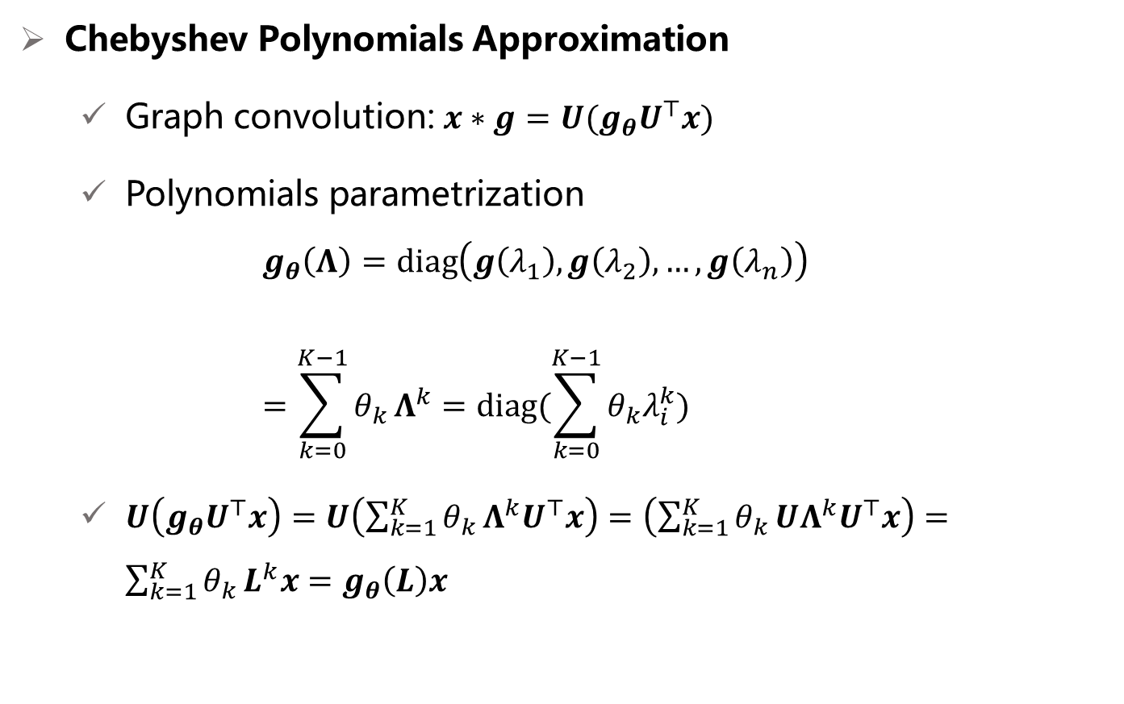
回顾图卷积
Chebyshev Polynomials Approximation
Graph convolution: $x∗g=U(g_{θ}U^{⊤}x)$
Polynomials parametrization
$$g_{θ}\left(Λ\right)=diag\left(g\left(λ_{1}\right),g\left(λ_{2}\right),…,g\left(λ_{n}\right)\right) \\ =\sum_{k=0}^{K−1}{θ_{k}}Λ^{k}=diag(\sum_{k=0}^{K−1}{θ_{k}λ_{i}^{k}})$$
$U\left(g_{θ}U^{⊤}x\right)=U\left(\sum_{k=1}^{K}{θ_{k}}Λ^{k}U^{⊤}x\right)=\left(\sum_{k=1}^{K}{θ_{k}}UΛ^{k}U^{⊤}x\right)=\sum_{k=1}^{K}{θ_{k}}L^{k}x=g_{θ}\left(L\right)x$
Defferrard, Michaël, Xavier Bresson, and Pierre Vandergheynst. "Convolutional neural networks on graphs with fast localized spectral filtering." Advances in neural information processing systems 29 (2016).
Notes:
Someone may want to ask what salient object detection means and how to define the salient object. The saliency detection is to find clear foreground objects that are significantly different from the surrounding background in the image. The differences can be reflected in the color, texture and object shape. Let‘s see the first row in the figure. The input of the salient object detection is a digitized image and the output is a saliency probability map as in the second row. Each pixel of the input image has a calculated probability value in the probability map. The probability value is bigger, the probability is
higher that the pixel belongs to the salient object. Otherwise , if the probability value is small, it indicates a higher probability that the pixel belongs to the background. Generally, in the practical application, we apply a constant value in the probability map to separate the salient object from the input image. Just like the third row in the figure. Salient object detection can be used in many fields, like visual tracking, video matting and robot navigation.

Slide 4
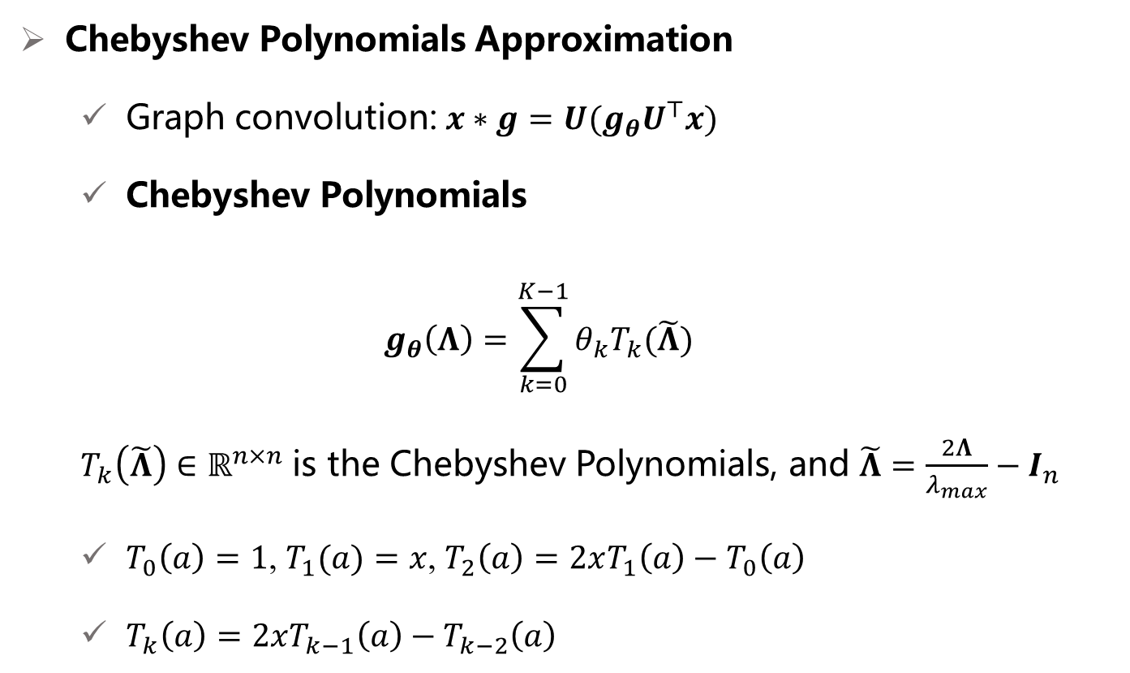
回顾图卷积
Chebyshev Polynomials Approximation
Graph convolution: $x∗g=U(g_{θ}U^{⊤}x)$
Chebyshev Polynomials
$$g_{θ}\left(Λ\right)=\sum_{k=0}^{K−1}{θ_{k}T_{k}(\tilde{Λ})}$$
$T_{k}\left(\tilde{Λ}\right)∈ℝ^{n×n}$ is the Chebyshev Polynomials, and $\tilde{Λ}=\frac{2Λ}{λ_{max}}−I_{n}$
$T_{0}\left(a\right)=1$, $T_{1}(a)=x$, $T_{2}\left(a\right)=2xT_{1}\left(a\right)−T_{0}\left(a\right)$
$T_{k}\left(a\right)=2xT_{k−1}\left(a\right)−T_{k−2}\left(a\right)$
Defferrard, Michaël, Xavier Bresson, and Pierre Vandergheynst. "Convolutional neural networks on graphs with fast localized spectral filtering." Advances in neural information processing systems 29 (2016).
Notes:
Someone may want to ask what salient object detection means and how to define the salient object. The saliency detection is to find clear foreground objects that are significantly different from the surrounding background in the image. The differences can be reflected in the color, texture and object shape. Let‘s see the first row in the figure. The input of the salient object detection is a digitized image and the output is a saliency probability map as in the second row. Each pixel of the input image has a calculated probability value in the probability map. The probability value is bigger, the probability is
higher that the pixel belongs to the salient object. Otherwise , if the probability value is small, it indicates a higher probability that the pixel belongs to the background. Generally, in the practical application, we apply a constant value in the probability map to separate the salient object from the input image. Just like the third row in the figure. Salient object detection can be used in many fields, like visual tracking, video matting and robot navigation.

Slide 5
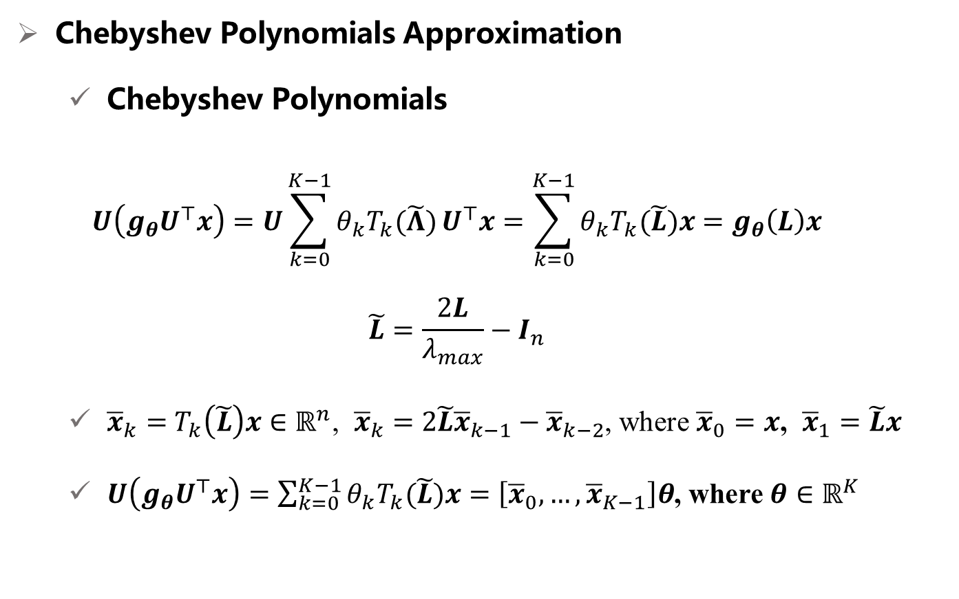
回顾图卷积
Chebyshev Polynomials Approximation
Chebyshev Polynomials
$$U\left(g_{θ}U^{⊤}x\right)=U\sum_{k=0}^{K−1}{θ_{k}T_{k}(\tilde{Λ})}U^{⊤}x=\sum_{k=0}^{K−1}{θ_{k}T_{k}(\tilde{L})x}=g_{θ}\left(L\right)x$$
$$\tilde{L}=\frac{2L}{λ_{max}}−I_{n}$$
${\overline{x}}_{k}=$ $T_{k}\left(\tilde{L}\right)x∈ℝ^{n}$, ${\overline{x}}_{k}=$ $2\tilde{L}{\overline{x}}_{k−1}−{\overline{x}}_{k−2}$, where ${\overline{x}}_{0}=x$, ${\overline{x}}_{1}=\tilde{L}x$
$U\left(g_{θ}U^{⊤}x\right)=\sum_{k=0}^{K−1}{θ_{k}T_{k}(\tilde{L})x}=\left[{\overline{x}}_{0},…,{\overline{x}}_{K−1}\right]θ$, where $θ∈ℝ^{K}$
Defferrard, Michaël, Xavier Bresson, and Pierre Vandergheynst. "Convolutional neural networks on graphs with fast localized spectral filtering." Advances in neural information processing systems 29 (2016).
Notes:
Someone may want to ask what salient object detection means and how to define the salient object. The saliency detection is to find clear foreground objects that are significantly different from the surrounding background in the image. The differences can be reflected in the color, texture and object shape. Let‘s see the first row in the figure. The input of the salient object detection is a digitized image and the output is a saliency probability map as in the second row. Each pixel of the input image has a calculated probability value in the probability map. The probability value is bigger, the probability is
higher that the pixel belongs to the salient object. Otherwise , if the probability value is small, it indicates a higher probability that the pixel belongs to the background. Generally, in the practical application, we apply a constant value in the probability map to separate the salient object from the input image. Just like the third row in the figure. Salient object detection can be used in many fields, like visual tracking, video matting and robot navigation.

Slide 6







张量化图卷积
取$K=2$
$U\left(g_{θ}U^{⊤}x\right)=\sum_{k=0}^{K−1}{θ_{k}T_{k}(\tilde{L})x}=\left[{\overline{x}}_{0},…,{\overline{x}}_{K−1}\right]θ$ $=\left[{\overline{x}}_{0},{\overline{x}}_{1},{\overline{x}}_{2}\right]θ$ $=[x,\tilde{L}x,2{\tilde{L}}^{2}x−x]θ$
用$L_{3}$替换$2{\tilde{L}}^{2}$
$$=[x,\tilde{L}x,{f(L}_{3},x)−x]θ$$
$$=[x,\tilde{L}×_{2}x^{⊤},{ L}_{3}×_{2}x^{⊤}×_{3}x^{⊤})−x]θ$$
1阶
2阶
3阶
$$ℝ^{n×n×n}$$
$$ℝ^{n}$$
$$ℝ^{n}$$
$$ℝ^{n}$$
$$ℝ^{3n}$$
$$ℝ^{n×3}$$
Defferrard, Michaël, Xavier Bresson, and Pierre Vandergheynst. "Convolutional neural networks on graphs with fast localized spectral filtering." Advances in neural information processing systems 29 (2016).
Notes:
Someone may want to ask what salient object detection means and how to define the salient object. The saliency detection is to find clear foreground objects that are significantly different from the surrounding background in the image. The differences can be reflected in the color, texture and object shape. Let‘s see the first row in the figure. The input of the salient object detection is a digitized image and the output is a saliency probability map as in the second row. Each pixel of the input image has a calculated probability value in the probability map. The probability value is bigger, the probability is
higher that the pixel belongs to the salient object. Otherwise , if the probability value is small, it indicates a higher probability that the pixel belongs to the background. Generally, in the practical application, we apply a constant value in the probability map to separate the salient object from the input image. Just like the third row in the figure. Salient object detection can be used in many fields, like visual tracking, video matting and robot navigation.

Slide 7

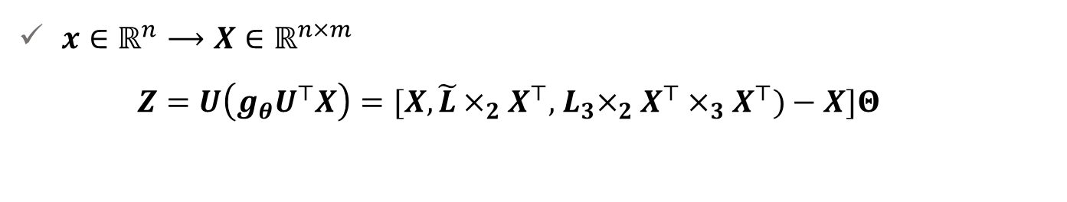









矩阵化
$x∈ℝ^{n}⟶X∈ℝ^{n×m}$
$$Z=U\left(g_{θ}U^{⊤}X\right)=[X,\tilde{L}×_{2}X^{⊤},{ L}_{3}×_{2}X^{⊤}×_{3}X^{⊤})−X]Θ$$
$$ℝ^{n×m}$$
$$ℝ^{n×m}$$
$$ℝ^{n×m×m}$$
$$ℝ^{?×d}$$
$$X=[x_{1},…,x_{m}]∈ℝ^{n×m}$$
$${M=[L}_{3}×_{2}x_{1}^{⊤}×_{3}x_{1}^{⊤},…,{L_{3}×}_{2}x_{m}^{⊤}×_{3}x_{m}^{⊤}]{∈ℝ}^{n×m}$$
$$ℝ^{n}$$
$$Z=U\left(g_{θ}U^{⊤}X\right)=[X,\tilde{L}×_{2}X^{⊤},M−X]Θ$$
$$ℝ^{n×m}$$
$$ℝ^{n×m}$$
$$ℝ^{n×m}$$
$$ℝ^{3m×d}$$
Notes:
Someone may want to ask what salient object detection means and how to define the salient object. The saliency detection is to find clear foreground objects that are significantly different from the surrounding background in the image. The differences can be reflected in the color, texture and object shape. Let‘s see the first row in the figure. The input of the salient object detection is a digitized image and the output is a saliency probability map as in the second row. Each pixel of the input image has a calculated probability value in the probability map. The probability value is bigger, the probability is
higher that the pixel belongs to the salient object. Otherwise , if the probability value is small, it indicates a higher probability that the pixel belongs to the background. Generally, in the practical application, we apply a constant value in the probability map to separate the salient object from the input image. Just like the third row in the figure. Salient object detection can be used in many fields, like visual tracking, video matting and robot navigation.

Slide 8
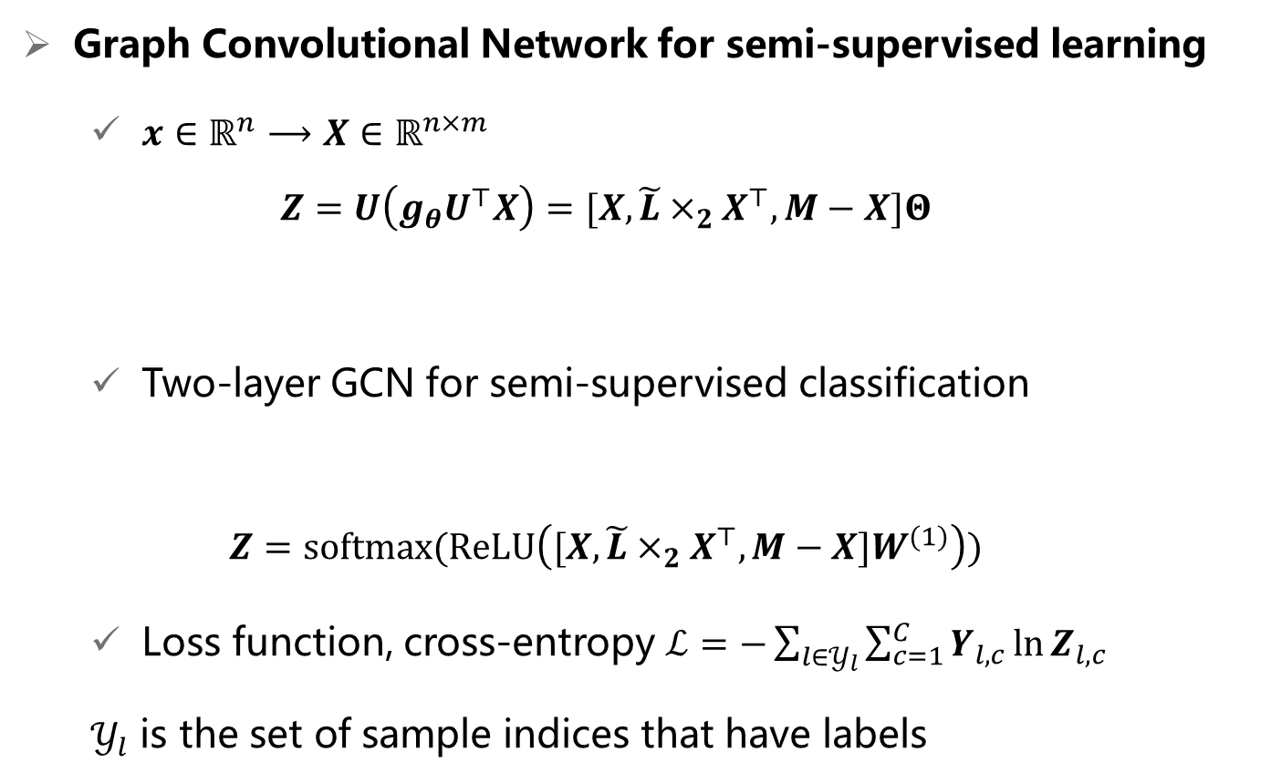
矩阵化
Graph Convolutional Network for semi-supervised learning
$x∈ℝ^{n}⟶X∈ℝ^{n×m}$
$$Z=U\left(g_{θ}U^{⊤}X\right)=[X,\tilde{L}×_{2}X^{⊤},M−X]Θ$$
Two-layer GCN for semi-supervised classification
$$Z=softmax(ReLU\left([X,\tilde{L}×_{2}X^{⊤},M−X]W^{(1)}\right))$$
Loss function, cross-entropy $ℒ=−\sum_{l∈𝒴_{l}}{\sum_{c=1}^{C}{Y_{l,c}\ln{Z_{l,c}}}}$
$𝒴_{l}$ is the set of sample indices that have labels
Notes:
Someone may want to ask what salient object detection means and how to define the salient object. The saliency detection is to find clear foreground objects that are significantly different from the surrounding background in the image. The differences can be reflected in the color, texture and object shape. Let‘s see the first row in the figure. The input of the salient object detection is a digitized image and the output is a saliency probability map as in the second row. Each pixel of the input image has a calculated probability value in the probability map. The probability value is bigger, the probability is
higher that the pixel belongs to the salient object. Otherwise , if the probability value is small, it indicates a higher probability that the pixel belongs to the background. Generally, in the practical application, we apply a constant value in the probability map to separate the salient object from the input image. Just like the third row in the figure. Salient object detection can be used in many fields, like visual tracking, video matting and robot navigation.

Slide 9
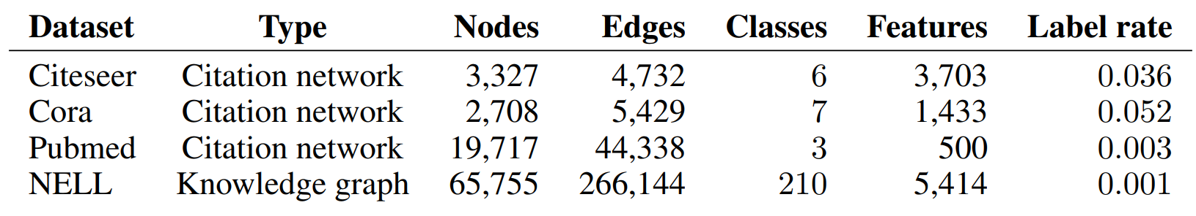
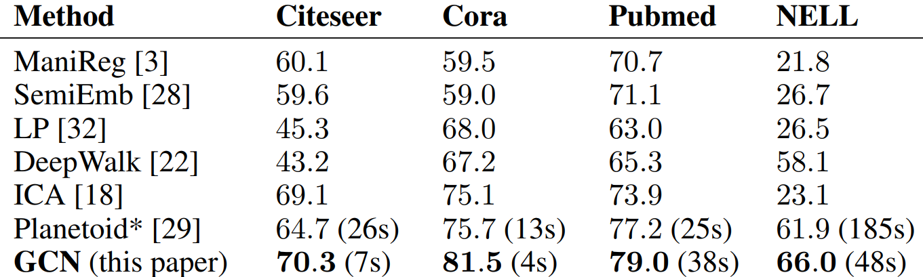
图卷积实验设计
Semi-supervised classification results
Thomas N. Kipf, Max Welling Semi-Supervised Classification with Graph Convolutional Networks. ICLR (Poster) 2017
Notes:
Someone may want to ask what salient object detection means and how to define the salient object. The saliency detection is to find clear foreground objects that are significantly different from the surrounding background in the image. The differences can be reflected in the color, texture and object shape. Let‘s see the first row in the figure. The input of the salient object detection is a digitized image and the output is a saliency probability map as in the second row. Each pixel of the input image has a calculated probability value in the probability map. The probability value is bigger, the probability is
higher that the pixel belongs to the salient object. Otherwise , if the probability value is small, it indicates a higher probability that the pixel belongs to the background. Generally, in the practical application, we apply a constant value in the probability map to separate the salient object from the input image. Just like the third row in the figure. Salient object detection can be used in many fields, like visual tracking, video matting and robot navigation.

Slide 10
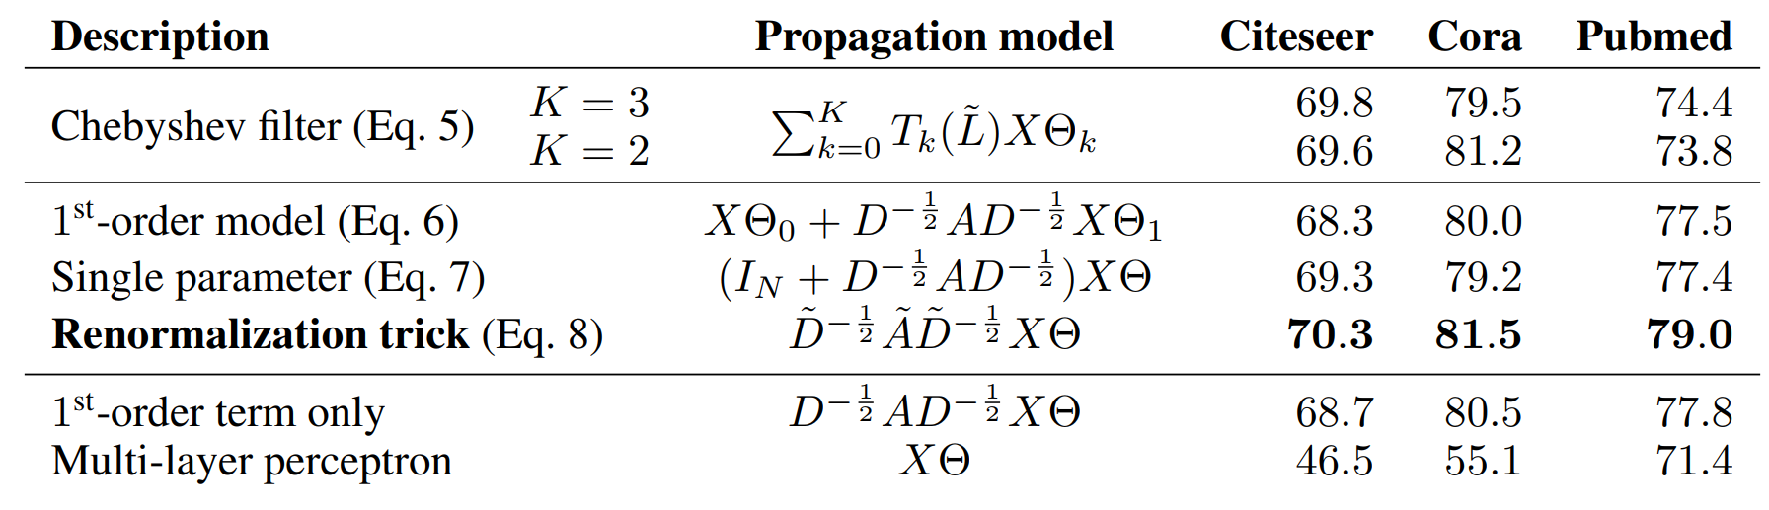
不同阶数的融合
Semi-supervised classification results
Thomas N. Kipf, Max Welling Semi-Supervised Classification with Graph Convolutional Networks. ICLR (Poster) 2017
Notes:
Someone may want to ask what salient object detection means and how to define the salient object. The saliency detection is to find clear foreground objects that are significantly different from the surrounding background in the image. The differences can be reflected in the color, texture and object shape. Let‘s see the first row in the figure. The input of the salient object detection is a digitized image and the output is a saliency probability map as in the second row. Each pixel of the input image has a calculated probability value in the probability map. The probability value is bigger, the probability is
higher that the pixel belongs to the salient object. Otherwise , if the probability value is small, it indicates a higher probability that the pixel belongs to the background. Generally, in the practical application, we apply a constant value in the probability map to separate the salient object from the input image. Just like the third row in the figure. Salient object detection can be used in many fields, like visual tracking, video matting and robot navigation.

