Slide 1
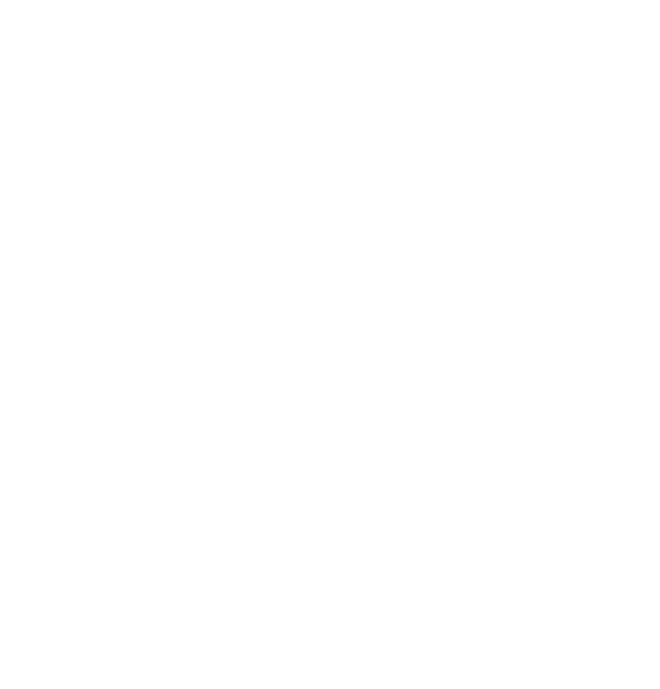
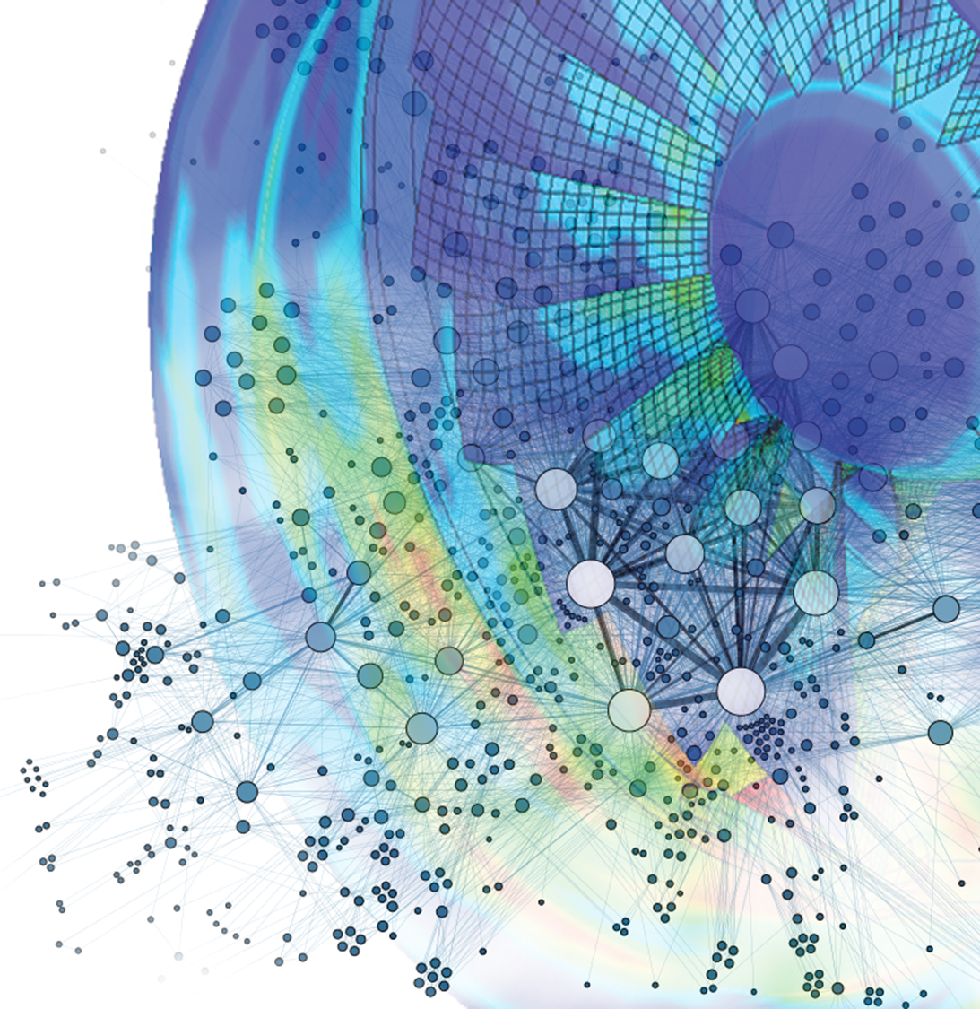

GT2021-65169
Tutorial of basics
On the use of Neural Networks in turbomachinery blade design
Alessandro Corsini, Giovanni Delibra, Lorenzo Tieghi and Francesco Aldo Tucci
Sapienza University of Rome,
Department of Mechanical and Aerospace Engineering
ASME Turbo Expo 2021
Turbomachinery Technical Conference and Exposition
June 7 – 11, Virtual, Online

Slide 2
Outline
Basics elements of neural networks
Neural network – Live tutorial
Neural network in turbomachinery design
Q&A
Notes:
Today we will show you the basics to understand Neural networks and how these can be applied to turbomachinery problems.
The first part of the tutorial is a brief introduction to neural networks which explains what their basic elements are and how they work. Then, I will leave the floor to my colleague Lorenzo and he will perform a live demonstration of programming a Neural Network. At the end of this tutorial you will learn how to program a neural network, you will understand a bit of exploratory data analysis and how you can possibly include a ML approach in your engineering problem solving.

Slide 3
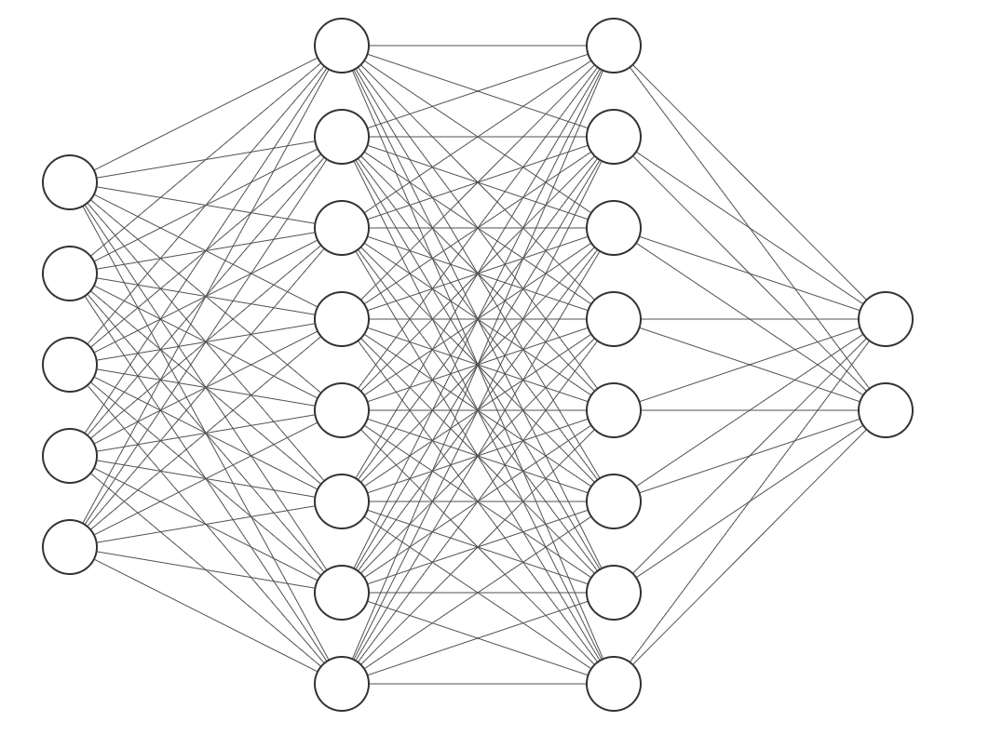
Goals & Methods
The goal of the tutorial is to build a model to derive aerodynamic performance of NACA 4 digit airfoils
The model to use is a feed-forward neural network
Each sample of the training dataset is parametrized by 5 features
Output of the NN are lift and drag coefficients of the airfoil
Input features
Angle of attack (AoA)
Maximum camber
Maximum camber position
Aerofoil thickness
Reynolds number
Output features
Lift coefficient
Drag coefficient
Notes:
The aim of the tutorial is to provide the audience the basis to understand Neural networks, and how these can be applied to turbomachinery problems.
The first part of the tutorial provides a brief introduction to neural networks which explains what their basic elements are and how they work. Then, I will leave the floor to my colleague Dr Lorenzo Tieghi and he will discuss the use of neural network to engineering problems focusing on how to model aerodynamic performances of a cascade using neural network.

Slide 4
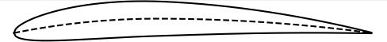
Data generation
The training database is generated using X-Foil^{[1]}
A full-factorial Design of Experiment is exploited to assess a correct representation of the airfoil features in the training space
Parameter | Min | Max
Angle of Attack | -2 deg | 16 deg
Maximum Camber¹ | 1 % | 4 %
Maximum Camber Location² | 10 % | 40 %
Airfoil Thickness¹ | 6 % | 12 %
Reynolds Number | 50 000 | 1 000 000
^{NACA 4410}
^{AoA}
^{Aerofoil Thickness}
^{Max. Camber}
¹Referred to the chord length
²Expressed as a distance from the leading edge
[1] Drela, Mark. "XFOIL: An analysis and design system for low Reynolds number airfoils." Low Reynolds number aerodynamics. Springer, Berlin, Heidelberg, 1989. 1-12.
Notes:
The aim of the tutorial is to provide the audience the basis to understand Neural networks, and how these can be applied to turbomachinery problems.
The first part of the tutorial provides a brief introduction to neural networks which explains what their basic elements are and how they work. Then, I will leave the floor to my colleague Dr Lorenzo Tieghi and he will discuss the use of neural network to engineering problems focusing on how to model aerodynamic performances of a cascade using neural network.

Slide 5




Required libraries & code availability
Requirements:
Python v3.6+
Numpy v1.20
Tensorflow v2.x
Keras v2.x and Keras-tuner v1.01
Pandas v1.2.4
Scikit-learn v0.24.2
Matplotlib v3.4.2
Training data is distributed with the tutorial
The code for this tutorial is available as a Github project: https://github.com/LolBurger/tutorialTE21.git
Notes:
The aim of the tutorial is to provide the audience the basis to understand Neural networks, and how these can be applied to turbomachinery problems.
The first part of the tutorial provides a brief introduction to neural networks which explains what their basic elements are and how they work. Then, I will leave the floor to my colleague Dr Lorenzo Tieghi and he will discuss the use of neural network to engineering problems focusing on how to model aerodynamic performances of a cascade using neural network.

