Slide 1
Arkana - Grounded AI for Historical and Cultural Exploration
Specialization Project Presentation
By
Abhishek Singh (2547103), Arjit Singhal (2547113), Nilesh Gupta(2547138)
Project Guide
Dr. Kavitha R
Department of Computer Science
CHRIST(Deemed to be University), Bengaluru-29

Slide 2
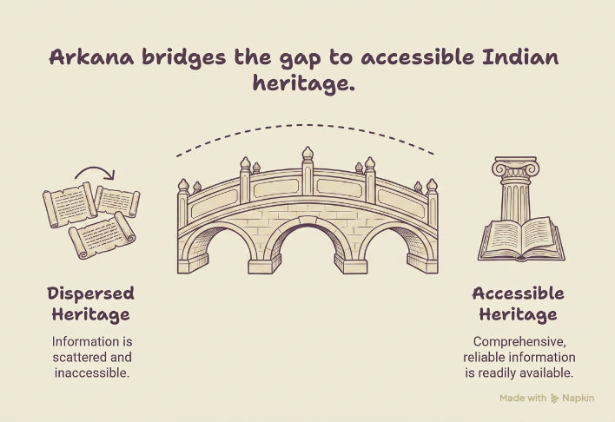
Introduction
Arkana is an AI-powered Retrieval-Augmented Generation (RAG) platform designed to make India's vast historical, cultural, and architectural heritage accessible through accurate, citation-backed conversations and an interactive geographic atlas.
India is home to more than 37,000 documented monuments and heritage sites, along with thousands of traditional art forms, archaeological records, museum collections, and historical manuscripts.
However, this information is dispersed across numerous repositories, including government archives, museum collections, with each source varying in structure, completeness, and accessibility.
As a result, obtaining comprehensive and reliable information often requires consulting multiple independent resources, making heritage exploration difficult for researchers, students, and the general public.

Slide 3
Analysis Phase
Study of Existing System: Existing platforms (ASI website, Wikipedia, Google Arts & Culture) offer fragmented, unverified information about Indian heritage sites. None provide grounded, citation-backed conversational access. AI systems like ChatGPT hallucinate heritage facts without citing verified sources.
Limitations of Existing System: No citation-grounded answers; information scattered across 37,000+ sites; no geographic atlas integration; no natural-language query support; AI hallucination without verified retrieval; no machine-readable unified knowledge base.
Features of Proposed System: RAG-powered conversational Q&A with source citations; interactive Leaflet.js heritage atlas; unified data from Wikidata, Wikipedia, UNESCO, OSM; semantic chunking and hybrid vector + FTS retrieval; image-based artifact identification via CLIP; grounded LLM responses.
Functional Requirements: Natural language Q&A on heritage sites; geographic map exploration; citation-linked answers; image-based artifact search; multi-source data ingestion (Wikidata, Wikipedia, UNESCO, OSM); streamed LLM responses.
Non-Functional Requirements: RAG retrieval latency p50 < 4 seconds; supports ~37,000 heritage site records; open-licensed data only (CC BY-SA, CC0, ODbL); scalable containerised deployment (Docker); retrieval precision >85% on golden test set; zero hallucination guarantee via citation grounding.

Slide 4

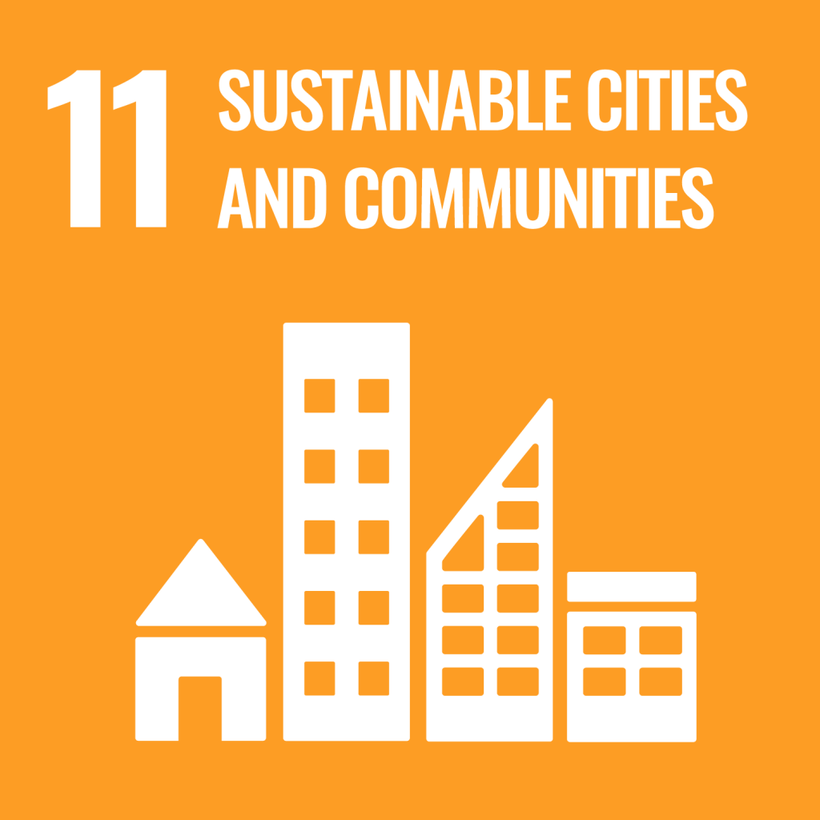
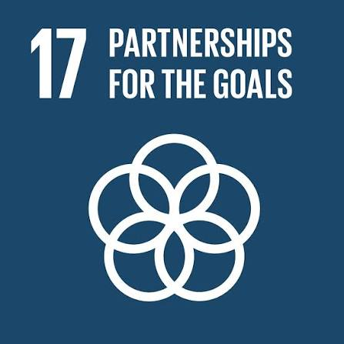
SDG Goals
SDG 4 – Quality Education
Provides free, AI-powered access to India's cultural heritage.
Delivers citation-backed information from trusted sources.
Supports students, researchers, educators, and lifelong learners.
SDG 11 – Sustainable Cities & Communities
Digitally preserves and promotes India's historical heritage.
Interactive heritage atlas encourages cultural awareness and tourism.
Improves public accessibility to heritage information.
SDG 17 – Partnerships for the Goals
Integrates data from Wikipedia, Wikidata, UNESCO, and OpenStreetMap.
Demonstrates collaboration through open-data platforms.
Encourages knowledge sharing and sustainable digital heritage preservation.

Slide 5
Existing system
Existing Platforms
ASI Website
Wikipedia
UNESCO Portal
Google Arts & Culture
Characteristics
Information spread across multiple websites
Mostly keyword-based search
No conversational interface
Limited integration between sources
Difficult to compare information from different repositories

Slide 6
Limitations of Existing System
Information scattered across multiple platforms.
No unified knowledge base.
AI systems may generate hallucinated responses.
Limited citation-backed answers.
No interactive geographic exploration.
No semantic or natural language search.
Difficult for users to verify information.
Time-consuming manual research.

Slide 7
Proposed System
Arkana is an AI-powered Retrieval-Augmented Generation (RAG) platform for exploring India's cultural heritage.
Features
Citation-grounded conversational AI.
Interactive heritage atlas using Leaflet.js.
Hybrid retrieval (Vector + BM25).
Data integrated from Wikipedia, Wikidata, UNESCO and OSM.
Image-based artifact identification.
Accurate, transparent, and explainable responses.

Slide 8
Advantages of Proposed System
Reliable and citation-backed responses.
Reduces AI hallucinations using RAG.
Unified access to multiple heritage sources.
Natural language question answering.
Interactive map-based exploration.
Fast semantic search with hybrid retrieval.
Supports education, tourism, and research.
Scalable and easy to extend with new data sources.

Slide 9
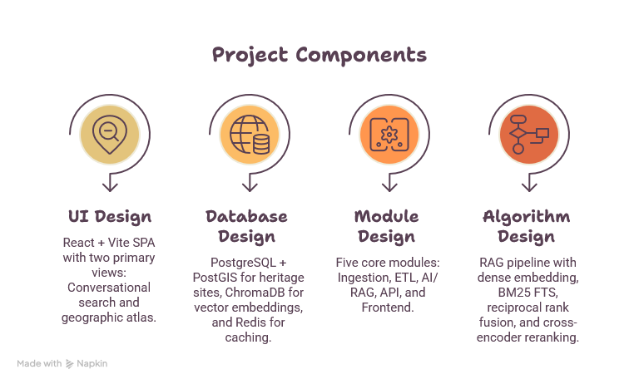
Design Phase

Slide 10
UI Design
Develop a simple, responsive, and interactive user interface.
Key Features
React + Vite Single Page Application
Conversational AI chat interface
Interactive Leaflet.js heritage atlas
Filters by state and heritage type
Site detail panels
Responsive and user-friendly design

Slide 11
Database Design
Technologies
PostgreSQL + PostGIS
ChromaDB
Redis
Design Features
Stores heritage site information
Spatial indexing using GiST
Full-text search support
Vector embeddings for semantic retrieval
Caching for improved performance
Unified Pydantic data schema

Slide 12
Module Design
Five Core Modules
Data Ingestion
ETL Processing
AI/RAG Engine
FastAPI Backend
React Frontend
Responsibilities
Collect and clean data
Generate embeddings
Retrieve relevant information
Generate citation-backed responses
Display results through web interface

Slide 13
Algorithm Design
RAG Pipeline
User Query
↓
Dense Embedding + BM25 Retrieval
↓
Reciprocal Rank Fusion (RRF)
↓
Cross-Encoder Re-ranking
↓
Gemini LLM
↓
Citation-Grounded Response
Additional Components
RapidFuzz Deduplication
CLIP-based Artifact Classification
Semantic Search
Streamed AI Responses

Slide 14
Conclusion
Arkana provides an AI-powered, citation-grounded platform for exploring India's historical and cultural heritage.
By combining RAG with trusted sources such as Wikipedia, Wikidata, UNESCO, and OpenStreetMap, it delivers accurate and verifiable information.
The interactive geographic atlas and natural-language interface make heritage exploration simple and engaging.
The project supports education, cultural preservation, tourism, and research, while aligning with SDGs 4, 11, and 17.
In the future, Arkana can be expanded with additional data sources, multilingual support, and enhanced AI capabilities to make India's heritage more accessible to everyone.

