Slide 1
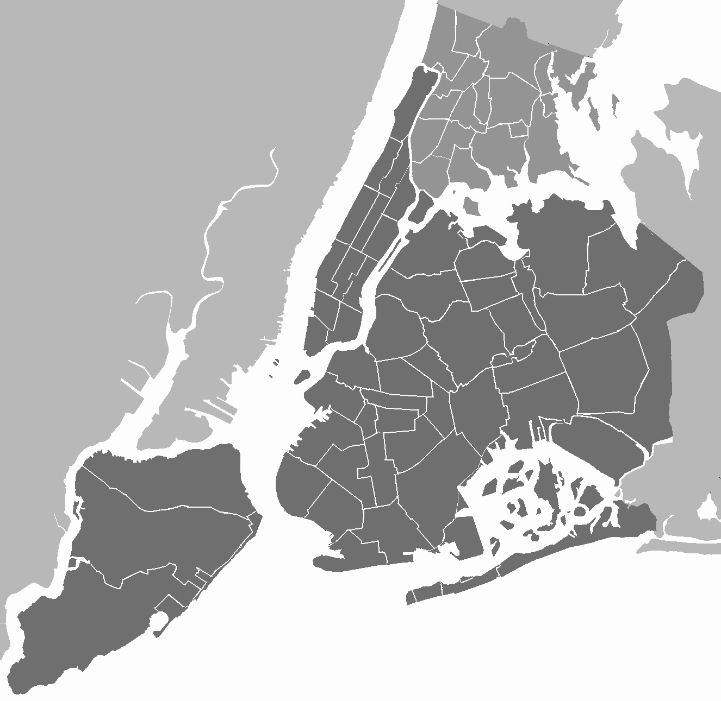
Data Analytics – Final Project
Exploratory Analysis and Visualizations of Airbnb Listings in New York City

Slide 2
Team
Bindu Naganapura Prabhuswamy – 47883062
Lolita Ancilla Miranda - 94172214
Avin Joju – 37270522
Leela Krishna Rakesh Kalidindi - 47133396

Slide 3
Introduction
Airbnb is an online marketplace based in the United States of America and offers hospitality services by allowing house owners to rent their homes and customers to find easy accommodation.
New York City is the most popular area in the USA and several people visit the place for personal or commercial purposes.
The current dataset includes Airbnb listings in 5 popular localities of the New York City.

Slide 4
Objective
Exploratory analysis of New York City Airbnb listings helps in understanding the important aspects like the:
Most preferred room type by the customers
Most popular neighborhoods
Most affordable or expensive neighborhoods
Most reviewed room types and localities, and so on.
Understanding these metrics will help the company to customize the locations as per customer’s preference and home owners to make necessary changes to improve ratings and bookings.

Slide 5
Analysis Conducted
Descriptive Statistics
Price Analysis
Host Analysis
Room Type Analysis
City-based Trends
Reviews Analysis
Spatial Analysis and
Correlation Analysis

Slide 6
Descriptive Statistics
Mean Price | 152.7206871868289
Median Price | 106.0
Mode Price | 100
Range of Prices | 10000
Standard Deviation | 240.15416974718758
Mean price is higher than the median, indicating a right-skewed distribution.
Mode indicates that $100 is a commonly occurring price.
Substantial range of prices suggests a wide variability in accommodation costs.
Standard deviation is relatively high, confirming the variability in prices.

Slide 7
Descriptive Statistics
ANOVA TEST:
Test Values:
ANOVA F-statistic: 1716.63
P-value: 0.0
Results:
Statistically significant differences in mean prices among different room types.
The F-statistic indicates a substantial difference in means, and the low p-value provides strong evidence against the idea that all room types have equal mean prices.

Slide 8
Descriptive Statistics
T-TEST:
T-test to compare mean prices between Brooklyn and Manhattan.
Test Values:
T-statistic: -30.009360251152064
P-value: 8.973192961269122e-196
Degrees of Freedom (df): 41763.0
Result:
Negative t-statistic indicates that, on average, prices in Brooklyn are significantly lower than prices in Manhattan.
Statistically significant difference in mean prices between Brooklyn and Manhattan, with Manhattan having higher average prices.

Slide 9
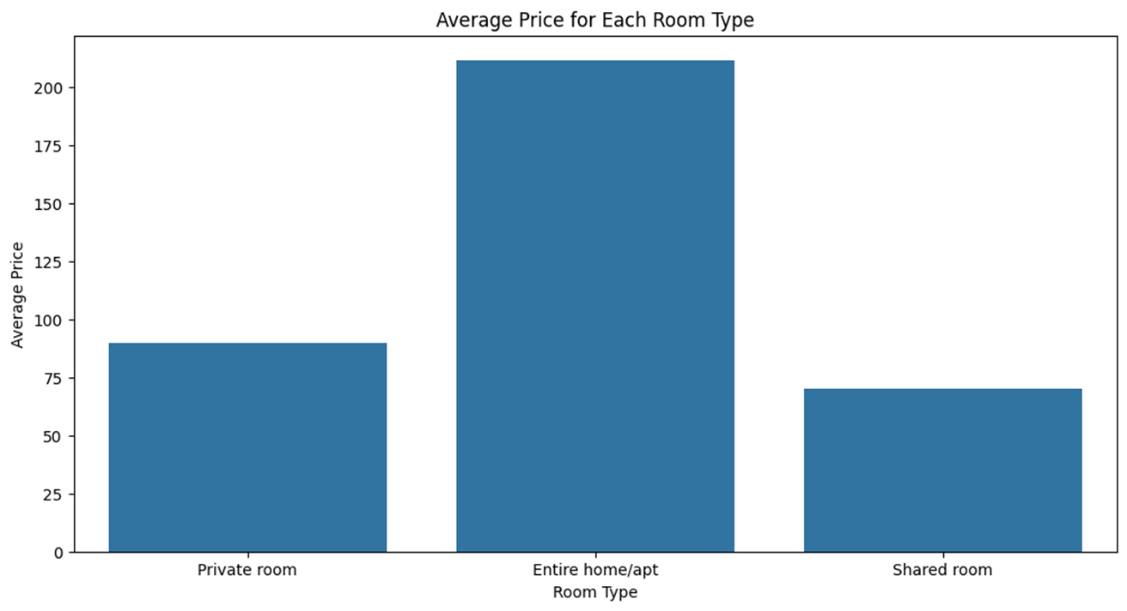
Price Analysis
Entire Home/Apartment:
Average price is above $200.
Relatively higher pricing.
Private Room:
Average price between $75 and $100.
A middle-range option with the comfort of a private space in a larger residence.
Shared Room:
Average price between $50 and $75.
Budget-friendly pricing, and best option for travelers to reduce costs.

Slide 10
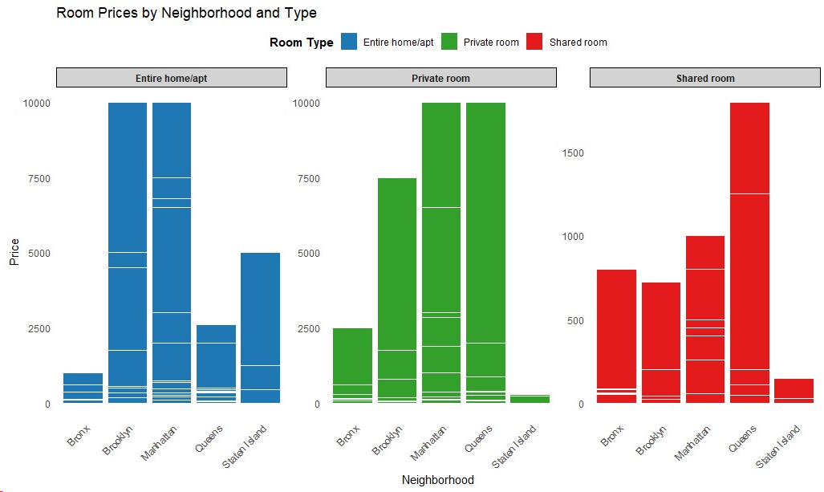
Price Analysis
Across all room types, Manhattan tends to be more expensive.
Staten Island and the Bronx offer more budget-friendly options for both 'Private Rooms' and 'Entire Home/Apt.’
Brooklyn stands out as having the most affordable 'Shared Rooms' among the boroughs.

Slide 11
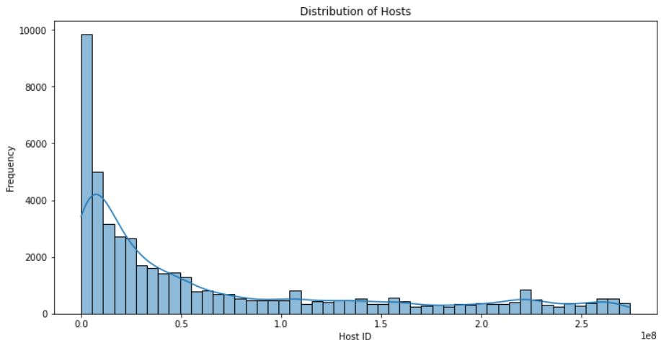
Host Analysis
Host analysis was conducted to understand the distribution of Airbnb hosts.
The histogram represents the distribution of hosts to identify prolific hosts based on the ‘host_id’.

Slide 12
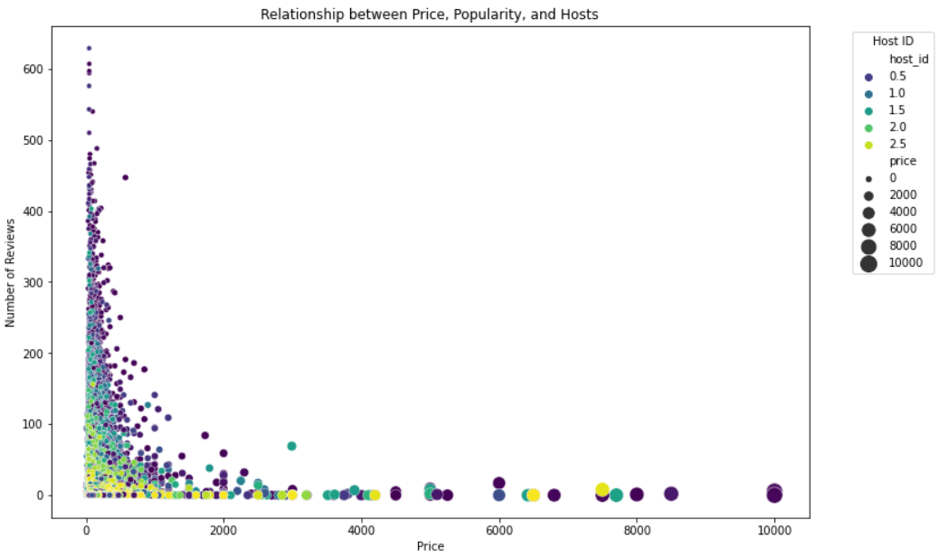
Host Analysis
Scatter plot analysis was also conducted to understand the distribution of the listings throughout New York city.
Only a few hosts with prices around 10000, but with no reviews. Hosts with prices at a minimal price recorded a very high number of reviews.

Slide 13
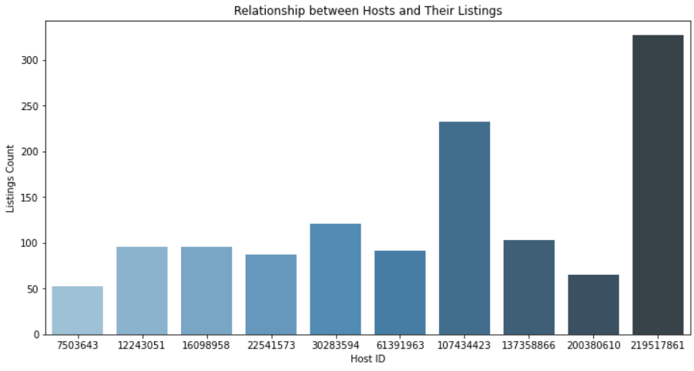
Host Analysis
The bar chart helps to understand the relation between hosts and their respective listings.
The listings of 10 hosts, which shows a minimum of 50 and maximum of over 300.

Slide 14
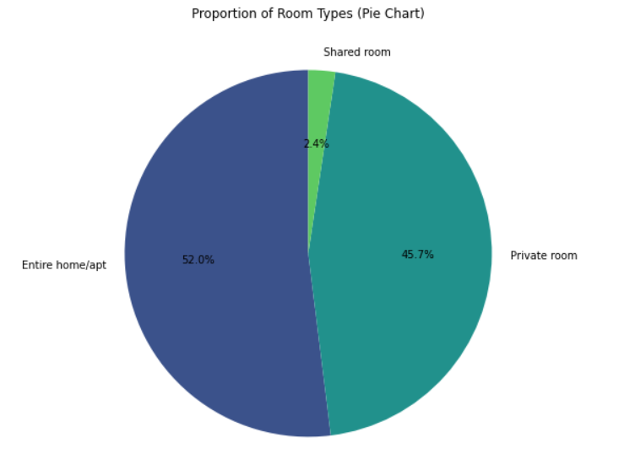
Room Type Analysis
Entire home/apartment room types accounted for more than half of the total listings, closely followed by private rooms.

Slide 15
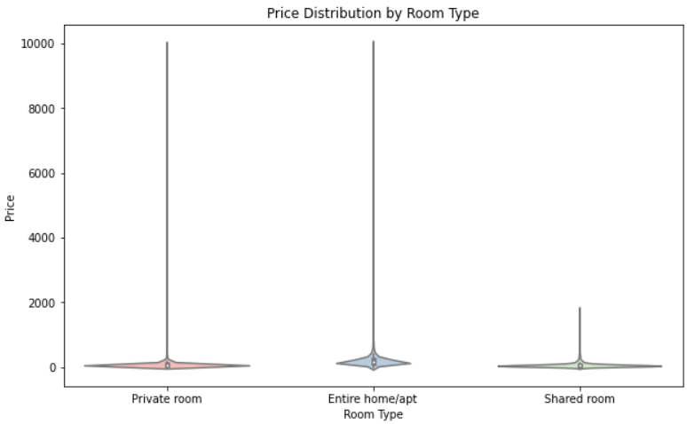
Room Type Analysis
Violin Plot visually compares listing prices among different room types, highlighting distinct patterns and potential outliers.
Entire home/Apt were comparatively costlier than the other two room types.

Slide 16
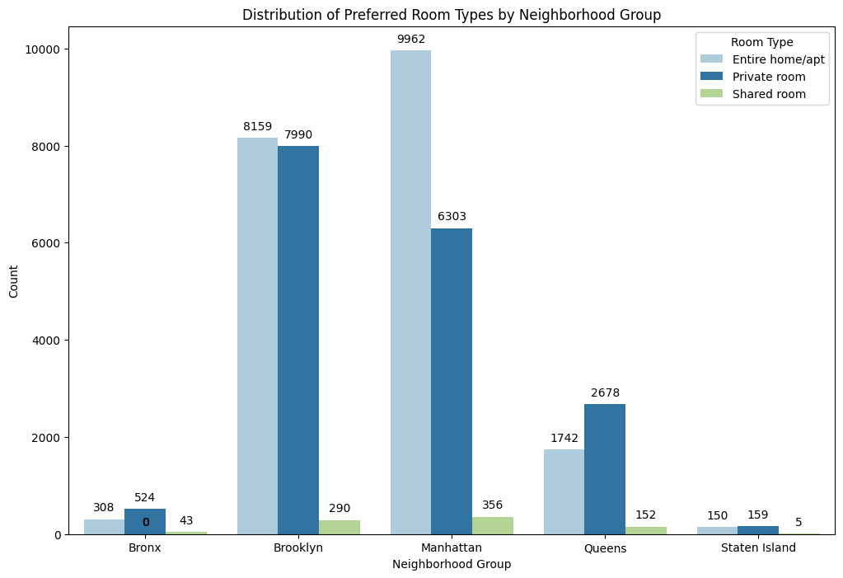
Location-based Trends
Guests preferred either Entire home/apt or private room in all the five neighborhoods.
In particular, people visiting Brooklyn and Manhattan preferred Entire home/Apt, while those visiting the remaining 3 areas preferred private rooms.
Shared rooms were the least in all five localities.

Slide 17
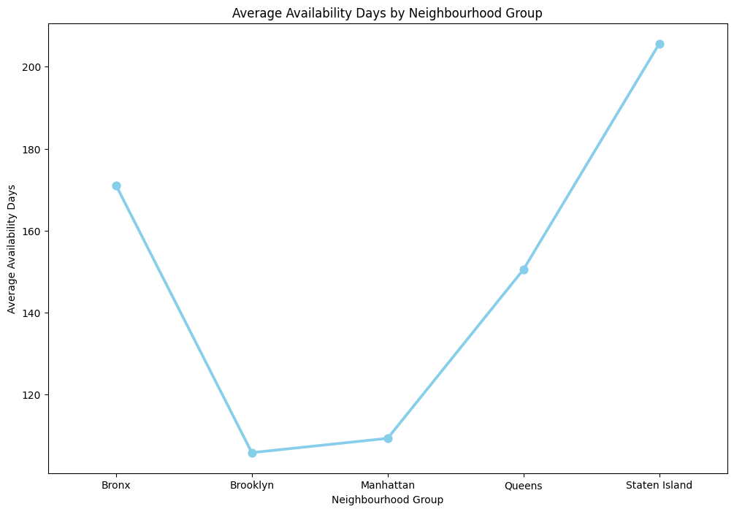
Location-based Trends
Staten Island had the highest number of rooms available in a year with an average of 205 days.
Brooklyn has the lowest availability in a year which is 105 days, closely followed by Manhattan.

Slide 18
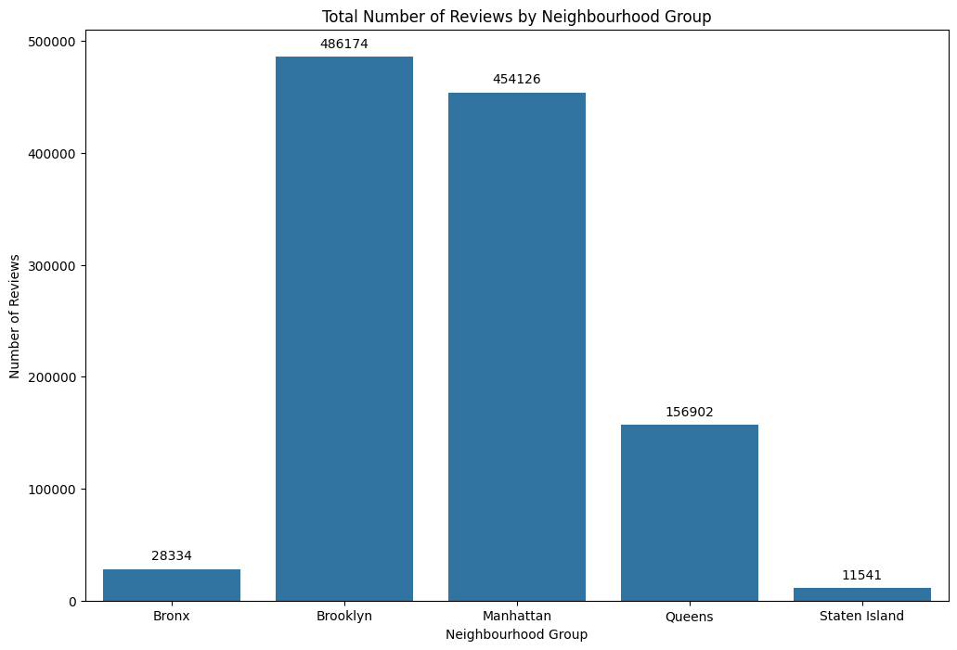
Reviews Analysis
Brooklyn and Manhattan were the highest reviewed neighborhood groups.
Staten Island registered the least reviews.
Higher reviews indicate higher customer satisfaction.

Slide 19
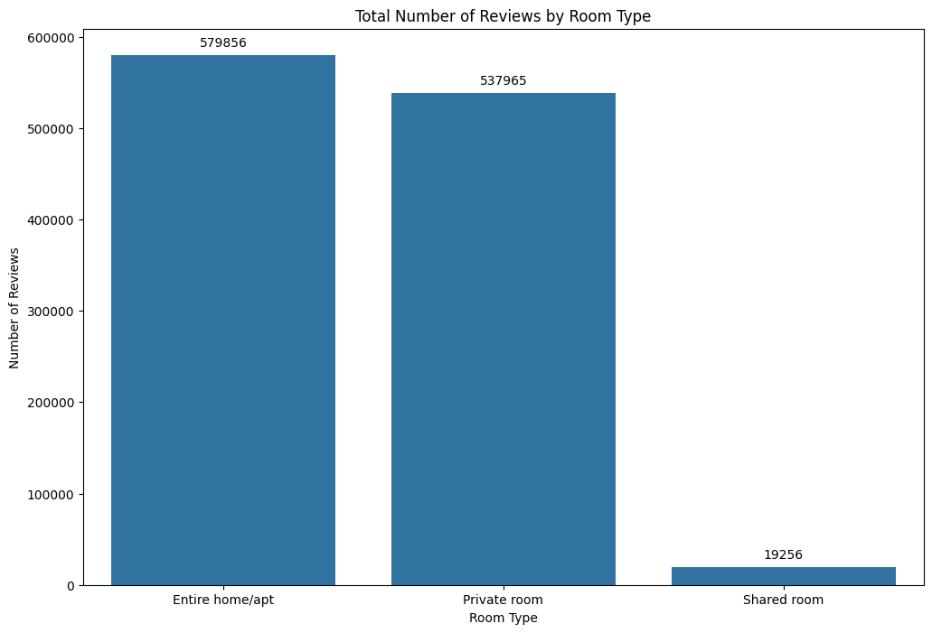
Reviews Analysis
More number of guests preferred the entire home/apartment or private rooms.
Only a few number of guests preferred shared apartments. It can be because of privacy and security reasons.

Slide 20
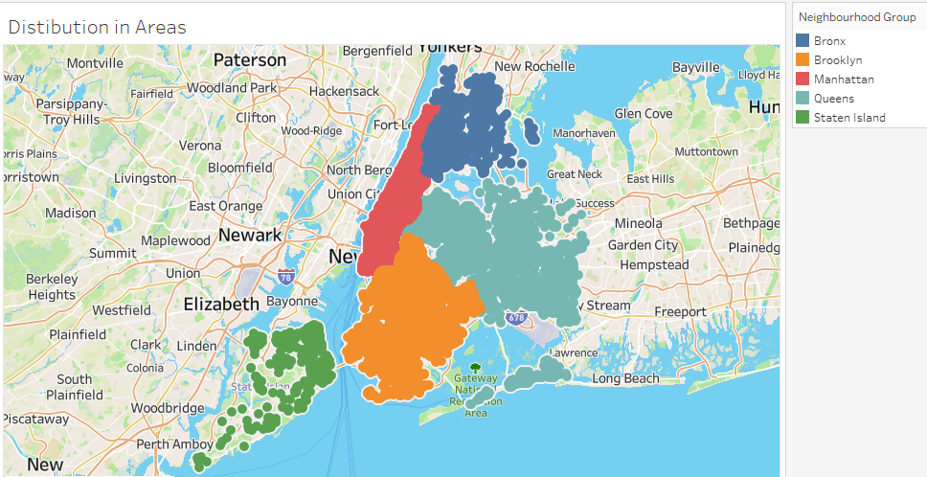
Spatial Analysis
Spatial analysis was conducted to understand the distribution of Airbnb listings throughout the city.
More options were available in the neighborhoods of Manhattan and Queens, followed by Brooklyn.

Slide 21
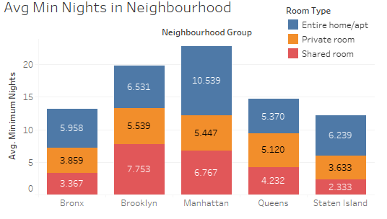
Spatial Analysis
Manhattan - highest average of minimum nights spend in terms of all room types.
Staten Island – lowest average in terms of the minimum nights spent in any room.

Slide 22
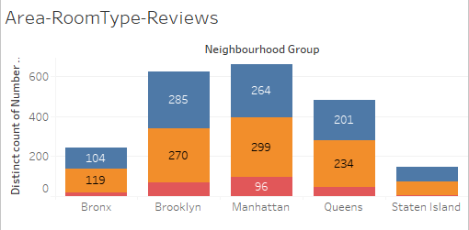
Spatial Analysis
Entire home/Apt and Private rooms were preferred in all the neighborhoods and the same was reflected in the reviews.
Manhattan has the highest and the Staten Island has lowest reviews.

Slide 23
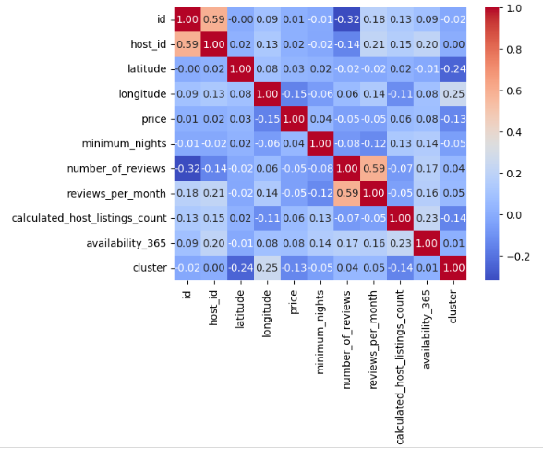
Correlation Analysis
Correlation analysis helps to understand relation between two variables in a dataset.
For instance, as per the data, minimum nights spent has a positive relation with the availability for the year.

Slide 24
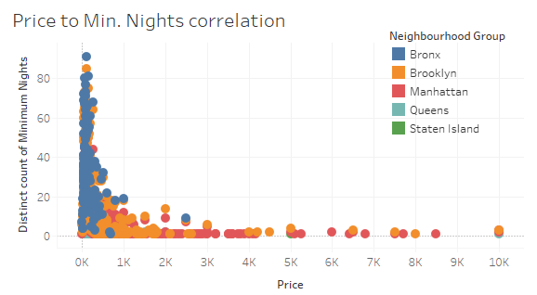
Correlation Analysis
Minimum nights spent at any room is directly related to the pricing of the listing.
For instance, Bronx recorded more minimum nights spend compared to Manhattan as the pricing was comparatively lower in Bronx.

Slide 25
Conclusion
Based on the exploratory analysis, it was evident from the data that:
Manhattan and Brooklyn were the most preferred localities for visitors.
Entire home/Apt or Private rooms were preferred by the majority of customers.
People also considered budget-friendly options like Bronx for spending more nights.
Manhattan has the most expensive listings and the Staten Island has the most affordable.
Staten Island has the highest availability of rooms in a year, whereas Brooklyn has the lowest
Most reviews were given to the entire room/apt in Manhattan, and least for shared rooms in Staten Island.

Slide 26
Thank you

