Slide 1
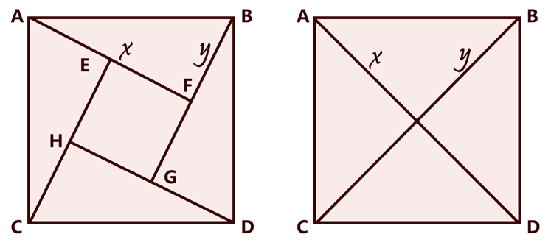
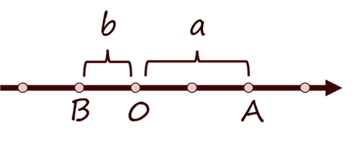
A
B
A
B
x
y
x
y
E
F
H
G
C
D
C
D
b
a
B
0
A

Slide 2
|a|+|b|
|a|+|b|
b
a
b
a
B
0
A
B
0
A
a-b
a-b
|a|+|b|
|a|+|b|
b
a
b
a
0
B
A
B
A
0
a-b
a-b

Slide 3
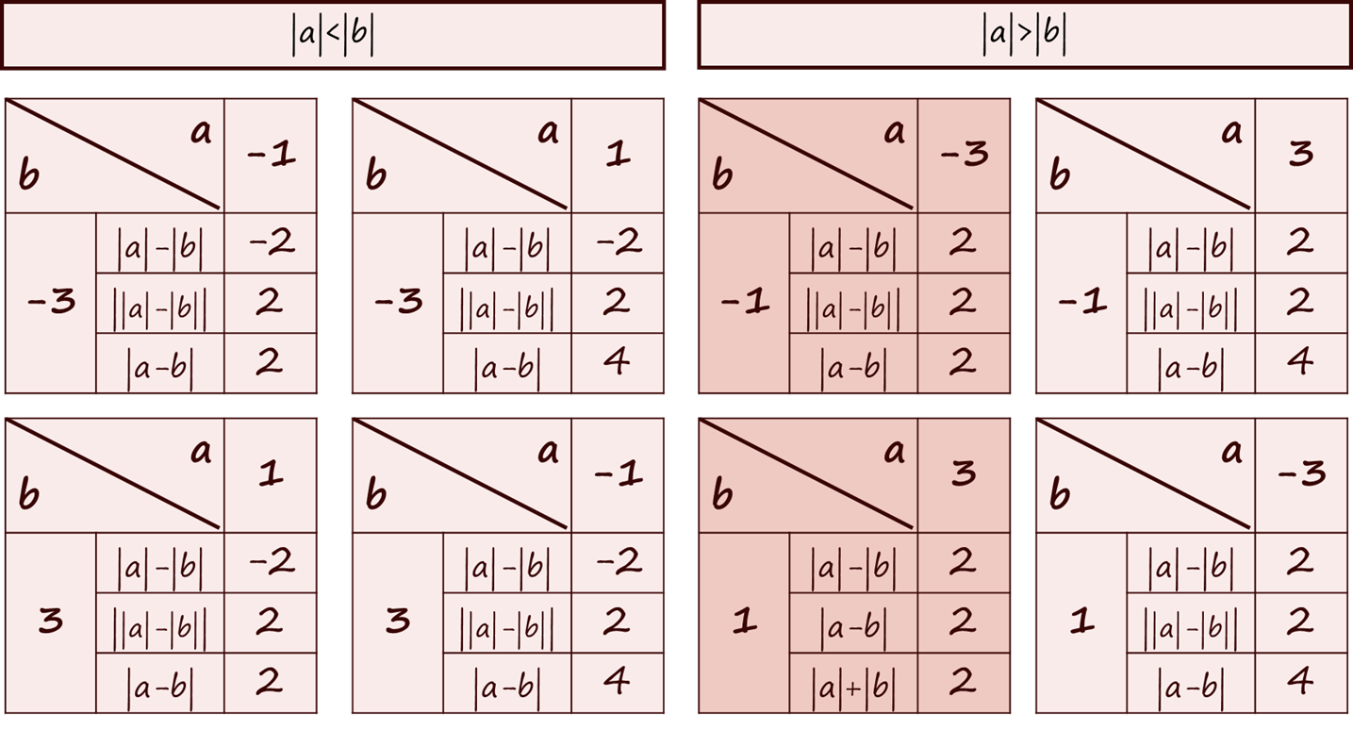

Slide 4
|a|>|b|
|a|<|b|
|a|>|b|
|a|<|b|
a b |  | -1
-3 | |a|-|b| | -2
 | ||a|-|b|| | 2
 | |a-b| | 2
a b |  | 1
-3 | |a|-|b| | -2
 | ||a|-|b|| | 2
 | |a-b| | 4
a b |  | -3
-1 | |a|-|b| | 2
 | ||a|-|b|| | 2
 | |a-b| | 2
a b |  | 3
-1 | |a|-|b| | 2
 | ||a|-|b|| | 2
 | |a-b| | 4
a b |  | 1
3 | |a|-|b| | -2
 | ||a|-|b|| | 2
 | |a-b| | 2
a b |  | -1
3 | |a|-|b| | -2
 | ||a|-|b|| | 2
 | |a-b| | 4
a b |  | 3
1 | |a|-|b| | 2
 | |a-b| | 2
 | |a|+|b| | 2
a b |  | -3
1 | |a|-|b| | 2
 | ||a|-|b|| | 2
 | |a-b| | 4

Slide 5
|a|>|b|
|a|<|b|
|a|>|b|
AB同侧
AB异侧
a b |  | -1
-3 | |a|-|b| | -2
 | |a-b| | 2
 | |a|+|b| | 4
a b |  | 1
-3 | |a|-|b| | -2
 | |a-b| | 4
 | |a|+|b| | 4
a b |  | -3
-1 | |a|-|b| | 2
 | |a-b| | 2
 | |a|+|b| | 4
a b |  | 3
-1 | |a|-|b| | 2
 | |a-b| | 4
 | |a|+|b| | 4
a b |  | -1
3 | |a|-|b| | -2
 | |a-b| | 4
 | |a|+|b| | 4
a b |  | 1
3 | |a|-|b| | -2
 | |a-b| | 2
 | |a|+|b| | 4
a b |  | 3
1 | |a|-|b| | 2
 | |a-b| | 2
 | |a|+|b| | 4
a b |  | -3
1 | |a|-|b| | 2
 | |a-b| | 4
 | |a|+|b| | 4

Slide 6
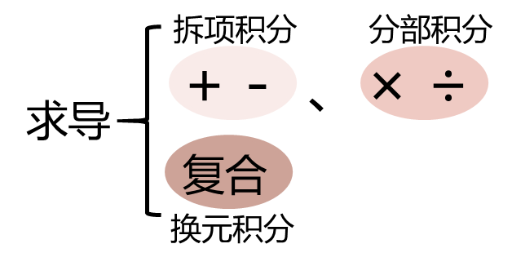
拆项积分 分部积分
+ - 、× ÷
复合
求导
换元积分

Slide 7
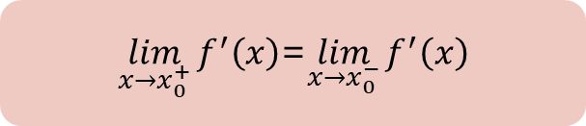
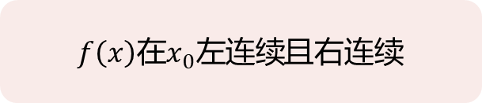
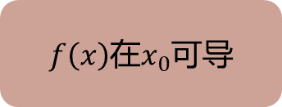
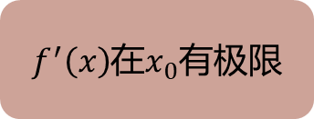
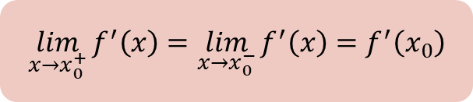
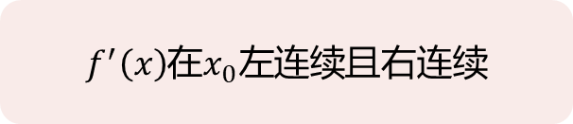

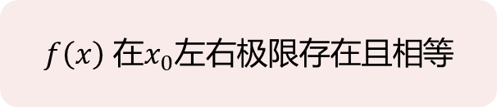
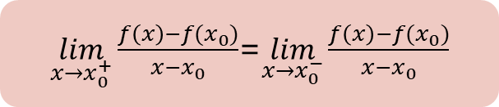
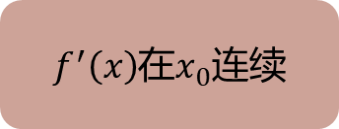
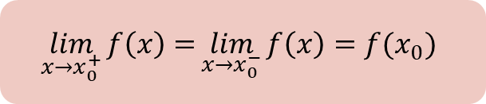
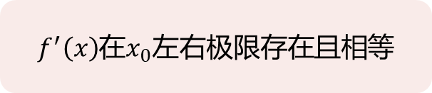

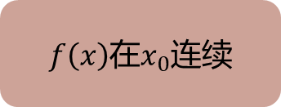


$f\left(x\right)$在$x_{0}$有极限
$$\lim_{x→x_{0}^{+}}{f\left(x\right)=}\lim_{x→x_{0}^{−}}{f(x)}$$
$f\left(x\right)$ ${在x}_{0}$左右极限存在且相等
×
$f\left(x\right)$在$x_{0}$连续
$$\lim_{x→x_{0}^{+}}{f\left(x\right)=}\lim_{x→x_{0}^{−}}{f\left(x\right)=f(x_{0})}$$
$f\left(x\right){在x}_{0}左连续$且右连续
×
×
$f\left(x\right)$在$x_{0}$可微
$f\left(x\right)$在$x_{0}$可导
$\lim_{x→x_{0}^{+}}{\frac{f\left(x\right)−f(x_{0})}{x−x_{0}}}$=$\lim_{x→x_{0}^{−}}{\frac{f\left(x\right)−f(x_{0})}{x−x_{0}}}$
$$f\left(x\right)一阶可导$$
×
$f^{′}\left(x\right)$在$x_{0}$有极限
$\lim_{x→x_{0}^{+}}{f^{′}\left(x\right)}$=$\lim_{x→x_{0}^{−}}{f^{′}\left(x\right)}$
$f^{′}\left(x\right)$在$x_{0}$左右极限存在且相等
×
$f^{′}\left(x\right)$在$x_{0}$连续
$\lim_{x→x_{0}^{+}}{f^{′}\left(x\right)}=\lim_{x→x_{0}^{−}}{f^{′}\left(x\right)=}$ $f^{′}\left(x_{0}\right)$
$f^{′}\left(x\right)$在$x_{0}左连续$且右连续

Slide 8
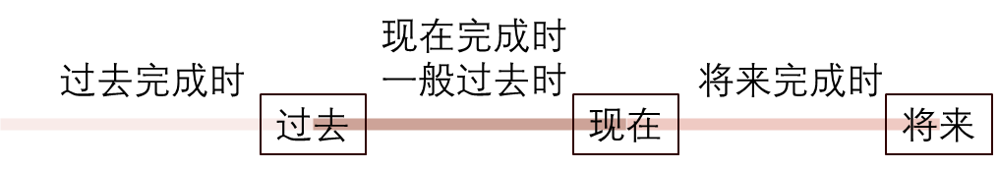
现在完成时
一般过去时
过去完成时
将来完成时
过去
现在
将来

Slide 9
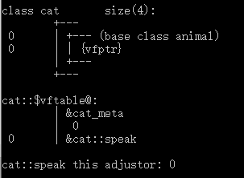
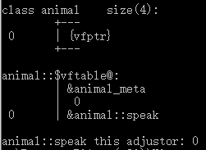
class animal
{
public:
virtual void speak()
{
cout<<"动物在叫"<<endl;
}
};
vfptr
Vftable
&animal::speak
class cat:public animal
{
public:
void speak()
{
cout<<"喵喵喵"<<endl;
}
};
vfptr
Vftable
&cat::speak

