Slide 1
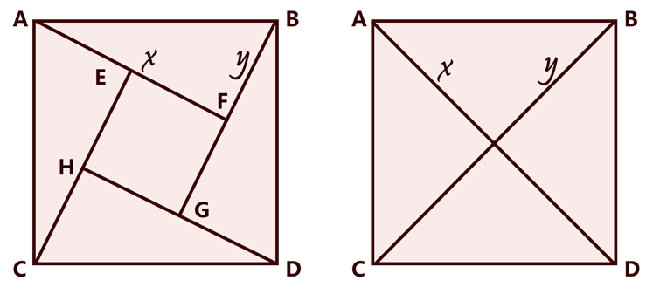
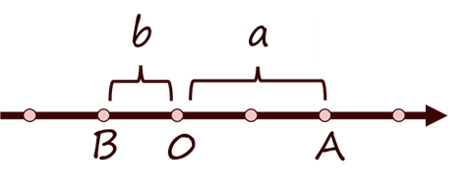
A
B
A
B
x
y
x
y
E
F
H
G
C
D
C
D
b
a
B
0
A

Slide 2
|a|+|b|
|a|+|b|
b
a
b
a
B
0
A
B
0
A
a-b
a-b
|a|+|b|
|a|+|b|
b
a
b
a
0
B
A
B
A
0
a-b
a-b

Slide 3
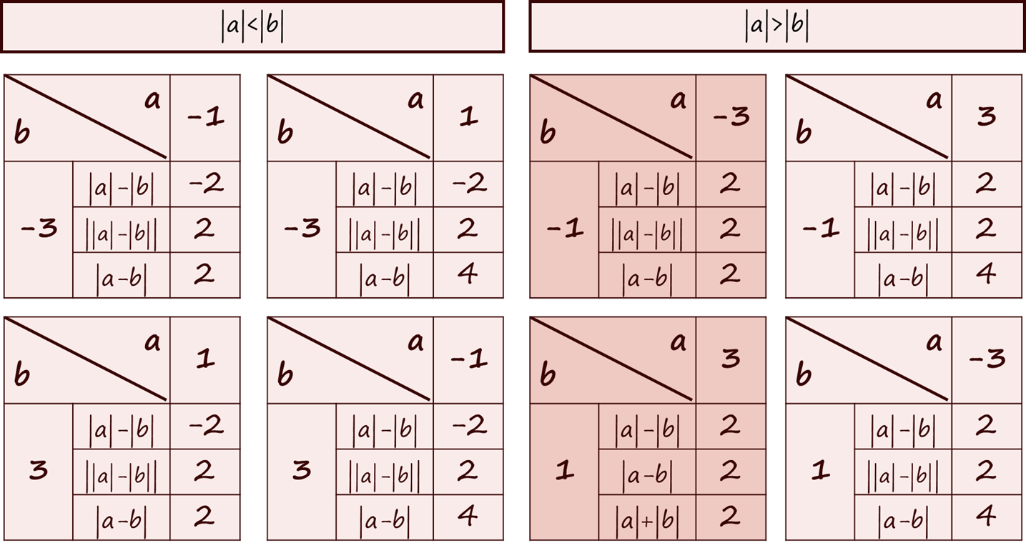

Slide 4
|a|>|b|
|a|<|b|
|a|>|b|
|a|<|b|
a b |  | -1
-3 | |a|-|b| | -2
 | ||a|-|b|| | 2
 | |a-b| | 2
a b |  | 1
-3 | |a|-|b| | -2
 | ||a|-|b|| | 2
 | |a-b| | 4
a b |  | -3
-1 | |a|-|b| | 2
 | ||a|-|b|| | 2
 | |a-b| | 2
a b |  | 3
-1 | |a|-|b| | 2
 | ||a|-|b|| | 2
 | |a-b| | 4
a b |  | 1
3 | |a|-|b| | -2
 | ||a|-|b|| | 2
 | |a-b| | 2
a b |  | -1
3 | |a|-|b| | -2
 | ||a|-|b|| | 2
 | |a-b| | 4
a b |  | 3
1 | |a|-|b| | 2
 | |a-b| | 2
 | |a|+|b| | 2
a b |  | -3
1 | |a|-|b| | 2
 | ||a|-|b|| | 2
 | |a-b| | 4

Slide 5
|a|>|b|
|a|<|b|
|a|>|b|
AB同侧
AB异侧
a b |  | -1
-3 | |a|-|b| | -2
 | |a-b| | 2
 | |a|+|b| | 4
a b |  | 1
-3 | |a|-|b| | -2
 | |a-b| | 4
 | |a|+|b| | 4
a b |  | -3
-1 | |a|-|b| | 2
 | |a-b| | 2
 | |a|+|b| | 4
a b |  | 3
-1 | |a|-|b| | 2
 | |a-b| | 4
 | |a|+|b| | 4
a b |  | -1
3 | |a|-|b| | -2
 | |a-b| | 4
 | |a|+|b| | 4
a b |  | 1
3 | |a|-|b| | -2
 | |a-b| | 2
 | |a|+|b| | 4
a b |  | 3
1 | |a|-|b| | 2
 | |a-b| | 2
 | |a|+|b| | 4
a b |  | -3
1 | |a|-|b| | 2
 | |a-b| | 4
 | |a|+|b| | 4

Slide 6
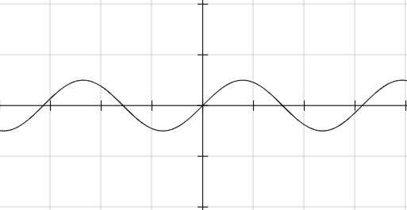
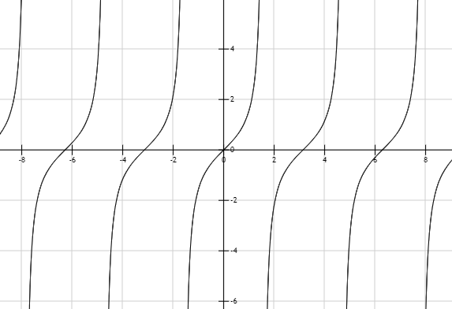
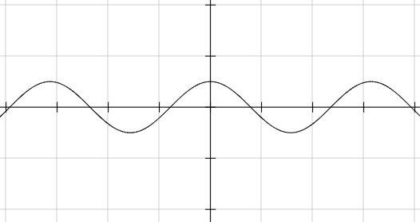


sin x
tan x
π
2π
$\frac{1}{2}$π
$\frac{3}{2}$π
cos x
π
2π

Slide 7
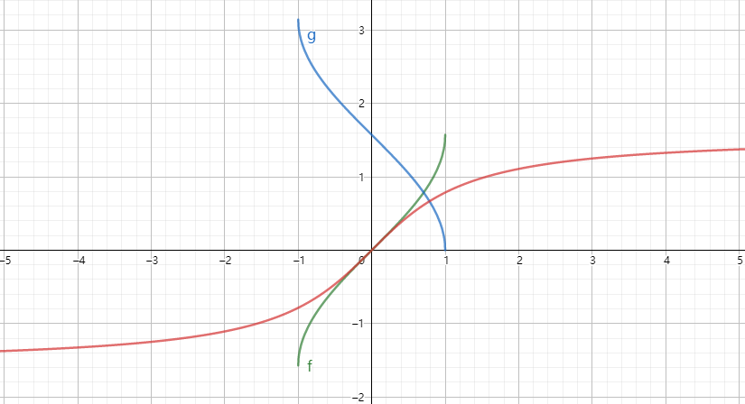
arccos x
arcsin x
arctan x

