Slide 1
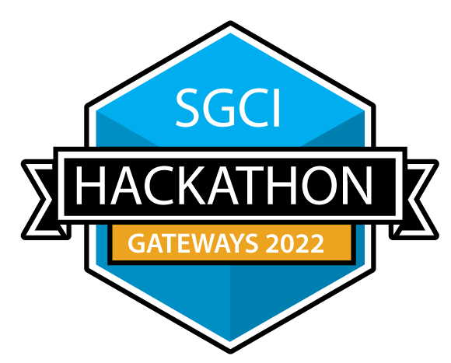

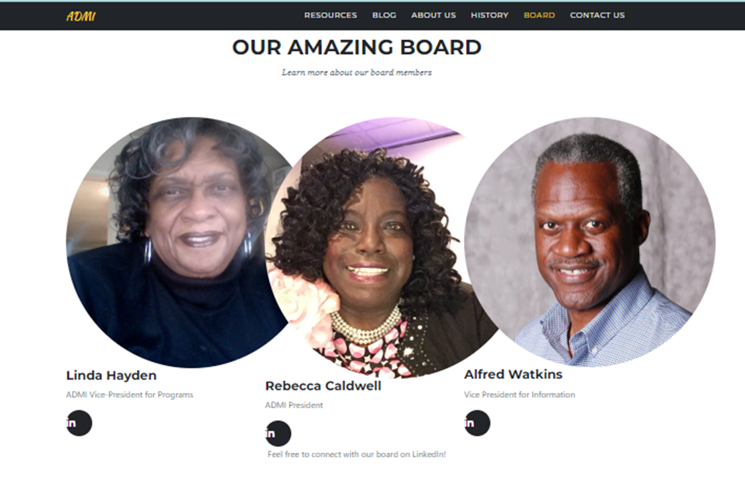
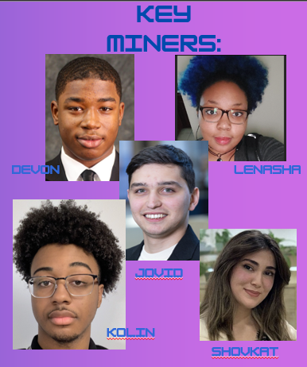

Title: The Data Miners and ADMI Reimagined
SGCI award # 1547611
Revised Description
Sample HPC/Gateways Exercise
Gateway Community Mentor Syllabus Suggestions
Introducing the newly reimagined website of the Association of Computer Science Departments at Minority Institutions (ADMI). Our redesigned platform aims to foster collaboration, empower minority students, and elevate the field of computing within educational institutions.
As a leading organization, ADMI is dedicated to addressing the unique challenges and opportunities that minority students and institutions face in the realm of computer science. Our symposium, which lies at the heart of our mission, serves as a dynamic forum for discussing critical computing issues, sharing insights, and fostering innovation.
With the revamped website, we strive to provide an enhanced user experience that reflects the vibrancy and inclusivity of ADMI.
1. Clearly Define Project Goals: Make sure you have a clear understanding of the goals and objectives you want to achieve with the reimagined ADMI website. This will help guide your decision-making process and ensure the project stays focused.
2. Plan and Prioritize: Create a detailed project plan with a timeline, tasks, and milestones. Prioritize the tasks based on their importance and dependencies to ensure a smooth and organized implementation process.
3. User-Centric Approach: Keep the target audience in mind throughout the development process. Understand their needs, preferences, and pain points to create a user-friendly and engaging website that addresses their requirements.
4. Engage Stakeholders: Involve key stakeholders such as ADMI members, educators, and students in the project. Seek their input and feedback to ensure the website meets their expectations and serves their needs effectively.
Possible Expansions
Moving forward, after completing the resources and board sections of our website, there are several potential future endeavors to consider. These include creating a dedicated section for events and conferences, where upcoming gatherings relevant to minority students and computing education can be showcased. Additionally, establishing a student showcase section would allow students from minority institutions to exhibit their projects and research accomplishments. Developing a mentorship program to connect experienced professionals with aspiring minority students is another valuable pursuit, as is expanding the resources section to encompass career-related materials. Building a community forum or discussion board could foster engagement and knowledge exchange, while featuring research and publications from minority institutions would promote their contributions in the field of computer science.
In this captivating picture, we proudly showcase the fresh and innovative format we have adopted to highlight our esteemed board members. With a renewed approach, we aim to bring their expertise, passion, and dedication to the forefront, captivating the attention of all who visit our platform.
Embracing change and progress, we have reimagined the way we present our exceptional leaders. Each board member's photo is thoughtfully framed within a circular, rounded-edge design, symbolizing inclusivity and unity.
The image captures the essence of our vibrant and diverse board, featuring individuals who are catalysts for growth and transformation within ADMI. Their smiling faces radiate enthusiasm and a shared commitment to advancing computing education for minority students and institutions.
Through this new format, we provide a captivating visual experience, complemented by concise and impactful information about each board member. We also proudly showcase their social media presence, allowing for seamless connectivity and engagement with the wider ADMI community.
Implementation Schedule
Resource Needs/List
Resources
Jekyll
Youtube
ChatGPT
Visual Code Studio
Github/Git Pages
1. Foundational Website: Develop the website structure, design a user-friendly interface, and implement necessary functionalities for a responsive design.
2. About Us: Create a comprehensive "About Us" section showcasing our organization's mission, achievements, team, and commitment to promoting computing education in minority institutions.
3. Resources Page: Curate and organize a range of resources including scholarships, internships, mentorship initiatives, and diversity best practices for a dedicated resources page.
4. Newsletter Data Repository: Establish a working newsletter data repository with a secure and user-friendly subscription system for regular updates and announcements.
5. Blog: Develop a blog section featuring informative and engaging articles, success stories, and emerging trends in computing education.
6. Testing and Refinement: Conduct rigorous testing, gather user feedback, and refine the website, newsletter repository, and blog for optimal functionality and user experience.
7. Launch and Promotion: Officially launch the website, promote it through social media campaigns, email marketing, collaborations, and targeted outreach to reach the target audience.
community.
- Jekyll: Utilize Jekyll, a static site generator, to streamline the development process and manage site content efficiently.
- HTML/CSS: Knowledge and expertise in HTML and CSS to design and implement the user interface.
- GitPages: Use GitPages, a hosting service, to deploy the website and ensure version control.
- Content Creation: Develop engaging and informative content for the "About Us" section, including mission statements, achievements, and team profiles.
- Graphic Design: Create visually appealing graphics and images to enhance the presentation of the "About Us" content.
- Content Organization: Structure the resources page in a user-friendly manner, categorizing and tagging resources for easy navigation.
- Content Management System (CMS): Implement a CMS, such as Jekyll CMS plugins, to efficiently manage and update the resources page.
- Database Management: Set up a database or utilize third-party services for securely storing and managing subscriber information.
Authors
Use Cases
Students and Prospective Students
Educators and Institutions
Professionals and Mentors
Industry and Organizations
Research Community
Your feedback is welcomed →

