Slide 1
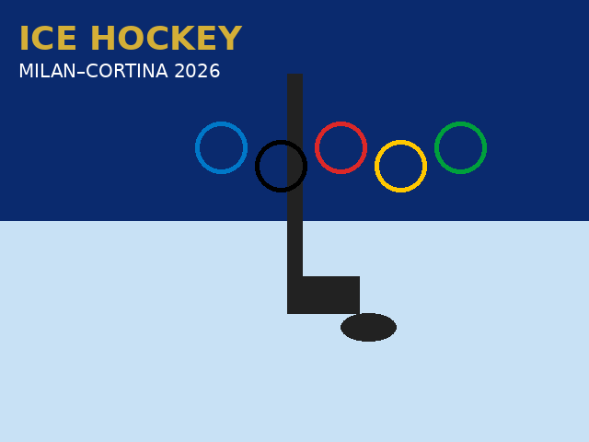
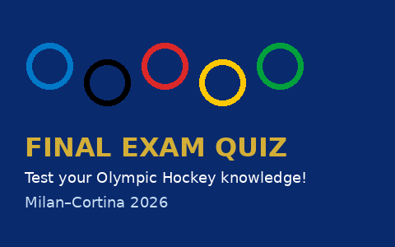
OLYMPIC ICE HOCKEY
Speed · Skill · Passion on Ice
Milan–Cortina 2026 Winter Olympics
Presented by: Olympic Sports Education Program
February 2026

Slide 2
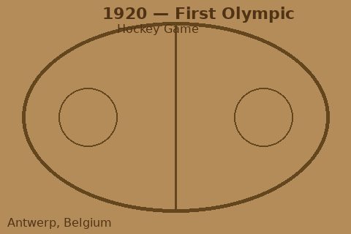
History & Background of Olympic Ice Hockey
From frozen ponds to the world's biggest stage
• Ice hockey originated in Canada in the mid-1800s, with the first recorded indoor game in Montreal in 1875.
• Canada dominated early Olympic hockey, winning gold in 1920, 1924, 1928, 1932, and 1948.
• Men's ice hockey became an Olympic sport at the 1920 Antwerp Summer Games — the only Summer Olympics to include it.
• It became a permanent fixture at the Winter Olympics starting with the 1924 Chamonix Games.
• The Soviet Union rose to dominance in the 1950s–1970s, winning multiple Olympic gold medals.
• Women's ice hockey was added to the Olympic program at the 1998 Nagano Winter Games.
• NHL players were allowed to compete starting with the 1998 Nagano Olympics, raising the level of play dramatically.
• The 2026 Milan–Cortina Games continue this storied tradition with the world's best players competing.
Key Moments
• First Olympic gold: Canada (1920)
• USSR won 7 Olympic golds between 1956–1992
• USA's 'Miracle on Ice': 1980 Lake Placid upset over USSR
• Canada won gold in both men's and women's in 2002, 2010, and 2014

Slide 3
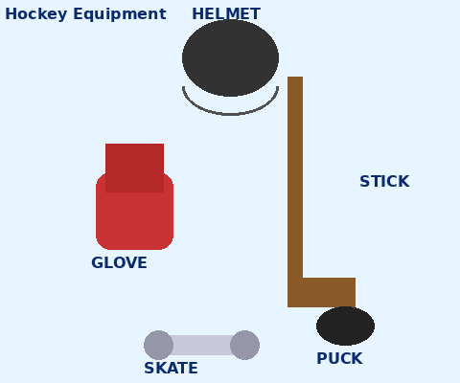
Rules, Equipment & How Scoring Works
Everything you need to know to follow the game
The Rules
Equipment
SCORING Goal (during play): 1 point Power Play Goal: 1 point (scored while opponent has a penalty) Short-Handed Goal: 1 point (scored while YOUR team has a penalty) Shootout goal: counts only if game is tied after OT
• Each team has 6 players on ice: 1 goalie, 2 defensemen, 3 forwards.
• 3 periods × 20 minutes each (regulation time); overtime & shootout if tied.
• A goal is scored when the puck fully crosses the goal line into the net.
• Offside: a player cannot enter the offensive zone before the puck.
• Icing: shooting the puck from behind the center line past the opponent's goal line (without scoring) is illegal.
• Penalties: minor (2 min), major (5 min), or misconduct (10 min); team plays shorthanded.
• At the Olympics, ties after 3 periods go to a 5-min sudden-death OT, then shootout.
• Skates – stiff boot with a sharp blade
• Stick & puck – vulcanized rubber puck (6 oz)
• Helmet with full cage or visor
• Shoulder & elbow pads, shin guards
• Gloves, padded pants (breezers)
• Goalie: extra leg pads, blocker, trapper, mask
• Jersey, neck guard, and mouth guard

Slide 4
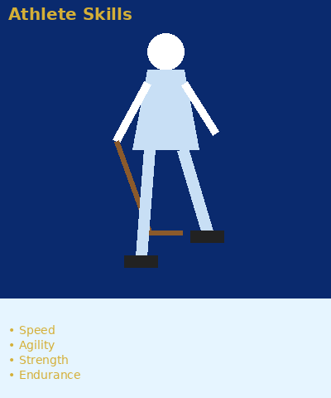
Skills an Athlete Needs to Compete
Fitness · Training · Nutrition
On-Ice Skills
Fitness & Training
• Skating speed & agility – explosive edge-work and quick turns
• Stickhandling – puck control at high speed with both hands
• Passing & receiving – crisp, accurate passes under pressure
• Shooting – wrist shot, slap shot, backhand with precision
• Defensive positioning – gap control, angling opponents
• Hockey IQ – reading plays, anticipating puck movement
• VO₂ max / cardiovascular endurance for 45-sec shifts
• Explosive leg power: squats, Olympic lifts, box jumps
• Core stability for balance on the ice
• Upper body strength for battling in corners & puck battles
• Flexibility & agility: lateral movements, hip mobility
• Elite players skate up to 5–6 km per game
Nutrition
• High carb intake pre-game (pasta, rice, oatmeal) for fuel
• Lean protein (chicken, fish, eggs) for muscle repair
• Hydration: 2–3 L water/day; electrolytes during play
• Recovery: protein shake + carbs within 30 min post-game
• Avoid heavy or fried food on game day
• Supplements: vitamin D, iron, omega-3 (doctor supervised)

Slide 5
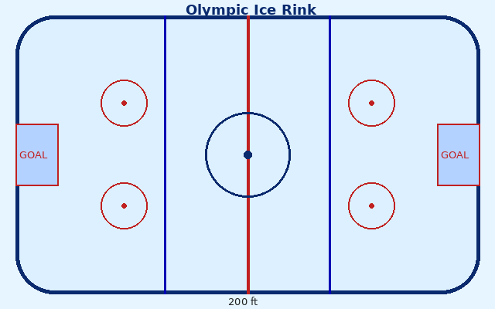
The Competition Process
How Olympic Ice Hockey is played and structured
Tournament Format & Game Structure
• 12 men's teams & 8 women's teams qualify for the Olympics.
• Teams are divided into groups for a preliminary round-robin stage.
• Top teams advance to a single-elimination playoff bracket.
• Quarterfinals → Semifinals → Bronze Medal Game → Gold Medal Game.
• Games are played on a 200 ft × 85 ft (61 m × 26 m) international rink.
• International rink is slightly wider than the NHL standard rink.
• IIHF (International Ice Hockey Federation) officiates all games.
• Two referees and two linesmen on the ice for each game.
• Video review (Coach's Challenge) available for disputed goals.
Key In-Game Situations
• Face-off: puck drop starts each period & after stoppages
• Power Play: 5-on-4 advantage when opponent penalized
• Penalty Kill: defending a power play situation
• Line Changes: players substitute on the fly (no stoppage needed)
• Icing & Offside: automatic stoppage, face-off in defensive zone

Slide 6
Watch Olympic Ice Hockey in Action
Highlight reel — see the speed, skill, and passion up close
▶ CLICK TO WATCH VIDEO
Olympic Ice Hockey – Best Goals & Highlights (Beijing 2022) https://www.youtube.com/watch?v=7oGfWJTFBF8 (Duration: approx. 2 min 45 sec)
Backup video (official Olympic channel): https://www.youtube.com/@Olympics → search "Ice Hockey Highlights"

Slide 7
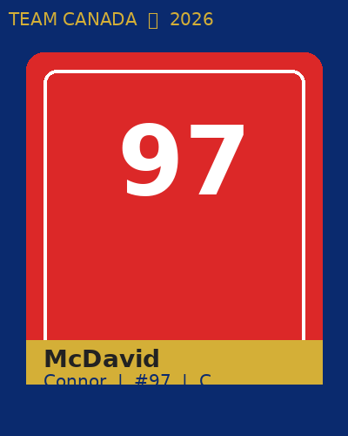
Spotlight Olympian: Connor McDavid
Team Canada | Center | 2026 Milan–Cortina Winter Olympics
Background & Career
2024-25 NHL Stats GP: 82 G: 62 A: 87 PTS: 149 +/-: +48 Career Points: 1,100+
• Born: January 13, 1997, in Richmond Hill, Ontario, Canada
• Position: Center | Shoots: Left | Height: 6'1" | Weight: 193 lbs
• NHL Team: Edmonton Oilers (Captain since age 19 — youngest in NHL history)
• First Overall NHL Draft Pick (2015 NHL Entry Draft)
• Grew up playing hockey in Richmond Hill; turned pro at age 18
• Known as the fastest and most skilled player of his generation
Major Achievements
• 6× Hart Trophy Winner (MVP) – 2017, 2021, 2022, 2023, 2024, 2025
• 6× Art Ross Trophy (scoring title) – NHL's top point scorer
• Ted Lindsay Award (players' choice MVP) – multiple times
• NHL All-Star Game – selected every eligible season
• 2025 Stanley Cup Champion with the Edmonton Oilers
• Team Canada – multiple World Championship gold medals
• 2022 Beijing Winter Olympics – Team Canada (did not take gold but was standout player)
• 2026 Milan–Cortina – expected to captain Team Canada
• "Every day I come to the rink, I want to be
• the best player on the ice."
• — Connor McDavid

Slide 8
Final Exam Review — Test Your Knowledge!
Choose the best answer for each question
1. In what year did men's ice hockey first appear at the Olympic Games?
2. How many periods are in a regulation Olympic ice hockey game?
A) 1896 B) 1900 C) 1920 ✓ D) 1936
A) 2 B) 3 ✓ C) 4 D) 5
Answer: C — 1920 Antwerp Summer Olympics
Answer: B — 3 periods of 20 minutes each
3. Which rule means a player cannot enter the offensive zone before the puck?
4. Connor McDavid was selected _____ overall in the 2015 NHL Draft.
A) Icing B) Hooking C) High-Sticking D) Offside ✓
A) 2nd B) 5th C) 1st ✓ D) 10th
Answer: D — Offside
Answer: C — 1st overall by the Edmonton Oilers

Slide 9
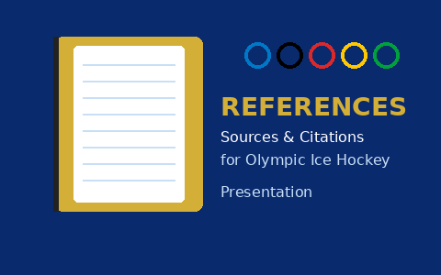
References
Sources used for information in this presentation
• International Ice Hockey Federation (IIHF) — Official rules, history, statistics: https://www.iihf.com
• International Olympic Committee — Olympic ice hockey history and results: https://olympics.com/en/sports/ice-hockey/
• National Hockey League (NHL) — Player stats, bios, game rules: https://www.nhl.com
• Connor McDavid — Official NHL player profile: https://www.nhl.com/player/connor-mcdavid-8478402
• Olympic.org — Milan Cortina 2026 Winter Olympics: https://olympics.com/en/olympic-games/milan-cortina-2026
• Wikipedia — Ice hockey at the Olympic Games: https://en.wikipedia.org/wiki/Ice_hockey_at_the_Olympic_Games
• Wikimedia Commons — Images used throughout this presentation: https://commons.wikimedia.org
• Hockey Canada — Athlete development, nutrition, and training guidelines: https://www.hockeycanada.ca
• YouTube / Olympic Channel — Video highlights: https://www.youtube.com/@Olympics
All images sourced from Wikimedia Commons (Public Domain / CC License) Video content from the Official Olympic YouTube Channel

