Slide 1



MATCHPROOF
Product discovery
that understands context
A merchant-side search pipeline for FPT ecommerce
Team Mát nét · UAVS Hackathon 2026
Notes:
Sources: FPT Problem Statement Final.pdf for the challenge framing and FPT/UAVS logos. MatchProof repository assets for the watch image. Team name from MatchProof_Round_1_Proposal.pdf.

Slide 2
Product search stops at the catalog surface
WHAT MERCHANTS EXPOSE
WHAT AGENTS ACTUALLY ASK
Text search
“Here is what I’m wearing. Find a smartwatch that suits it for a wedding.”
Works when the buyer uses the same words as the catalog.
Image search
Works only when visual meaning has been captured in metadata or a compatible visual index.
The answer depends on the image, the occasion, the requested product type, and the merchant’s actual inventory.
Today, those signals rarely meet in one retrieval path.
MATCHPROOF · FPT AUSTRALASIA CHALLENGE
02
Notes:
Sources: User-supplied problem description. FPT Problem Statement Final.pdf describes the merchant-side B2A challenge, semantic intention matching, and the need to decode complex, multi-constraint requests.

Slide 3
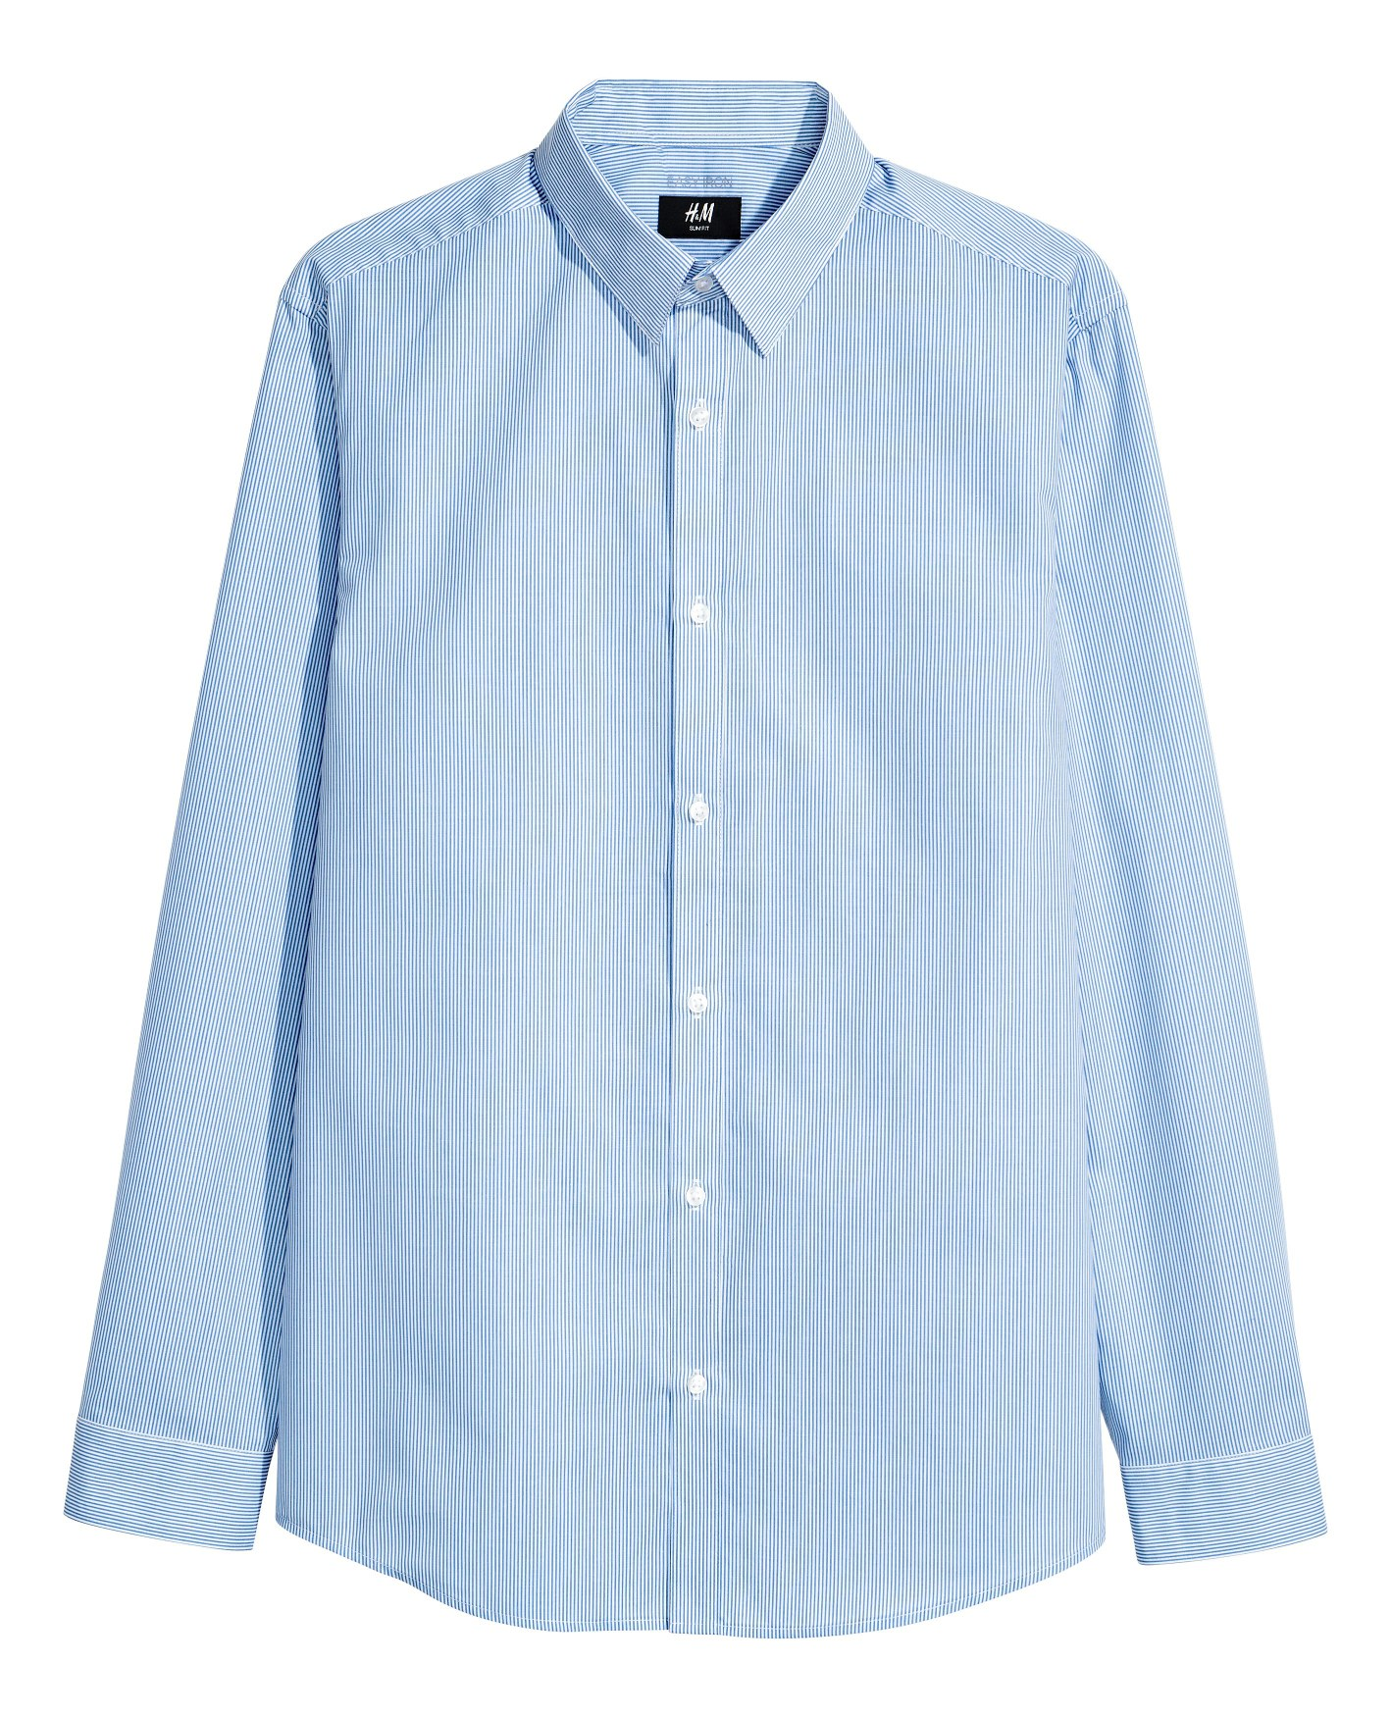
One request carries two kinds of intent
“Find a smartwatch that looks right with this outfit at a wedding. Keep it understated and suitable for all-day wear.”
+
The image supplies visual style
The text supplies product type, occasion, and preferences
REFERENCE IMAGE
MatchProof combines both before searching.
MATCHPROOF · FPT AUSTRALASIA CHALLENGE
03
Notes:
Scenario supplied by the user. The outfit image is an illustrative project catalog asset from the H&M competition sample; see data/README.md for non-commercial licensing limits. The deck does not represent this as a measured live query result.

Slide 4
Merchant-side multimodal retrieval pipeline
CATALOG PREPARATION
Product image
+ existing metadata
Gemini multimodal
embedding
Shared vector index
(sqlite-vec)
Image meaning no longer depends only on merchant-authored visual tags.
LIVE AGENT REQUEST
MCP call
image + text
LLM intent
plan
Query
embedding
Retrieve +
verify
Ranked result
with evidence
Intent is rewritten before retrieval, then mandatory conditions gate the final answer.
MATCHPROOF · FPT AUSTRALASIA CHALLENGE
04
Notes:
Sources: README.md and implementation files src/extraction/intent.ts, src/embedding/gemini.ts, src/mcp/searchPipeline.ts, src/ranking/rank.ts, and src/server.ts. Diagram is editable. Gemini model names and sqlite-vec reflect the current repository configuration.

Slide 5
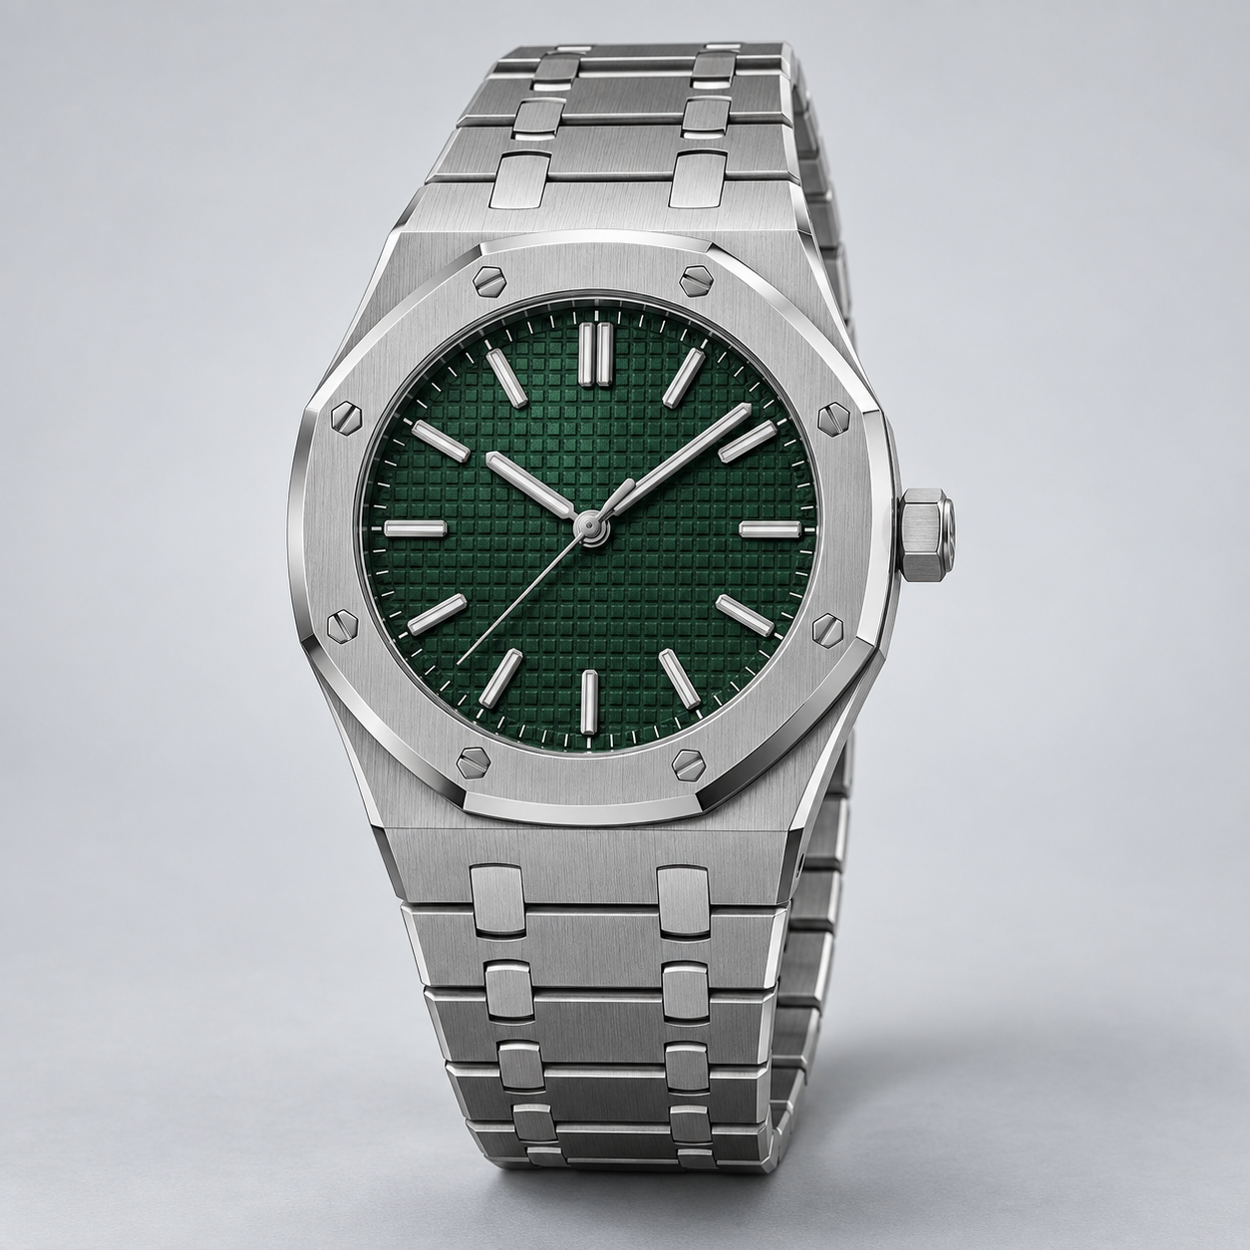
Relevance and eligibility serve different jobs
ELIGIBILITY
Mandatory
Preferred
Correct product type
Fits the occasion
Within any hard limits
Understated styling
Dark face or strap
Comfort for all-day wear
+
RETRIEVAL
Find visually and semantically close candidates
A highly similar item can still be rejected when it fails a mandatory condition.
MATCHPROOF · FPT AUSTRALASIA CHALLENGE
05
Notes:
Sources: README.md and src/ranking/rank.ts. The repository ranks eligible items by preferred matches and vector similarity, while mandatory-condition failures remain secondary results. Product image is an illustrative local demo asset.

Slide 6

The interface today is MCP
Buyer agents call a merchant tool and receive structured results they can inspect, compare, and continue from.
ILLUSTRATIVE TOOL RESPONSE
status
ok
top_result
formal smartwatch candidate
why_match
formal styling aligns with the reference outfit and wedding context
evidence
per-condition outcomes, source metadata, similarity, near misses
next_action
clarify, bundle, or pass the selected product to commerce APIs
Same decision payload powers the inline product-card view.
MATCHPROOF · FPT AUSTRALASIA CHALLENGE
06
Notes:
Sources: README.md, src/server.ts, src/mcp/format.ts, and src/mcp/ui/productResults.ts. The response shown is illustrative, not a captured live transaction. Current transport is MCP JSON-RPC over stdio.

Slide 7
What this gives an FPT retail client
01
More inventory becomes discoverable
The image contributes meaning directly, reducing reliance on manually authored visual descriptors for every product.
02
Recommendations become easier to trust
The response shows why an item matched and keeps mandatory failures visible as near misses instead of hiding them.
03
One merchant layer can serve many agents
MCP exposes the capability today. Commerce adapters can connect the same pipeline to future agent protocols and channels.
MATCHPROOF · FPT AUSTRALASIA CHALLENGE
07
Notes:
Sources: User-supplied solution framing and repository architecture. These are expected merchant benefits and hypotheses for a pilot, not measured commercial outcomes. FPT Problem Statement Final.pdf identifies intention accuracy, technical architecture, and business value as evaluation priorities.

Slide 8
Prototype scope and production boundary
IMPLEMENTED IN THE MVP
PRODUCTION WORK REMAINING
TypeScript MCP server
Live merchant catalog sync
Structured intent extraction with clarification
Tenant isolation, durable sessions, and operational monitoring
Gemini image + text embeddings with sqlite-vec retrieval
Availability and price revalidation
Mandatory and preferred checks with explainable ranking
Checkout or order creation integration
Search, matching, complement, bundle, and clarification tools
Evaluation on a real retail catalog and real agent traffic
Inline MCP product results
Demo hardening: refresh fixtures and complete the end-to-end rehearsal.
MATCHPROOF · FPT AUSTRALASIA CHALLENGE
08
Notes:
Sources: README.md, task.md, package.json, and current source tree. TypeScript tsc --noEmit passed on 13 Sep 2026. The local demo-catalog test currently stops because data/electronics/dress_watches_catalog.json is missing; the deck discloses this in small text rather than claiming all tests pass.

Slide 9
A focused FPT pilot
Prove the pipeline on one high-intent retail category with a real catalog and a defined query set.
01
02
03
Connect
Benchmark
Integrate
Map product images and existing catalog fields into the merchant index.
Test complex agent requests, failure cases, and useful abstentions.
Add live availability, price checks, and a handoff to checkout.
What we need from FPT
A sample merchant catalog, an integration owner, and agreed success criteria for agent recommendations.
TEAM MÁT NÉT
MATCHPROOF
MATCHPROOF · FPT AUSTRALASIA CHALLENGE
09
Notes:
Sources: Pilot scope is a proposal based on the current repository boundaries and the FPT challenge brief. No commercial performance claims are made. Suggested close: ask FPT for a single-category pilot catalog and an integration counterpart.

