Slide 1








Marvin Sevilla; Marc Cruz; Dennis Uryeu

Slide 2
The Problem
Create a virtual assistant for the SUAS project, leveraging project documentation such as RFP, Reports, Student Documentation, etc. to streamline information access over years and decades.
Marvin Sevilla; Marc Cruz; Dennis Uryeu

Slide 3
The Problem
Create a virtual assistant for the SUAS project, leveraging project documentation such as RFP, Reports, Student Documentation, etc. to streamline information access over years and decades.
Marvin Sevilla; Marc Cruz; Dennis Uryeu

Slide 4
The Problem
Create a virtual assistant for the SUAS project, leveraging project documentation such as RFP, Reports, Student Documentation, etc. to streamline information access over years and decades.
Objectives
Develop a Machine Learning model that is capable of answering basic questions about SUAS
e.g. “What is SUAS?”
Sub-Objective: Accept advanced questions
e.g. “For the OBC trade study, which of the three components were chosen?”

Slide 5
The Problem
Create a virtual assistant for the SUAS project, leveraging project documentation such as RFP, Reports, Student Documentation, etc. to streamline information access over years and decades.
Objectives
Develop a Machine Learning model that is capable of answering basic questions about SUAS
e.g. “What is SUAS?”
Sub-Objective: Accept advanced questions
e.g. “For the OBC trade study, which of the three components were chosen?”
Problem Domain
Logistical Challenges: Aerodynamics Dept. Paperwork
Class material Systems and Project Management stress documentation
Critical Documents such as Risk Matrix, Trade Studies, Main and Derived Objectives, equipment schematics (e.g., Payload, Object Recognition)
Paperwork load increases each semester
Team Challenges: Morale and Knowledge Banks
COVID disruptions destroyed student rapport
Loss of contact with previously experienced students

Slide 6
Available Solution
Objectives
Knowledge-bank is inherited via word-of-mouth
Drawing on knowledge-bank improves net understanding and goal setting
An improved team has potential for modifications to RFP/Rules
Develop a Machine Learning model that is capable of answering basic questions about SUAS
e.g. “What is SUAS?”
Sub-Objective: Accept advanced questions
e.g. “For the OBC trade study, which of the three components were chosen?”
Problem Domain
Logistical Challenges: Aerodynamics Dept. Paperwork
Class material Systems and Project Management stress documentation
Critical Documents such as Risk Matrix, Trade Studies, Main and Derived Objectives, equipment schematics (e.g., Payload, Object Recognition)
Paperwork load increases each semester
Team Challenges: Morale and Knowledge Banks
COVID disruptions destroyed student rapport
Loss of contact with previously experienced students

Slide 7
Detailed Objective
Develop a Question Answering Model for Basic User Inquiries
Utilize BERT framework for Extractive QA Model
Bidirectional Encoder Representations from Transformers
* Input context and question to extract answers
Available Solution
Knowledge-bank is inherited via word-of-mouth
Drawing on knowledge-bank improves net understanding and goal setting
An improved team has potential for modifications to RFP/Rules
Problem Domain
Logistical Challenges: Aerodynamics Dept. Paperwork
Class material Systems and Project Management stress documentation
Critical Documents such as Risk Matrix, Trade Studies, Main and Derived Objectives, equipment schematics (e.g., Payload, Object Recognition)
Paperwork load increases each semester
Team Challenges: Morale and Knowledge Banks
COVID disruptions destroyed student rapport
Loss of contact with previously experienced students

Slide 8
Detailed Objective
Develop a Question Answering Model for Basic User Inquiries
Utilize BERT framework for Extractive QA Model
Bidirectional Encoder Representations from Transformers
* Input context and question to extract answers
Available Solution
Data Collection and Processing
Knowledge-bank is inherited via word-of-mouth
Drawing on knowledge-bank improves net understanding and goal setting
An improved team has potential for modifications to RFP/Rules
Process the raw SUAS-project text files using:
Lowercasing
Punctuation & Special Character removal
Tab removal
Trailing space removal
Tokenize

Slide 9
Detailed Objective
Develop a Question Answering Model for Basic User Inquiries
Utilize BERT framework for Extractive QA Model
Bidirectional Encoder Representations from Transformers
* Input context and question to extract answers
Data Collection and Processing
Process the raw SUAS-project text files using:
Lowercasing
Punctuation & Special Character removal
Tab removal
Trailing space removal
Tokenize

Slide 10
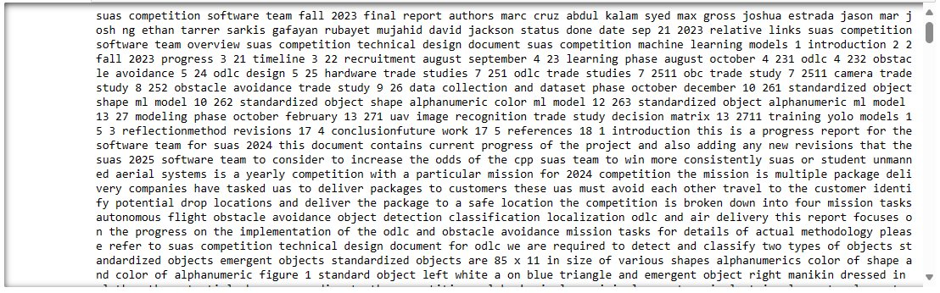
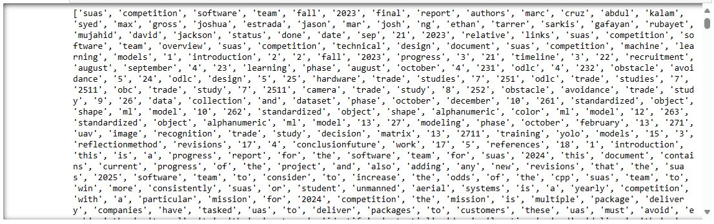
Data Collection and Processing
Cleaned Data
Tokenized Data
Tokenization
BERT Tokenization:
Converts text into numerical tokens
Maps words to unique IDs in BERT's vocabulary
Ensures consistent input dimensions
Special tokens provide structural context
Enables effective text processing

Slide 11
Data Collection and Processing
Tokenization Special Token
Cleaned Data
For example, CLS (Classification Token) and SEP (Separator Token)
Special tokens like CLS and SEP are essential in BERT's architecture. CLS is used for sequence classification tasks, while SEP separates text segments. Mastering their roles is vital for leveraging BERT effectively in NLP tasks.
Tokenized Data
Tokenization
BERT Tokenization:
Converts text into numerical tokens
Maps words to unique IDs in BERT's vocabulary
Ensures consistent input dimensions
Special tokens provide structural context
Enables effective text processing

Slide 12
Methodology
Input Data: Provide context and question
BERT Encoding: Convert input text into numerical representations using BERT
QA Model: Implement an Extractive QA model
Answer Generation: Generate answers based on encoded context and question
Tokenization Special Token
For example, CLS (Classification Token) and SEP (Separator Token)
Special tokens like CLS and SEP are essential in BERT's architecture. CLS is used for sequence classification tasks, while SEP separates text segments. Mastering their roles is vital for leveraging BERT effectively in NLP tasks.
Tokenization
BERT Tokenization:
Converts text into numerical tokens
Maps words to unique IDs in BERT's vocabulary
Ensures consistent input dimensions
Special tokens provide structural context
Enables effective text processing

Slide 13
Methodology
Input Data: Provide context and question
BERT Encoding: Convert input text into numerical representations using BERT
QA Model: Implement an Extractive QA model
Answer Generation: Generate answers based on encoded context and question
Tokenization Special Token
Implementation
For example, CLS (Classification Token) and SEP (Separator Token)
Special tokens like CLS and SEP are essential in BERT's architecture. CLS is used for sequence classification tasks, while SEP separates text segments. Mastering their roles is vital for leveraging BERT effectively in NLP tasks.
Input Data & BERT Encoding
Utilizing regular expressions to clean text (i.e. punctuation, special characters, tabs)
Create BERT formatted Dataset [Questions, Context, Answer]
Questions
Utilizing NER, Named Entity Recognition, to determine subjects to make questions with. Then using question structures to make simple questions
Context
Processed text is turned into size of 512 token chunks to ensure the BERT architecture accepts the shape of the dataset. When tokenized, additional [PAD] Labels ensure the shape size is uniform throughout the model.
Answers
Utilized window size of 10 words before and after an entity in the processed text to extract relevant information that answers the question

Slide 14
Methodology
Input Data: Provide context and question
BERT Encoding: Convert input text into numerical representations using BERT
QA Model: Implement an Extractive QA model
Answer Generation: Generate answers based on encoded context and question
Implementation
Input Data & BERT Encoding
Utilizing regular expressions to clean text (i.e. punctuation, special characters, tabs)
Create BERT formatted Dataset [Questions, Context, Answer]
Questions
Utilizing NER, Named Entity Recognition, to determine subjects to make questions with. Then using question structures to make simple questions
Context
Processed text is turned into size of 512 token chunks to ensure the BERT architecture accepts the shape of the dataset. When tokenized, additional [PAD] Labels ensure the shape size is uniform throughout the model.
Answers
Utilized window size of 10 words before and after an entity in the processed text to extract relevant information that answers the question

Slide 15
Implementation
(QA Model) Extractive QA BERT Model:
Utilizing Hugging Face Transformer library to utilize pretrained model to obtain comprehension between relationship between question and context. Necessary as to teach the model a general 'sense' of questions and extraction of context that should have context
Fine Tuning
Using the preprocessed "specific domain" dataset, allows the model to further understand the domain specific question structure.
Libraries
Pytorch Dataset, DataLoader libraries, transformer library
Architecture
Input Encoding
Transformer Encoder Blocks
Output Layer
Parameters
Base Model: ~110 M
Large Model: ~340 M
Anatomy

Slide 16
Implementation
Architecture
Input Encoding
Transformer Encoder Blocks
Output Layer
Parameters
Base Model: ~110 M
Large Model: ~340 M
Anatomy
Functionality
Bidirectional Context
Understands both left and right context for better comprehension
Bidirectional Context
Trained on large corpora using unsupervised learning tasks such as:
masked language modelling
next sentence prediction

Slide 17
Implementation
Architecture
Input Encoding
Transformer Encoder Blocks
Output Layer
Parameters
Base Model: ~110 M
Large Model: ~340 M
Anatomy
Bidirectional Context
Understands both left and right context for better comprehension
Bidirectional Context
Trained on large corpora using unsupervised learning tasks such as:
masked language modelling
next sentence prediction
Functionality

Slide 18
Implementation
Answer Generation
Load the saved model use it to tokenize a given question and context, which * NEEDS TO BE GIVEN with the question in order to generate an answer
* Resolved with RAG (Retrieval-Augmented Generation)
Determining if the model can answer rudimentary questions that include:
"What is SUAS?"
"What is GCS?"
"What are the SUAS objects?"
Results
Due to requiring a sufficient context to come with a question, the model has limitations until RAG is implemented.
It’s able to provide rough answers to some basic questions.
"What is SUAS?"
"What is SUAS competition technical design?"

Slide 19
Implementation
Discussion
Answer Generation
Load the saved model use it to tokenize a given question and context, which * NEEDS TO BE GIVEN with the question in order to generate an answer
* Resolved with RAG (Retrieval-Augmented Generation)
Determining if the model can answer rudimentary questions that include:
"What is SUAS?"
"What is GCS?"
"What are the SUAS objects?"
Results
Due to requiring a sufficient context to come with a question, the model has limitations until RAG is implemented.
It’s able to provide rough answers to some basic questions.
"What is SUAS?"
"What is SUAS competition technical design?"

Slide 20
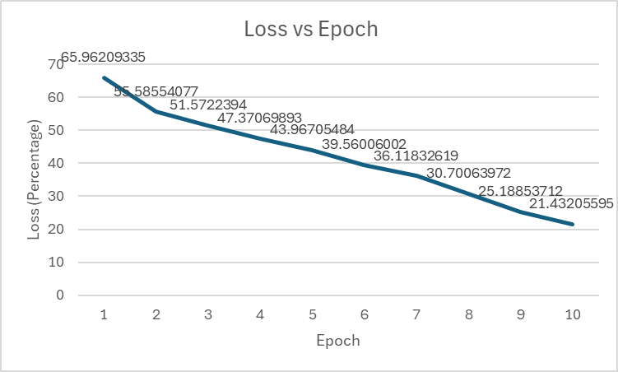
Implementation
Discussion
Large weakness in using NER as it struggled to see several important words like "ODLC" and additional usage of TF-IDF did not catch this issue.
* Attempts to use Bio-tagging to increase the odds of finding entities/subjects to create questions also was futile.
Limitation in the specific domain unless an extreme amount of Aerospace specific paperwork can be used
Emphasis in the necessary need for RAG, or Retrieval-Augmented Generation
* The process of optimizing the output of a large language model
Results
Average Epoch Time:
128.33 seconds/epoch
Loss (%):
21.43206
Exact Match (EM):
0.607
Recall-Oriented Understudy for Gisting Evaluation (ROUGE):
0.724

Slide 21
Conclusion
Dataset Optimization
Testing indicated NER with SpaCy as optimal (specifically using core_web_lg)
Potential Improvements
Consideration of bio-tagging for further enhancement (we witnessed increased algorithmic complexity)
Handling Ambiguity
Introduction of sliding window concept (we noted its effectiveness in addressing answer fuzziness)
Results from Context Extraction
Positive outcomes observed from extracting context around entities
Discussion
Large weakness in using NER as it struggled to see several important words like "ODLC" and additional usage of TF-IDF did not catch this issue.
* Attempts to use Bio-tagging to increase the odds of finding entities/subjects to create questions also were futile
Limitation in the specific domain unless an extreme amount of Aerospace specific paperwork can be used
Emphasis in the necessary need for RAG, or Retrieval-Augmented Generation
* The process of optimizing the output of a large language model
Results
Average Epoch Time:
128.33 seconds/epoch
Loss:
21.43206
Exact Match (EM):
0.607
Recall-Oriented Understudy for Gisting Evaluation (ROUGE):
0.724
Due to requiring a sufficient context to come with a question, the model has limitations until RAG is implemented.
It’s able to provide rough answers to some basic questions.
"What is SUAS?"
"What is SUAS competition technical design?"

Slide 22
Conclusion
Dataset Optimization
Testing indicated NER with SpaCy as optimal (specifically using core_web_lg)
Potential Improvements
Consideration of bio-tagging for further enhancement (we witnessed increased algorithmic complexity)
Handling Ambiguity
Introduction of sliding window concept (we noted its effectiveness in addressing answer fuzziness)
Results from Context Extraction
Positive outcomes observed from extracting context around entities
Limitations and Future Work
Discussion
Current reports and documents are not sufficient material for the BERT model to interpret technical questions
Requires several more years of information gathering or introduction of outside documents to go further into the domain
Evaluation metrics are extremely basic due to the objective scope, new questions, or test cases, and should be developed to thoroughly test the capability of future models
Large weakness in using NER as it struggled to see several important words like "ODLC" and additional usage of TF-IDF did not catch this issue.
* Attempts to use Bio-tagging to increase the odds of finding entities/subjects to create questions also was futile.
Limitation in the specific domain unless an extreme amount of Aerospace specific paperwork can be used
Emphasis in the necessary need for RAG, or Retrieval-Augmented Generation
* The process of optimizing the output of a large language model

Slide 23
Conclusion
Dataset Optimization
Testing indicated NER with SpaCy as optimal (specifically using core_web_lg)
Potential Improvements
Consideration of bio-tagging for further enhancement (we witnessed increased algorithmic complexity)
Handling Ambiguity
Introduction of sliding window concept (we noted its effectiveness in addressing answer fuzziness)
Results from Context Extraction
Positive outcomes observed from extracting context around entities
Limitations and Future Work
Current reports and documents are not sufficient material for the BERT model to interpret technical questions
Requires several more years of information gathering or introduction of outside documents to go further into the domain
Evaluation metrics are extremely basic due to the objective scope, new questions, or test cases, and should be developed to thoroughly test the capability of future models
Future Goals
Support individuals interested in data analysis, to work on making aerospace domain specific dataset that consists of highly detailed documentation mixed with fundamental topics
Developing QA dataset for aerospace-domain specific models
Acquiring aerospace-related paperwork that is generally simple and readily available to be inputted in a QA format (question, context, and answer).
Potentially web scraping from wikipedia pages, which still requires aerospace expertise on essential basics (Fixed wings, V-TOL, systems, etc.)
Implementing RAG for the model in order to make the model inference more intuitive.

Slide 24
Limitations and Future Work
Current reports and documents are not sufficient material for the BERT model to interpret technical questions
Requires several more years of information gathering or introduction of outside documents to go further into the domain
Evaluation metrics are extremely basic due to the objective scope, new questions, or test cases, and should be developed to thoroughly test the capability of future models
Questions?
Future Goals
Support individuals interested in data analysis, to work on making aerospace domain specific dataset that consists of highly detailed documentation mixed with fundamental topics
Developing QA dataset for aerospace-domain specific models
Acquiring aerospace-related paperwork that is generally simple and readily available to be inputted in a QA format (question, context, and answer).
Potentially web scraping from wikipedia pages, which still requires aerospace expertise on essential basics (Fixed wings, V-TOL, systems, etc.)
Implementing RAG for the model in order to make the model inference more intuitive.

Slide 25
FAQ
Why 512 tokens?
Due to BERT architecture, the limitation for amount of tokens in one context is due to the input sequence length increases, the computational complexity of calculating the attention scores that comes with each token becomes more expensive.
All reasons to Tokenize:
Input Representation: Convert text to numerical tokens for neural network processing
Vocabulary Mapping: Map words to unique tokens in BERT's fixed vocabulary
Fixed-Length Input: Ensure consistent input dimensions through padding or truncation
Special Tokens: Introduce structural tokens like [CLS] and [SEP] for context
Segmentation: Handle multi-segment inputs for tasks like question answering
Questions?
Future Goals
Support individuals interested in data analysis, to work on making aerospace domain specific dataset that consists of highly detailed documentation mixed with fundamental topics
Developing QA dataset for aerospace-domain specific models
Acquiring aerospace-related paperwork that is generally simple and readily available to be inputted in a QA format (question, context, and answer).
Potentially web scraping from wikipedia pages, which still requires aerospace expertise on essential basics (Fixed wings, V-TOL, systems, etc.)
Implementing RAG for the model in order to make the model inference more intuitive.

Slide 26
Limitations and Future Work
Current reports and documents are not enough that would allow the BERT model to interpret technical questions.
Requires several more years or outside documents to go further into the domain.
Evaluation metrics are extremely basic due to the objective scope, new questions, or test cases, should be developed to thoroughly test the capability of future models
FAQ
Why 512 tokens?
Due to BERT architecture, the limitation for amount of tokens in one context is due to the input sequence length increases, the computational complexity of calculating the attention scores that comes with each token becomes more expensive.
All reasons to Tokenize:
Input Representation: Convert text to numerical tokens for neural network processing
Vocabulary Mapping: Map words to unique tokens in BERT's fixed vocabulary
Fixed-Length Input: Ensure consistent input dimensions through padding or truncation
Special Tokens: Introduce structural tokens like [CLS] and [SEP] for context
Segmentation: Handle multi-segment inputs for tasks like question answering
Future Goals
Support individuals interested in data analysis, to work on making aerospace domain specific dataset that consists of highly detailed documentation mixed with fundamental topics
Developing QA dataset for aerospace-domain specific models
Acquiring aerospace-related paperwork that is generally simple and readily available to be inputted in a QA format (question, context, and answer).
Potentially web scraping from wikipedia pages, which still requires aerospace expertise on essential basics (Fixed wings, V-TOL, systems, etc.)
Implementing RAG for the model in order to make the model inference more intuitive.
Questions?

Slide 27
FAQ
Exact Match (EM)
This represents the percentage of predictions that exactly match the ground truth answers. You can plot this as a line chart with epochs on the x-axis and EM values on the y-axis.
Token-Level F1 Score
This measures the accuracy of the model's predictions by computing the harmonic mean of precision and recall. Similar to EM, you can plot this as a line chart with epochs on the x-axis and F1 scores on the y-axis.
Questions?

Slide 28
FAQ
BLEU Score
BLEU (Bilingual Evaluation Understudy) is a metric used for evaluating the quality of text which has been machine-translated from one natural language to another. It measures how many n-grams in the generated text match the reference text. You can also plot this as a line chart with epochs on the x-axis and BLEU scores on the y-axis.
ROUGE Score
ROUGE (Recall-Oriented Understudy for Gisting Evaluation) is a metric used for evaluating automatic summarization and machine translation. It measures the overlap between the generated text and the reference summaries in terms of n-grams. Again, you can plot this as a line chart with epochs on the x-axis and ROUGE scores on the y-axis.
Questions?

