Slide 2
Introduction
Large Language Models (LLMs) are used to interpret a statement in a human language and then interpret the meaning of that statement.
Users than can ask questions about that statement, or user can ask the model to expand upon a statement.
A LLM can be used to create a Virtual Assistant that is used to aggregate information from all SUAS papers.

Slide 3
Problem Statement
Creating a virtual assistant for SUAS project, leveraging project documentation (RFP, Reports, Student Documentation) to streamline information access over years and decades.

Slide 4
Objectives
Develop a Machine Learning model that is capable of answering basic questions about SUAS
Ex. "What is SUAS?"
Sub Objective:
Design the work to go into advanced questions.
Ex. "For the OBC trade study, which of the three components was chosen?"

Slide 5
Background
At the beginning of each semester new students join SUAS program.
In order to get basic understanding of what this program is about, they have to read papers written by other students.
Those papers can be hard to understand because they are very technical.
Usually newly joined students have a lot of follow-up questions.

Slide 6
Problem Domain
Paperwork Emphasis in Aerospace Department at CPP
Classes like Systems and Project Management stress documentation.
Required documents: Risk Matrix, Trade Studies, Main and Derived Objectives, equipment schematics (e.g., Payload, Object Recognition).
Paperwork load increases each semester.
Challenge for SUAS Project
COVID disruptions severed student continuity.
Previous students with critical insights graduated without ongoing contact.

Slide 7
Existing Solutions
Current Approach of SUAS Project
Relies on word of mouth for project knowledge.
Past student experiences drive understanding and inform new objectives.
Previous work shapes modifications for new competition RFP/Rules.

Slide 8
Detailed Objective
Develop a Extractive Question Answering Model for basic user inquiries on the SUAS domain, or Aerospace domain.
Approach:
Utilize BERT framework for Extractive QA model.
Bidirectional Encoder Representations from Transformers
Input context and question to extract answers

Slide 9
Data Collection and Processing
Utilizing raw text files of SUAS project, preprocessed the text with the following procedures:
Lowercasing
Punctuation & Special Character removal
Tab removal
Trailing space removal
Tokenize
RECYCLE IMAGES OF RAW TEXT FROM PREV PRESENTATION

Slide 10
Tokenization
BERT Tokenization:
- Converts text into numerical tokens.
- Maps words to unique IDs in BERT's vocabulary.
- Ensures consistent input dimensions.
- Special tokens provide structural context.
- Enables effective text processing.

Slide 11
Tokenization Special Token
Ex. [CLS] (Classification Token) and [SEP] (Separator Token)
Special tokens like [CLS] and [SEP] are essential in BERT's architecture. [CLS] is used for sequence classification tasks, while [SEP] separates text segments. Mastering their roles is vital for leveraging BERT effectively in NLP tasks.

Slide 12
Mythodology LMAO
Theres this horny lightning old guy right. He FUCKS bruh and yeah.
Input Data: Provide context and question.
BERT Encoding: Convert input text into numerical representations using BERT.
QA Model: Implement an Extractive QA model.
Answer Generation: Generate answers based on encoded context and question.

Slide 13
Implementation
Input Data & BERT Encoding:
Utilizing regular expressions to clean text
(I.E. punctuation, special characters, tabs)
Create BERT formatted Dataset [Questions, Context, Answer]
Questions:
Utilizing NER, Named Entity Recognition, to determine subjects to make questions with. Then using question structures to make simple questions
Context:
Processed text is turned into size of 512 token chunks to ensure the BERT architecture accepts the shape of the dataset. When tokenized, additional [PAD] Labels ensure the shape size is uniform throughout the model.
Answers:
Utilized window size of 10 words before and after an entity in the processed text to extract relevant information that answers the question.

Slide 14
Implementation
BERT Tokenizer Encoder:
Enable BERT to process raw text inputs effectively
Determine Input ID, or numerical representation of tokens
Attention mask, or indication BERT focus on relevant tokens during processing
Libraries:
BERTTokenizer, spaCy, nltk, re, json, and os

Slide 15
Implementation (Cont.)
(QA Model) Extractive QA BERT Model:
Utilizing Hugging Face Transformer library to utilize pretrained model to obtain comprehension between relationship between question and context.
Necessary as to teach the model a general 'sense' of questions and extraction of context that should have context
Finetuning:
Using the preprocessed "specific domain" dataset, allows the model to further understand the domain specific question structure.
Libraries:
Pytorch Dataset, DataLoader libraries, transformer library

Slide 16
BERT Model
BERT QA model:
A neural network architecture for question answering.
BERT:
Bidirectional Encoder Representations from Transformers
A pre-trained language model understanding word relationships in sentences.
Fine-tuning:
BERT is trained on question-answer pairs, enabling nuanced understanding of connections between questions and answers in text passages.

Slide 17
BERT Model
Architecture:
Input Encoding
Transformer Encoder Blocks
Output Layer
Parameters:
Base Model: ~110M
Large Model: ~340M
Functionality:
Bidirectional Context: Understands both left and right context for better comprehension.
Pre-training: Trained on large corpora using unsupervised learning tasks like masked language modeling and next sentence prediction.

Slide 18
Implementation
Answer Generation
Loading saved model, and using it to tokenize a given question and context
NOTE: Context needs to be given with the question in order to generate an answer
Resolved with RAG, or Retrieval-Augmented Generation.
Determining if the model is able to answer rudimentary questions that include:
"What is SUAS?"
"What is GCS?"
"What are the SUAS objects?"

Slide 19
Results
Due to requiring a sufficient context to come with a question, the model has limitations until RAG is implemented.
Can provide rough answers to some basic questions:
"What is SUAS?"
"What is SUAS competition technical design?"

Slide 20
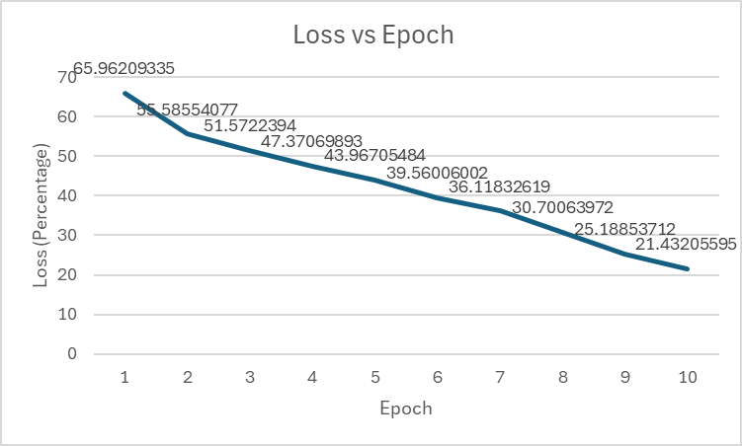
Results
Average Epoch Time:
128.33 seconds/epoch
Loss:
21.43206
Exact Match (EM):
0.607
Recall-Oriented Understudy for Gisting Evaluation (ROUGE):
0.724

Slide 21
Discussion
Large weakness in using NER as it struggled to see several important words like "ODLC" and additional usage of TF-IDF did not catch this issue.
Attempts to use Bio-tagging to increase the odds of finding entities/subjects to create questions also was futile.
Limitation in the specific domain unless an extreme amount of Aerospace specific paperwork can be used
Emphasis in the necessary need for RAG, or Retrieval-Augmented Generation
The process of optimizing the output of a large language model

Slide 22
Conclusion
Dataset Optimization:
Testing indicated NER with SpaCy as optimal. Specifically using core_web_lg
Potential Improvements:
Consideration of bio-tagging for further enhancement.
Note on increased algorithmic complexity.
Handling Ambiguity:
Introduction of sliding window concept.
Mention of its effectiveness in addressing answer fuzziness.
Results from Context Extraction:
Positive outcomes observed from extracting context around entities.

Slide 23
Limitations and Future Work
Current reports and documents are not enough that would allow the BERT model to interpret technical questions.
Requires several more years or outside documents to go further into the domain.
Evaluation metrics are extremely basic due to the objective scope, new questions, or test cases, should be developed to thoroughly test the capability of future models

Slide 24
Future Goals
Individuals interested in Data analysis, to work on making aerospace domain specific dataset that consists of highly detailed documentation mixed with fundamental topics.
Developing QA dataset for Aerospace domain specific models:
Acquiring Aerospace related paperwork that isn't complicated and readily available to be inputted in a QA format (question, context, and answer).
Potentially web scraping from wikipedia pages, but require Aerospace expertise on essential basics (Fixed wings, V-TOL, systems, etc...)
Implementing RAG for the model in order to make the model inference more intuitive.

Slide 25
FAQ
Why 512 tokens?
Due to BERT architecture, the limitation for amount of tokens in one context is due to the input sequence length increases, the computational complexity of calculating the attention scores that comes with each token becomes more expensive.
All reasons to Tokenize:
Input Representation: Convert text to numerical tokens for neural network processing.
Vocabulary Mapping: Map words to unique tokens in BERT's fixed vocabulary.
Fixed-Length Input: Ensure consistent input dimensions through padding or truncation.
Special Tokens: Introduce structural tokens like [CLS] and [SEP] for context.
Segmentation: Handle multi-segment inputs for tasks like question answering.

Slide 26
FAQ
Exact Match (EM): This represents the percentage of predictions that exactly match the ground truth answers. You can plot this as a line chart with epochs on the x-axis and EM values on the y-axis.
Token-Level F1 Score: This measures the accuracy of the model's predictions by computing the harmonic mean of precision and recall. Similar to EM, you can plot this as a line chart with epochs on the x-axis and F1 scores on the y-axis.
BLEU Score: BLEU (Bilingual Evaluation Understudy) is a metric used for evaluating the quality of text which has been machine-translated from one natural language to another. It measures how many n-grams in the generated text match the reference text. You can also plot this as a line chart with epochs on the x-axis and BLEU scores on the y-axis.
ROUGE Score: ROUGE (Recall-Oriented Understudy for Gisting Evaluation) is a metric used for evaluating automatic summarization and machine translation. It measures the overlap between the generated text and the reference summaries in terms of n-grams. Again, you can plot this as a line chart with epochs on the x-axis and ROUGE scores on the y-axis.

Slide 27
REAL SLIDES AFTER THIS POINT DON’T TOUCH

Slide 28








Marvin Sevilla; Marc Cruz; Dennis Uryeu

Slide 29
The Problem
Create a virtual assistant for the SUAS project, leveraging project documentation such as RFP, Reports, Student Documentation, etc. to streamline information access over years and decades.
Marvin Sevilla; Marc Cruz; Dennis Uryeu

Slide 30
The Problem
Create a virtual assistant for the SUAS project, leveraging project documentation such as RFP, Reports, Student Documentation, etc. to streamline information access over years and decades.
Marvin Sevilla; Marc Cruz; Dennis Uryeu

Slide 31
The Problem
Create a virtual assistant for the SUAS project, leveraging project documentation such as RFP, Reports, Student Documentation, etc. to streamline information access over years and decades.
Objectives
Develop a Machine Learning model that is capable of answering basic questions about SUAS
e.g. “What is SUAS?”
Sub-Objective: Accept advanced questions
e.g. “For the OBC trade study, which of the three components were chosen?”

Slide 32
The Problem
Create a virtual assistant for the SUAS project, leveraging project documentation such as RFP, Reports, Student Documentation, etc. to streamline information access over years and decades.
Objectives
Develop a Machine Learning model that is capable of answering basic questions about SUAS
e.g. “What is SUAS?”
Sub-Objective: Accept advanced questions
e.g. “For the OBC trade study, which of the three components were chosen?”
Problem Domain
Logistical Challenges: Aerodynamics Dept. Paperwork
Class material Systems and Project Management stress documentation
Critical Documents such as Risk Matrix, Trade Studies, Main and Derived Objectives, equipment schematics (e.g., Payload, Object Recognition)
Paperwork load increases each semester
Team Challenges: Morale and Knowledge Banks
COVID disruptions destroyed student rapport
Loss of contact with previously experienced students

Slide 33
Available Solution
Objectives
Knowledge-bank is inherited via word-of-mouth
Drawing on knowledge-bank improves net understanding and goal setting
An improved team has potential for modifications to RFP/Rules
Develop a Machine Learning model that is capable of answering basic questions about SUAS
e.g. “What is SUAS?”
Sub-Objective: Accept advanced questions
e.g. “For the OBC trade study, which of the three components were chosen?”
Problem Domain
Logistical Challenges: Aerodynamics Dept. Paperwork
Class material Systems and Project Management stress documentation
Critical Documents such as Risk Matrix, Trade Studies, Main and Derived Objectives, equipment schematics (e.g., Payload, Object Recognition)
Paperwork load increases each semester
Team Challenges: Morale and Knowledge Banks
COVID disruptions destroyed student rapport
Loss of contact with previously experienced students

Slide 34
Detailed Objective
Develop a Question Answering Model for Basic User Inquiries
Utilize BERT framework for Extractive QA Model
Bidirectional Encoder Representations from Transformers
* Input context and question to extract answers
Available Solution
Knowledge-bank is inherited via word-of-mouth
Drawing on knowledge-bank improves net understanding and goal setting
An improved team has potential for modifications to RFP/Rules
Problem Domain
Logistical Challenges: Aerodynamics Dept. Paperwork
Class material Systems and Project Management stress documentation
Critical Documents such as Risk Matrix, Trade Studies, Main and Derived Objectives, equipment schematics (e.g., Payload, Object Recognition)
Paperwork load increases each semester
Team Challenges: Morale and Knowledge Banks
COVID disruptions destroyed student rapport
Loss of contact with previously experienced students

Slide 35
Detailed Objective
Develop a Question Answering Model for Basic User Inquiries
Utilize BERT framework for Extractive QA Model
Bidirectional Encoder Representations from Transformers
* Input context and question to extract answers
Available Solution
Data Collection and Processing
Knowledge-bank is inherited via word-of-mouth
Drawing on knowledge-bank improves net understanding and goal setting
An improved team has potential for modifications to RFP/Rules
Process the raw SUAS-project text files using:
Lowercasing
Punctuation & Special Character removal
Tab removal
Trailing space removal
Tokenize

Slide 36
Detailed Objective
Develop a Question Answering Model for Basic User Inquiries
Utilize BERT framework for Extractive QA Model
Bidirectional Encoder Representations from Transformers
* Input context and question to extract answers
Data Collection and Processing
Process the raw SUAS-project text files using:
Lowercasing
Punctuation & Special Character removal
Tab removal
Trailing space removal
Tokenize

Slide 37
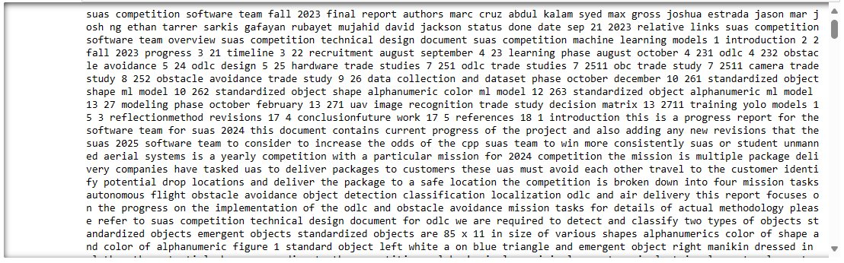
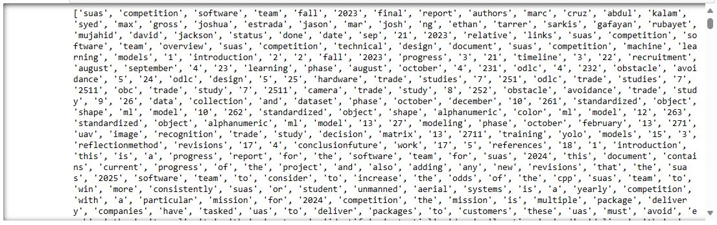
Data Collection and Processing
Cleaned Data
Tokenized Data
Tokenization
BERT Tokenization:
Converts text into numerical tokens
Maps words to unique IDs in BERT's vocabulary
Ensures consistent input dimensions
Special tokens provide structural context
Enables effective text processing

Slide 38
Data Collection and Processing
Tokenization Special Token
Cleaned Data
For example, CLS (Classification Token) and SEP (Separator Token)
Special tokens like CLS and SEP are essential in BERT's architecture. CLS is used for sequence classification tasks, while SEP separates text segments. Mastering their roles is vital for leveraging BERT effectively in NLP tasks.
Tokenized Data
Tokenization
BERT Tokenization:
Converts text into numerical tokens
Maps words to unique IDs in BERT's vocabulary
Ensures consistent input dimensions
Special tokens provide structural context
Enables effective text processing

Slide 39
Methodology
Input Data: Provide context and question
BERT Encoding: Convert input text into numerical representations using BERT
QA Model: Implement an Extractive QA model
Answer Generation: Generate answers based on encoded context and question
Tokenization Special Token
For example, CLS (Classification Token) and SEP (Separator Token)
Special tokens like CLS and SEP are essential in BERT's architecture. CLS is used for sequence classification tasks, while SEP separates text segments. Mastering their roles is vital for leveraging BERT effectively in NLP tasks.
Tokenization
BERT Tokenization:
Converts text into numerical tokens
Maps words to unique IDs in BERT's vocabulary
Ensures consistent input dimensions
Special tokens provide structural context
Enables effective text processing

Slide 40
Methodology
Input Data: Provide context and question
BERT Encoding: Convert input text into numerical representations using BERT
QA Model: Implement an Extractive QA model
Answer Generation: Generate answers based on encoded context and question
Tokenization Special Token
Implementation
For example, CLS (Classification Token) and SEP (Separator Token)
Special tokens like CLS and SEP are essential in BERT's architecture. CLS is used for sequence classification tasks, while SEP separates text segments. Mastering their roles is vital for leveraging BERT effectively in NLP tasks.
Input Data & BERT Encoding
Utilizing regular expressions to clean text (i.e. punctuation, special characters, tabs)
Create BERT formatted Dataset [Questions, Context, Answer]
Questions
Utilizing NER, Named Entity Recognition, to determine subjects to make questions with. Then using question structures to make simple questions
Context
Processed text is turned into size of 512 token chunks to ensure the BERT architecture accepts the shape of the dataset. When tokenized, additional [PAD] Labels ensure the shape size is uniform throughout the model.
Answers
Utilized window size of 10 words before and after an entity in the processed text to extract relevant information that answers the question

Slide 41
Methodology
Input Data: Provide context and question
BERT Encoding: Convert input text into numerical representations using BERT
QA Model: Implement an Extractive QA model
Answer Generation: Generate answers based on encoded context and question
Implementation
Input Data & BERT Encoding
Utilizing regular expressions to clean text (i.e. punctuation, special characters, tabs)
Create BERT formatted Dataset [Questions, Context, Answer]
Questions
Utilizing NER, Named Entity Recognition, to determine subjects to make questions with. Then using question structures to make simple questions
Context
Processed text is turned into size of 512 token chunks to ensure the BERT architecture accepts the shape of the dataset. When tokenized, additional [PAD] Labels ensure the shape size is uniform throughout the model.
Answers
Utilized window size of 10 words before and after an entity in the processed text to extract relevant information that answers the question

Slide 42
Implementation
(QA Model) Extractive QA BERT Model:
Utilizing Hugging Face Transformer library to utilize pretrained model to obtain comprehension between relationship between question and context. Necessary as to teach the model a general 'sense' of questions and extraction of context that should have context
Fine Tuning
Using the preprocessed "specific domain" dataset, allows the model to further understand the domain specific question structure.
Libraries
Pytorch Dataset, DataLoader libraries, transformer library
Architecture
Input Encoding
Transformer Encoder Blocks
Output Layer
Parameters
Base Model: ~110 M
Large Model: ~340 M
Anatomy

Slide 43
Implementation
Architecture
Input Encoding
Transformer Encoder Blocks
Output Layer
Parameters
Base Model: ~110 M
Large Model: ~340 M
Anatomy
Functionality
Bidirectional Context
Understands both left and right context for better comprehension
Bidirectional Context
Trained on large corpora using unsupervised learning tasks such as:
masked language modelling
next sentence prediction)

Slide 44
Implementation
Architecture
Input Encoding
Transformer Encoder Blocks
Output Layer
Parameters
Base Model: ~110 M
Large Model: ~340 M
Anatomy
Bidirectional Context
Understands both left and right context for better comprehension
Bidirectional Context
Trained on large corpora using unsupervised learning tasks such as:
masked language modelling
next sentence prediction)
Functionality

Slide 45
Implementation
Answer Generation
Load the saved model use it to tokenize a given question and context, which * NEEDS TO BE GIVEN with the question in order to generate an answer
* Resolved with RAG (Retrieval-Augmented Generation)
Determining if the model can answer rudimentary questions that include:
"What is SUAS?"
"What is GCS?"
"What are the SUAS objects?"
Results
Due to requiring a sufficient context to come with a question, the model has limitations until RAG is implemented.
It’s able to provide rough answers to some basic questions.
"What is SUAS?"
"What is SUAS competition technical design?"

Slide 46
Implementation
Discussion
Large weakness in using NER as it struggled to see several important words like "ODLC" and additional usage of TF-IDF did not catch this issue.
* Attempts to use Bio-tagging to increase the odds of finding entities/subjects to create questions also was futile.
Limitation in the specific domain unless an extreme amount of Aerospace specific paperwork can be used
Emphasis in the necessary need for RAG, or Retrieval-Augmented Generation
* The process of optimizing the output of a large language model
Answer Generation
Load the saved model use it to tokenize a given question and context, which * NEEDS TO BE GIVEN with the question in order to generate an answer
* Resolved with RAG (Retrieval-Augmented Generation)
Determining if the model can answer rudimentary questions that include:
"What is SUAS?"
"What is GCS?"
"What are the SUAS objects?"
Results
Due to requiring a sufficient context to come with a question, the model has limitations until RAG is implemented.
It’s able to provide rough answers to some basic questions.
"What is SUAS?"
"What is SUAS competition technical design?"

Slide 47
Implementation
Discussion
Results
Average Epoch Time:
128.33 seconds/epoch
Loss:
21.43206
Exact Match (EM):
0.607
Recall-Oriented Understudy for Gisting Evaluation (ROUGE):
0.724

Slide 48
Conclusion
Dataset Optimization
Testing indicated NER with SpaCy as optimal (specifically using core_web_lg)
Potential Improvements
Consideration of bio-tagging for further enhancement (we witnessed increased algorithmic complexity)
Handling Ambiguity
Introduction of sliding window concept (we noted its effectiveness in addressing answer fuzziness)
Results from Context Extraction
Positive outcomes observed from extracting context around entities
Discussion
Large weakness in using NER as it struggled to see several important words like "ODLC" and additional usage of TF-IDF did not catch this issue.
* Attempts to use Bio-tagging to increase the odds of finding entities/subjects to create questions also was futile.
Limitation in the specific domain unless an extreme amount of Aerospace specific paperwork can be used
Emphasis in the necessary need for RAG, or Retrieval-Augmented Generation
* The process of optimizing the output of a large language model
Results
Due to requiring a sufficient context to come with a question, the model has limitations until RAG is implemented.
It’s able to provide rough answers to some basic questions.
"What is SUAS?"
"What is SUAS competition technical design?"

Slide 49
Conclusion
Dataset Optimization
Testing indicated NER with SpaCy as optimal (specifically using core_web_lg)
Potential Improvements
Consideration of bio-tagging for further enhancement (we witnessed increased algorithmic complexity)
Handling Ambiguity
Introduction of sliding window concept (we noted its effectiveness in addressing answer fuzziness)
Results from Context Extraction
Positive outcomes observed from extracting context around entities
Limitations and Future Work
Discussion
Current reports and documents are not sufficient material for the BERT model to interpret technical questions
Requires several more years of information gathering or introduction of outside documents to go further into the domain
Evaluation metrics are extremely basic due to the objective scope, new questions, or test cases, and should be developed to thoroughly test the capability of future models
Large weakness in using NER as it struggled to see several important words like "ODLC" and additional usage of TF-IDF did not catch this issue.
* Attempts to use Bio-tagging to increase the odds of finding entities/subjects to create questions also was futile.
Limitation in the specific domain unless an extreme amount of Aerospace specific paperwork can be used
Emphasis in the necessary need for RAG, or Retrieval-Augmented Generation
* The process of optimizing the output of a large language model

Slide 50
Conclusion
Dataset Optimization
Testing indicated NER with SpaCy as optimal (specifically using core_web_lg)
Potential Improvements
Consideration of bio-tagging for further enhancement (we witnessed increased algorithmic complexity)
Handling Ambiguity
Introduction of sliding window concept (we noted its effectiveness in addressing answer fuzziness)
Results from Context Extraction
Positive outcomes observed from extracting context around entities
Limitations and Future Work
Current reports and documents are not sufficient material for the BERT model to interpret technical questions
Requires several more years of information gathering or introduction of outside documents to go further into the domain
Evaluation metrics are extremely basic due to the objective scope, new questions, or test cases, and should be developed to thoroughly test the capability of future models
Future Goals
Support individuals interested in data analysis, to work on making aerospace domain specific dataset that consists of highly detailed documentation mixed with fundamental topics
Developing QA dataset for aerospace-domain specific models
Acquiring aerospace-related paperwork that is generally simple and readily available to be inputted in a QA format (question, context, and answer).
Potentially web scraping from wikipedia pages, which still requires aerospace expertise on essential basics (Fixed wings, V-TOL, systems, etc.)
Implementing RAG for the model in order to make the model inference more intuitive.

Slide 51
Limitations and Future Work
Current reports and documents are not sufficient material for the BERT model to interpret technical questions
Requires several more years of information gathering or introduction of outside documents to go further into the domain
Evaluation metrics are extremely basic due to the objective scope, new questions, or test cases, and should be developed to thoroughly test the capability of future models
Questions?
Future Goals
Support individuals interested in data analysis, to work on making aerospace domain specific dataset that consists of highly detailed documentation mixed with fundamental topics
Developing QA dataset for aerospace-domain specific models
Acquiring aerospace-related paperwork that is generally simple and readily available to be inputted in a QA format (question, context, and answer).
Potentially web scraping from wikipedia pages, which still requires aerospace expertise on essential basics (Fixed wings, V-TOL, systems, etc.)
Implementing RAG for the model in order to make the model inference more intuitive.

Slide 52
FAQ
Why 512 tokens?
Due to BERT architecture, the limitation for amount of tokens in one context is due to the input sequence length increases, the computational complexity of calculating the attention scores that comes with each token becomes more expensive.
All reasons to Tokenize:
Input Representation: Convert text to numerical tokens for neural network processing
Vocabulary Mapping: Map words to unique tokens in BERT's fixed vocabulary
Fixed-Length Input: Ensure consistent input dimensions through padding or truncation
Special Tokens: Introduce structural tokens like [CLS] and [SEP] for context
Segmentation: Handle multi-segment inputs for tasks like question answering
Questions?
Future Goals
Support individuals interested in data analysis, to work on making aerospace domain specific dataset that consists of highly detailed documentation mixed with fundamental topics
Developing QA dataset for aerospace-domain specific models
Acquiring aerospace-related paperwork that is generally simple and readily available to be inputted in a QA format (question, context, and answer).
Potentially web scraping from wikipedia pages, which still requires aerospace expertise on essential basics (Fixed wings, V-TOL, systems, etc.)
Implementing RAG for the model in order to make the model inference more intuitive.

Slide 53
Limitations and Future Work
Current reports and documents are not enough that would allow the BERT model to interpret technical questions.
Requires several more years or outside documents to go further into the domain.
Evaluation metrics are extremely basic due to the objective scope, new questions, or test cases, should be developed to thoroughly test the capability of future models
FAQ
Why 512 tokens?
Due to BERT architecture, the limitation for amount of tokens in one context is due to the input sequence length increases, the computational complexity of calculating the attention scores that comes with each token becomes more expensive.
All reasons to Tokenize:
Input Representation: Convert text to numerical tokens for neural network processing
Vocabulary Mapping: Map words to unique tokens in BERT's fixed vocabulary
Fixed-Length Input: Ensure consistent input dimensions through padding or truncation
Special Tokens: Introduce structural tokens like [CLS] and [SEP] for context
Segmentation: Handle multi-segment inputs for tasks like question answering
Future Goals
Support individuals interested in data analysis, to work on making aerospace domain specific dataset that consists of highly detailed documentation mixed with fundamental topics
Developing QA dataset for aerospace-domain specific models
Acquiring aerospace-related paperwork that is generally simple and readily available to be inputted in a QA format (question, context, and answer).
Potentially web scraping from wikipedia pages, which still requires aerospace expertise on essential basics (Fixed wings, V-TOL, systems, etc.)
Implementing RAG for the model in order to make the model inference more intuitive.
Questions?

Slide 54
FAQ
Exact Match (EM)
This represents the percentage of predictions that exactly match the ground truth answers. You can plot this as a line chart with epochs on the x-axis and EM values on the y-axis.
Token-Level F1 Score
This measures the accuracy of the model's predictions by computing the harmonic mean of precision and recall. Similar to EM, you can plot this as a line chart with epochs on the x-axis and F1 scores on the y-axis.
Questions?

Slide 55
FAQ
BLEU Score
BLEU (Bilingual Evaluation Understudy) is a metric used for evaluating the quality of text which has been machine-translated from one natural language to another. It measures how many n-grams in the generated text match the reference text. You can also plot this as a line chart with epochs on the x-axis and BLEU scores on the y-axis.
ROUGE Score
ROUGE (Recall-Oriented Understudy for Gisting Evaluation) is a metric used for evaluating automatic summarization and machine translation. It measures the overlap between the generated text and the reference summaries in terms of n-grams. Again, you can plot this as a line chart with epochs on the x-axis and ROUGE scores on the y-axis.
Questions?

