Slide 1
Are You Smarter Than a 5th Grader in Stocks?
Analyzing Knowledge of Stocks During COVID-19

Slide 2
Introduction
This presentation explores the understanding of stocks during the COVID-19 outbreak among two groups: 5th graders and adults. The data highlights differences in knowledge and perception during this period.

Slide 3
Survey results showed that 65% of 5th graders could correctly answer questions about stock market basics during the COVID-19 pandemic.

Slide 4
Survey results showed that 85% of adults correctly answered questions about stock market basics during the same period.

Slide 5
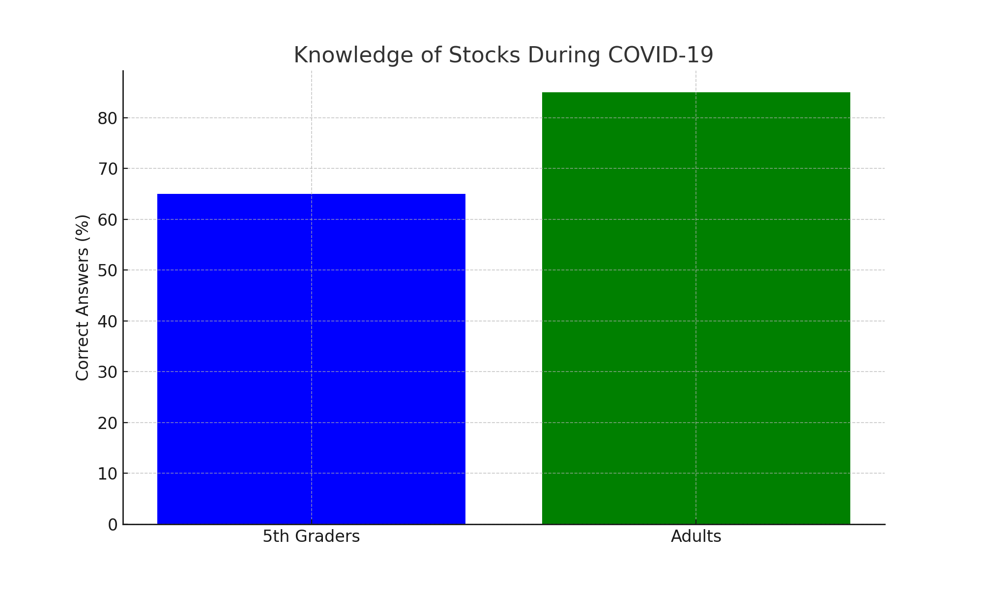
Stock Knowledge Comparison

Slide 6
Conclusion
The data reveals that adults had a higher understanding of stocks compared to 5th graders during the COVID-19 outbreak. This highlights the importance of financial education across age groups.

Slide 7
Sources
National Financial Educators Council and Junior Achievement USA
Pew Research Center, Gallup and Statista
Fidelity, Vanguard and Morningstar
Bloomberg
Financial Literacy and Education Commission
ChatGPT
Google
Youtube

