Slide 1
TETRIS 57
Presented By:
Muhammad Shiraz Husnain
Syed Ali Jaseem

Slide 2
Introduction
Tetris has a simple goal of destroying horizontal lines of blocks before the blocks reach the top. A tetromino is the shape formed by the four connected blocks that fall vertically down. The player will have to use the tetrominos to create lines that fill the grid horizontally, as the blocks in each completely filled horizontal line will be cleared. The game continues as long as the lines of blocks does not reach the top. Tetris has levels of difficulties which rises as it is being played.

Slide 3
Objectives
A form of entertainment
Improves quick decision making
Improves pattern recognition
A healthy pastime

Slide 4
Implementation Details
Functions interlinked with each other
Usage of various modules

Slide 5
Library and Modules Used
pygame
pygame.display
pygame.event
pygame.font
pygame.time
pygame.mixer
random

Slide 6
Novelty and Creativity
Displaying the current score while the game is running
Saving and displaying high score
Displaying the number of lines destroyed
Better graphical representation
Displaying end message corresponding to the score

Slide 7
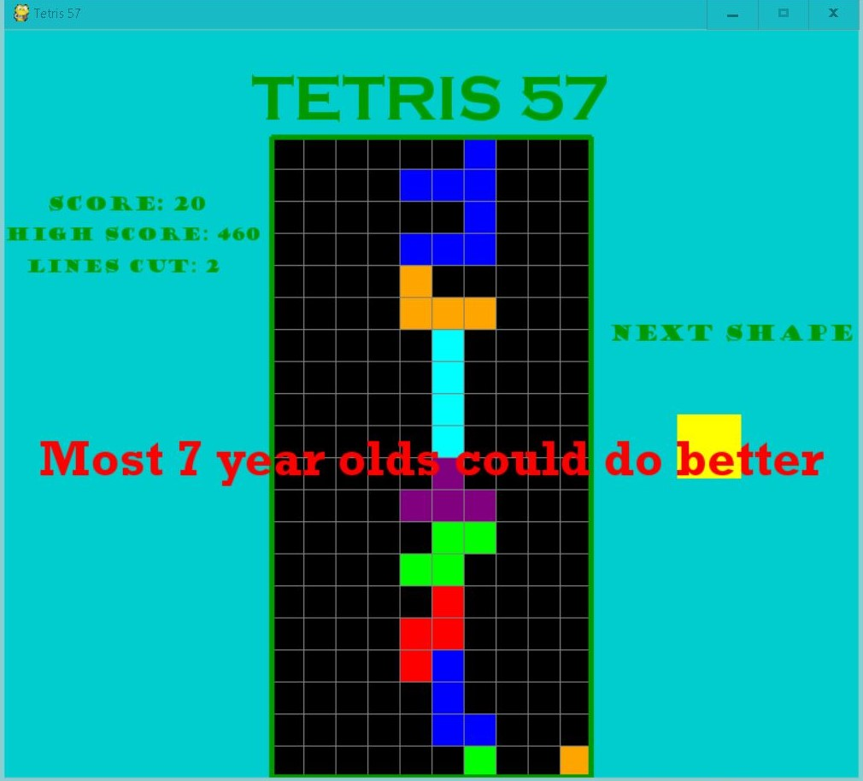
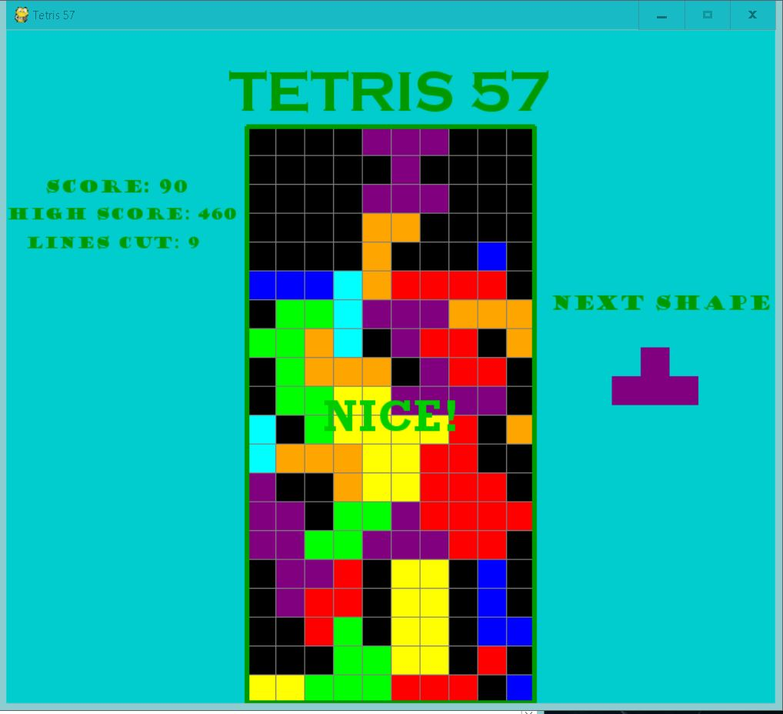
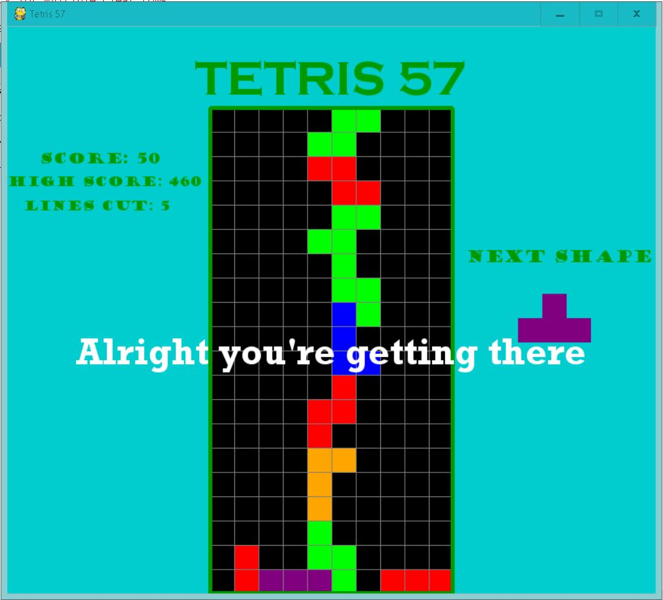
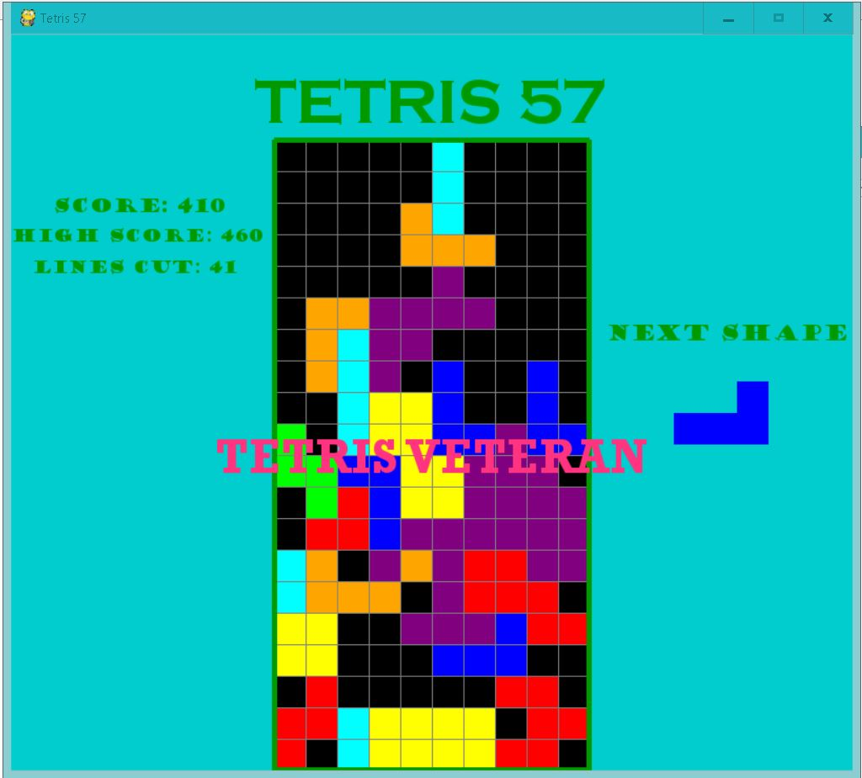

Slide 8
Problems Faced while Creating
Understanding the modules of pygame
Creating the algorithm of the game
Creating the design of game
Applying concepts in the game
Debugging of the Game
Implementation of the Game

Slide 9
Solution to the Problems Faced
Researching the different modules of pygame on the internet
Comprehensive planning for creating the algorithm
Watching online tutorials
Understanding the concepts used in the game
Repeated testing of the game

Slide 10
Conclusion
All in all, Tetris was a fun game to create. We learned a lot of new things including the usage of modules and their applications, the thinking process required to create algorithms for games and much more. We definitely succeeded in our objective of making Tetris a more fun game to play by adding high scores, displaying current scores, adding music and using a better GUI.

Slide 11
Thank You

