Slide 1
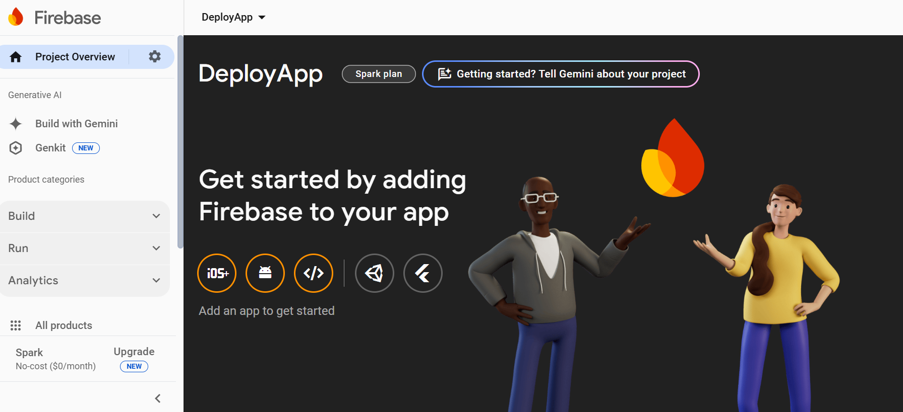

Slide 2
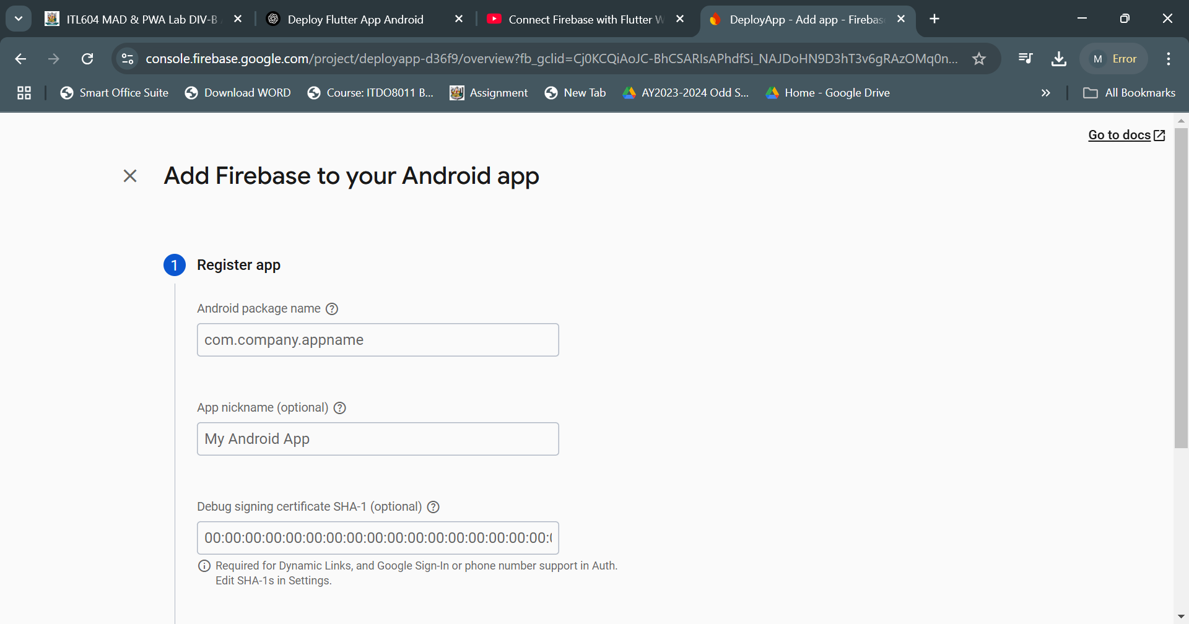

Slide 3
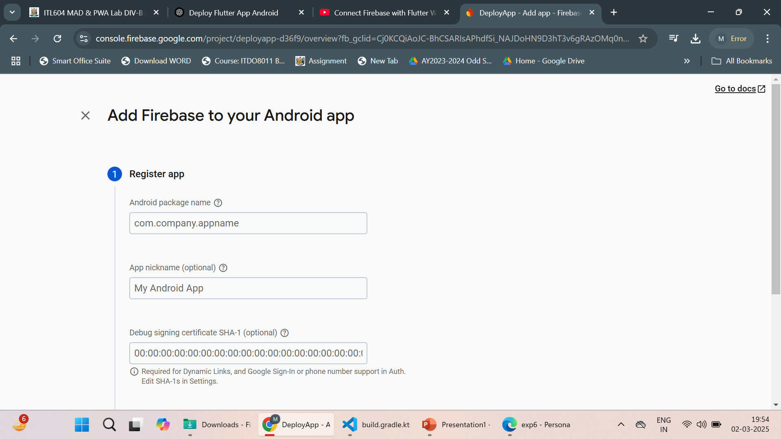

Slide 4
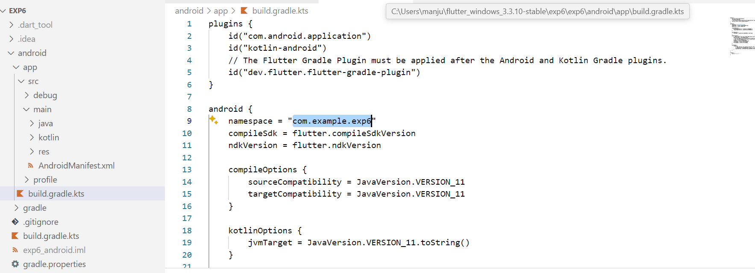

Slide 5
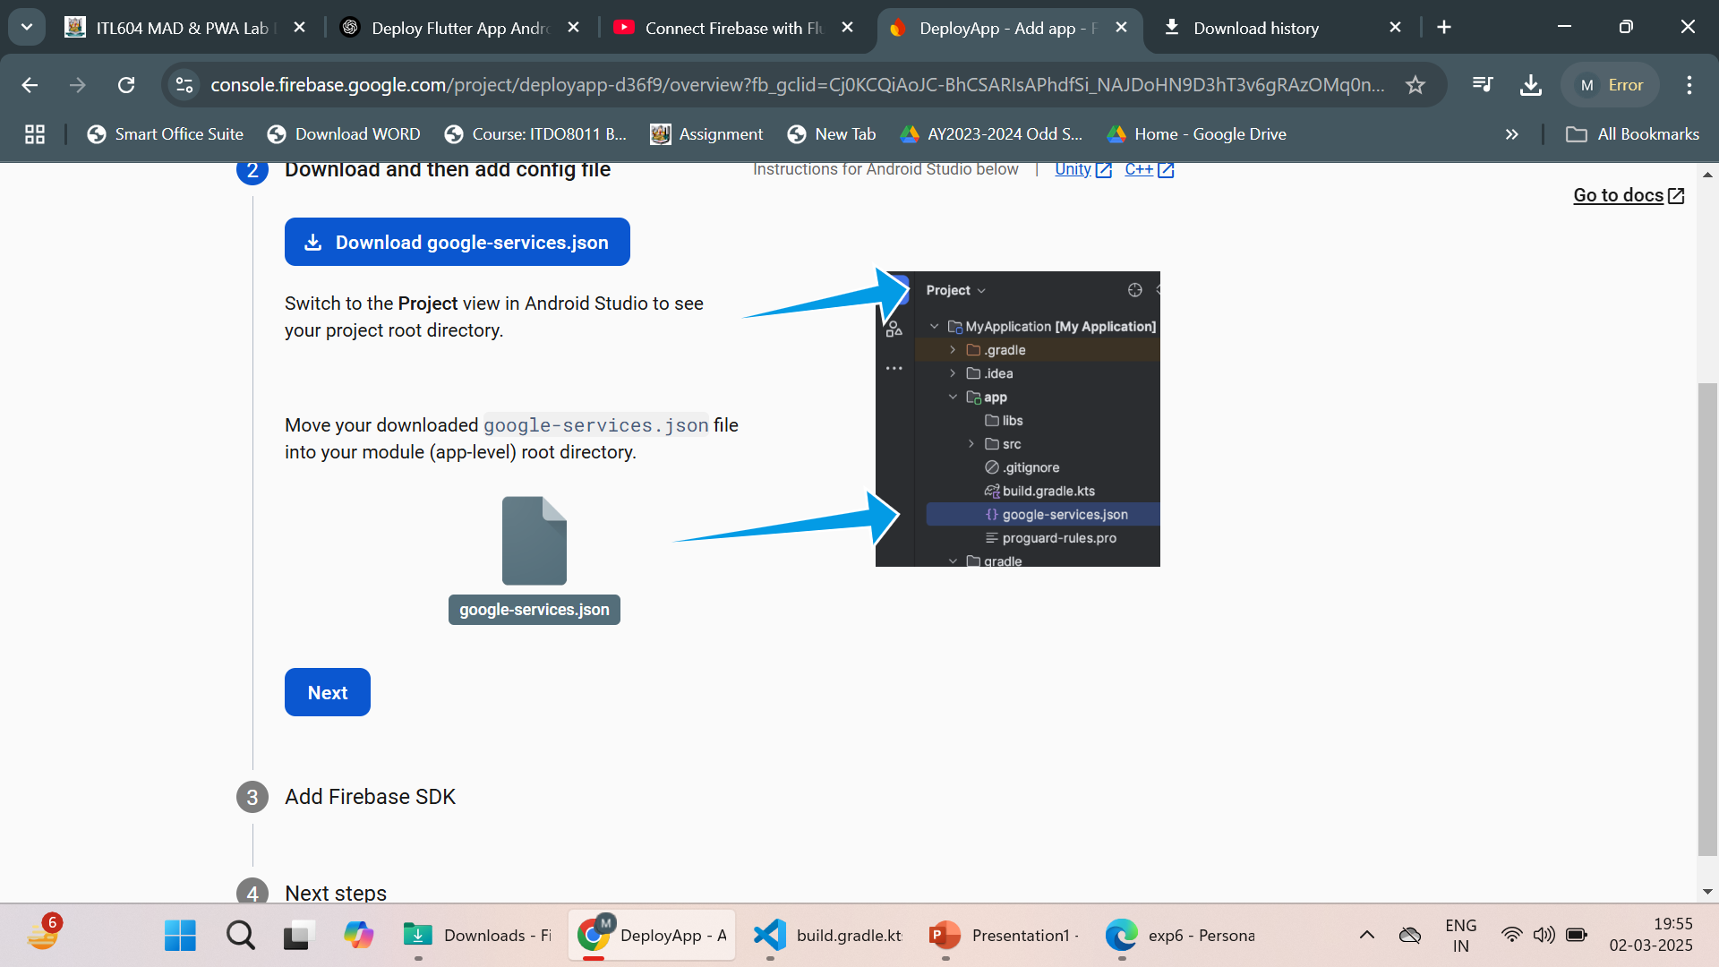

Slide 6
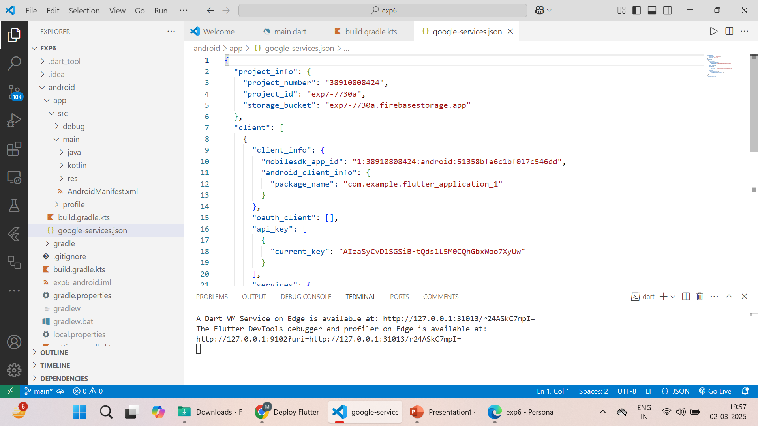

Slide 7
Configure Firebase in the Flutter App
Install Firebase dependencies:
Command to run on terminal
flutter pub add firebase_core firebase_auth cloud_firestore

Slide 8
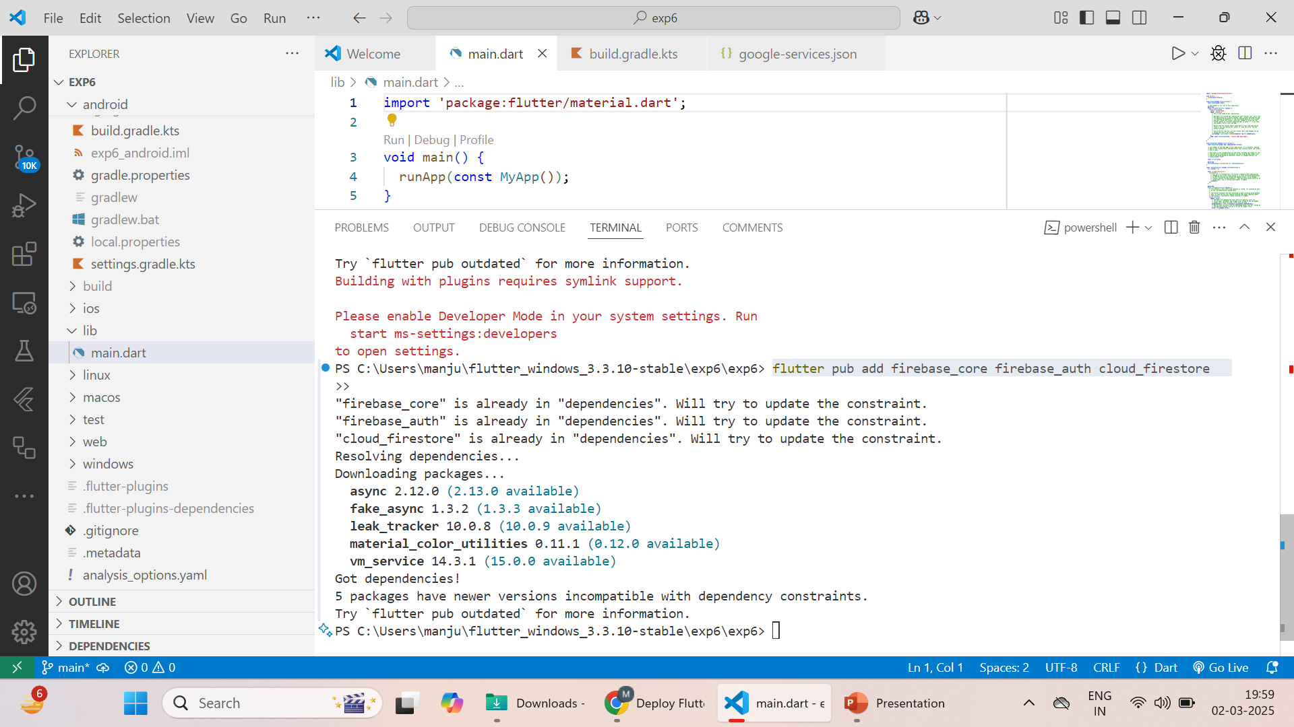

Slide 9
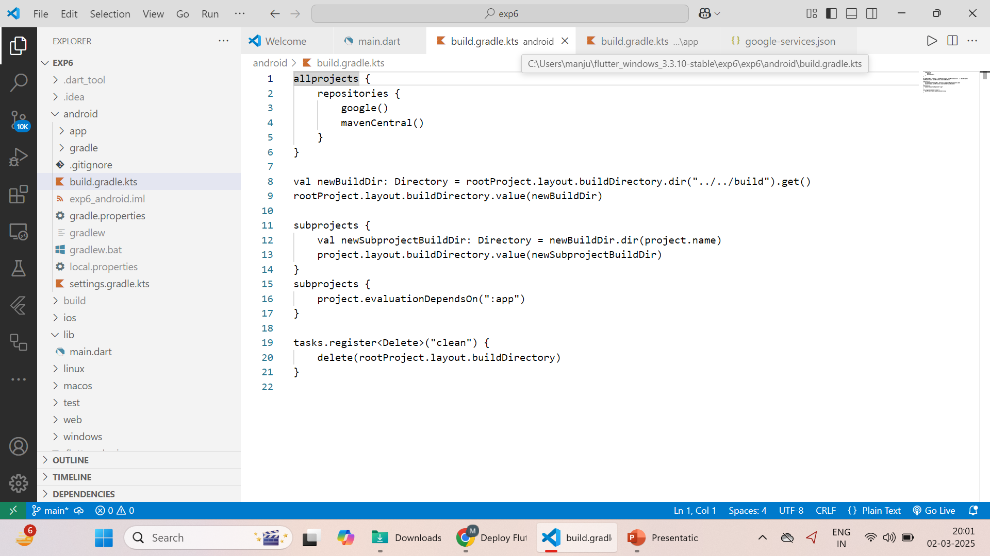
Open Android/ gradle

Slide 10
Open - android/build.gradle
Add in the end
dependencies { classpath 'com.google.gms:google-services:4.4.0' }

Slide 11
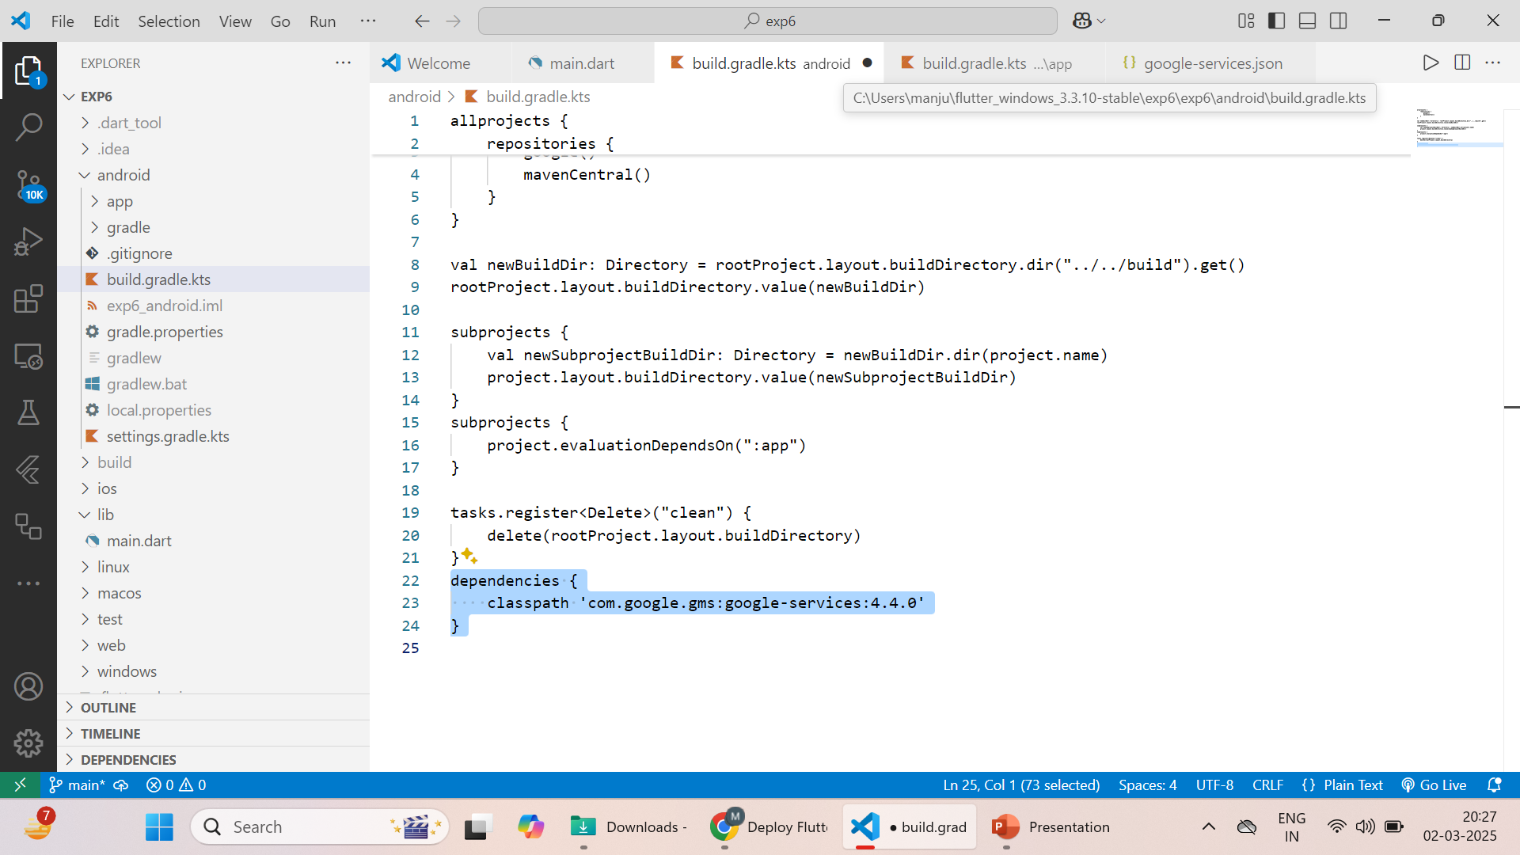

Slide 12
Open android/app/build.gradle and add:
apply plugin: 'com.google.gms.google-services'

Slide 13
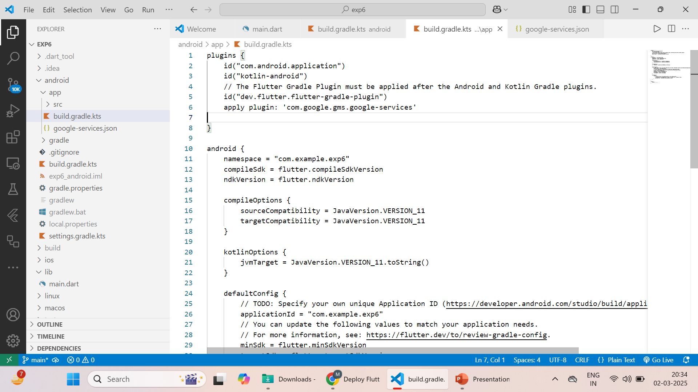

Slide 14
Initialize Firebase in Flutter
Refer file attached

Slide 15
5.1. Install Firebase CLI
npm install -g firebase-tools
5.2. Login to Firebase
firebase login
5.3. Initialize Firebase in the Project
firebase init
Select Hosting.
Choose "Use an existing project" and select counter_app.
Set the public directory to build/web.
5.4. Build the Flutter Web App
flutter build web
5.5. Deploy the App
firebase deploy

