Slide 1


Identification of malwares from Windows PE files
Artificial Intelligence for Cybersecurity Project
AY 2024/2025
Matteo Giannini
Giacomo Lombardi

Slide 2








Identification of malwares from Windows PE files
Goal Definition
Data Acquisition and Data Exploration
Data Preprocessing
Data Processing
Result Summary and Relevant Insights
Table of Contents
xAI
References
Backup

Slide 3
Goal Definition
Developing a machine learning model capable of classifying Windows Portable executable (PE) files as malicious or bening based on static features extracted from the files themselves.
To achieve this objective, the dataset used consists of PE file characteristics extracted from a collection of Windows executable and DLL files. Each entry represents a unique file with various attributes extracted from its PE header and structure. The dataset includes both benign software samples and known malware samples.

Slide 4
Data Acquisition and Data Exploration
Head Dataset
Alcune righe
Informazioni sui tipi delle feature
Statistiche
No missing data
FileName e MD5Hash hanno valore diverso x ogni riga
Divisione tra variabili categoriche e variabili numeriche
Describe delle variabili numeriche
Zeri significativi per queste variabili
Visualizzazione dei plot
Bitcoin address è binaria, sbilanciata, non è certo che sia malware
Unione delle variabili
Correlazione -> Problema con chi2 quindi Cramer, tutti test + ANOVA

Slide 5
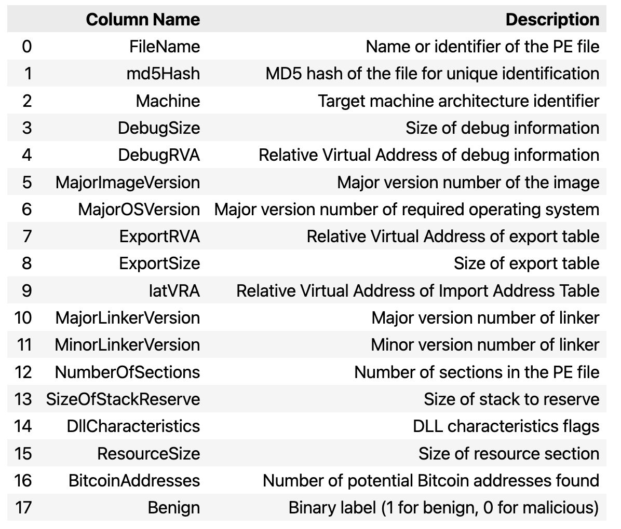
Data Acquisition and Data Exploration
Dataset Feaures

Slide 6
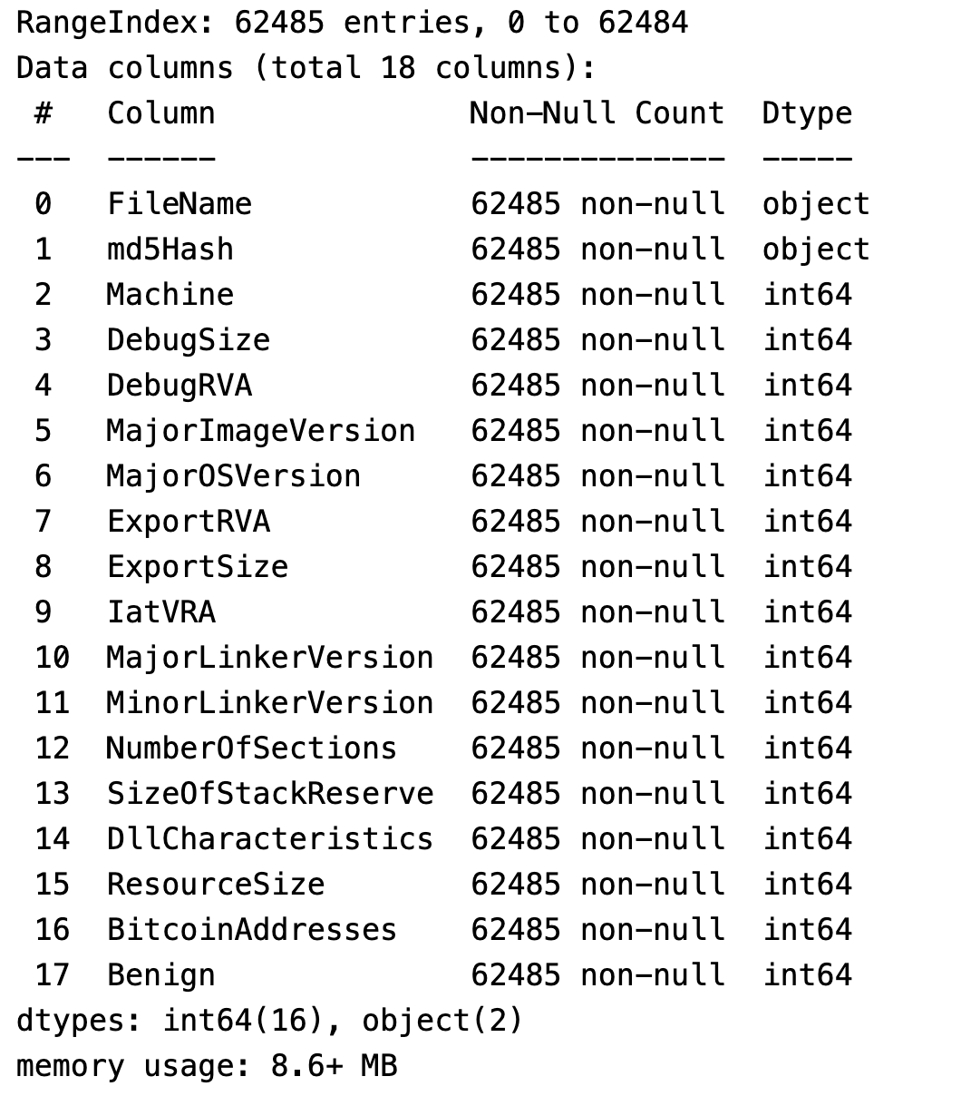
Data Acquisition and Data Exploration
Dataset Feaures

Slide 7
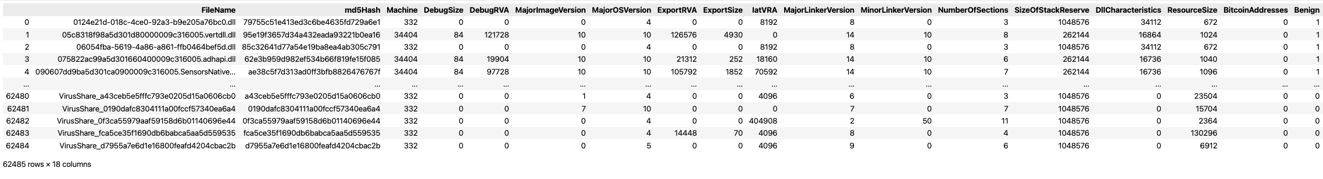
Data Acquisition and Data Exploration
Dataset Feaures

Slide 8
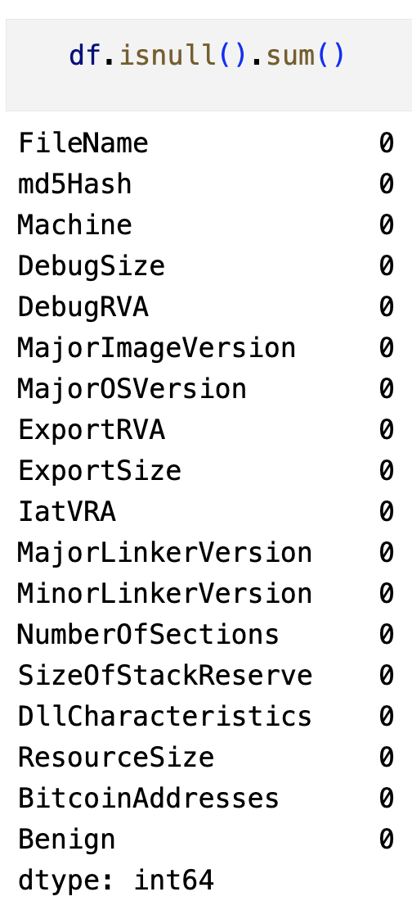
Data Acquisition and Data Exploration
Dataset Feaures

Slide 9
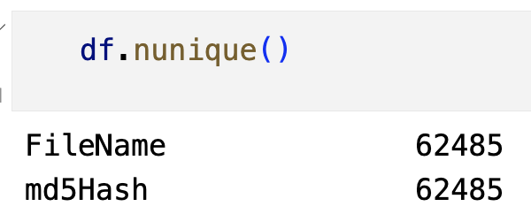
Data Acquisition and Data Exploration
Dataset Feaures

Slide 10
Data Acquisition and Data Exploration
Dataset Feaures
From the number of unique values for each feature and knowing their meaning, we can conclude that the following features are categorical:
- Machine: CPU for which the file was designed (it has 6 unique values).
- MajorImageVersion: main version of the software.
- MajorOSVersion: main version number of the required operating system.
- MajorLinkerVersion: main version number of the linker that created the file.
- MinorLinkerVersion: secondary version number of the linker that created the file.
- DllCharacteristics: under which circumstances to initialize the DLL.
- NumberOfSections: number of sections the PE file should contain.
On the other hand, the following features have continuous numerical values:
- DebugSize: size of the debug information.
- DebugRVA: Relative Virtual Address (RVA) of the debug information.
- ExportRVA: RVA of the export table.
- ExportSize: size of the export table.
- IatVRA: RVA of the Import Address Table (IAT).
- SizeOfStackReserve: amount of memory to reserve for the initial thread stack.
- ResourceSize: size of the resources.

Slide 11
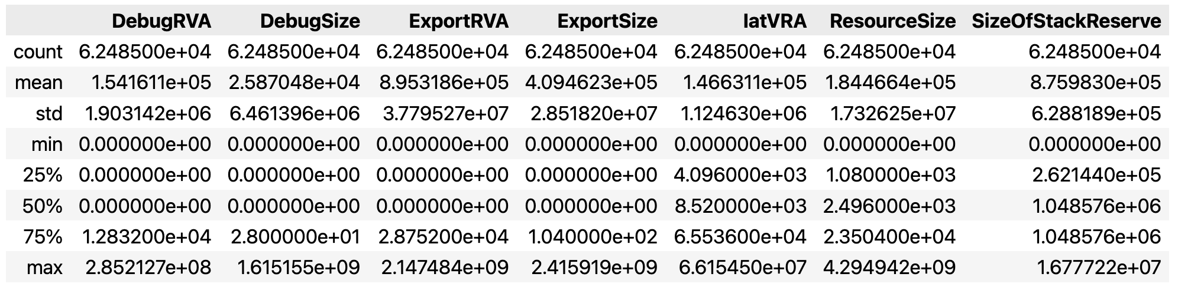
Data Acquisition and Data Exploration
Dataset Feaures

Slide 12
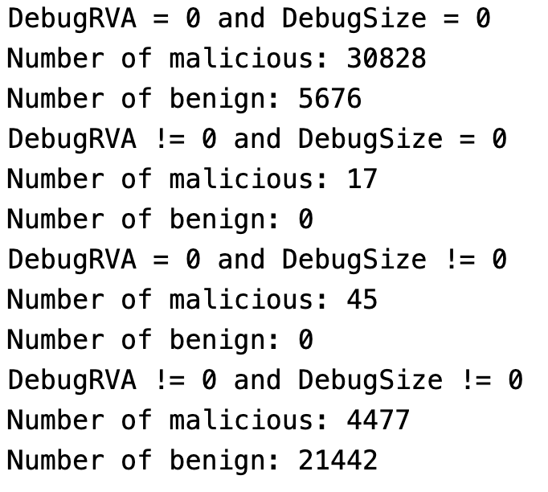
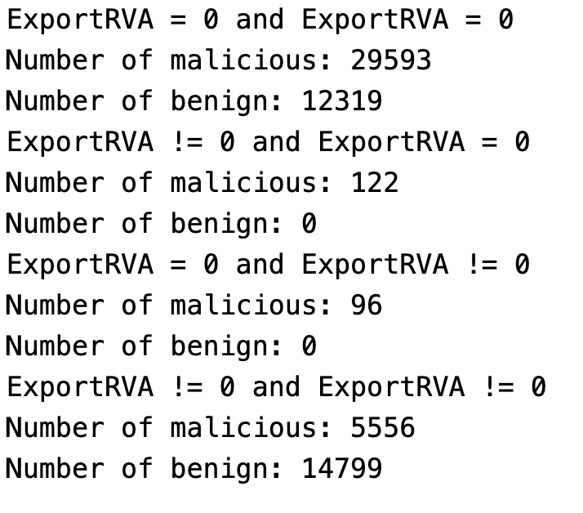
Data Acquisition and Data Exploration
Dataset Feaures

Slide 13
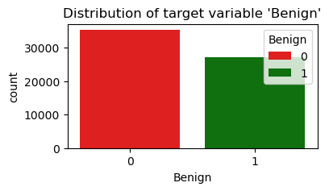
Data Acquisition and Data Exploration
Dataset Feaures

Slide 14
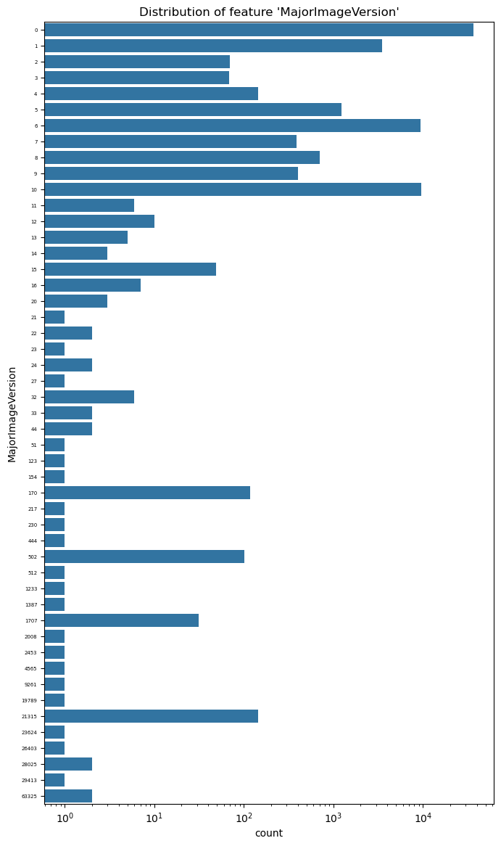
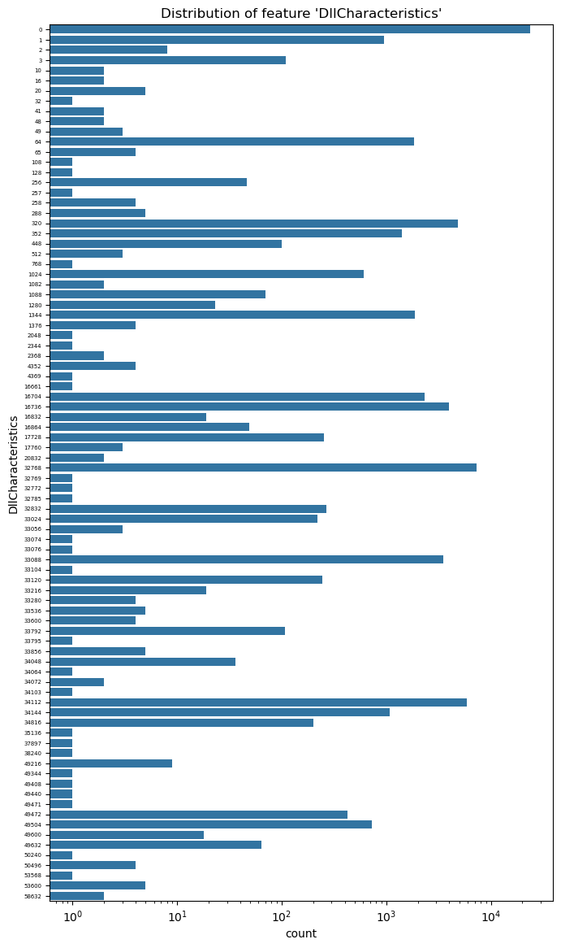
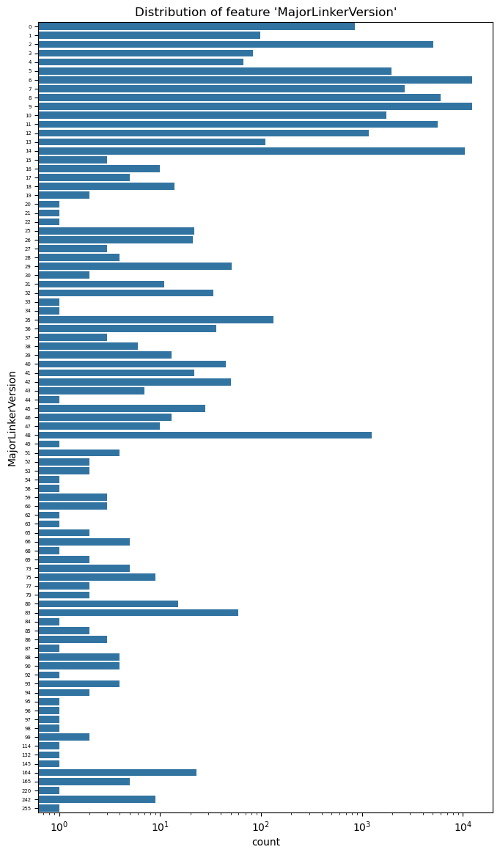
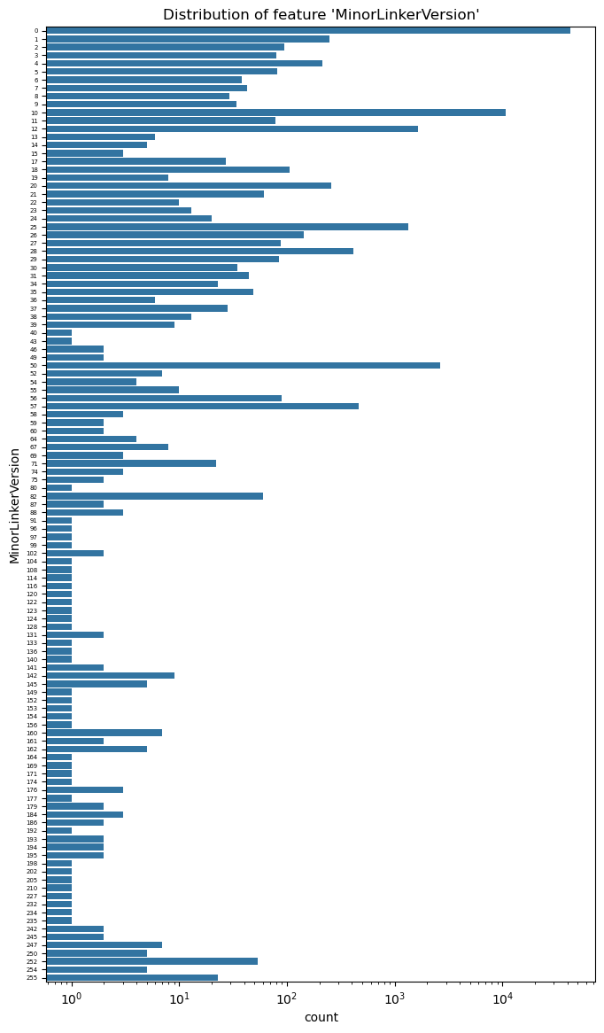
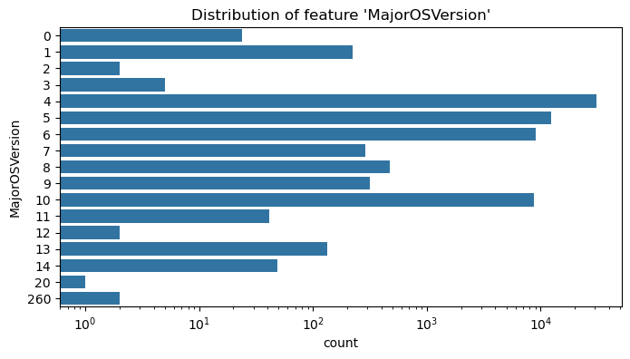
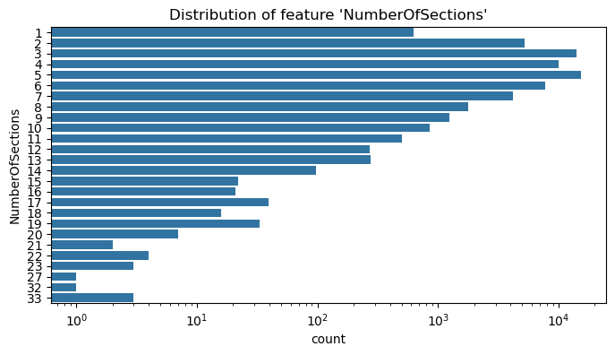
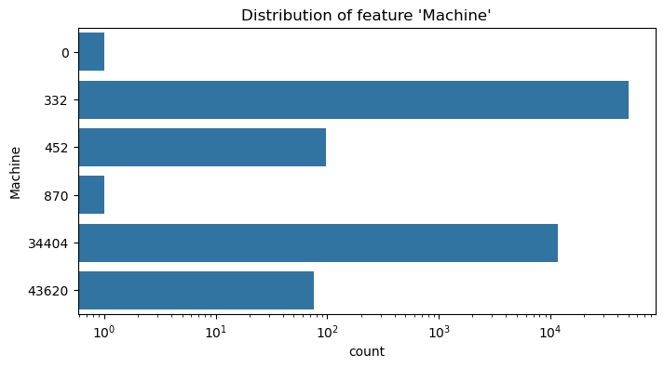
Data Acquisition and Data Exploration
Dataset Feaures

Slide 15
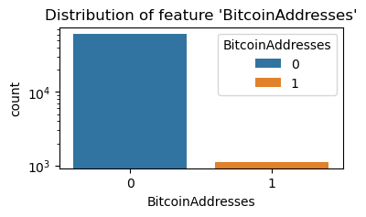
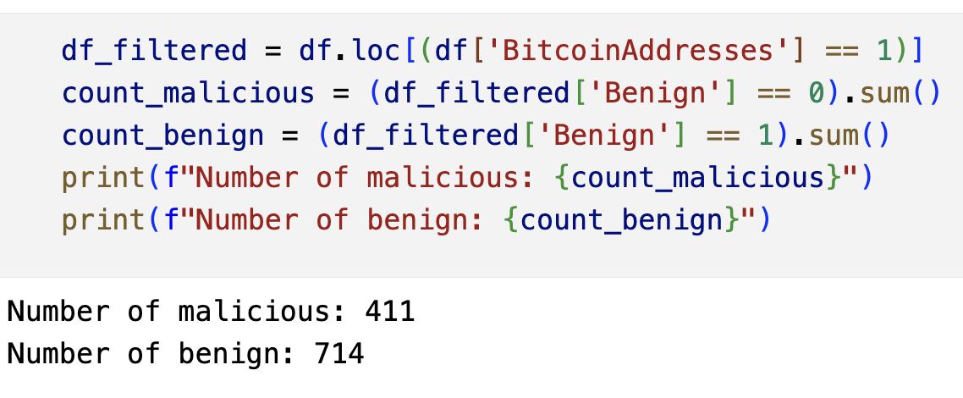
Data Acquisition and Data Exploration
Dataset Feaures

Slide 16
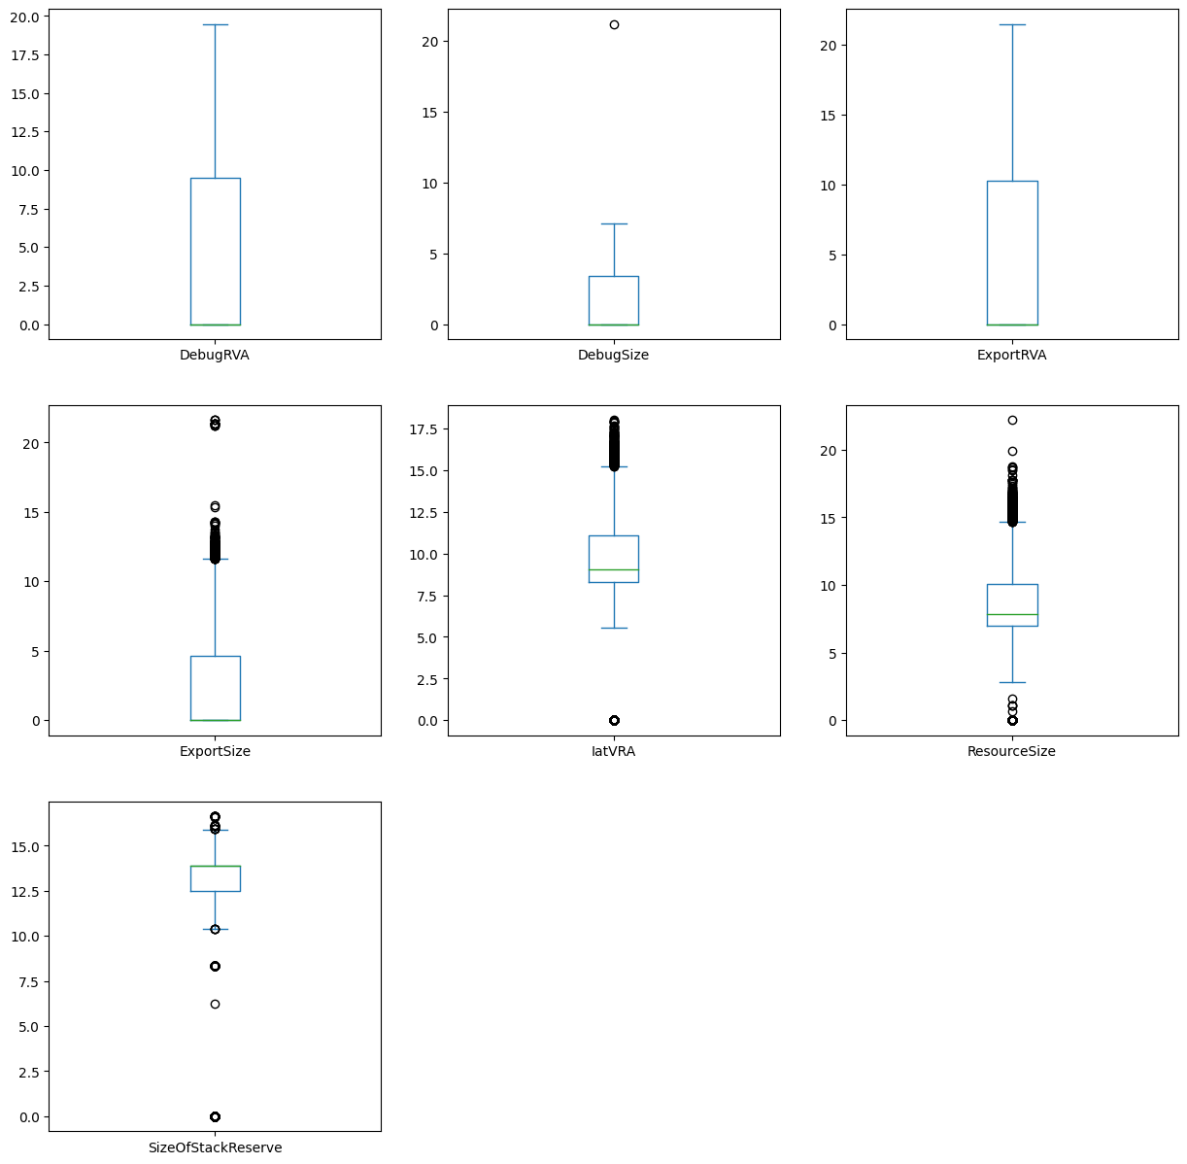
Data Acquisition and Data Exploration
Dataset Feaures

Slide 17
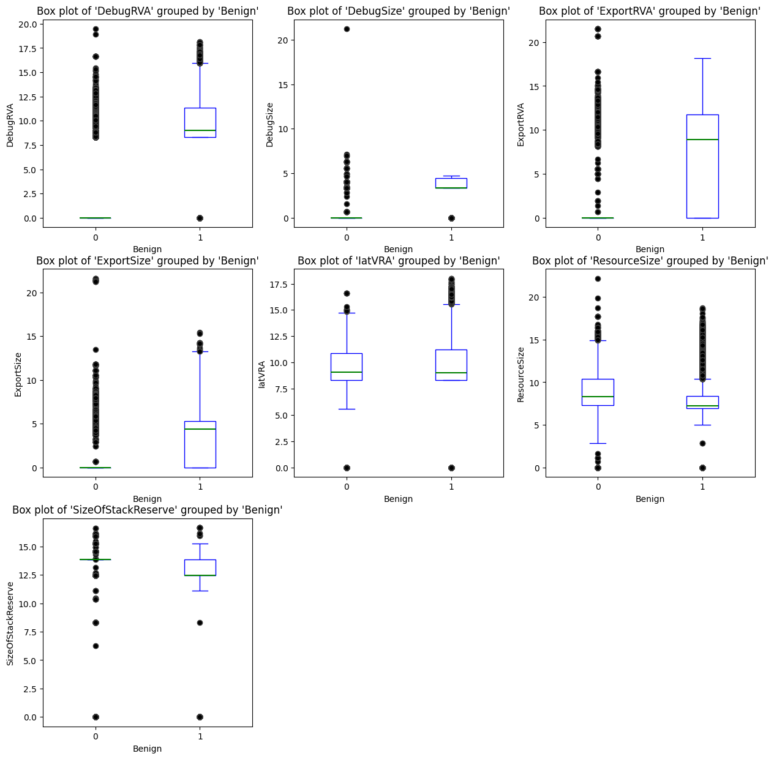
Data Acquisition and Data Exploration
Dataset Feaures

Slide 18
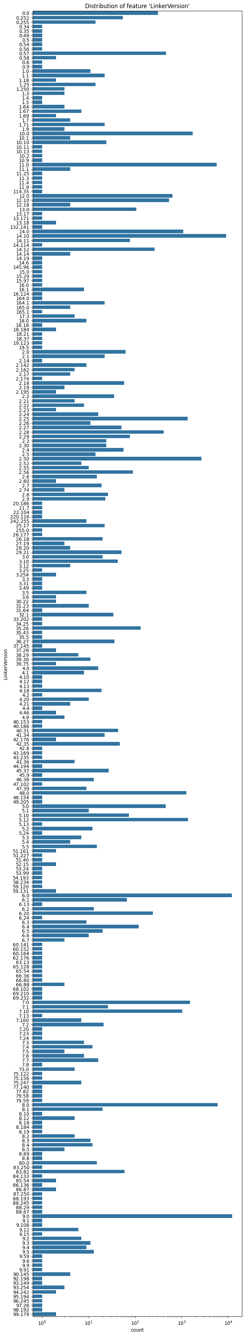
Data Acquisition and Data Exploration
Dataset Feaures

Slide 19
Data Preprocessing
Xvalidation per valutare performance
Intro agli esperimenti
Variabili categoriche + numeriche con pre-processing diversi
Cat + LR -> OHE
Num + LR -> StandardScaler
Int + LR -> SS + OHE + FS(SFM)
Num + RF -> Niente
Cat + RF -> Niente (+ conversione prima)
Int + RF -> Niente

Slide 20
Data Processing
Spiega algoritmi
Tabelle risultati
T-test

Slide 21
Result Summary and Relevant Insights
Mean values e conclusione che utilizzare intero dataset non ha particolari vantaggi in termini di accuratezza
Variabili categoriche interessanti
xAI

Slide 22
xAI
White vs Black Box
SHAP spiega cos’è e utilizzi –> Su LR per avere la stessa metrica di RandomForest + aggregazione delle variabili di OneHotEncoding nelle variabili originali

Slide 23
References
Link PE
Link seaborn
Giacomo

