Slide 1

Data Acquisition and Data Exploration
Head Dataset
Alcune righe
Informazioni sui tipi delle feature
Statistiche
No missing data
FileName e MD5Hash hanno valore diverso x ogni riga
Divisione tra variabili categoriche e variabili numeriche
Describe delle variabili numeriche
Zeri significativi per queste variabili
Visualizzazione dei plot
Bitcoin address è binaria, sbilanciata, non è certo che sia malware
Unione delle variabili
Correlazione -> Problema con chi2 quindi Cramer, tutti test + ANOVA

Slide 2


Identification of malwares from Windows PE files
Artificial Intelligence for Cybersecurity Project
AY 2024/2025
Matteo Giannini
Giacomo Lombardi

Slide 3







Identification of malwares from Windows PE files
Goal Definition
Data Acquisition and Data Exploration
Data Preprocessing
Data Processing
Result Summary and Relevant Insights
Table of Contents
xAI
References
Backup

Slide 4
Goal Definition
Developing a machine learning model capable of classifying Windows Portable executable (PE) files as malicious or bening based on static features extracted from the files themselves.
To achieve this objective, the dataset used consists of PE file characteristics extracted from a collection of Windows executable and DLL files. Each entry represents a unique file with various attributes extracted from its PE header and structure. The dataset includes both benign software samples and known malware samples.

Slide 5
Identification of malwares from Windows PE files
Goal Definition
Data Acquisition and Data Exploration
Data Preprocessing
Data Processing
Result Summary and Relevant Insights
Table of Contents
xAI
References
Backup

Slide 6
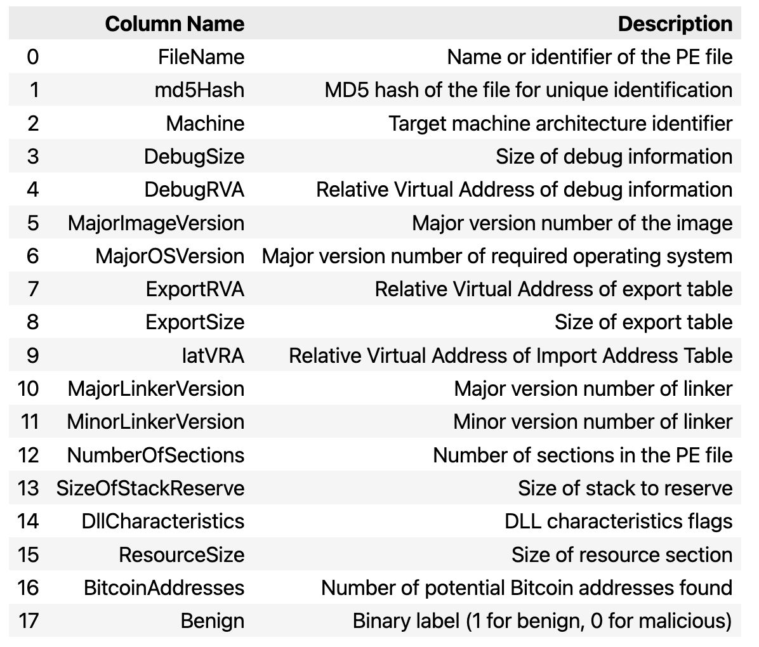
Dataset Features
Description
Data Acquisition and Data Exploration

Slide 7
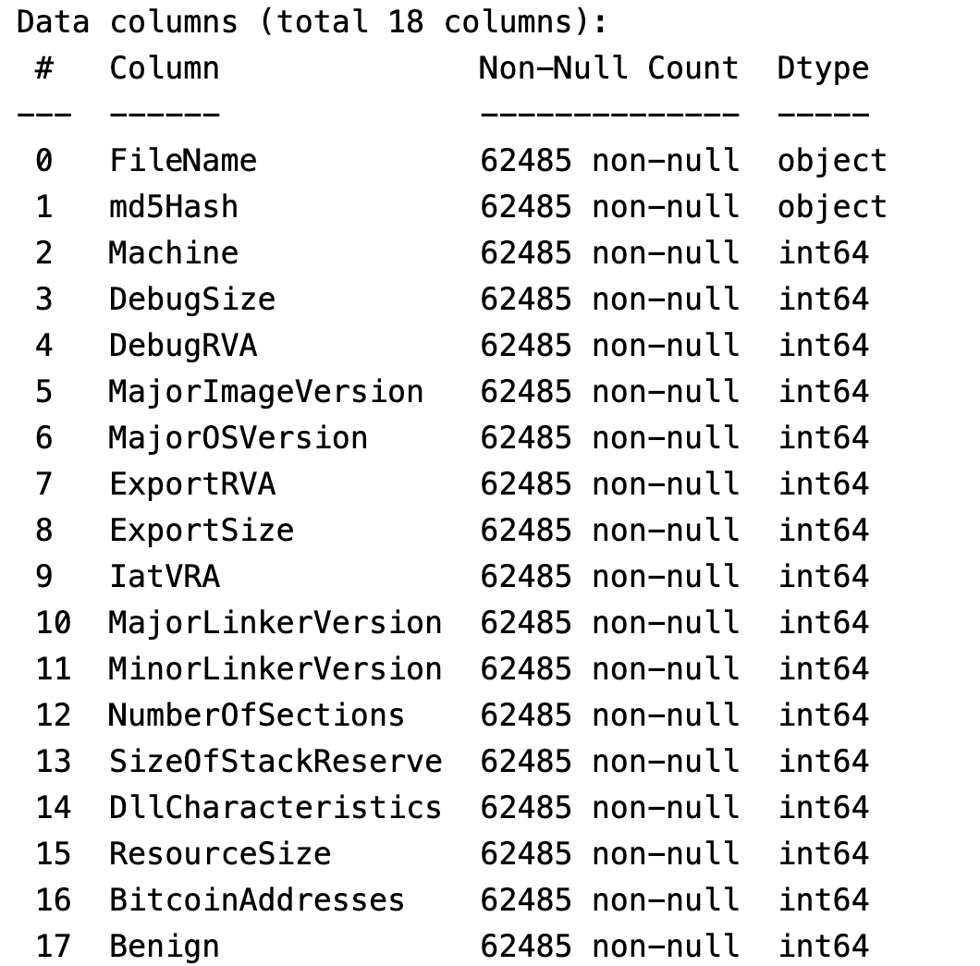
Dataset Features
Feature Types
Data Acquisition and Data Exploration

Slide 8
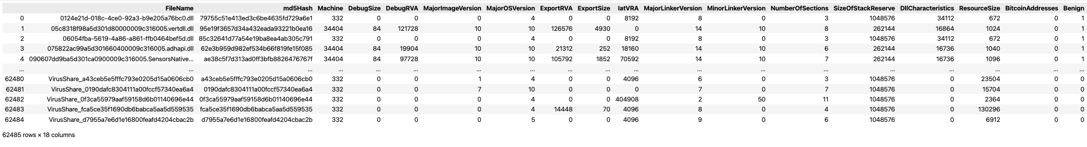
Dataset Features
df.head()
Data Acquisition and Data Exploration

Slide 9
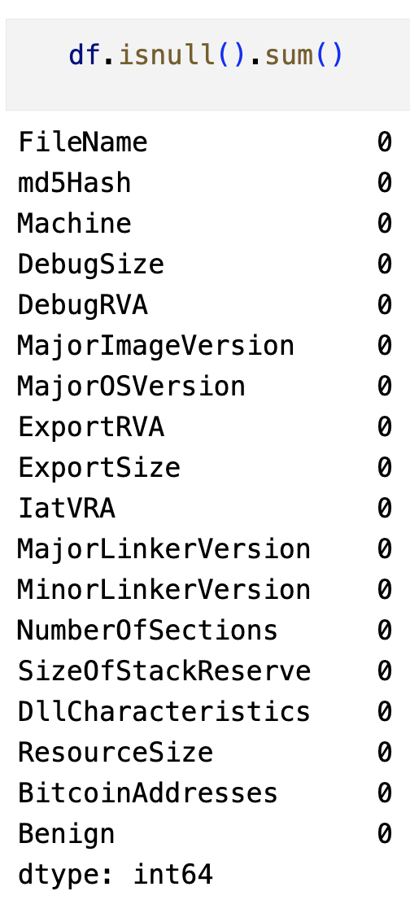
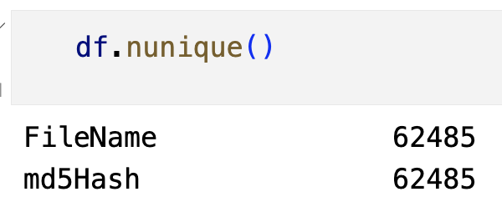
Dataset Features
Null and Unique Values
Data Acquisition and Data Exploration

Slide 10
Dataset Features
Categorical and Numerical Features
Data Acquisition and Data Exploration
Categorical Features
- Machine: CPU for which the file was designed (it has 6 unique values).
- MajorImageVersion: main version of the software.
- MajorOSVersion: main version number of the required operating system.
- MajorLinkerVersion: main version number of the linker that created the file.
- MinorLinkerVersion: secondary version number of the linker that created the file.
- DllCharacteristics: under which circumstances to initialize the DLL.
- NumberOfSections: number of sections the PE file should contain.
Numerical Features
- DebugSize: size of the debug information.
- DebugRVA: Relative Virtual Address (RVA) of the debug information.
- ExportRVA: RVA of the export table.
- ExportSize: size of the export table.
- IatVRA: RVA of the Import Address Table (IAT).
- SizeOfStackReserve: amount of memory to reserve for the initial thread stack.
- ResourceSize: size of the resources.

Slide 11
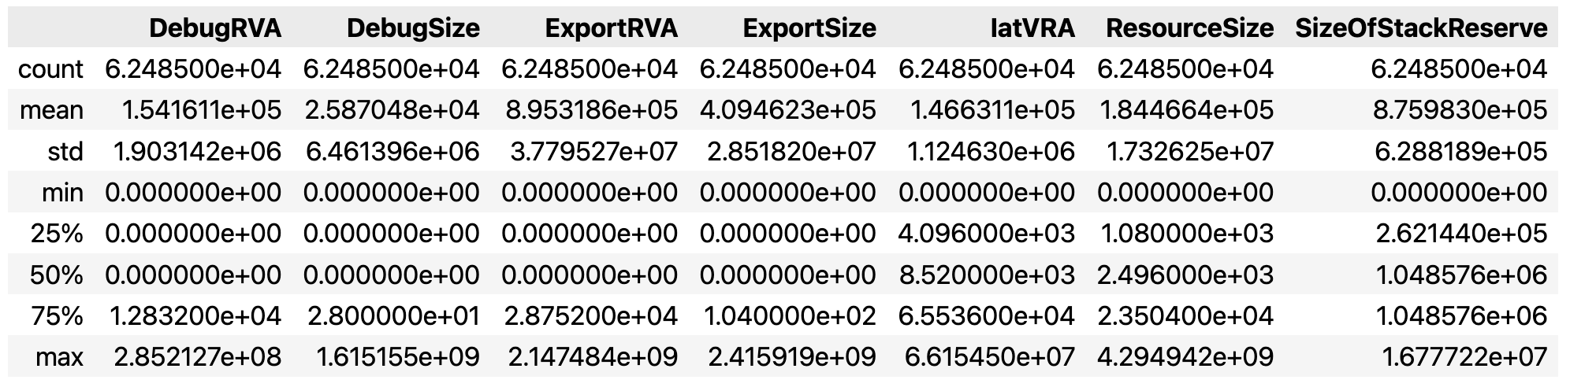
Dataset Features
Distribution of Numerical Features
Data Acquisition and Data Exploration

Slide 12

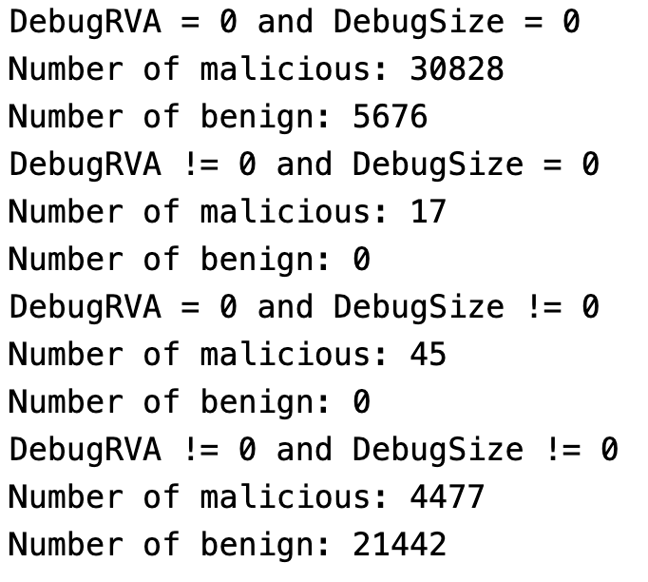
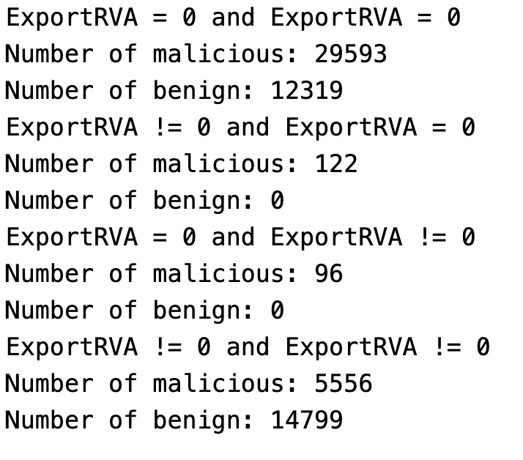

Dataset Features
Importance of zeroes in numerical features
Data Acquisition and Data Exploration
Lots of 0s
Significant for the classification

Slide 13
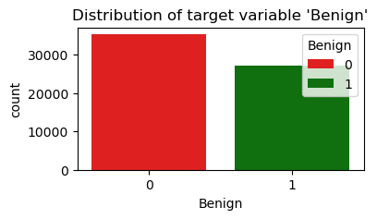
Variables Plot
Distribution of target variable
Data Acquisition and Data Exploration
Balanced Dataset
Unusual for this type of dataset

Slide 14
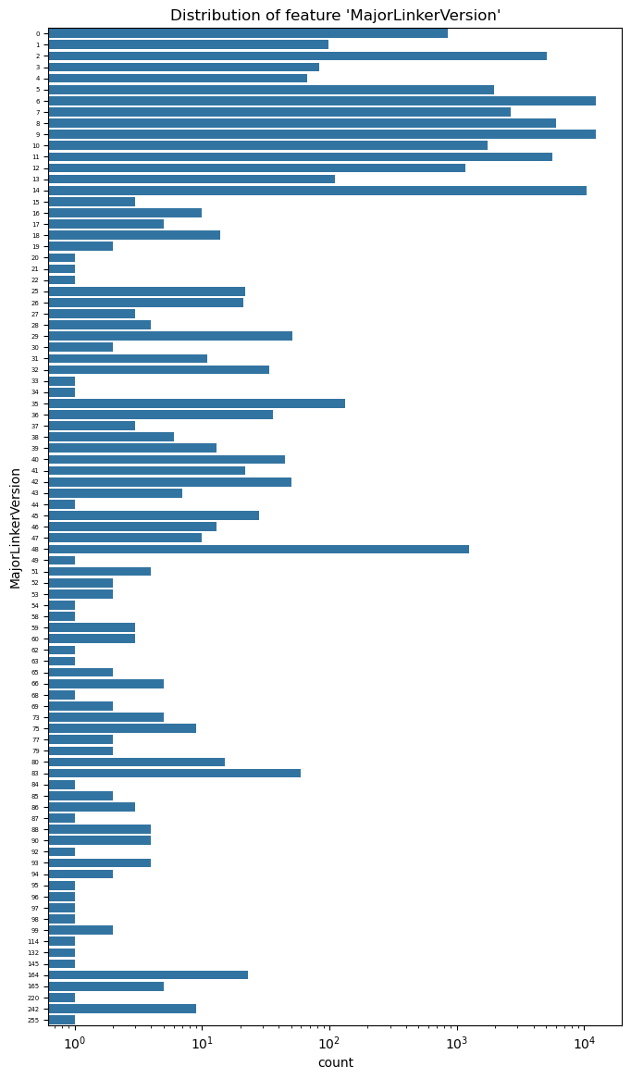
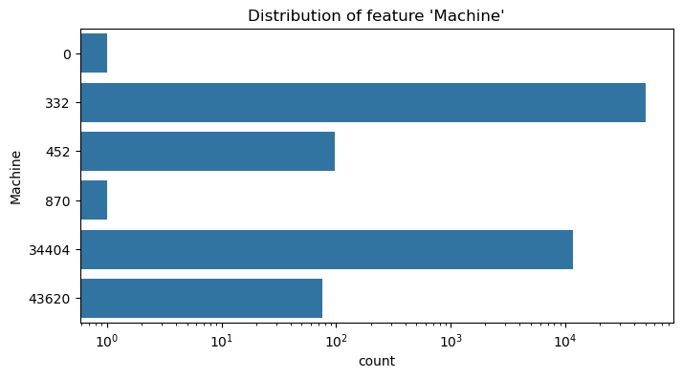
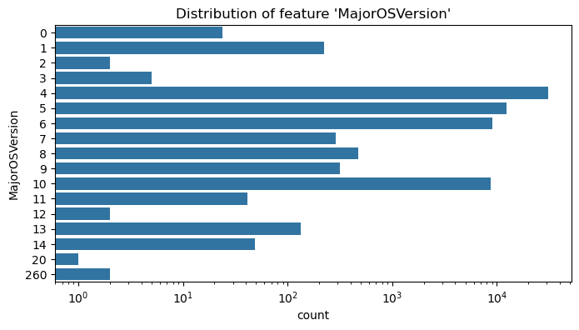
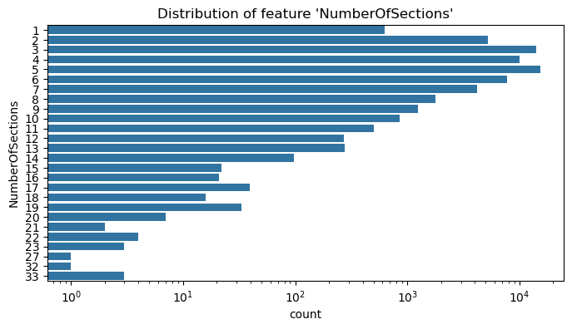
Variables Plot
Distribution of categorical variables
Part 1
Data Acquisition and Data Exploration

Slide 15
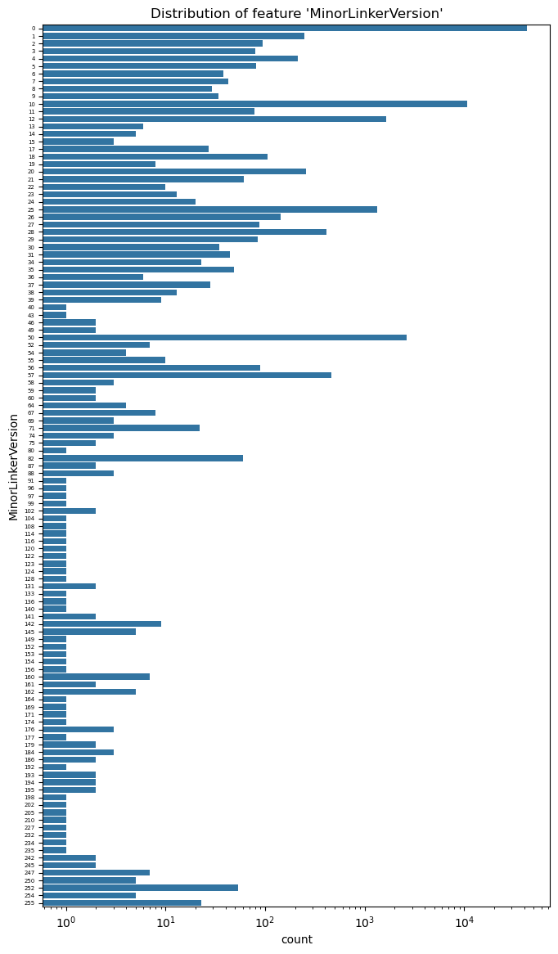
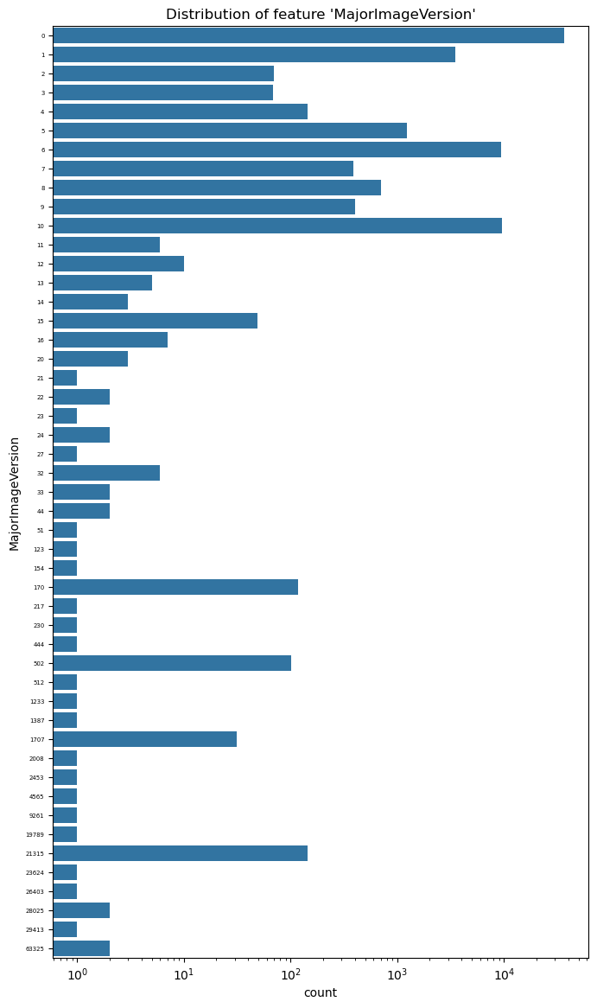
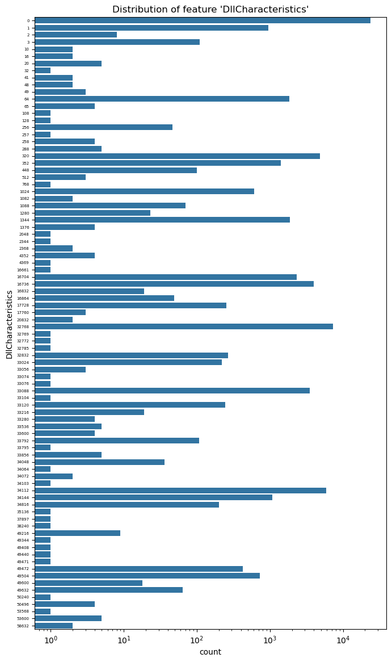
Variables Plot
Distribution of categorical variables
Part 2
Data Acquisition and Data Exploration

Slide 16
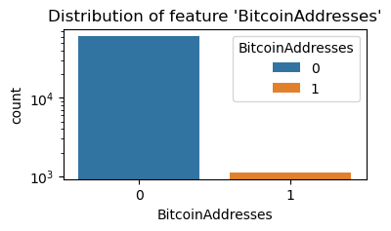

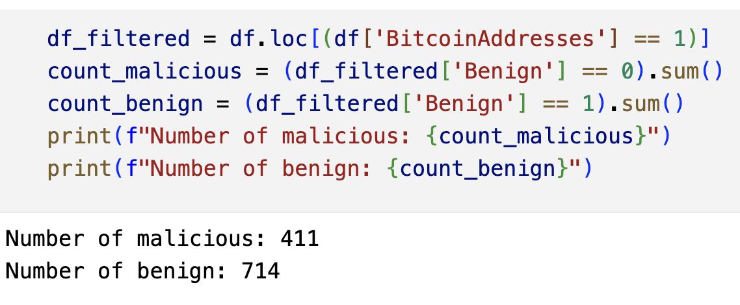

Variables Plot
Distribution of BitcoinAddress
Data Acquisition and Data Exploration
Lots of 0s
+
No relevance of 1s
=
Feature removal

Slide 17
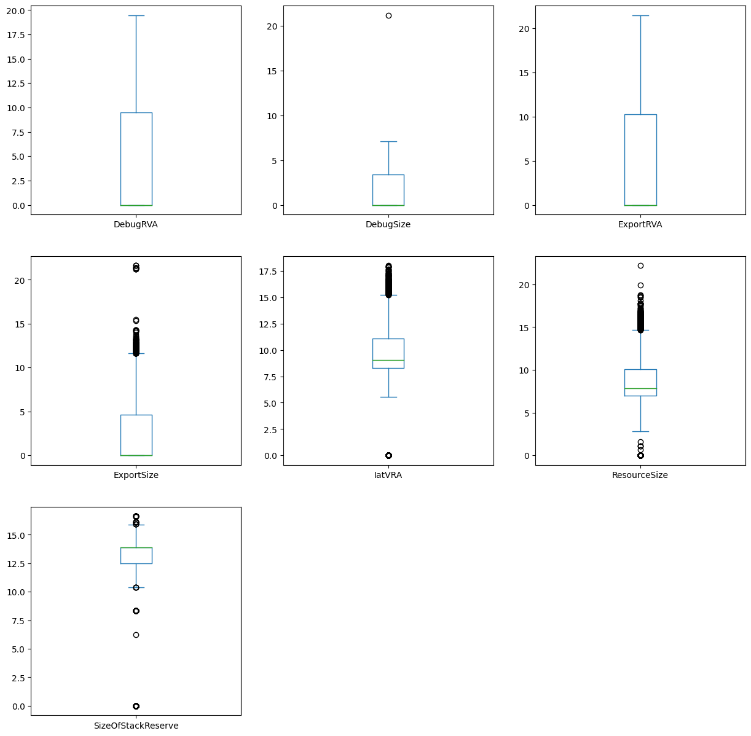
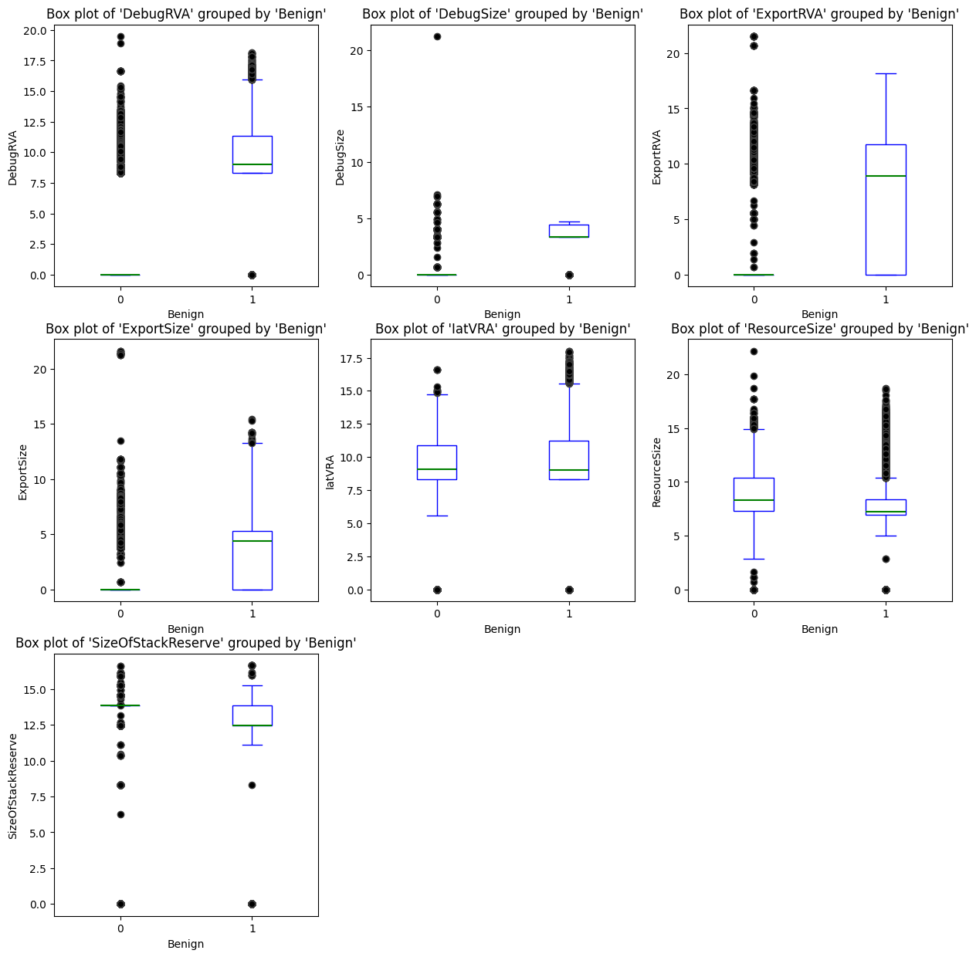
Variables Plot
Numerical Variables Box Plots
Data Acquisition and Data Exploration

Slide 18
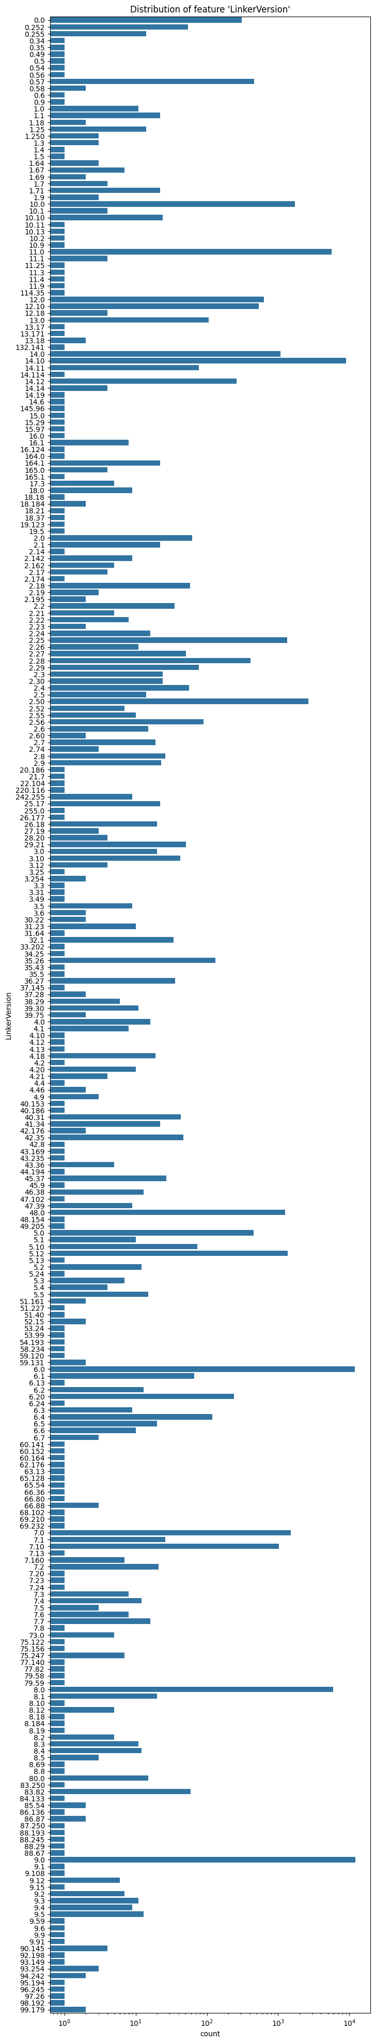
Data Acquisition and Data Exploration
Dataset Feaures
Merging MajorLinkerVersion and MinorLinkerVersion

Slide 19
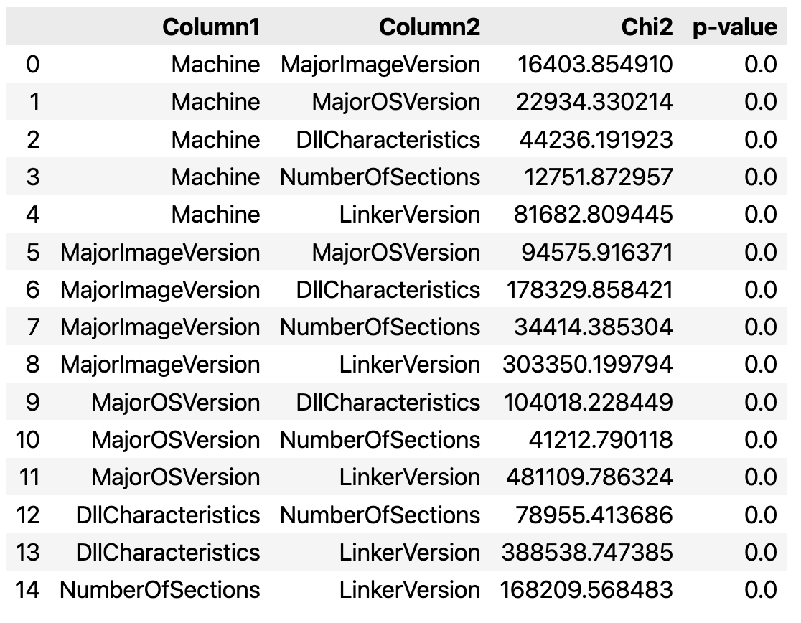
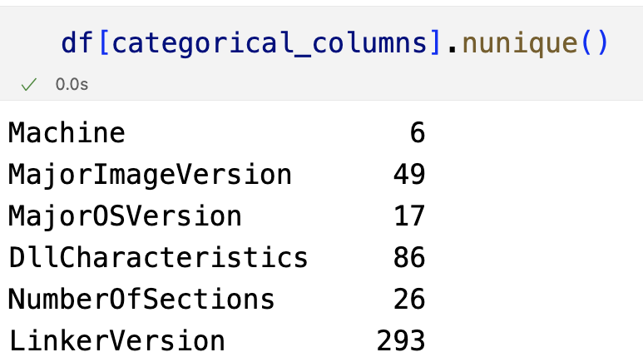
Variables Correlation
Categorical Variables Correlation with Chi2 Test
Data Acquisition and Data Exploration
No statistical relevance: All p-values are equal to 0 due to the high number of categories.

Slide 20
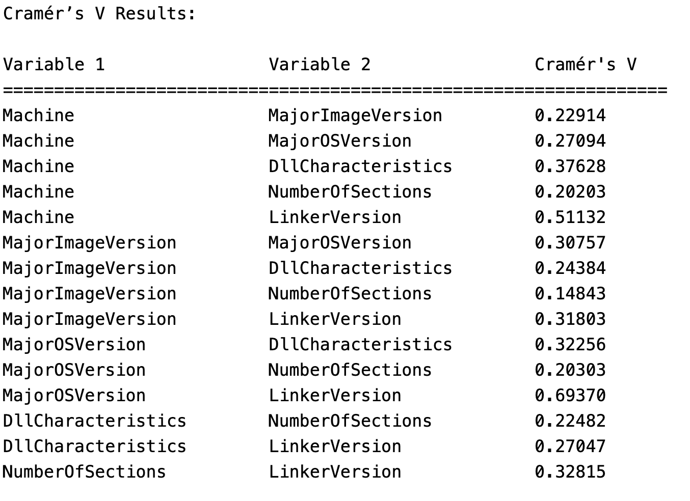
Variables Correlation
Categorical Variables Correlation with Cramer’s V Index
Data Acquisition and Data Exploration

Slide 21
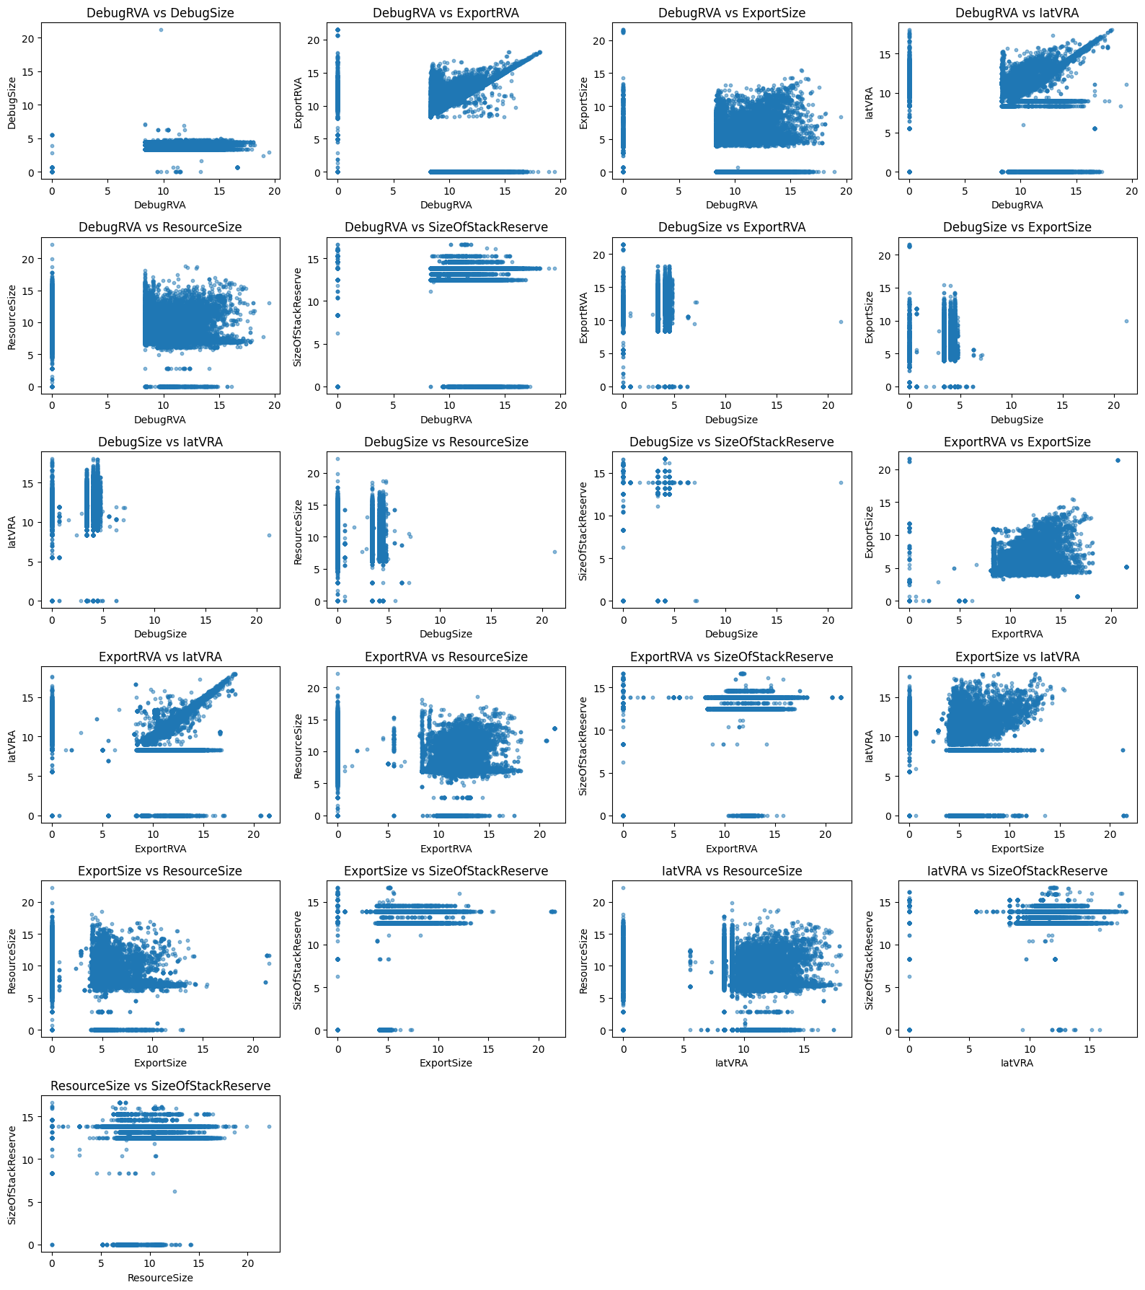
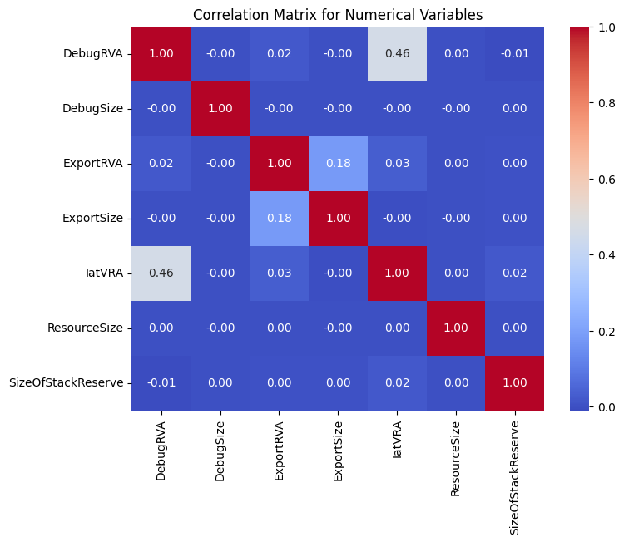
Variables Correlation
Numerical Variables Correlation with Scatter Plots and Correlation Matrix
Data Acquisition and Data Exploration
Given the confusion matrix and the scatter plots, we can see that the numerical variables are mostly uncorrelated with the exception of IatVRA and DebugRVA

Slide 22
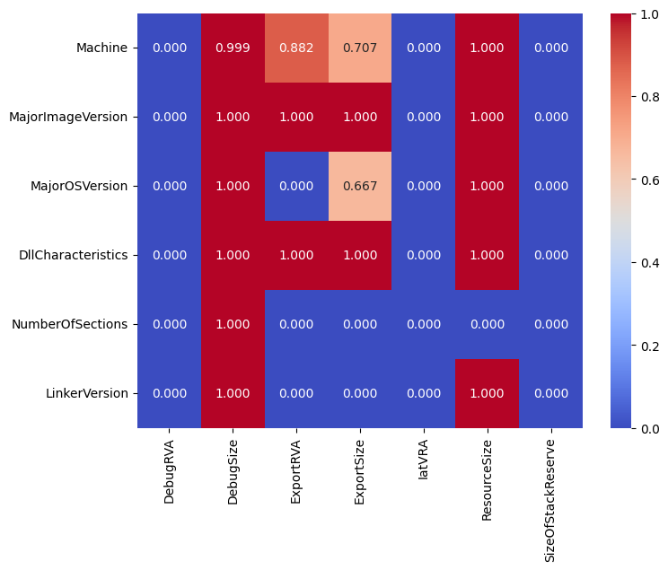
Variables Correlation
Numerical and Categorical Variables Correlation with ANOVA Test
Data Acquisition and Data Exploration
Given the results of the correlation matrix drawn with the ANOVA test we can see that most of the categorical variables are correlated with numerical variables. For this reason, in the following processing phase we will try to classify malwares using numerical and categorical variables separately

Slide 23
Data Preprocessing
Xvalidation per valutare performance
Intro agli esperimenti
Variabili categoriche + numeriche con pre-processing diversi
Cat + LR -> OHE
Num + LR -> StandardScaler
Int + LR -> SS + OHE + FS(SFM)
Num + RF -> Niente
Cat + RF -> Niente (+ conversione prima)
Int + RF -> Niente

Slide 24
Data Processing
Spiega algoritmi
Tabelle risultati
T-test

Slide 25
Result Summary and Relevant Insights
Mean values e conclusione che utilizzare intero dataset non ha particolari vantaggi in termini di accuratezza
Variabili categoriche interessanti
xAI

Slide 26
xAI
White vs Black Box
SHAP spiega cos’è e utilizzi –> Su LR per avere la stessa metrica di RandomForest + aggregazione delle variabili di OneHotEncoding nelle variabili originali

Slide 27
References
Link PE
Link seaborn
Giacomo

