Slide 1

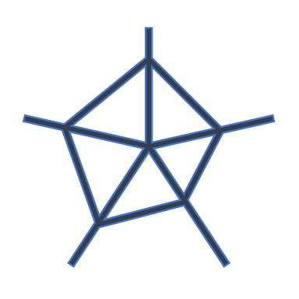
SIEMplexity.
SIEMplexity

