Slide 1
MUMSched Software
A software that helps the student to register and schedule their courses
Team members
Gebreslassie Kahsay, 109053
Lominat Gebreselassie, 109030
Ranjan Bhusal, 986767

Slide 2
Introduction
Compro students should be able to view the schedule and register for classes.
MUMSched is a new software tool that will build a Compro schedule of classes with faculty assigned to each class and will also offer a simple tool for students to register for those classes.

Slide 3
Problem Statement
The problem of managing the Compro schedule and allowing students to register for classes
Affects Faculty, students and administrators
The impact is scheduling is complex and must be manually maintained and it requires frequent changes.
The solution of this problem is to build a tool that will help student to register for the available course based on first come first serve basis.

Slide 4
Overview of the Project
Each Student must be able to register for a course
All the student will have first course as FPP and second course as MPP
For the next four courses, student can select the offered course from the dropdown list of all the offered courses.
System will register the student based on first come first serve basis
Student can view their profile which can display the course the they are enrolled in
Faculty can view their profile which can display the students info who take their classes

Slide 5
Key Abstractions
Users
Users role
Roles
Blocks
Student course Block
Entries
Courses
Schedule
Section

Slide 6
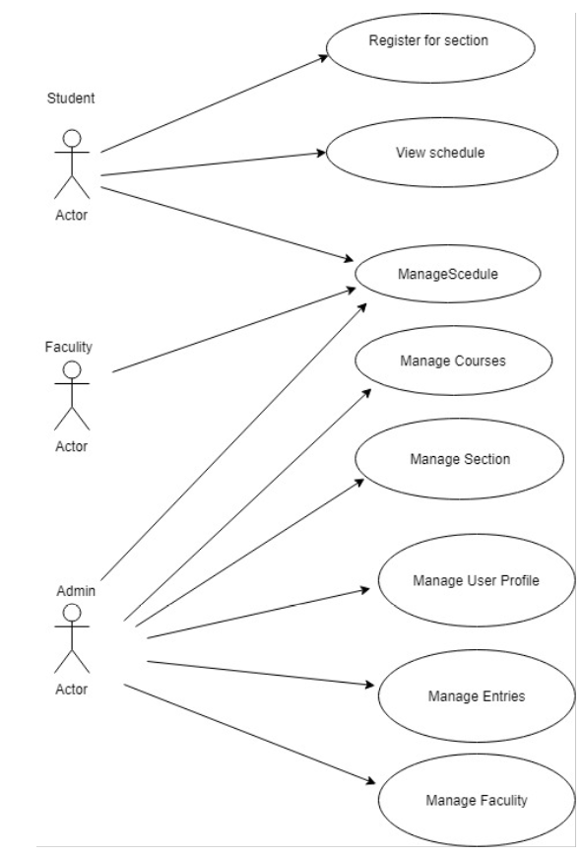

Slide 7
Actors and their capabilities
Schedule Admin
Log in to the application system
Add/update Student Profile

Slide 8
Use case descriptions Add/Update Student Profile
User Action | System Response
1. Admission staff logs in to the System | 1. System display the list of all students for the current block with the necessary details
2. Schedule Admin clicks add new Student button | 2. System opens the UI where admin can add the information about student
3. Schedule Admin clicks submit button | 3. System stores the information about student in Student table
4. Schedule Admin clicks edit button for a Student in the UI list | 4. System opens the window with the information of student populated that can be edited

Slide 9
Actors and their capabilities
Student
Log in to the application system.
Register for the courses offered
View their profile

Slide 10
Use case descriptions Student register for the courses offered
User Action | System Response
1.Student selects register for courses | 1. System display the screen with the four blocks each containing a dropdown menu of all the available courses
2. Student selects all courses on the consecutive four blocks | 2.System stores the information of courses on DB along with the block information.

Slide 11
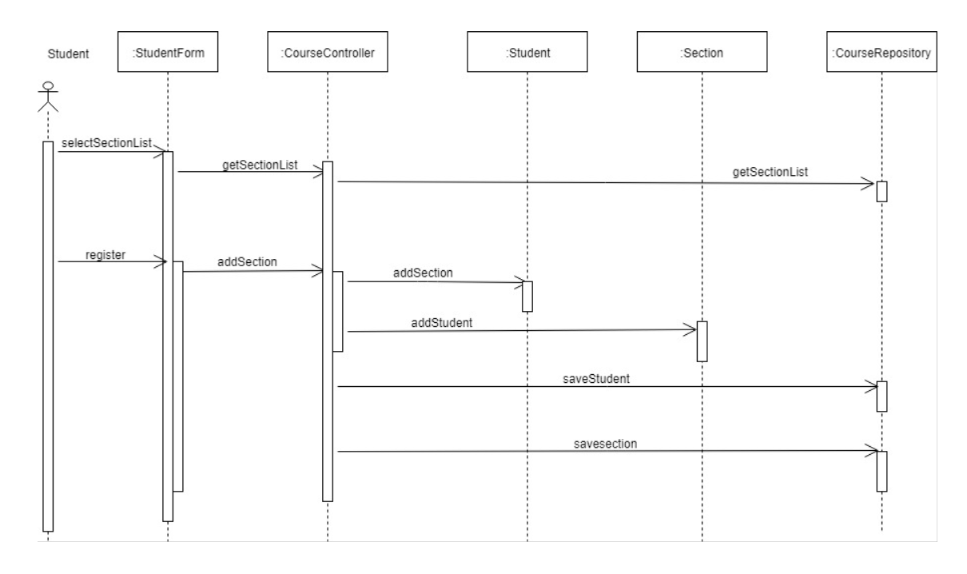

Slide 12
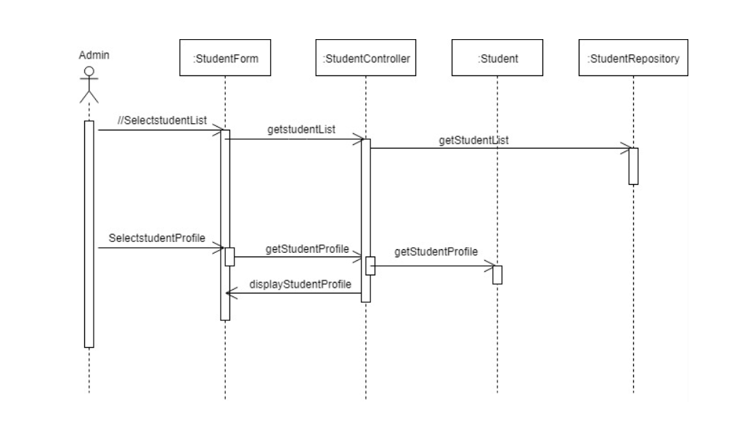

Slide 13
Actors and their capabilities
Faculty Staff
Log in to the application system
View the list of students in his course

Slide 14
Use case descriptions View the list of students in his course
User Action | System Response
1.Faculty selects view the list of Students | 1. System does a query to the Student table that matches the name of the faculty as the Student’s professor and then display the info of those students.

Slide 15
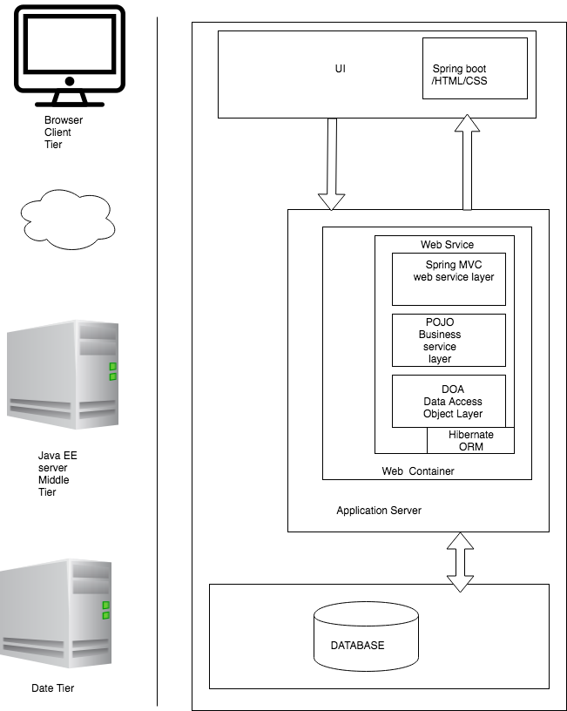
Architecture Analysis

