Slide 1
Project Access

Slide 2

14
Made by Team14

Slide 3
You want to apply UK universities
But you know nothing about the application system
You are lost
You don’t know what to do
Think about this situation

Slide 4
What if there is a website
。。。
。。。
You are lost
All the information are spread on the internet
What if there is a website

Slide 5
Has all the information for your application

Slide 6
Select the most important information for you
Has all the information for your application

Slide 7

Instead of searching online
How about the universities
We suggest the correct one for you
Looking for various universities

Slide 8
We want to help you solve
every problem in your application

Slide 9
We will evaluate your information
And try out best…..
What happens next …..?

Slide 10
To match applications and suitable universities

Slide 11
Help me to…

Slide 12
Help me to…

Slide 13
Help me to…

Slide 14



Chatbot
Help me to…
Search Engine
Database

Slide 15
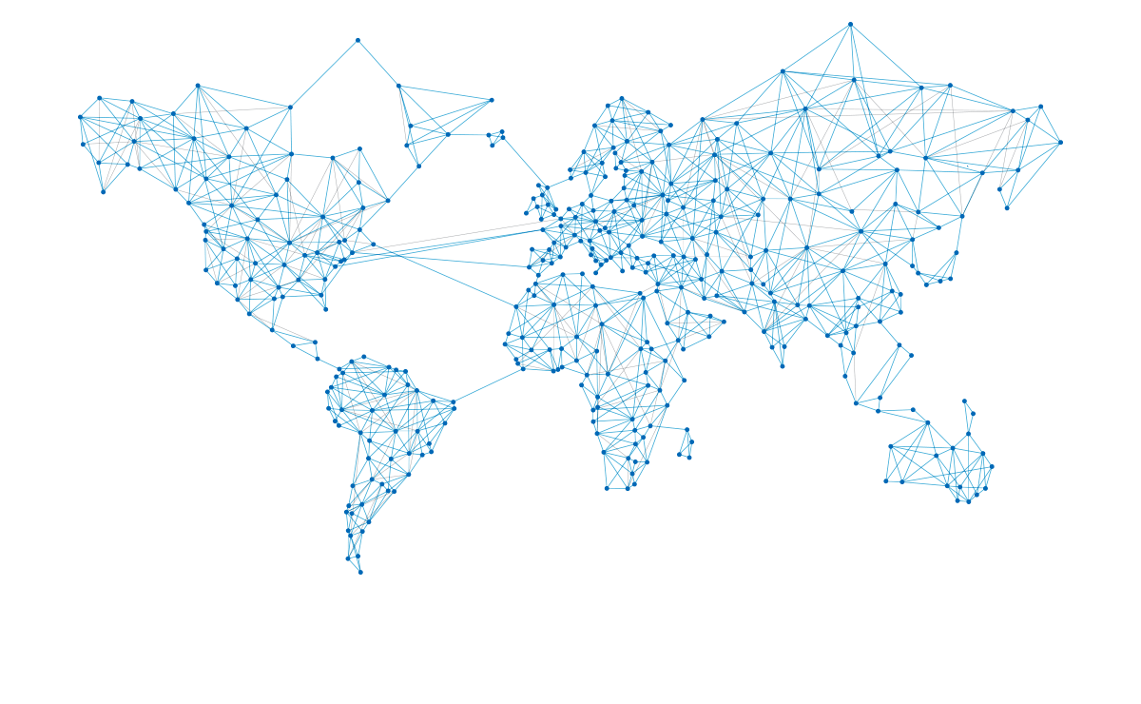
OUR GOALS
Destination
Language Test
Interview
Grades
Universities
Major
Sponsorship
Tuition Fee
Personal Statement

Slide 16
Help me to…

Slide 17
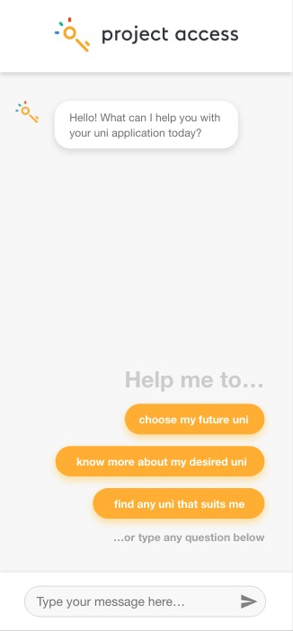
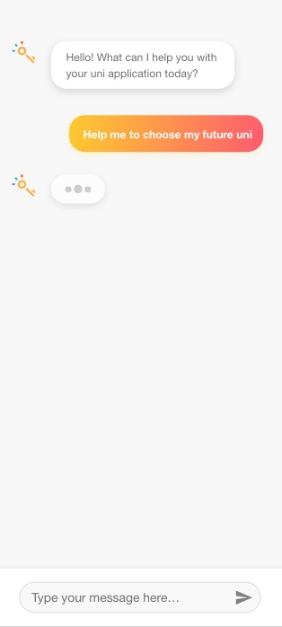
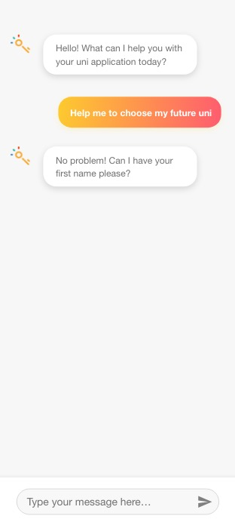

Slide 18
Demo

Slide 19
Chatbot
Backend
Database

Slide 20
Database
Mock use in-memory data base
Scraper to pull the data from UCAS Website base on C++
Use certain mathematical algorithm to rank the universities

Slide 21
Chatbot
Backends
Database

Slide 22
Backends
API Implement
Post Register
Get supported Universities
Get Universities Name
Get Universities Name
Course Name
Get matched University Name
Course Name

Slide 23
Chatbot
Backends
Database

Slide 24
Chatbot UI
All the styles 100% designed by ourselves
Base on vue.js
Use responsive design, mobile friendly
Use axios to directly connect to backend
User friendly design

Slide 25
Thank you

