Slide 1
Project Access

Slide 2

14
Made by Team14

Slide 3
You want to apply UK universities
But you know nothing about the application system
You are lost
You don’t know what to do
Think about this situation

Slide 4
What if there is a website
。。。
。。。
You are lost
All the information are spread on the internet
What if there is a website

Slide 5
Has all the information for your application

Slide 6
Select the most important information for you
Has all the information for your application

Slide 7

Instead of searching online
How about the universities
We suggest the correct one for you
Looking for various universities

Slide 8
We want to help you solve
every problem in your application

Slide 9
We will evaluate your information
And try out best…..
What happens next …..?

Slide 10
To find the most suitable mentor for you!

Slide 11
Help me to…

Slide 12
Help me to…

Slide 13
Help me to…

Slide 14



Chatbot
Help me to…
Search Engine
Database

Slide 15

OUR GOALS
Destination
Language Test
Interview
Grades
Universities
Major
Sponsorship
Tuition Fee
Personal Statement

Slide 16
Help me to…

Slide 17
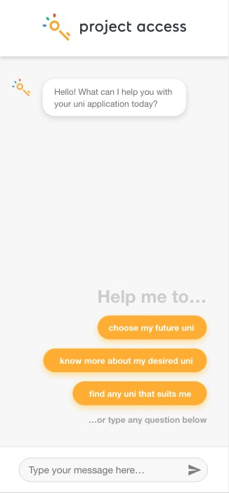
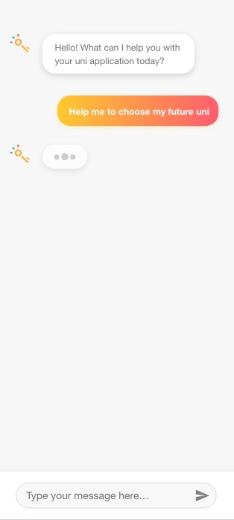
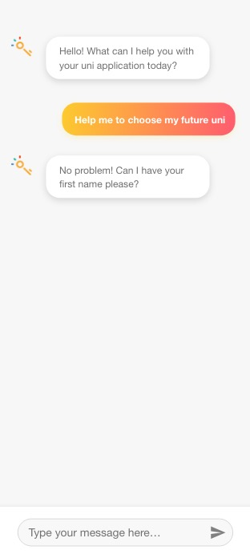

Slide 18
Demo

Slide 19
Chatbot
Search Engine
Database

Slide 20
Database

Slide 21
Chatbot
Search Engine
Database

Slide 22
Search Engine

Slide 23
Chatbot
Search Engine
Database

Slide 24
Chatbot

Slide 25
Thank you

