Slide 1
Notes 08/03

Slide 2
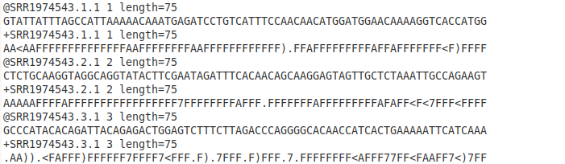
Data download
https://www.youtube.com/watch?v=NSIkUHKRPpo
1.To get read, use SRA toolkit (have tool kit in folder so in path):
sratoolkit.3.0.0-ubuntu64/bin/./prefetch SRR1974543 SRR1974544 SRR1974545 SRR1974546
*Whole data analysis process using SRR1974543_1.fastq and SRR1974543_2.fastq. Will use FastQC to show effects of each step.
2. To convert SRA files to fastq (and split files):
sratoolkit.3.0.0-ubuntu64/bin/./fastq-dump -I --split-files SRR1974543 -O /home/sesm2/SRA_data/test_fastq
Reads generated for 1 of two paired files is as follows:

Slide 3
Read formatting – will add in Josephine’s script
1. Remove quality ID after + from each read using prinseq (use singleton files for next step):
perl /home/sesm2/prinseq-lite-0.20.4/prinseq-lite.pl -fastq SRR1974895_1.fastq -fastq2 SRR1974895_2.fastq -no_qual_header -out_format 3
2. Remove .1 or .2 from identifiers using sort_1.py or sort_2.py scripts (insert file names into script).
3. Add in /1 or /2 to end of identifiers using below commands:
cat SRR1974895_rf_1.fastq | paste - - - - | sed 's/^\(\S*\)/\1\/1/' | tr "\t" "\n" > SRR1974895_rf2_1.fastq
cat SRR1974895_rf_2.fastq | paste - - - - | sed 's/^\(\S*\)/\1\/2/' | tr "\t" "\n" > SRR1974895_rf2_2.fastq

Slide 4
Convert/Adapt Identifier using Python
Run idAdaptor.py by typing in terminal:
Python idAdaptor.py inputFileName
Will output inputFileName_adp.fastq
Example:
python idAdaptor.py SRR1974543_1_prinseq_good_singletons_5_H4.fastq

Slide 5
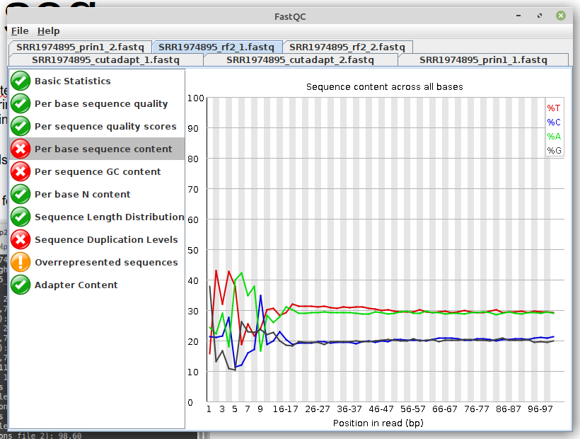
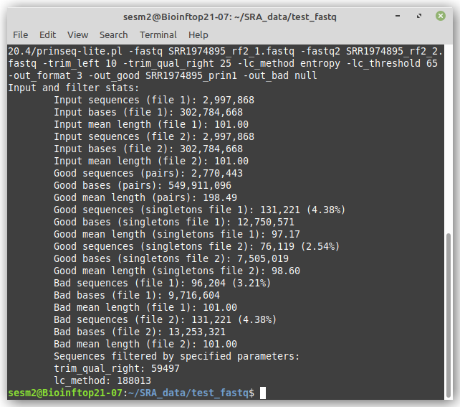
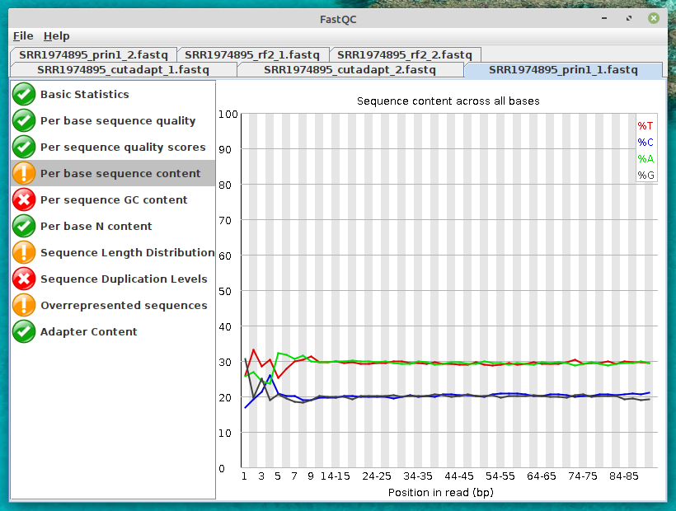
1.Prinseq Version: prinseq-lite-0.20.4 (2013)
perl /home/sesm2/prinseq-lite-0.20.4/prinseq-lite.pl -fastq SRR1974895_rf2_1.fastq -fastq2 SRR1974895_rf2_2.fastq -trim_left 10 -trim_qual_right 25 -lc_method entropy -lc_threshold 65 -out_format 3 -out_good SRR1974895_prin1 -out_bad null
*out_format used is fastq. Also, does not return bad sequences file.
Take forward prinseq ‘good’ for cut adapt, left good_singletons.

Slide 6
1. Prinseq (Alternate)
perl ../../../scripts/prinseq-lite-0.20.4/prinseq-lite.pl -fastq SRR1974543_s0_1.fastq -fastq2 SRR1974543_s0_2.fastq -min_len 30 -out_format 3 -out_good SRR1974543_s1a
perl ../../../scripts/prinseq-lite-0.20.4/prinseq-lite.pl -fastq SRR1974543_s1a_1.fastq -fastq2 SRR1974543_s1a_2.fastq -trim_left 10 -out_format 3 -out_good SRR1974543_s1b
perl ../../../scripts/prinseq-lite-0.20.4/prinseq-lite.pl -fastq SRR1974543_s1b_1.fastq -fastq2 SRR1974543_s1b_2.fastq -trim_qual_right 25 -out_format 3 -out_good SRR1974543_s1c
perl ../../../scripts/prinseq-lite-0.20.4/prinseq-lite.pl -fastq SRR1974543_s1c_1.fastq -fastq2 SRR1974543_s1c_2.fastq -lc_method entropy -lc_threshold 65 -out_format 3 -out_good SRR1974543_s1d

Slide 7
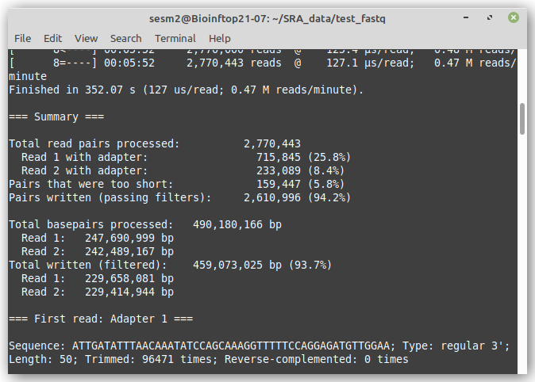
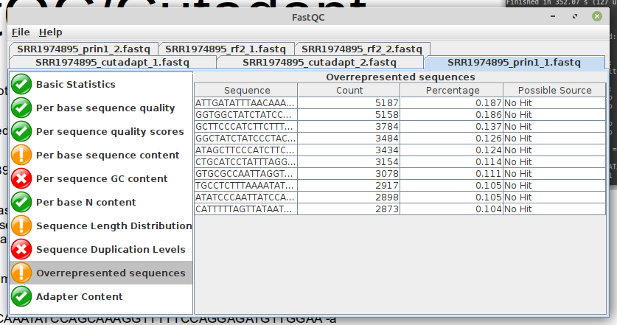
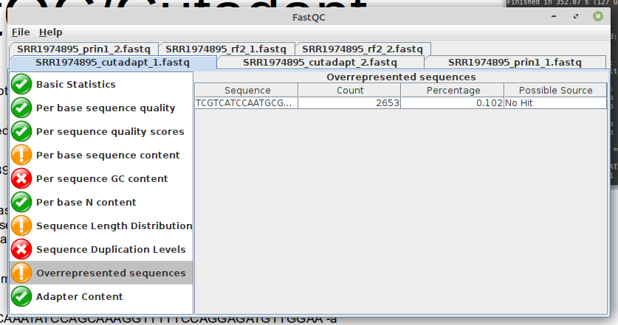
2.FastQC/Cutadapt
***** using later versions of both at current.
1.Removal of over represented sequences (threads, 6):
fastqc -extract -t 6 SRR1974895_prin1_1.fastq SRR1974895_prin1_2.fastq
2. Must write script to parse fastqc_data.txt file (in generated read file specific directory) to read ‘overrepresented sequences section’ and write the SRR number followed by the adapter information to an output file if there is a warning generated by the report.
*parameters taken directly from paper’s supplementary info.
cutadapt -a ATTGATATTTAACAAATATCCAGCAAAGGTTTTTCCAGGAGATGTTGGAA -a GGTGGCTATCTATCCCTACCAAGGCTTATATTGAAGTATAAACCAATGAG -a GCTTCCCATCTTCTTTGAGAGTTGTTGGTTTATGCTCATCCCTACTCATA -a GGCTATCTATCCCTACCAAGGCTTATATTGAAGTATAAACCAATGAGAGA -a ATAGCTTCCCATCTTCTTTGAGAGTTGTTGGTTTATGCTCATCCCTACTC -a CTGCATCCTATTTAGGGCTATTGATATTTAACAAATATCCAGCAAAGGTT -a GTGCGCCAATTAGGTCGTCATTGCGCCAGCTCGTCAGCGCTGGTCGTCTA -a TGCCTCTTTAAAATATCTAAGTGCTGGGGTTATGAGTAGGGATGAGCATA -a ATATCCCAATTATCCATAAAACTGTAACTAAGTGAGGCTCTCTCATTGGT -a CATTTTTAGTTATAATGATGCCTTATGTGATAGATGCCTCTTTAAAATAT -A GACCGCCGGAAGGGATCACATTATGGTCAGTGCGAAATTTGAGGACGACG -A GGTGGCTATCTATCCCTACCAAGGCTTATATTGAAGTATAAACCAATGAG -A GCTTCCCATCTTCTTTGAGAGTTGTTGGTTTATGCTCATCCCTACTCATA -A GGCTATCTATCCCTACCAAGGCTTATATTGAAGTATAAACCAATGAGAGA -e 0.15 -m 30 -o SRR1974895_cutadapt_1.fastq -p SRR1974895_cutadapt_2.fastq SRR1974895_prin1_1.fastq SRR1974895_prin1_2.fastq

Slide 8
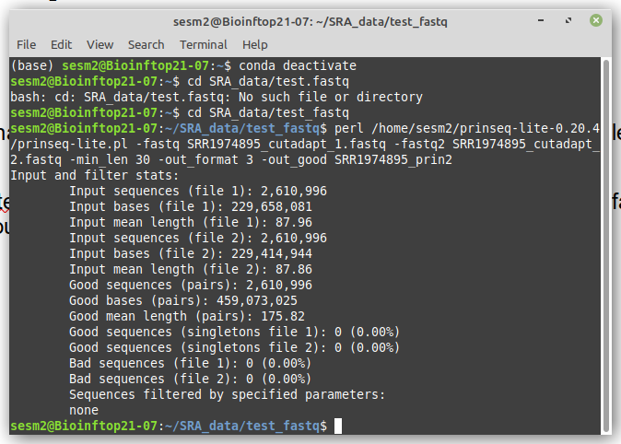
3.Prinseq Version: prinseq-lite-0.20.4 (2013)
Remove orphan pairs less than 30bp in length (do this my excluding the good_singletons file and using just the good output).
perl /home/sesm2/prinseq-lite-0.20.4/prinseq-lite.pl -fastq SRR1974895_cutadapt_1.fastq -fastq2 SRR1974895_cutadapt_2.fastq -min_len 30 -out_format 3 -out_good SRR1974895_prin2 -out_bad null
*out_format used is fastq.

Slide 9
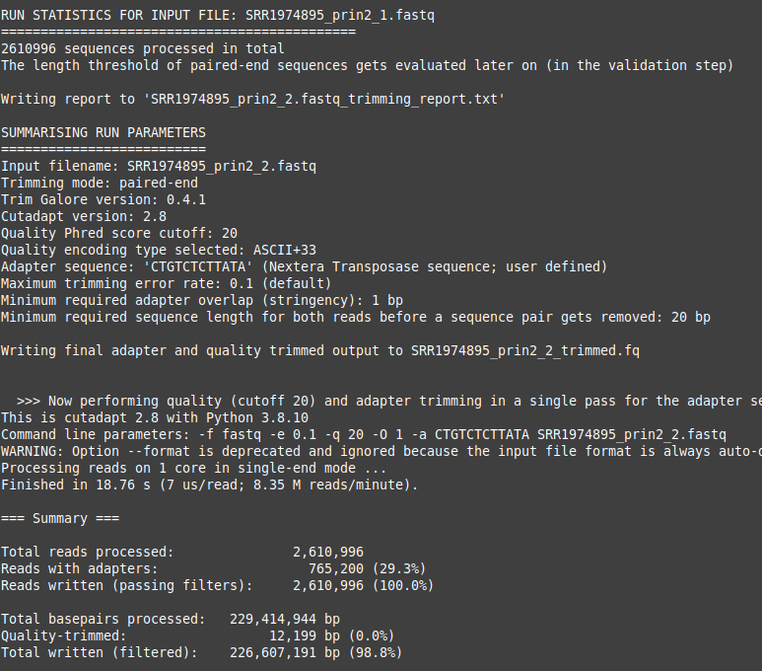
4.TrimGalore v0.4.1
Removal of nextera adapters (--stringency 1):
perl /home/sesm2/SRA_data/trim-galore-0.4.1-0/bin/trim_galore --nextera --stringency 1 --paired SRR1974895_prin2_1.fastq SRR1974895_prin2_2.fastq

Slide 10
STAR
To run on your laptop, use the following:
$ export PATH=/home/sesm2/SRA_data/STAR-STAR_2.4.0h/bin/Linux_x86_64_static:$PATH
$ STAR --runMode genomeGenerate --runThreadN 24 --genomeDir /home/sesm2/SRA_data/genome_directory --genomeFastaFiles GRCh37.p13.genome.fa --sjdbGTFfile gencode.v19.annotation.gtf --sjdbOverhang 74 --genomeChrBinNbits 12
You can alter thread number and genomeChrBinNbits to try to optimise its ability to run. I also have a .sh file to run on spectre when we have it working properly...

Slide 11
4.TrimGalore v0.4.1
Removal of nextera adapters (--stringency 1):
perl /home/sesm2/SRA_data/trim-galore-0.4.1-0/bin/trim_galore --nextera --stringency 1 --paired SRR1974895_prin2_1.fastq SRR1974895_prin2_2.fastq

Slide 12
4.TrimGalore v0.4.1
Removal of nextera adapters (--stringency 1):
perl /home/sesm2/SRA_data/trim-galore-0.4.1-0/bin/trim_galore --nextera --stringency 1 --paired SRR1974895_prin2_1.fastq SRR1974895_prin2_2.fastq

Slide 13
4.TrimGalore v0.4.1
Removal of nextera adapters (--stringency 1):
perl /home/sesm2/SRA_data/trim-galore-0.4.1-0/bin/trim_galore --nextera --stringency 1 --paired SRR1974895_prin2_1.fastq SRR1974895_prin2_2.fastq

Slide 14
4.TrimGalore v0.4.1
Removal of nextera adapters (--stringency 1):
perl /home/sesm2/SRA_data/trim-galore-0.4.1-0/bin/trim_galore --nextera --stringency 1 --paired SRR1974895_prin2_1.fastq SRR1974895_prin2_2.fastq

Slide 15
4.TrimGalore v0.4.1
Removal of nextera adapters (--stringency 1):
perl /home/sesm2/SRA_data/trim-galore-0.4.1-0/bin/trim_galore --nextera --stringency 1 --paired SRR1974895_prin2_1.fastq SRR1974895_prin2_2.fastq

Slide 16
Questions
Check fastqc/cutadapt section with Ralf/Richard.
Next steps:
1. get fastqc/cutadapt step scripted.
2. get next half data processing sorted.
3. get older versions working.
4. streamline scripts so can work with input file names from user.
5. run whole process with 8 gz files to improve speed and up threads where possible.
NOTE for multiple files, some programs want them written in a pairwise fashion, worth checking.

