Slide 1
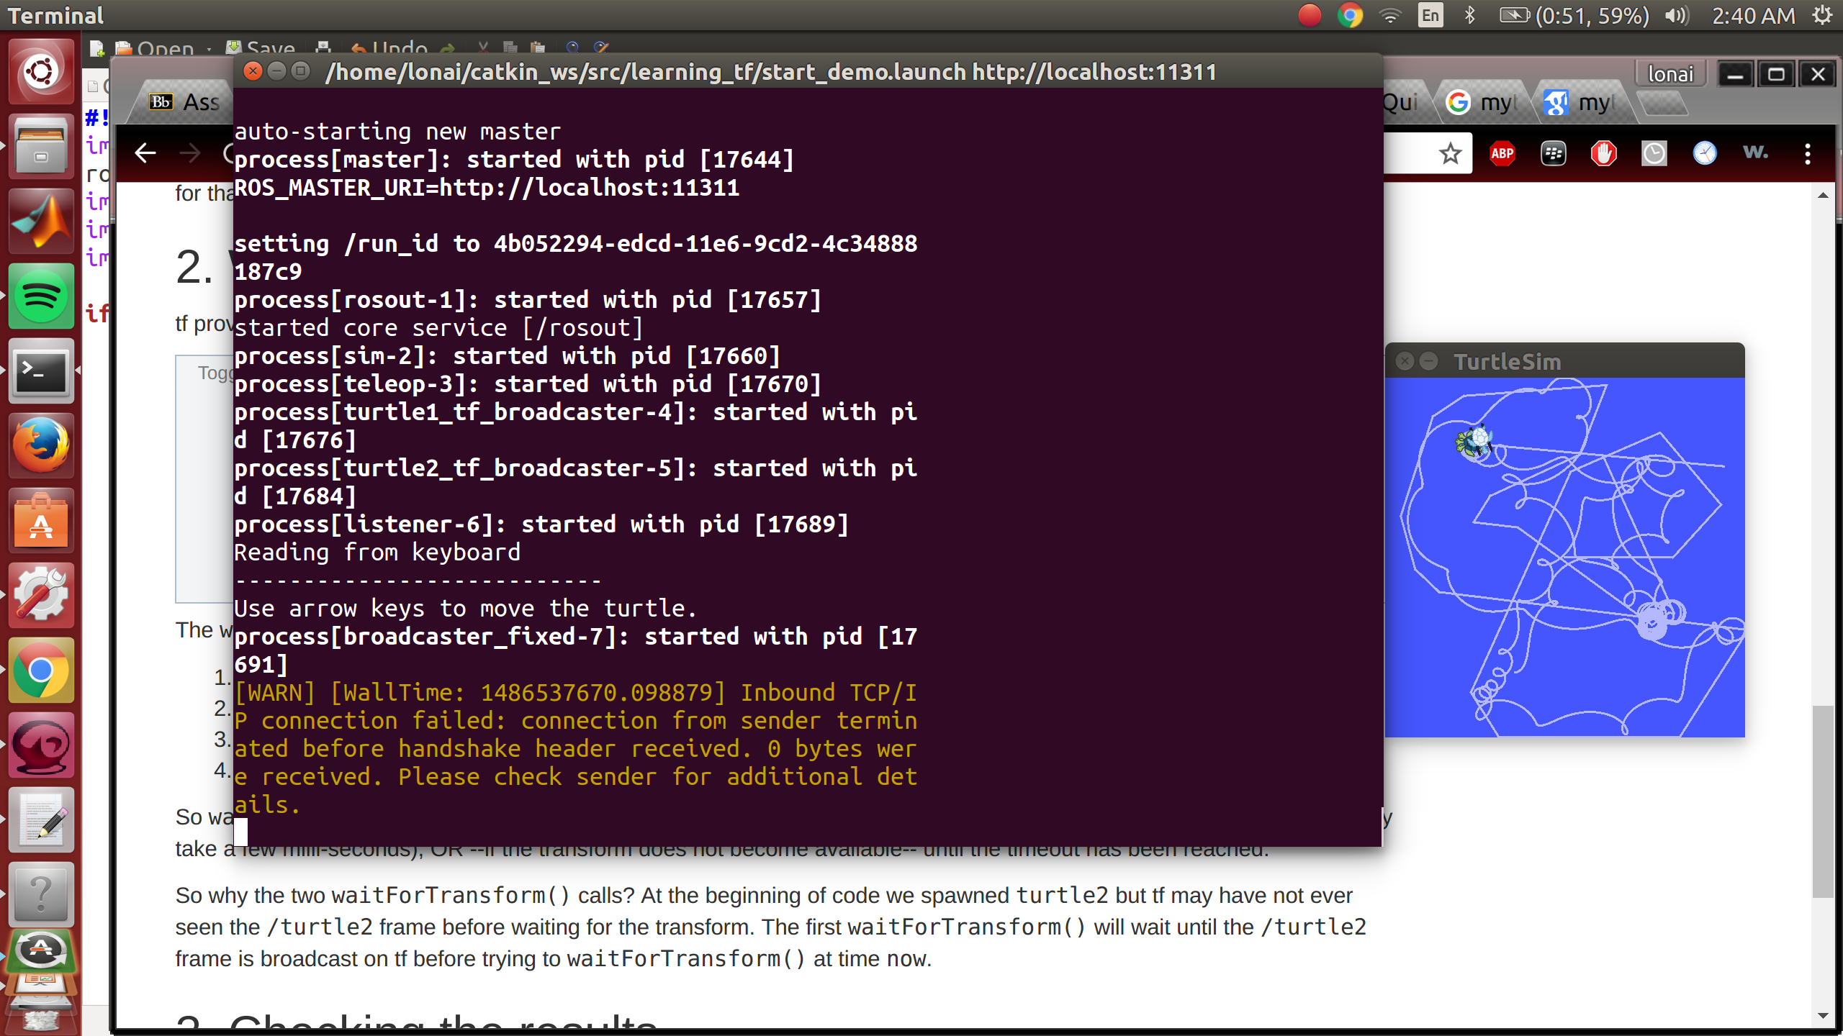
Adding a moving tf frame

Slide 2
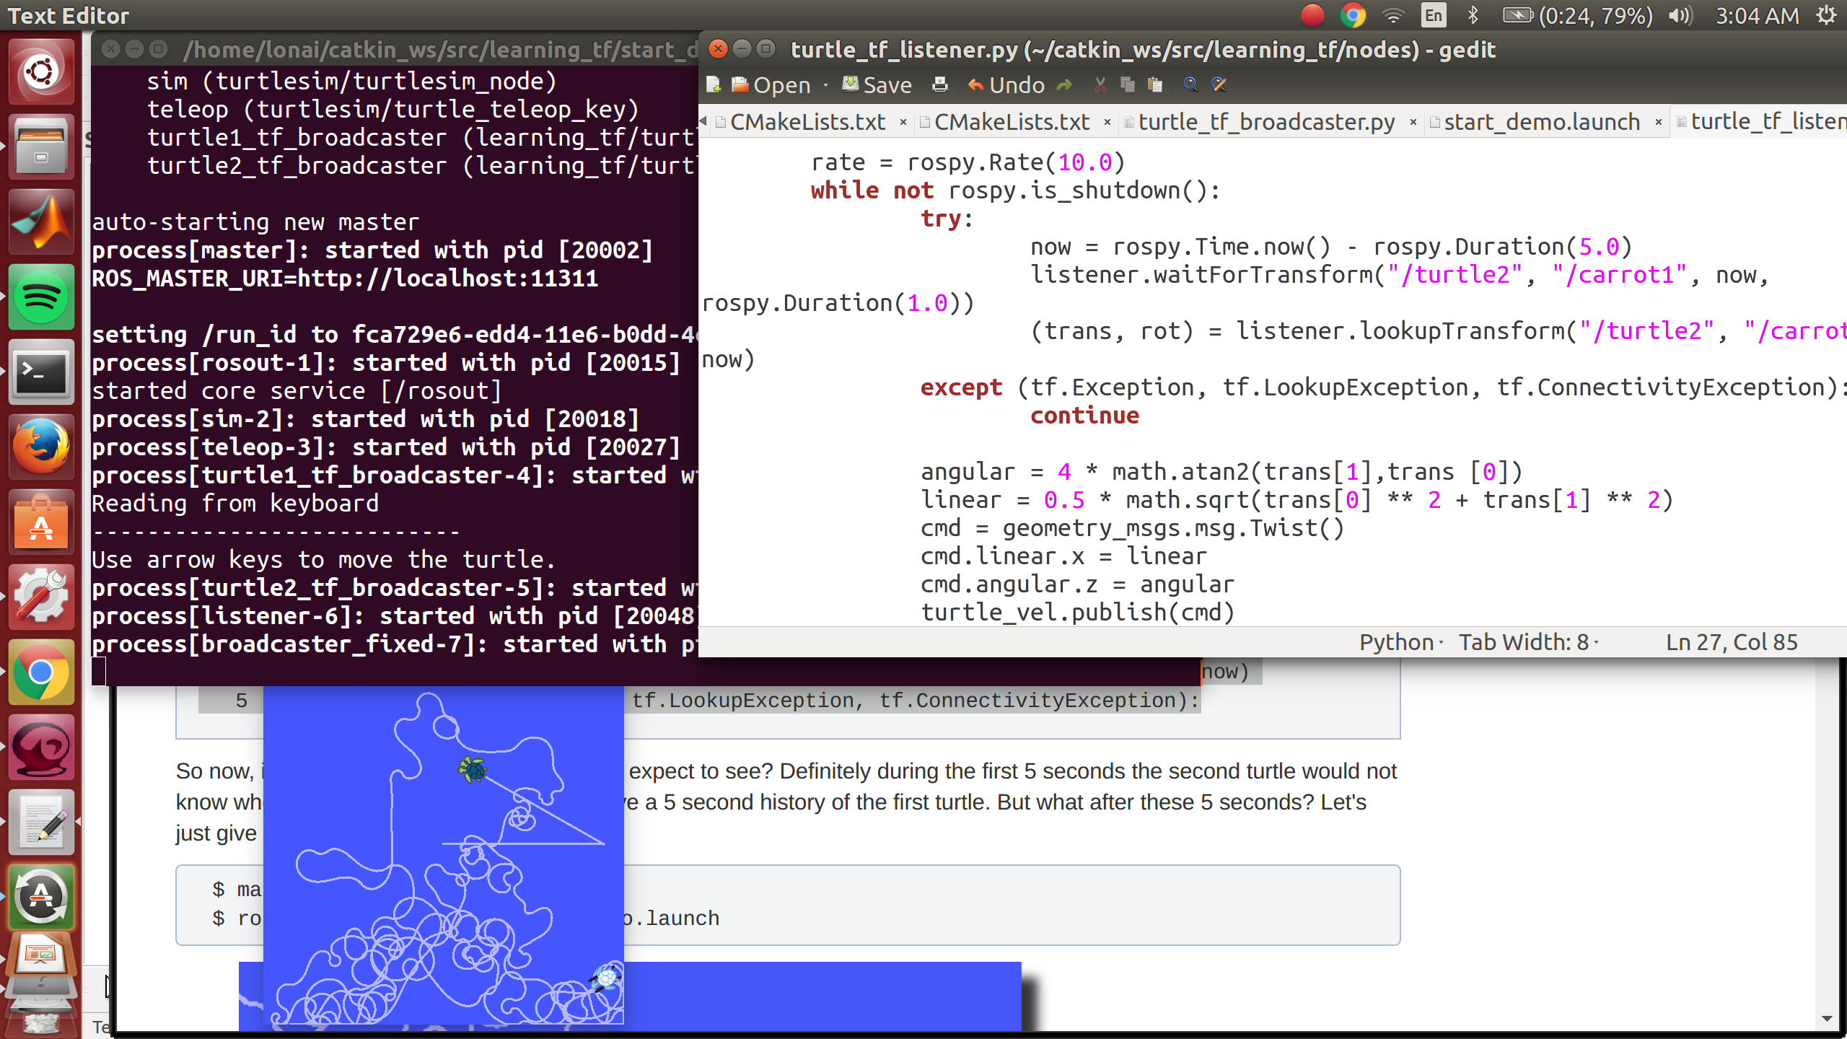
Adding Time travel with tf
now = rospy.Time.now()
3 past = now - rospy.Duration(5.0)

Slide 3
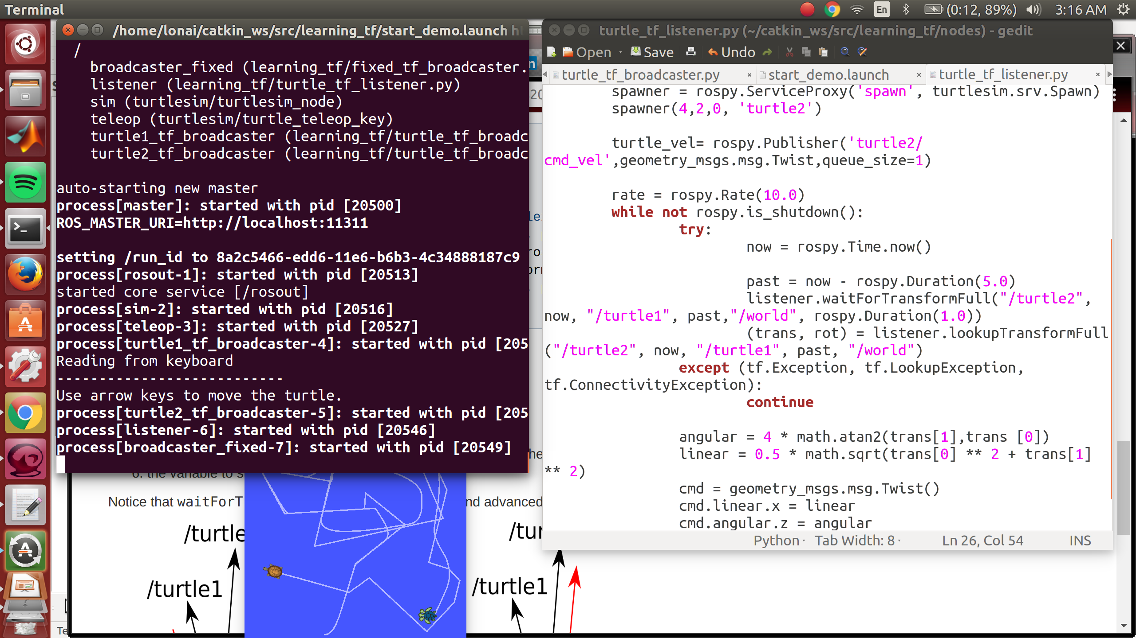
Adding controllability to time travel

Slide 4
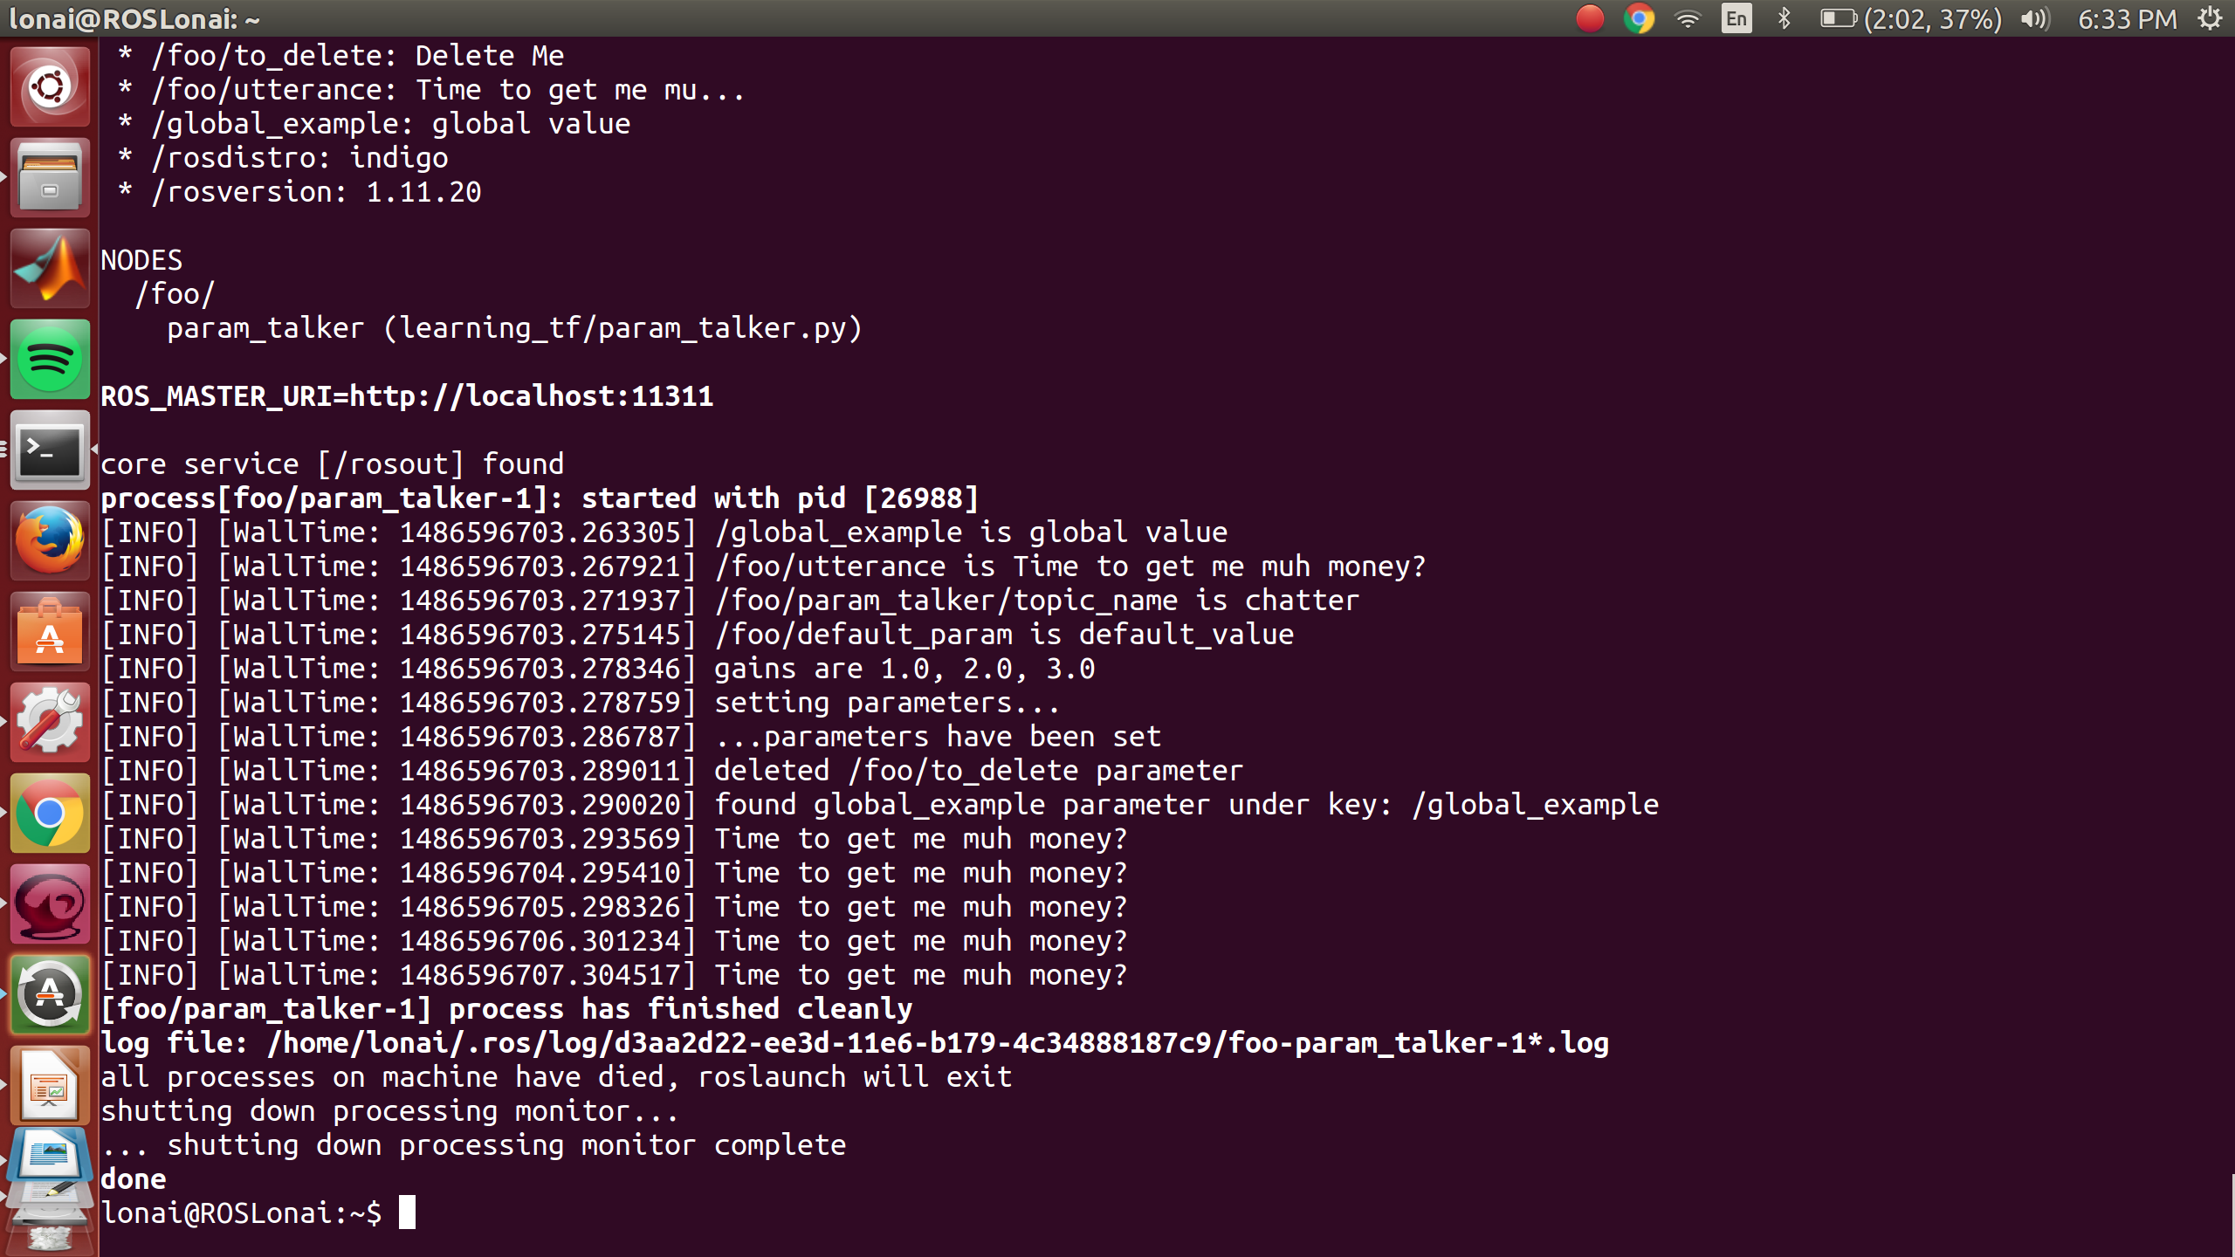
ROS Parameters

